Slide 1
^{Making Change}
Revitalizing the Library in the University Knowledge Community
Karen Calhoun
Assistant University Librarian for Organizational
Development and Strategic Initiatives

Slide 2
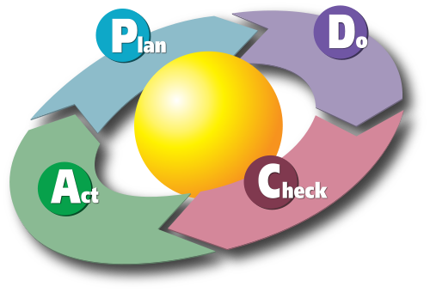
The Deming circle.
Image: CC BY 3.0
Diagram by Karn G. Bulsuk (http://blog.bulsuk.com)

Slide 3
Outline
Review of research library trends
  The Pitt ULS and Cambridge strategies in context
Change and revitalization
  Studying university communities of practice
  Some principles and methods of library service redesign
  A proposed approach: innovation and life cycle management
  Closing thoughts
Discussion
Notes:
Slides will be available for download
(SlideShare?)
Throughout the presentation I will be referring to various reports and articles.
The intent is of doing so is to provide you and your colleagues at home with some sources of ideas and best practices for later reference and further study, if you wish.

Slide 4
Themes of the ULS Library Strategic Framework
(Long Range Plan)
Overarching Theme: User-Centered Collections and Services
Long Range Goals | Objectives
Information resources and collections | Understand user needs, expectations Deliver innovation (enhance access) Stewardship of collections (conservation, preservation)
Infrastructure (space, equipment, systems) | User-centered renovation of space, equipment, systems Closer integration within and across ULS with faculty and departments
Services | Develop a new service model for reference blending traditional and digital formats Innovate information literacy instruction and assessment Innovate access services
Scholarly communication | Articulate and exemplify new models of scholarly communication Partner with faculty and researchers at and beyond Pitt Support creation of new digital collections, publishing services, trusted repositories
Organizational agility | Increase effectiveness by directing resources to highest priorities (as indicated by assessment data analysis) Monitor and respond quickly to needs New skills development Recruit and retain professional staff

Slide 5
Themes of the Cambridge University Library Strategic Framework
Overarching Theme: User-Centered Collections and Services
Long Range Goals | Objectives
Teaching, learning, research | Understand user needs, expectations Deliver innovation Closer integration, collaboration of Cambridge libraries
Content development and delivery Digital infrastructure | Emphasis on e-content and digitisation programme Develop special collections Further develop institutional repositories Print collection management, deduplication, storage New approaches to discovery and ‘anytime, anywhere’ delivery
Library as place (physical and virtual) | Welcome and inspire; innovate user space Develop Web presence (virtual space)
Finance – reduced central funding | Ensure optimal use of existing resources;direct resources to emerging needs Better use of technology Cost savings through collaboration with peers and external partners Development (fund raising) activities
Developing as an organization | New skills development Monitoring effectiveness

Slide 6
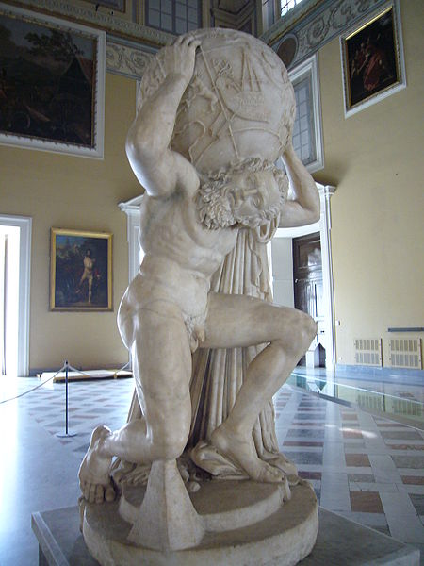
Atlas’ Burden
Farnese Atlas Image by Lalupa CC BY SA
Notes:
So how do we do it?
This sculpture depicts Atlas, who was condemned to support the sky on his shoulders. He was a Titan, a person of inconceivable strength and power.
Now I maintain, with some pride, that technical services has always supported the library on its shoulders, and we have accomplished a great deal.
But how, faced with these new demands, do we continue to keep the sky up there?

Slide 7
Median Circulation and Reference Transactions in North American Research Libraries 1991-2008, with 5 Year Forecast
“65% of information requests originate
off-campus.”
University of Minnesota
Discoverability report, p. 4
Data source: ARL Statistics 2007-2008 http://www.arl.org/bm~doc/arlstat08.pdf
Notes:
I want to take off where Rick left off, with a quick review of trends around library physical collections.
Those of you from academic libraries may know instantly what this chart depicts, even w/o looking at the captions.
This chart depicts change in circulation and reference desk transactions since 1991.
I have added a linear trend line to the chart. If the trend holds, this year annual median circulation will dip below 200,000 transactions—on collections generally comprised of 4 to 7 million volumes.
As a rule in North America, coming to the research library to take advantage of the local collections and services is in decline.

Slide 8
Circ declining faster at Pitt
Percent change since 2001
Pitt 28%
ARL median 18%

Slide 9
Reference declining faster at Pitt
Percent change since 2001
Pitt 52%
ARL median 47%
At Pitt, virtual reference is not voluminous enough to materially impact this downward trend.
(2008: 11,003 virtual reference
transactions against a total of 134,523)

Slide 10
Percentage Change in Median Resources Per Student at ARL Libraries, 2000-2008 (Compared to 2000)
In 2008, Pitt expended 66% of its materials budget on e-resources.
The ARL median was 57%.
Change in Staff, Volumes Added,
Monographs Purchased Per Student
Change in E-Serials Expenditures
Per Student
Data source: ARL Statistics 2007-2008
http://www.arl.org/bm~doc/arlstat08.pdf
Notes:
Here is some additional analysis of the latest ARL data.
This chart depicts median resources expended per student -- library staff per student, monographs purchased per student, volumes added per student – from 2000 to 2008. The chart tracks percentage change from the base year for analysis, the year 2000, each year through 2008.
Modest declines are evident in investment per student in volumes added and monographs purchased.
Staffing per student is the most striking decline. ARLS devoted a median of over 14 staff per student in 2000, down to around 11 in 2008.
(Click.) Meanwhile, the dollars invested per student in electronic serials changed from $39 per student in 2000 to $215 per student in 2008.
Part of this is due to dramatic price increases in serials, but part is because users are demanding online materials, and libraries are trading dollars traditionally spent on print for e-resources.

Slide 11
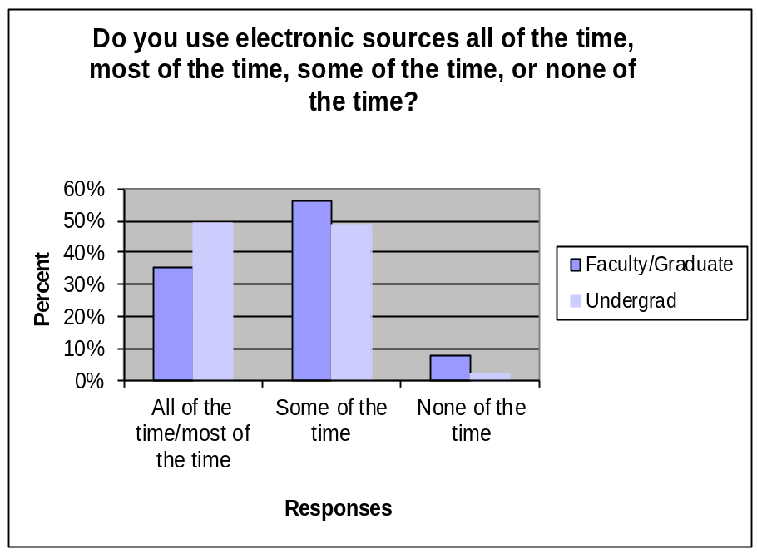
What Did Users Say
They Want? (2002)
Faculty and students do more work and study away from campus
Loyal to the library, but library is only one element in complex information structure
Print still important, but almost half of undergraduates say they rely exclusively or almost exclusively on electronic materials
Seamless linking from one information object to another is expected
Fast forward to 2011: these trends many times stronger!
http://www.clir.org/PUBS/reports/pub110/contents.html
Notes:
The demand for e-resources seems unquenchable.
This slide reports findings from research completed in 2002 on behalf of the Digital Library Federation and the Council on Library and Information Resources.
The study found that already in 2002, faculty and students were reporting that they like to work online.
Nine years later, in 2011, the importance of electronic resources to faculty and students has grown even more.
Providing good service now means providing online access to materials and supporting user self-sufficiency.

Slide 12
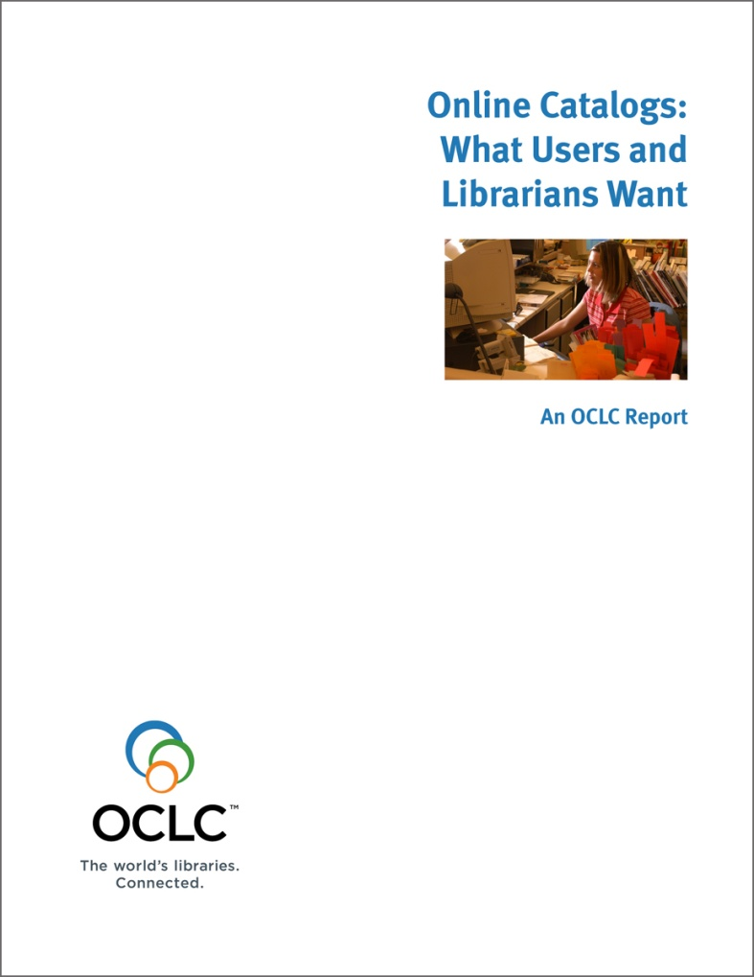
Online Catalogs:
What Users and Librarians Want
http://www.oclc.org/us/en/reports/onlinecatalogs/default.htm
End-Users want
online catalogs:
#1: to link directly to online content
(and they want linking to be easy)
“The end user’s experience of the
delivery of wanted items is as important,
if not more important, than his or her
discovery experience.”—page 11.
Notes:
Some say we don’t know much about what information seekers want, but actually there is a large body of research already available, inside and outside the field of librarianship.
New reports appear all the time, like this one that a research team and I produced last year.
We found …
12

Slide 13
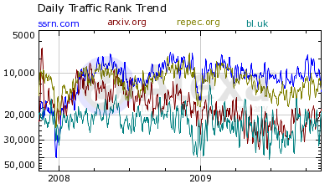
Open Access Repositories
Gaining Visibility and Impact
2008-2009
Traffic Compared
Social Science Research Network
arXiv.org
Research Papers in Economics
British Library (bl.uk)
Sources: Alexa.com 15 Nov 2009 and the Cybermetrics Lab’s ranking of top Repositories (disciplinary and institutional) at http://repositories.webometrics.info/about.html
Notes:
Before moving on to discuss trends in special collections, I should not fail to mention new forms of discovery and access to born digital materials, for example, open access repositories, both discipline- and institutionally-based.
Along with licensed e-resources, these repositories are also gaining in visibility and impact, although gaining faculty commitment to contribute to institutional repositories is still an issue.
This chart from Alexa.com, tracks web traffic in 2008 and 2009 to three of the top open access repositories, as ranked by the Cybermetrics Lab, against the traffic to bl.uk, the British Library’s domain, to give you a sense of the scope and scale of attention received by these repositories.
I checked the results again this week on Alexa.com, and the trends captured here still hold.

Slide 14
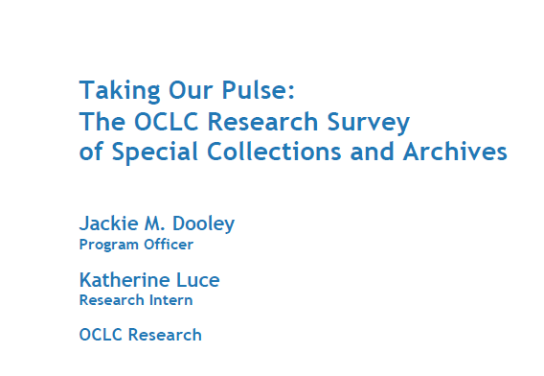
October 2010
“Special collections and archives are increasingly seen as elements
of distinction that serve to differentiate an academic or research library from its peers …
however, much rare and unique material remains undiscoverable, and monetary resources are shrinking at the same time that user demand is growing.”
—Executive summary
http://www.oclc.org/research/publications/library/2010/2010-11.pdf
Notes:
So, reviewing up to this point, interest in the physical collections of academic research libraries is waning; and the demand for e-resources seems unquenchable.
There is also rising interest in library special collections, which are often insufficiently cataloged and processed.
This is a report released only a few months ago by the OCLC Office of Research.
The report affirms that interest in special collections is rising …
But at the moment many are undiscoverable …
At a time when monetary and staffing resources to describe and manage them are scarcer than ever

Slide 15
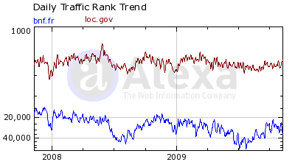
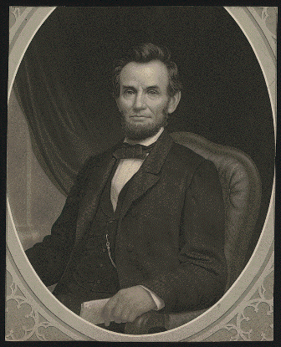

Rising Interest in Digital Collections on the BnF and LC Web Sites
Where do people go on bnf.fr and loc.gov?
LC:
American Memory: 41%
Catalog: 17%
Legislative information
(THOMAS): 6%
BnF:
Expositions: 30%
Catalogue: 26%
Gallica: 26%
Source: Alexa.com, 15 Nov 2009
Notes:
Here are some other indications that digital library special collections are attracting more attention than expected.
This is also a chart from Alexa. com, a Web traffic analysis service, showing Web traffic to the bnf.fr and loc.gov domains. Alexa provides data about where users go once they are on a site. This screen capture is from 2008, but I checked the results this week, and the percentages are holding.
In the case of those who visit bnf.fr, 30% visit the expositions pages—a virtual gallery of curated exhibits around the collections. More than 50% of the traffic is split between the BnF library catalog and Gallica—the digital library of France.
Over 40% of the visitors to the Library of Congress web site go to American Memory, which LC describes it as a digital record of American history and creativity.
Contrast this with the other two most popular destinations for loc.gov visitors—the catalog, at 17%, and federal legislative information at 6%.

Slide 16
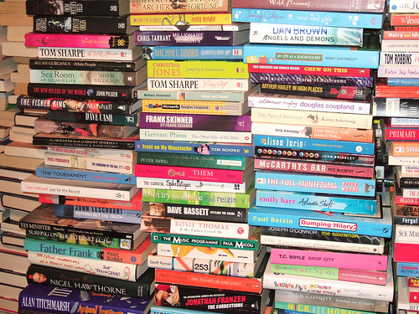
Meanwhile …
… the traditional collections continue to dominate how library staff spend their time
By Ulleskelf
CC-BY-NC-ND 2.0
http://www.flickr.com/photos/ulleskelf/349312876/
Notes:
Again, reviewing up to this point:
Interest in the physical collections of academic research libraries is waning; the demand for e-resources seems unquenchable; there is also rising interest in library special collections, which are often insufficiently cataloged and processed.
Would you agree that e-resources and special collections description, access and management should be library priorities?
Yet the demands of processing the traditional physical collections continues to dominate how most academic library technical services departments spend their time.

Slide 17

What to do?
Study people
“Much research focuses on information sources (e.g., books or newspapers) and systems (e.g., catalogs) rather than on the needs, motivations and behavior of information users.
In other words, much research has emphasized information objects and systems over people.”
–Online catalogs, p. 10
Micah Toll
Pitt Senior, School of Engineering
Finalist, College Entrepreneur of the Year

Slide 18
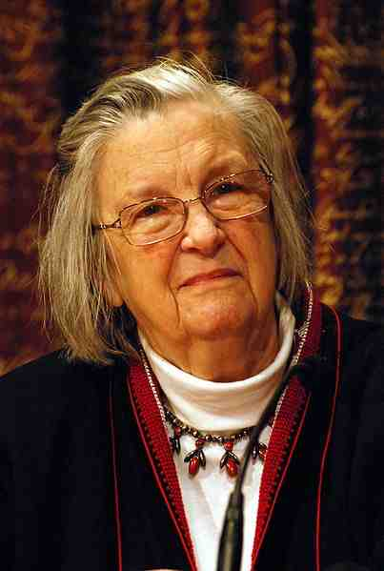
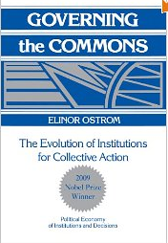
Elinor Ostrom
2009 Nobel Prize, Economics
Born: Los Angeles
Fields: Political theory, policy analysis, economics
How does a research library help her create new knowledge?
What are her information seeking/sharing behaviors and preferences?
In what ways does the library serve her colleagues and her graduate and post-doctoral students?
Elinor Ostrom at 2009 Nobel prize press conference
Attribution: © Prolineserver 2010, Wikipedia/Wikimedia Commons (cc-by-sa-3.0)
Notes:
Research is becoming more interdisciplinary
Faculty and researchers continue to publish in the journal literature, but there are now many ways in which they use the Web to communicate with other scholars
This is Osamu Shimomura, who won the 2008 Nobel Prize in chemistry for his innovative work across three academic fields
This distinguished professor’s achievements provide just one example of how research, teaching, and learning are changing
Beyond supplying him with the online journals he needs, the library has new opportunities to help him, his colleagues and research associates, to create new knowledge.

Slide 19
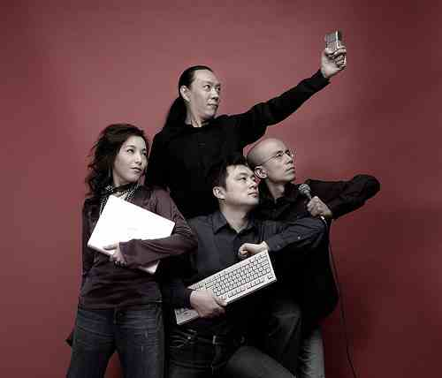
And Then There’s Today’s (and Tomorrow’s) Student
Tech-savvy
Nimble
Enthusiastic
Achievement-oriented
“We’re special”
How does Micah Toll get his information and ideas?
By: acroamatic
http://www.flickr.com/photos/acroamatic/387565075/
Notes:
Students are also changing.
Their information seeking needs, expectations, and behaviors are different than those of past generations
They are very comfortable with technology and with the social Web, including sites like GREE—the Japanese answer to Facebook

Slide 20
The Larger Context:
Knowledge Management
Knowledge communities “interpret information about the environment in order to construct meaning … create new knowledge by converting and combining the expertise and know-how of their members …[and] analyze information in order to select and commit to appropriate courses of action.”
—Chun Wei Choo,
Professor of Information Studies, University of Toronto
The Knowing Organization: How Organizations Use Information to Construct
Meaning, Create Knowledge, and Make Decisions (New York: Oxford
University Press, 1998), xii.
Notes:
To begin to answer that question, let us examine the context in which academic libraries exist, higher education.
To help me I’d like to draw upon the work of Chun Wei Choo, an expert in knowledge management on the faculty of the University of Toronto.
Read
If we assume that the university is a knowledge community that observes and makes sense of the world, creates new knowledge, and seeks information to support decision-making, then the role of an information service such as a library comes into focus: to participate in the generation and processing of information and knowledge for our communities.

Slide 21
Knowledge Pyramid
DOMAIN
EXPERTS:
Professors, grad.
students, researchers, deans,
university leaders and staff
UNIVERSITY COMMUNITIES
OF
PRACTICE
INFORMATION
EXPERTS:
Librarians, records
managers, archivists,
others
IT EXPERTS:
Desktop, computer lab
and server support;
applications for academic,
research, administrative
support; networks,
telecommunications, security
Adapted from Choo, Information Management for the Intelligent Organization, 238.
Notes:
Choo further defines a proactive role, rather than a reactive one, for the library.
He says “in the knowing organization, information systems and services go beyond simply what people want to know, to why and how they will use the information.”
This figure is an adaptation of Choo’s illustration of a highly collaborative model for knowledge creation and organizational growth.
This figure suggests new partnerships between “domain experts, information experts, and IT experts” to bring together the communities’ capabilities.
Domain experts – personally involved in creating and using info
Info experts – have the skills to select, acquire, organize info into systems and structures, to enhance the accessibility and quality of info, and to provide services to promote learning and awareness
IT experts – possess specialized technical expertise to build and maintain IT infrastructures

Slide 22
Knowledge Creation and Information Network Processes
“Improving efficiency and effectiveness in knowledge-intensive work demands more than sophisticated technologies—it requires attending to the often idiosyncratic ways that people seek out knowledge, learn from and solve problems with other people.”
—Rob Cross,
University of Virginia
Rob Cross et al., “Knowing what we know” Organizational Dynamics 30, no. 2
(November 2001), 101.
Notes:
If as Choo suggests with his notion of a “knowledge pyramid,” being a librarian will require more active participation in its knowledge communities, librarians will also need to have a deeper understanding of where students and scholars turn for information.
This is a quote from Rob Cross, assistant professor at University of Virginia's McIntire School of Commerce, and others. Cross and his team’s research into social networks builds evidence that working relationships and personal contacts are enormously important to the ways people obtain information and learn.
Read

Slide 23
Implications for Research Libraries
Students and faculty engage in information network processes with or without libraries.
Libraries have the opportunity to engage more proactively with teachers and learners.
Librarians have natural partnerships with subject domain and IT experts.
Libraries and librarians need to better understand how communities of practice learn, teach, and turn “information” into new knowledge, insight, and action.
Notes:
This concludes my brief look at libraries and information processes in the context of higher education.
Here is a quick summary to make explicit what I’ve tried to say about the implications and opportunities for libraries of today’s technology-driven, community-based and interactive study, teaching, and learning.
(read)

Slide 24
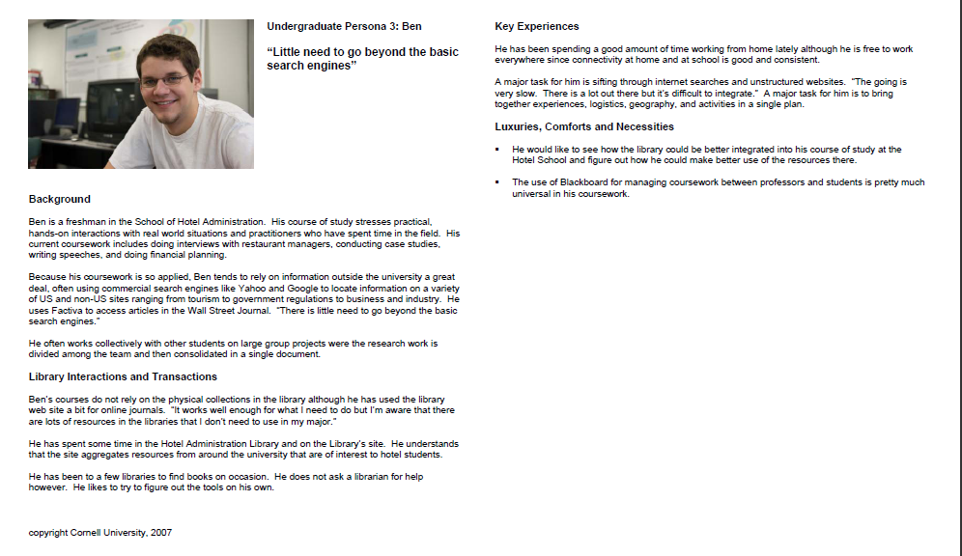
Research technique: Personas
Source: Cornell University Library Web Vision Team; TKG Consulting LLC. 2007. Cornell University Library Personas.
Undergraduate persona 3: Ben
http://ecommons.cornell.edu/bitstream/1813/8302/2/cul_personas_final2.pdf

Slide 25
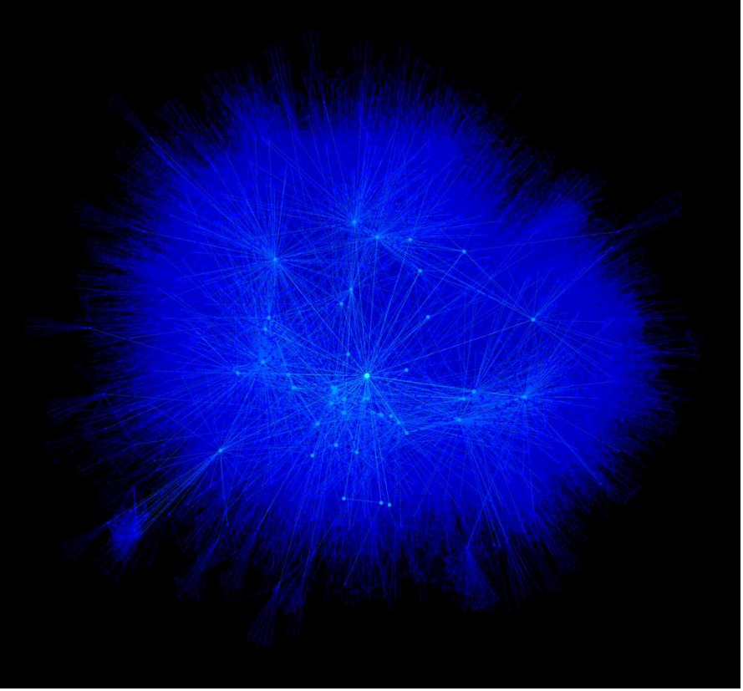
A New Kind of Library
Build a vision of a new kind of library
Be more involved with research and learning materials and systems
Be more engaged with campus communities
Make library collections, services, and librarians more visible in university communities of practice
Move to next generation systems and services
The library in the community
Notes:
This slide attempts to articulate a new service model for the library, in which, instead of having users come to us and to our Web pages—that is, to our well-- the library meets users where they are—navigating the waterways of the Web.
The library has the opportunity to be more proactive both locally and globally by (read—start with second bullet)

Slide 26
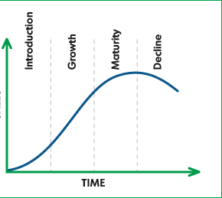
The Concepts of Service Introduction, Growth, Maturity, and Decline
USE

Slide 27
A Blueprint for Change: Innovation, Engagement, Assessment, and Annual Life Cycle Management
Manage,
Engage,
Collaborate
Evaluate and Plan
Design and Develop
Implement and Introduce
Distribute and Promote
Exit this service
Innovate, renew, or
maintain this service
Ongoing
assessment
Ongoing
outreach and
communications
Build or
enhance
and
validate
(test)
Notes:
I became aware of Deming’s approach when I was working at OCLC in the 1990s as the head of the Online Data Quality Control Section. It was in that job when I first developed strong working relationships with colleagues at the Library of Congress.
Later, in my position in technical services at the Cornell University Library, with my team I began applying the concepts and practices of process redesign, with striking results in effective and less labor-intensive workflows with high productivity.
As a result of these intersections of professional relationships and experience, some years ago the Library of Congress asked me to prepare a report on the future of the catalog, together with a blueprint for action.
Click. One section of the blueprint I produced had to do with actions to innovate and reduce the costs of the processes that produce the catalog.
These were not just abstract ideas. We had implemented them at Cornell and we knew they produced good results. At the time they were viewed by some as radical, but over the past five years they are becoming more accepted and widely implemented.

Slide 28
Proforma FY12 Roadmap
(overlapping activities not shown)
Q1
Q2
Q3
Q4
Environmental scan
Repeat Don King study
Repeat user satisfaction study
Establish public services design principles
Create and share a vision (zero based)
Create and share a roadmap of needed new services
Personas study
Current awareness
Conduct existing services assessment
Identify existing services for enhancement/renewal
Identify services to maintain
Identify services to exit
Renew public services organization
Skills analysis
Training programs
Implement collaboration tools
Job descriptions and assignments
Recommend principles for space redesign
Second phase of input for space redesign
Single set of
recommendations
packaged for
internal and external
communications
Articulated vision &
proposed strategic
initiatives for
FY12 and FY13
Measurable
objectives
and timelines
for FY12-FY13
By July 1 2012,
phase 1 of reorganization
complete

Slide 29
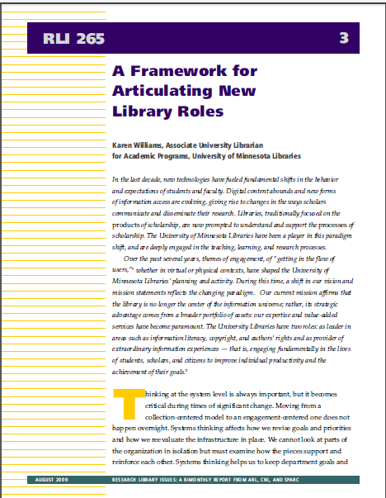
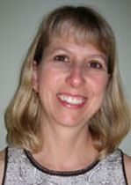
Karen Williams, AUL for Academic Programs, University of Minnesota Libraries

Slide 30

Committing to a shared planning, design and implementation process

Slide 31
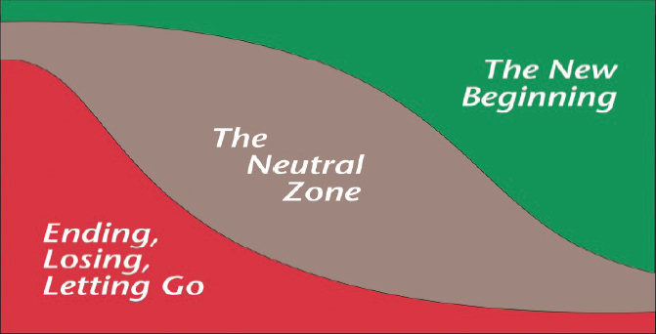
“It’s not the changes that do you in, it’s the transitions” –William Bridges
Change = something in the external environment changes
(e.g., a new library director is hired; a new system is being introduced;
a reorganization occurs; new procedures or policies are planned)
Transition = an internal reorientation process to a change
The three phases of transition
It is critical to manage transitions
inclusively by engaging staff in
the process.
Bridges, William. 1991. Managing transitions: making the most of change.
Reading, Mass: Addison-Wesley.

Slide 32
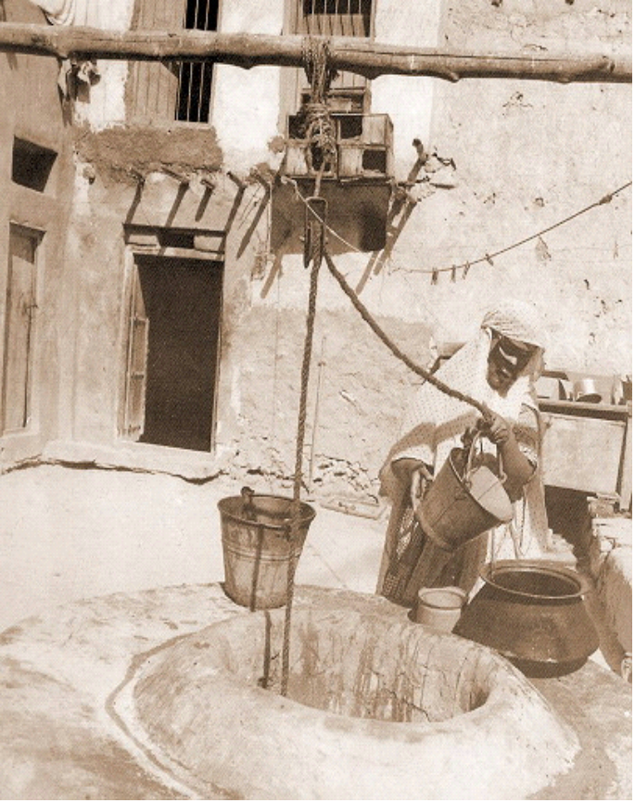

What We Were: The Well
“They come and go and draw
from the well”
The Library as a center of collections
The Library as a center of experts and tools to guide users to appropriate resources
Notes:
I’ll come back to the catalog in a bit.
For now, let’s thing about libraries in light of the discontinuous changes wrought by the Internet, widespread ownership of personal computers and rising computer literacy, and the shift in information seekers’ demand for online, easy to use sources of information.
In the 20th cent., two conceptualizations have dominated our profession’s thinking about academic libraries: 1) the library as a warehouse of collections and 2) the library as a center of experts and tools that guide users to appropriate library resources.
Within their communities, libraries have been a well of knowledge and nourishment of the human mind and spirit.

Slide 33
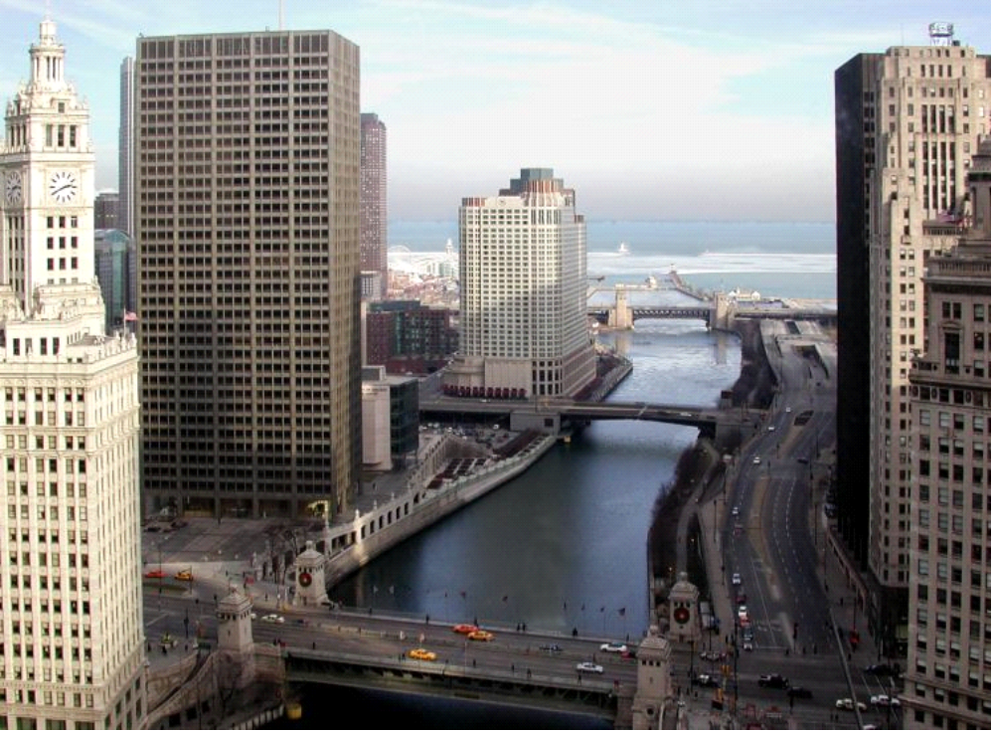
What We Need to Be:
The River
Notes:
Today, at the beginning of the 21st century, both of these concepts of the library are having the effect of restricting academic librarians to an unnecessarily narrow role in their communities and in the learning process.
We need to be part of the flowing rivers that tie us all together in the messy but invigorating process of technology-driven, community-based and interactive learning, study, and teaching. The goals—contributing to the nourishment of the human mind and spirit and to the public good—are the same, but new conditions are driving changes in librarians’ and libraries’ roles.
Information seekers interact with libraries, services and collections both in library buildings and on the Web. Numerous studies support the view that information seekers in university communities prefer to work online from their homes and offices. Many types of information objects interest and engage them, not just books and the scholarly journal literature. Their interests go well beyond what libraries have traditionally provided stewardship over. In fact, today, library collections and scholarly journals are only part of the flowing rivers of information that engage the attention of students and faculty.
This situation provides not the death knell for libraries or their information systems, but the opportunity for libraries to be more and to do more for students and faculty.

Slide 34
Endings
What we call the beginning is often the end
And to make an end is to make a beginning
The end is where we start from
--T.S. Eliot

Slide 35

Questions and Comments?
Notes:
Thanks for the opportunity etc …

