Slide 1
Reporting to Senior Staff
FY13 Planning Task Force
User Services Task Force
November 21 2011

Slide 2
Agenda
What the task forces were asked to do
Executive summary
  What we learned
  What we recommend
Introduction to the Strategic Options Analyses
Discussion
Anticipated Next Steps

Slide 3
The main events so far
September
kick off – Lankes, Fransen, Hanson
October :
-Task force rosters and charges
-Development of Sharepoint sites
-TF weekly mtgs, project mgt workshops, Future Search conferences
Mid-November:
-Convey first set of TF reports to Senior Staff
Early November:
-USTF receives assessment data from John Fudrow
-DeskTracker reports
-Early results of user satisfaction survey

Slide 4
What the task forces were asked to do
Planning TF
  Increase opportunities for ULS staff to participate in FY13 planning process
  Focus on digital library
  Produce strategic option analysis as input to development of ULS FY13 plan
User Services TF
  Focus on organizational redesign/new service model for FY12
  Engage with ULS stakeholders
  Produce strategic options analysis as input to development of ULS FY13 plan

Slide 5
What the task forces are asked to do next
Dec-early Jan
-TF reports to Admin Council, ULS PBC, PTDG, ULS staff
-Sr. Staff develop draft FY13 objectives
January
-TFs facilitate and contribute to all-staff workshops to prioritize objectives
-FY13 TF submit 2nd advisory report to Sr. Staff
Feb-March
-Sr Staff submit FY13 Planning and Budget Report
-USTF deliver design principles for reorganization of user services and space to Sr. Staff

Slide 6
What we learned: the big issues
Improving remote access to licensed resources is essential
Internal communication – up, down, and sideways – is a major concern (“we are too compartmentalized”)
Need more outreach and collaboration outside the library with campus partners
“Light under a bushel” - need more marketing and promotion at individual and organizational levels
Staff training and cross-training – technology skills, communications skills, outreach skills
Need to improve ULS web site
Considerable interest in mobile and social media
Next organizational review – ULS digital library

Slide 7
What we recommend
Communicate
Participate
Mobilize
Deliver
Shine

Slide 8
Some key ideas
Communicate
Internal and external
Collaboratives
Participate
Outreach and engagement
Campus partners
Advisory boards
Mobile
Social media
Cross-unit
On site and online
Mobile; social media
Point of need visibility and service
Relationships
Expertise
E-Science?
Mobilize
Cross train
Data driven decisions
Tech savvy
Well equipped
Professional development
Inclusive planning
Project management framework
Shine
E-publishing
Center of excellence-open access
D-Scholarship ingest at scale
User-driven digitization program
Unique collections
Area studies
International
Deliver
SRemote
Raise awareness
Space redesign
New service desk
Liaison program
Web site redesign
Library as place, place as library

Slide 9
What is a strategic option?
Strategic options are creative, action-oriented responses to the library’s changing environment. They take into account the facts, community needs, trends, opportunities and threats facing the ULS. Strategic options are identified following an organizational assessment that keeps in mind the changing environment, mission and aspirations of the library. The TF will conduct the organizational assessment inclusively by using “Future Search” conferences focusing on (1) public and collections services and (2) the ULS digital library. They will analyze the output of the Future Search conferences to develop and submit a strategic options analysis …
--Charge, ULS FY13 Planning Task Force

Slide 10
Our Strategic Options Analyses
Structure
Strategic traceability
Sources of information
Represents ideal
Actions (column 4) not prioritized or ranked in any way
No assessment of what ULS has capacity to do
User Services SOA presupposes completion of user service organizational redesign in FY12

Slide 11
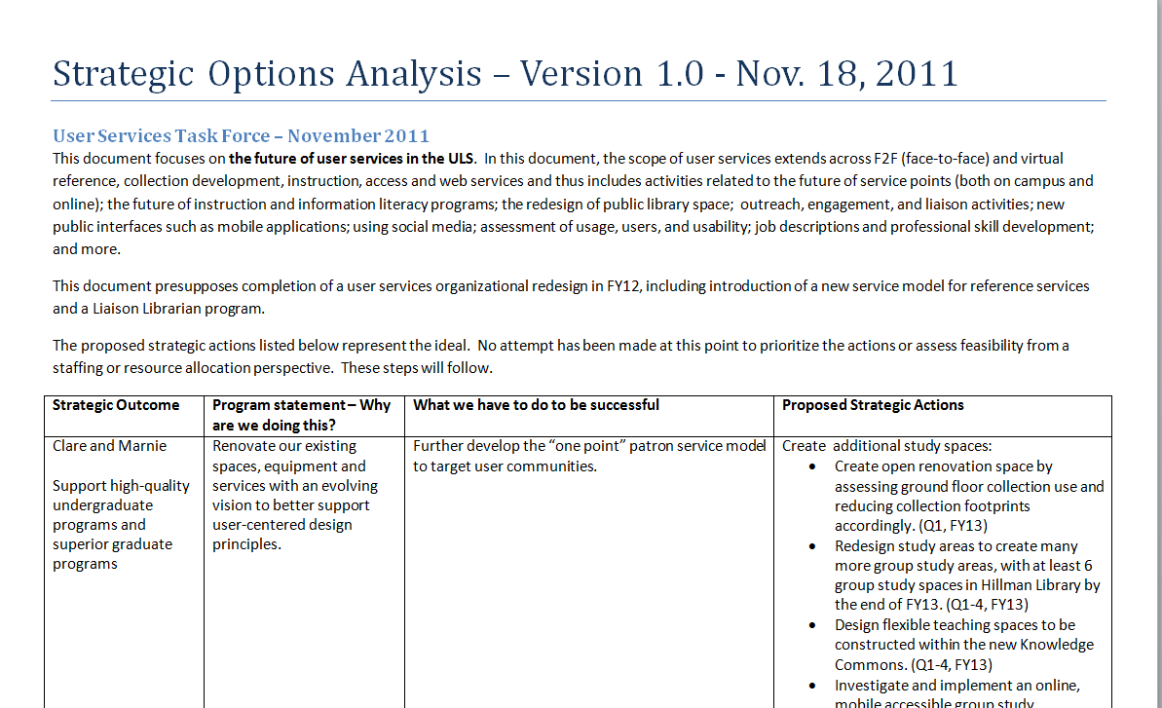
From university mission
statement
From ULS
Long Range
Plan
Themes discussed by TFs
Readings
Future Search results
Discussion boards

Slide 12
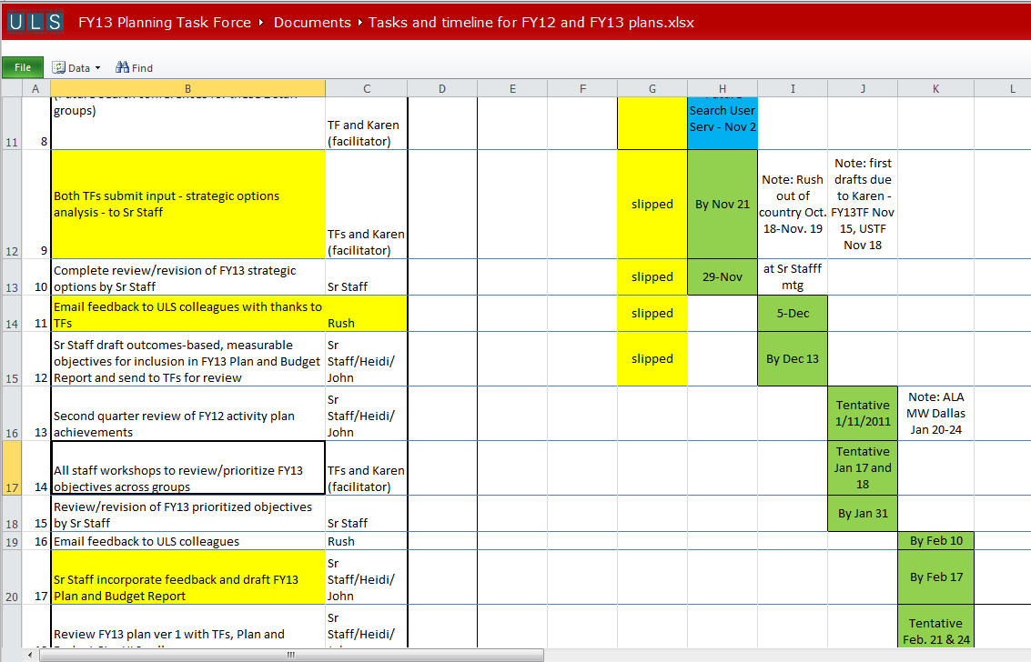


Slide 13
Next steps for User Services TF (from the charge)
Establish public and collections services design principles by:
  Creating a user-centered vision (zero based) of ULS public and collections services three years from now
  Creating a prioritized roadmap for the design, development, and implementation of the envisioned services
  Recommending principles for user services space redesign that is aligned with best practices, the vision and roadmap
  Recommending principles for the redefinition of traditional roles (e.g., reference, instruction, collection development librarians) and the integration of new roles that are aligned with the vision and roadmap
  Recommending principles for professional training and development needed to move to these new roles
December
February
March
January

Slide 14
A few questions about next steps
How and when should TFs report to Admin Council, ULS PBC, PTDG … and ULS staff?
Reactions to proposed timeline for Senior Staff development of FY13 objectives?
Timing for all-staff workshop (open space meeting?) to prioritize, comment on objectives?

Slide 15

Task Force members
Heidi Card
Elvia Arroyo-Ramirez
Noreen Jerin
Rick Hoover
John Fudrow
Susan Neuman
Many others!!!

