Slide 1

The Library as Publisher:
University Library System,
University of Pittsburgh
Timothy S. Deliyannides
Director, Office of Scholarly Communication and Publishing
University Library System
University of Pittsburgh
PALCI Member Meeting, June 12, 2013

Slide 2

Strategic Goal
Innovation in Scholarly Communication
Support researchers in
  efficient knowledge production
  rapid dissemination of new research
  open access to scholarly information
Build collaborative partnerships
around the world
Improve the production and sharing of scholarly research
Support innovative publishing services
Establish trusted repositories for the research output of the University

Slide 3
Why become a Publisher?
Provide services that scholars understand, need and value
Incentivize Open Access
Transform the subscription pricing system that punishes libraries and scholars
Deepen our understanding of scholarly communications issues

Slide 4


Collaboration with
University of Pittsburgh Press
Press Digital Editions
  collaborative project between Press and Library
  750 books digitized by ULS
  includes both in-print and out-of-print titles
  all are Open Access
  increased sales for some titles
Notes:
At Pitt, the University Press is separate from the Library, however, we share a highly collaborative relationship with the Press. We offer over 750 titles from their backlist through Open Access, and this program has actually driven an increase in sales of some of their older titles. The Press is named as a Cosponsor of all of our peer-reviewed journals, and the Director of the Press serves on our Publications Advisory Board.

Slide 5
Synergies with
University of Pittsburgh Press
Press focuses on books and
monographs rather than journal publishing
Press is named as cosponsor for all refereed journals
Press Director serves on ULS Publications Advisory Board
Library and Press cooperate on acquisitions

Slide 6
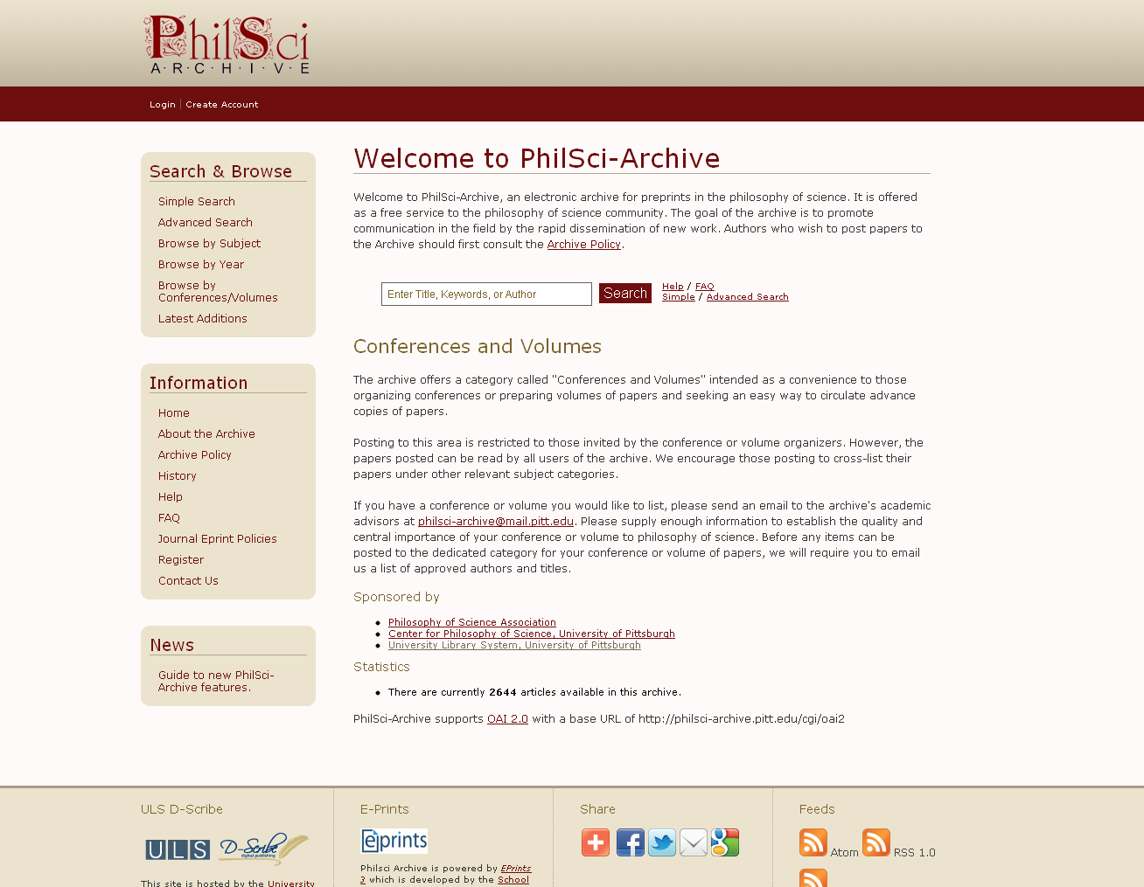
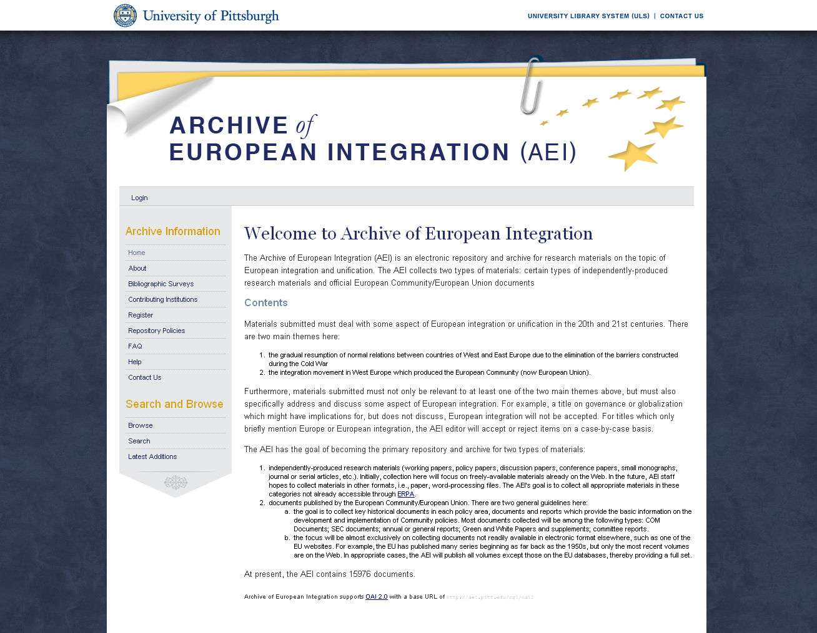

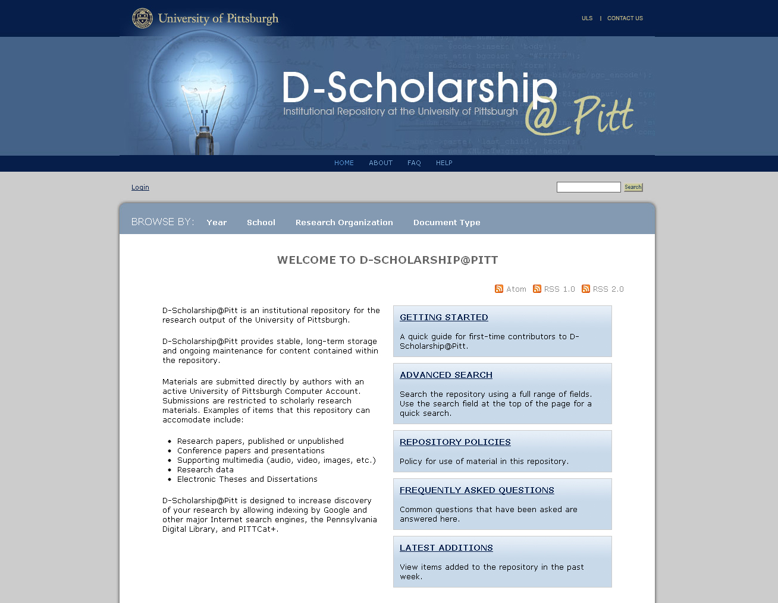
Open Access
Author Self-archiving Repositories
2001 PhilSci Archive
2001 Electronic Theses & Dissertations
2002 Archive of European Integration
2003 Minority Health Archive
2003 Aphasiology Archive
2009 D-Scholarship@Pitt
(general Institutional Repository)
2010 Industry Studies Working Papers
2012 Archive for Essential Limb Care
Notes:
We have been offering subject-based Open Access repositories over the last decade. Most of these began as projects proposed by Pitt faculty but are intended for an international audience. For instance, the PhilSci-Archive is widely recognized as the global repository for rapid dissemination of new research in the discipline of Philosophy of Science. Many preprints first deposited there are later published in refereed journals.

Slide 7
Documents in repositories and journals

Slide 8
Growth in number of titles published

Slide 9
ULS E-Journal Publishing http://www.library.pitt.edu/e-journals
Rapid growth to 35 journals since 2007
Peer-reviewed scholarly research journals
Most are Open Access and electronic-only
Based on PKP Open Journal Systems (OJS)
Editorial teams are located around the world
Six journals have multilingual content

Slide 10

Journal publishing goals
Propel scholarship at the University of Pittsburgh
Extend service beyond the home institution
Save ‘at-risk’ journals without the infrastructure or know-how to go electronic
Incentivize Open Access Publishing worldwide

Slide 11

Journal Publishing Strategies
Maintain quality and academic integrity
Choose partners carefully
Rely on self-sufficient editors
Work smart, not hard
Keep costs low

Slide 12

Selection Criteria
Original scholarly content
Rigorous blind review process
Commitment to Open Access for content
Editorial Board of internationally recognized scholars

Slide 13
Publications Advisory Board
Includes leaders in scholarly publishing and Open Access issues
Provides strategic guidance and expertise for ULS digital publishing program
Assists in development of publication policies governing:
  Selection and evaluation criteria for partners
  Open Access and Creative Commons licensing
  Cost recovery mechanisms

Slide 14
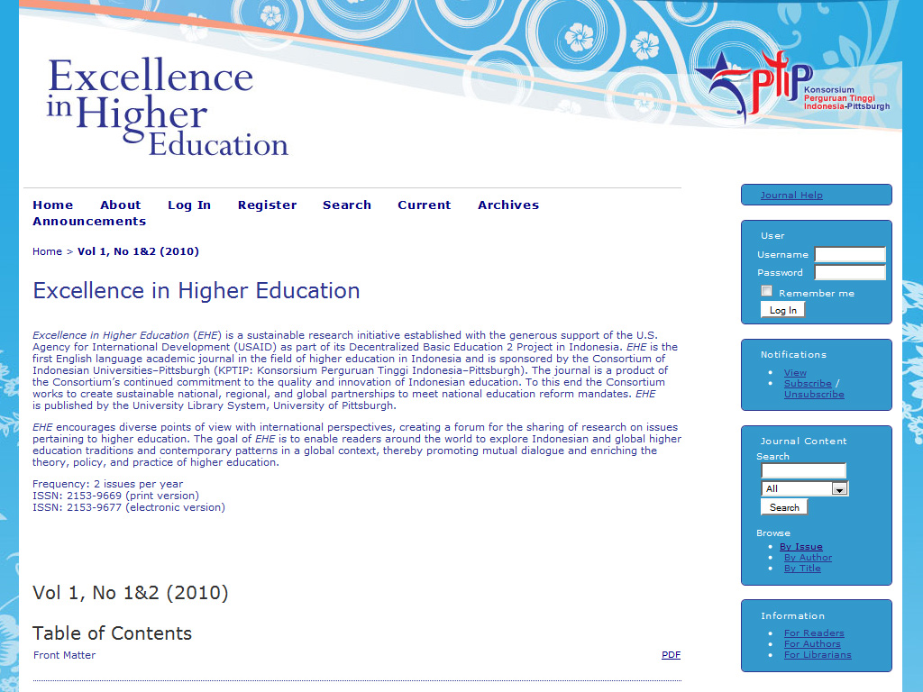

Slide 15


Slide 16
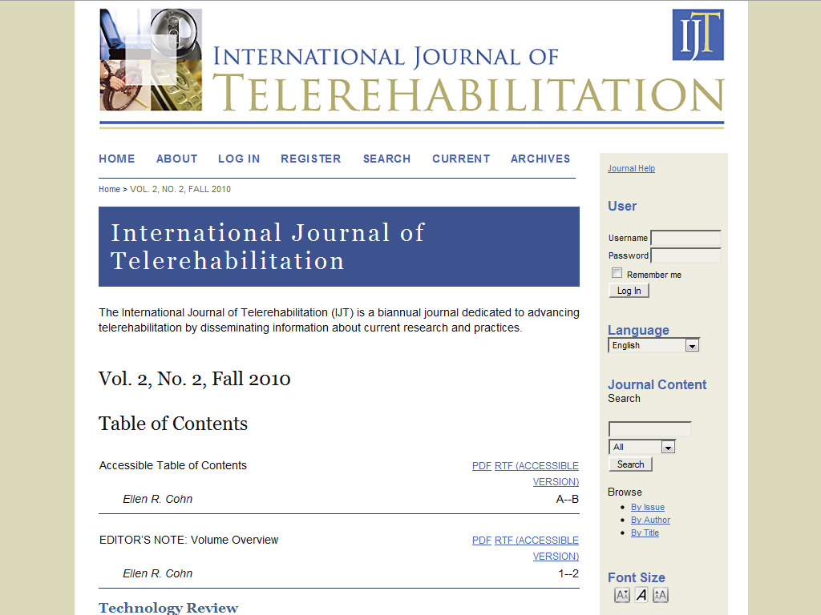

Slide 17
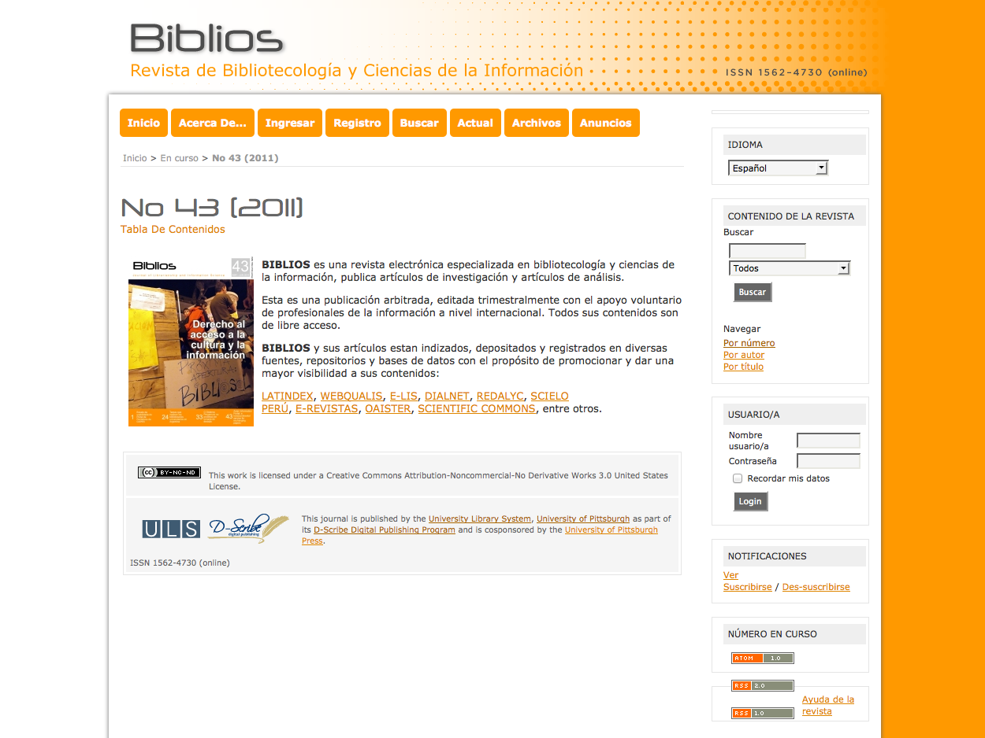

Slide 18


Slide 19
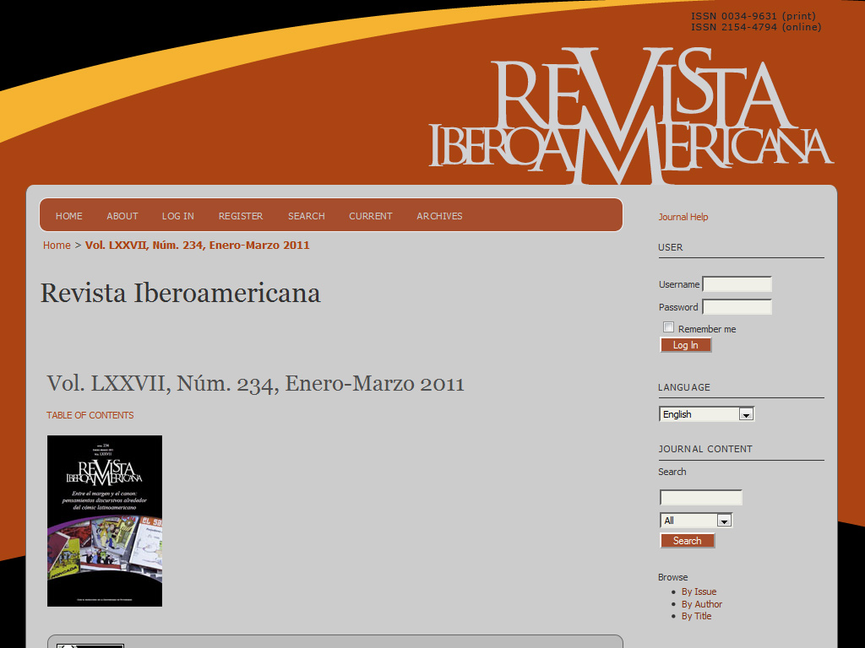

Slide 20
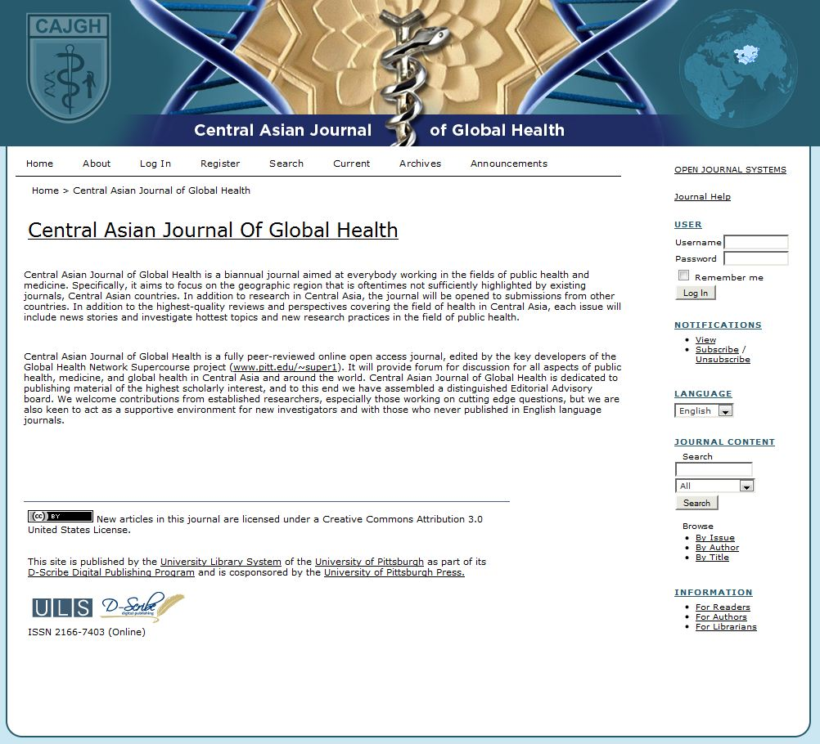

Slide 21
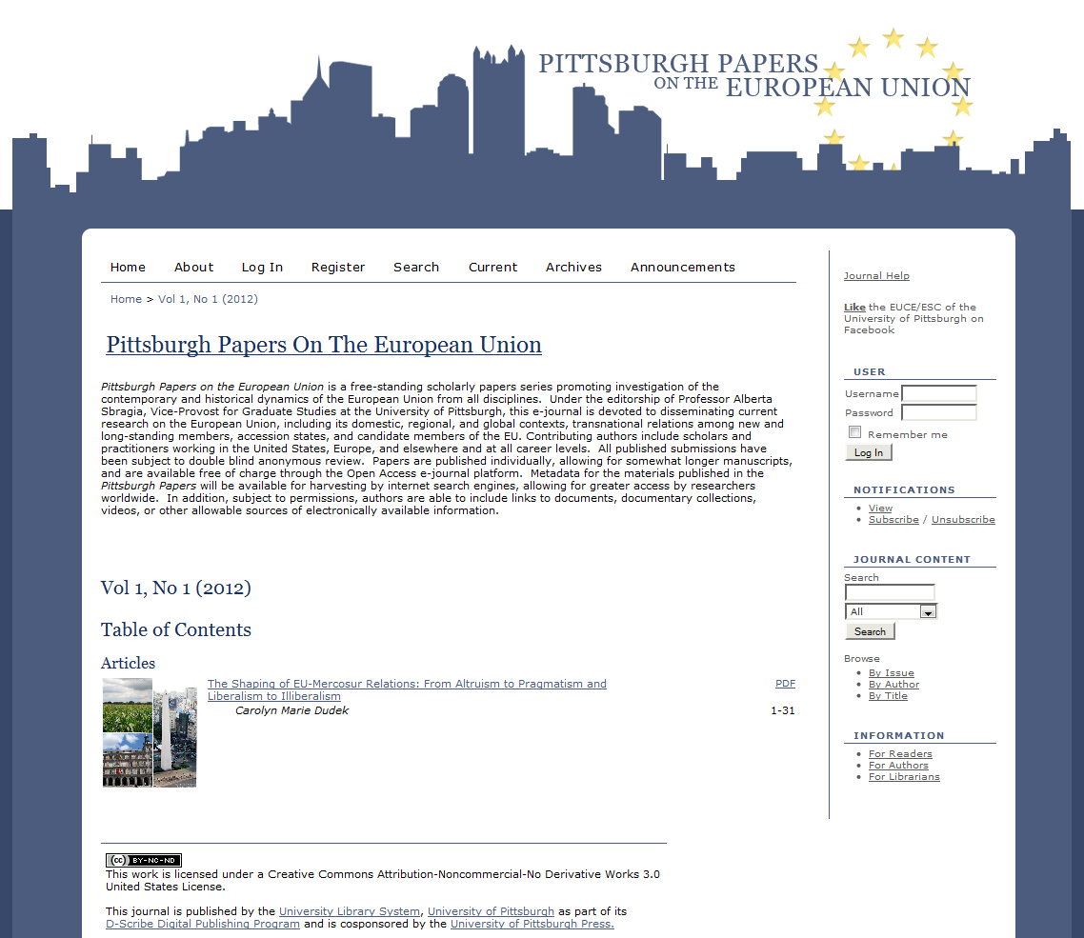

Slide 22
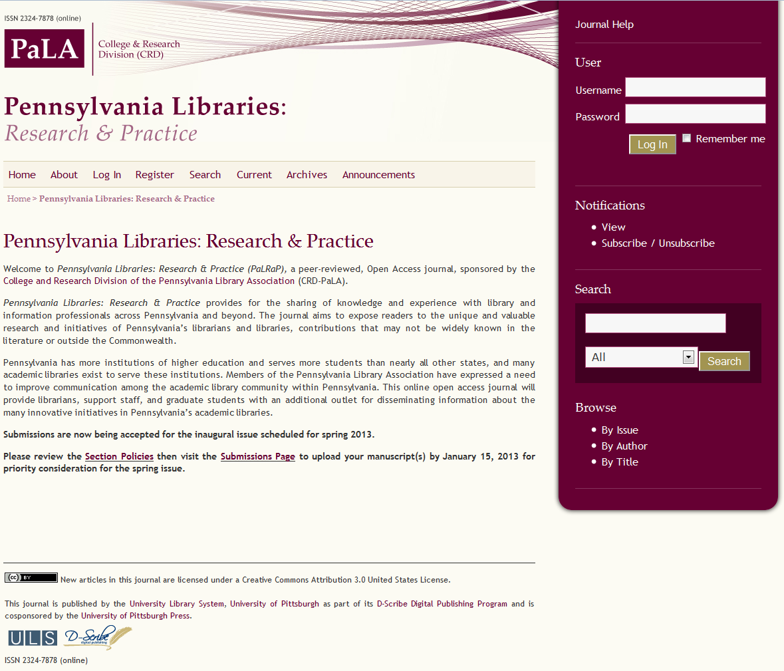

Slide 23

Innovative open, dual review process
Dialogic Pedagogy: An International Online Journal http://dpj.pitt.edu
Initial check for scope by Editors
Submission is posted immediately community forum for public comment
Traditional 4-week peer review takes place simultaneously with public comment on submissions
Peer reviewer comments are posted to the public comment forum for additional discussion for 4 weeks
Final acceptance decision is made by the Editors
Refereed content is formally published in a separate area.

Slide 24
Monographic Publishing
Based on Open Monograph Press (OMP)
developed by Public Knowledge Project (PKP)
Pitt participating in early testing and software development
forthcoming titles:
  Rescher, Nicholas. Leibniz and cryptography: an account on the occasion of the initial exhibition of the reconstruction of Leibniz’s cipher machine
  Russell, Daniel S. The emblem and device in France

Slide 25
Scholarly Exchange®
http://www.scholarlyexchange.org
Approximately 40 additional Open Access journals
Acquired by the ULS on August 1, 2012
Hosting service only
ULS is NOT the publisher and does not provide publishing services

Slide 26

Staffing for journal publishing
2.00 FTE OJS operations and customer support
0.25 FTE administration, partner relations, marketing
0.30 FTE graphic designers
0.50 FTE OJS sys admin
_____________________
3.05 FTE TOTAL
100% funded from internal reallocation of operating budget

Slide 27
Sustaining our publishing program
Since July 1, 2012, we charge fees for services to all new publishing partners
We incentivize Open Access through subsidies
We subsidize Pitt publications
Pitt student publications are still free!

Slide 28

Leadership in advocacy for
OA publishing
Founding member of Coalition for Library Publishing
Member of Compact for Open-Access Publishing Equity (COPE)
Major development partner for Public Knowledge Project (PKP)
First library publisher in North America to join the Open Access Scholarly Publishers Association (OASPA)

Slide 29
Multiple approaches are needed
OA journal publishing
OA Institutional Repository & deposit mandates
Support for other OA archives & conference hosting
OA awareness raising
Subsidy of OA author fees
Support the development of Open Source publishing software

Slide 30
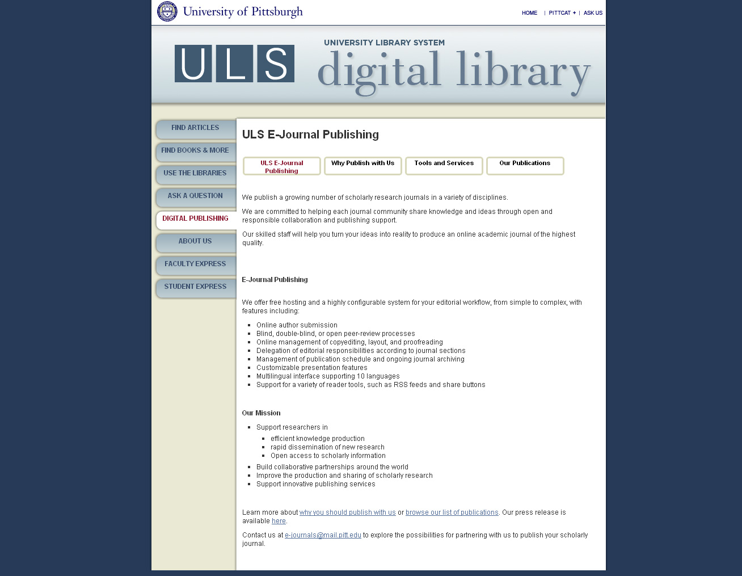
http://www.library.pitt.edu/e-journals

