Slide 1

PlumX and Pitt: Understanding and Visualizing Research Impact
Rush G. Miller
Hillman University Librarian and Director, ULS
University Library System
University of Pittsburgh

Slide 2

Why Pitt?
Strategic goal:
Innovation in scholarly communication
Providing services that scholars understand, need, and value
Putting ourselves in faculty “spaces”
Re-envisioning our librarian liaison program
Deepening our understanding of scholarly communications issues

Slide 3

Why PlumX?
Making research “more assessable
and accessible”
  Gathering information in one place
  Making it intelligible and useful
Measuring and visualizing research
impact
Correlating metrics from traditional and new forms of scholarly communication
Allowing researchers, labs, departments, institutions to track real-time scholarly impact
Promoting research, comparing with peers, connecting with new research

Slide 4
Plum Analytics
Founded in January 2012
Co-Founder: Andrea Michalek
  Expertise in Internet information technology, datamining, search and natural language processing
  Previous work at Topular, Fast PDF, Serials Solutions
Co-Founder: Mike Buschman
  Expertise in product management, training, marketing
  Previous work at Serials Solutions, IEEE, Microsoft
Headquarters in Philadelphia and Seattle
Notes:
Mike and Andrea worked together on developing the Summon system at Serials Solutions.

Slide 5
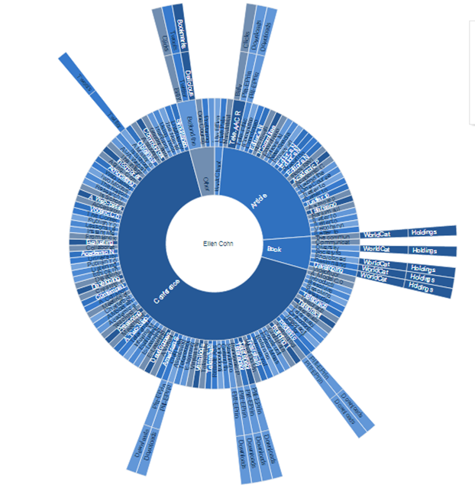
The Premise
Browsable, searchable
directories of research
authors
Can be organized to highlight:
  schools
  departments
  research groups
Deep data mining gathers timely measures of impact
Metrics-based reporting and visualization tools for measuring, comparing, and benchmarking impact
Notes:
Understand impact of faculty research in social media (Twitter, Facebook, etc.)
See impact of alternative scholarly communication methods (websites, repositories, etc.)
Help determine where to disseminate works to increase research impact

Slide 6

Traditional vs. new
Traditional measures are also
counted
Findings are complementary
to conventional methods of
measuring research impact
(e.g., H-Index)
Not intended to replace them

Slide 7
New measures
More comprehensive: Altmetrics = ALL METRICS
  Citations
  Usage
  Captures
  Mentions
  Social Media
Covers impact of online behavior
  Because scholars increasingly work online
Measures impact immediately
  Because citation counts take years to appear in literature
Notes:
Different categories of impact
• Usage
Downloads, views, book holdings, ILL, document delivery
• Captures
Favorites, bookmarks, saves, readers, groups, watchers
• Mentions
Blog post, news story, Wikipedia article, comments, review
• Social Media
Tweets, Google +1s, likes, shares, ratings
• Citations
Web of Science, Scopus, Google Scholar, Microsoft Academic Search, patents

Slide 8
Timeline
Spring 2012:
  First meeting with Plum Analytics
Summer 2012:
  Announcement of Pitt as Plum Analytics’ first partner
Fall 2012
  Gathered data from pilot participants
Winter 2013
  PlumX pilot system made public
Spring 2013
  Faculty surveyed; enhancements made

Slide 9

Our approach
Created Altmetrics Task Force
Engaged liaison librarians to work with pilot participants
Selected faculty participants, diversified by:
  discipline
  school/department
  online behavior
  level of career advancement

Slide 10

Pilot Project Participants
32 researchers
9 schools
18 departments
1 complete research group
Others joined as they learned about the project

Slide 11

Data collection for pilot project
Created records in D-Scholarship@Pitt, our institutional repository
Focused on articles, books, book chapters, proceedings
Scholarly output with standard identifiers
  DOI, ISBN, PubMed
  ID, official URL, etc.
Scholarship
produced since
2000

Slide 12
Other Library work
Developed guidelines to standardize record creation
Data entry from faculty c.v.’s into IR (2 to 3 student workers with QA by librarians)
Librarian liaisons and other staff trained in record creation
SharePoint site used to track work completed
Coordination with pilot faculty
Gathered feedback and administered online survey

Slide 13
Plum Analytics processing activities
Harvest records from Pitt IR for each participant
Build profile for each researcher in PlumX
Harvest additional online artifacts NOT in Pitt IR
Use data mining to harvest publically available metrics from hundreds of sites on the Web
Create visualizations to display metrics on PlumX interface

Slide 14
Key features
Faculty profiles
Online ‘artifacts’
  Article
  Book
  Book chapter
  Video
  Etc.
Impact graph
Sunburst
Notes:
PlumX sports a highly interactive interface where nearly everything is clickable. You can navigate according to your insitutions academic hierarchy and view aggregate data for each school, program, or research center.
Starting from a researcher profile, you can drill down to view each document, or online ‘artifact’, and then drill down further to view each individual metric for that artifact (the number of times is was cited, or downloaded, or tweeted about, or bookmarked in Mendeley. Two visualization schemes show the impact of each researcher graphcally (the Impact graph and the Sunburst view).

Slide 15
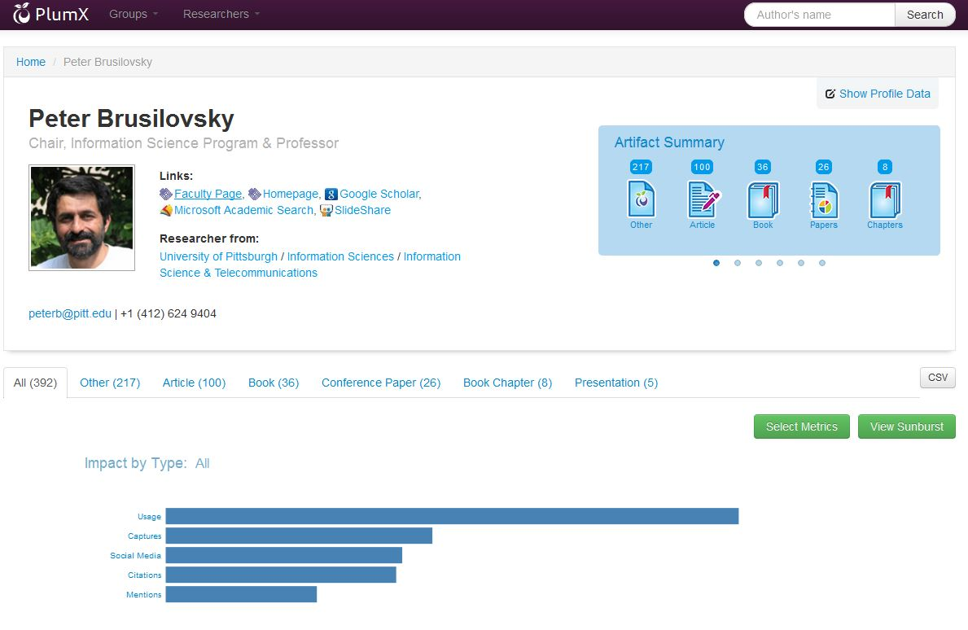
Faculty profile
Notes:
Includes
Affiliation
Contact information
Links to faculty page, homepage
Presence in Google Scholar, SlideShare, etc.

Slide 16
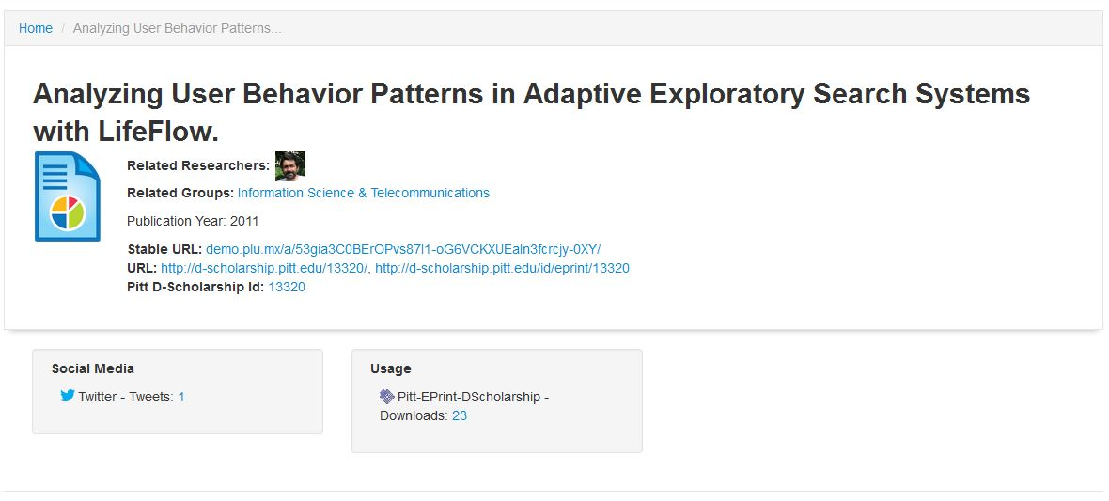
Online ‘artifact’ display
Notes:
Shows information on each artifact such as an article, book chapter, book, video or slide presentation.
Provides details on each research item, including title, links to original, standard number, and stable URL on PlumX site
Details usage, social media, citations, etc.
Data reharvested at least once per week, more as needed

Slide 17
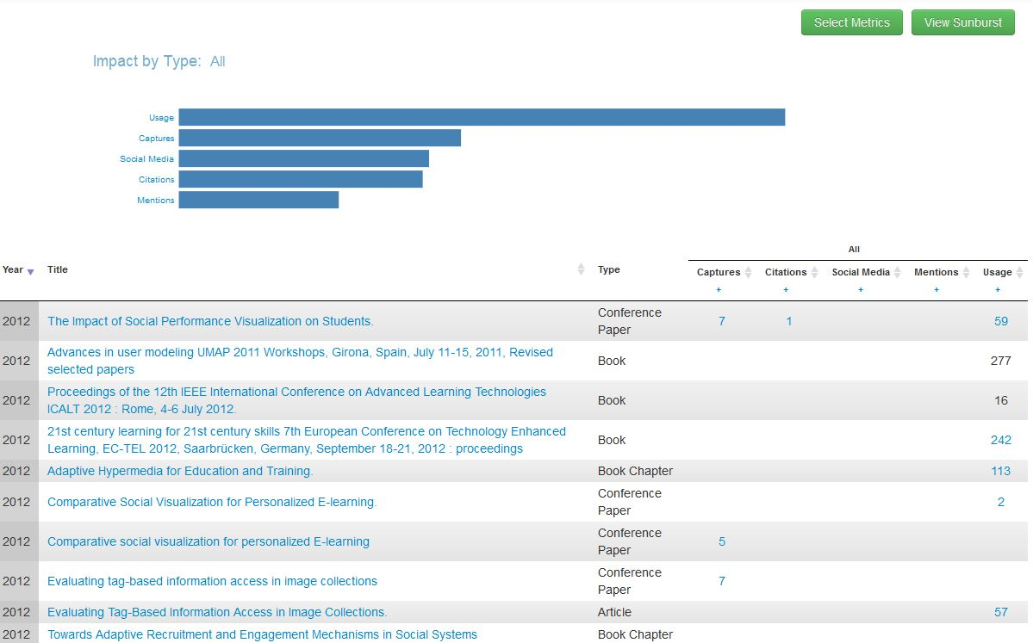
Impact graph
Notes:
Impact organized by
Usage (views, holdings, downloads)
Captures (readers, groups, favorites, bookmarks)
Social media (likes, tweets, +1s)
Citations (cited by)
Mentions (comments)

Slide 18
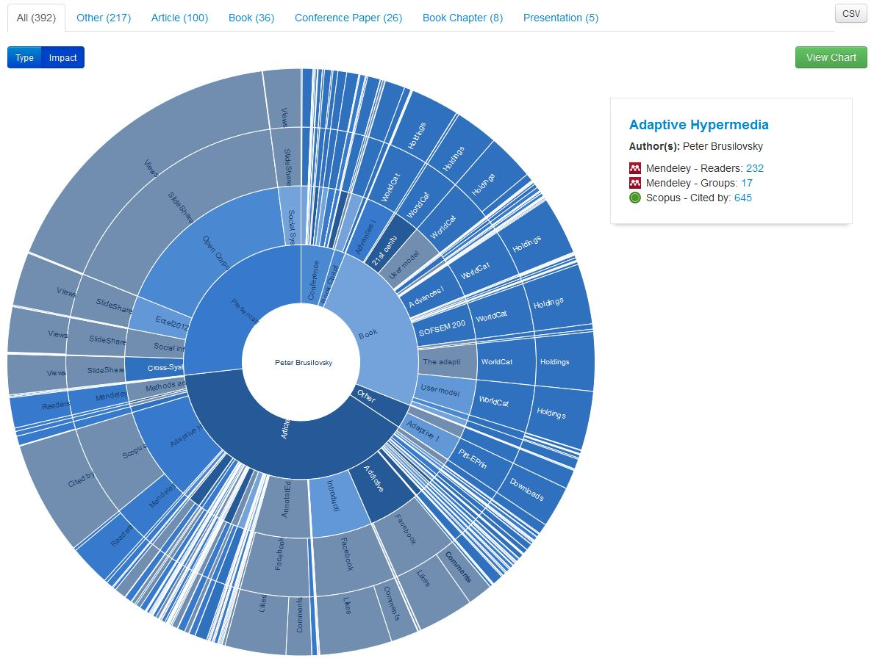
Sunburst
Notes:
Sunbursts show work by type and by impact
Default Type Sunburst
Content arranged by type of research artifact
Emphasizes types of research output
Mouse over reveals detailed view of artifact slice
Impact Sunburst
Reorders artifacts so that the viewer can quickly determine where artifacts have most impact

Slide 19
Feedback
Solicited via email and online survey
Generally positive in most cases
Data corrections
  Errors in profiles
  Links to wrong data
  Quickly corrected by Plum staff
Requests for results from additional online sources (Google Scholar, SlideShare, Reddit, etc.)
  PlumX collects data from these but did not gather information in advance for profiles

Slide 20
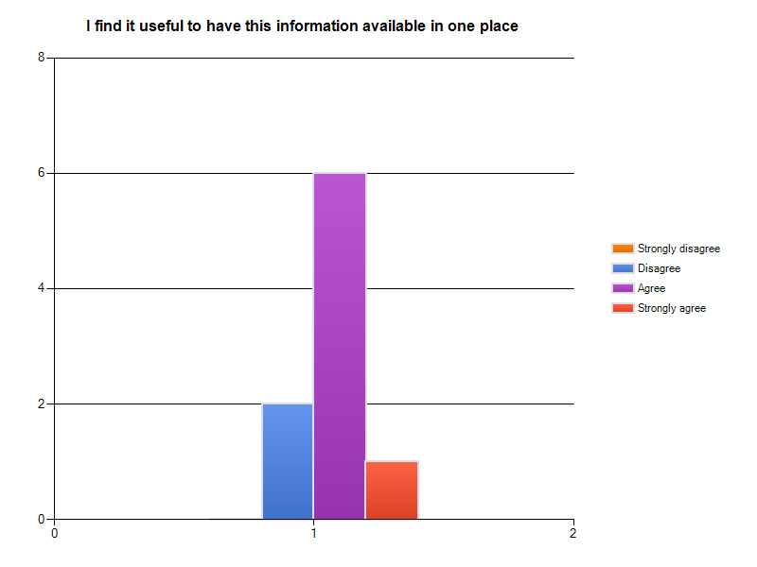
Data collection
Notes:
All data in one place
Very positive

Slide 21
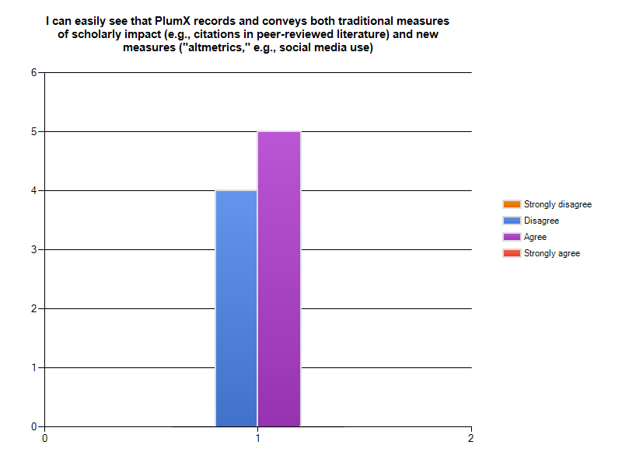
Traditional vs. new measures
Notes:
Mixed reaction
May relate to value placed on traditional (citation) vs. new (social media)

Slide 22
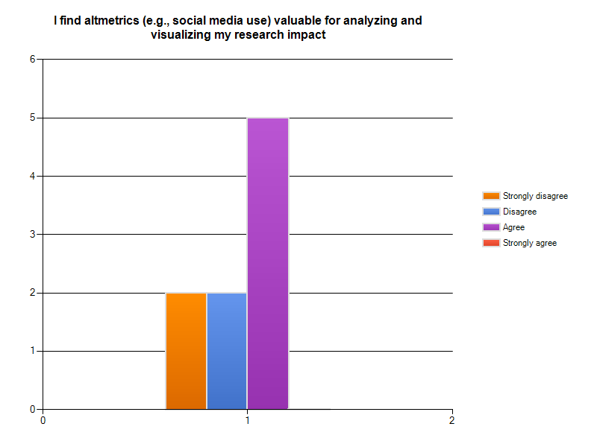
Value of altmetrics
Notes:
Mixed
Concerns over what is being measured
What the measurements mean (“mentions” vs. “captures” vs. “tweets”)
Whether measurements are important
How results might be used by others (for or against the faculty member)
Suggests that the interface may need some way of applying relative weights to the result, so that a citation in a published work is ‘worth more’ than a tweet. Weightings might need to be school- or discipline- specific.

Slide 23
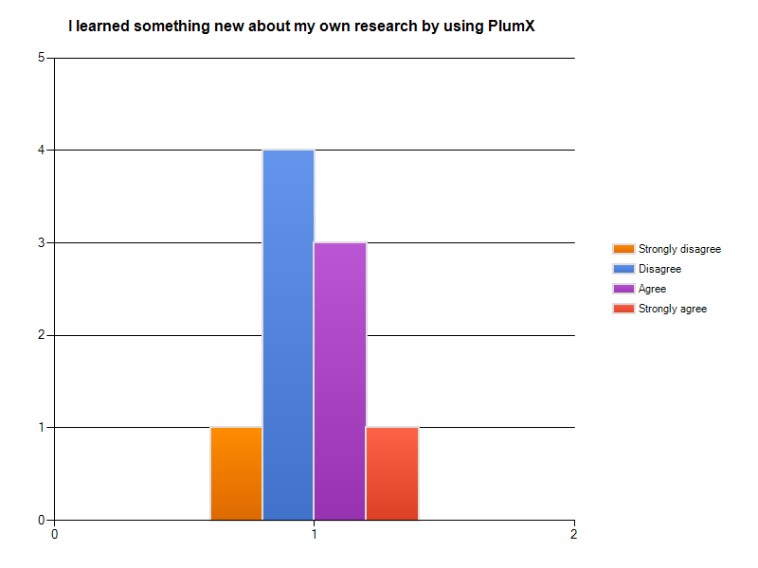
Overall impression
Notes:
Mixed results
Impression that newer faculty value altmetrics more and are willing to use them as a way to view their scholarly impact
Impression that veteran faculty appear to place less value on altmetrics
May require more outreach from the ULS (liaisons, Office of Scholarly Communication and Publishing) to communicate value
Again, we need to put ourselves in faculty spaces to understand what data they need, how they use this, its value to them

Slide 24
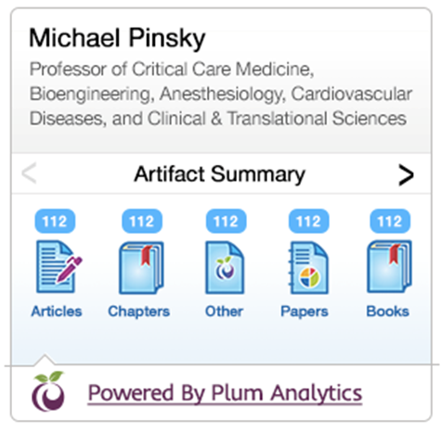
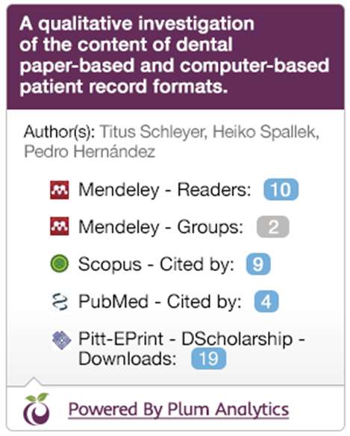
Embeddable widgets
(in development)
For researchers, to add to:
  their own Web pages
  department directories
  IR researcher profile page
For individual artifacts,
to build article level metrics
for imbedding in:
  IR document abstract page
  Article abstract page for
  journals we publish
Notes:
Plum Analytics is working on widgets that can be imbedded in any Web page. There will be two kinds of widgets: one that will summarize the total impact of an individual researcher and all their scholarly output. This could be imbedded anywhere where the faculty member has an online profile, including on their own Web site, their department’s Web site, or their profile page on their local institutional repository. The second widget shows the impact that an individual online document has. This could appear on the abstract page for an article on a publisher’s Web site or in a local insitutional repository.

Slide 25
Other future plans
Record merging/deduping
  Help merge artifact records even when standard identifiers aren’t present to help with deduping
Ability to edit user profiles and artifact records locally
Open API
  To allow integration with other online systems
Rollout to all Pitt Researchers
  Will use automatic feed from Pitt IR to PlumX

