Slide 1

The Public Knowledge Project and the ULS
Scholarly Communications Lunch and Learn Discussion
Thursday, September 12, 2013
Office of Scholarly Communication & Publishing
University Library System
University of Pittsburgh

Slide 2
What is the Public Knowledge Project?
A research initiative on scholarly publishing
The world’s leading open source publishing software developer
Founded by John Willinsky at UBC in 1998
MISSION: to improve the scholarly and public quality of academic research through the development of innovative online environments.

Slide 3
PKP Software is critical to the ULS’ success as a publisher
Open Journal Systems
Open Conference Systems
Open Harvester Systems
Open Monograph Press

Slide 4
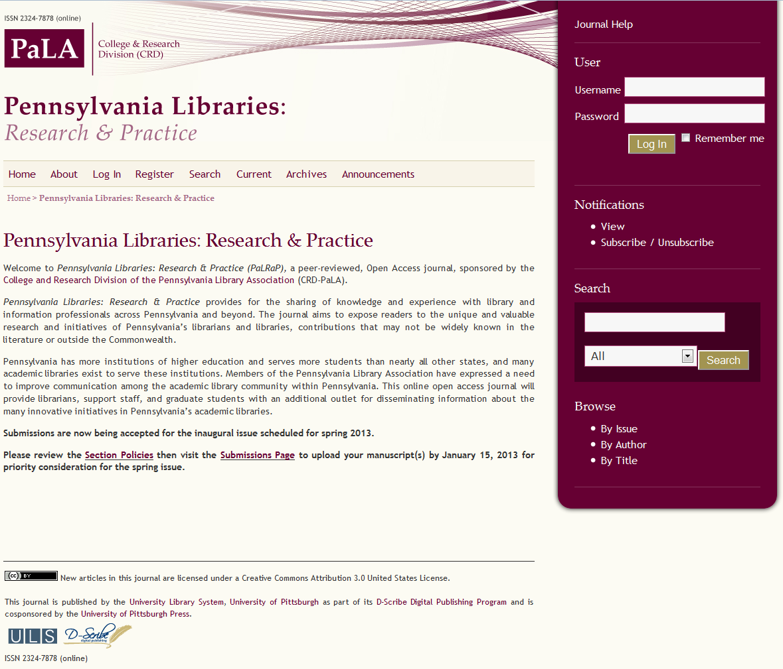

Slide 5
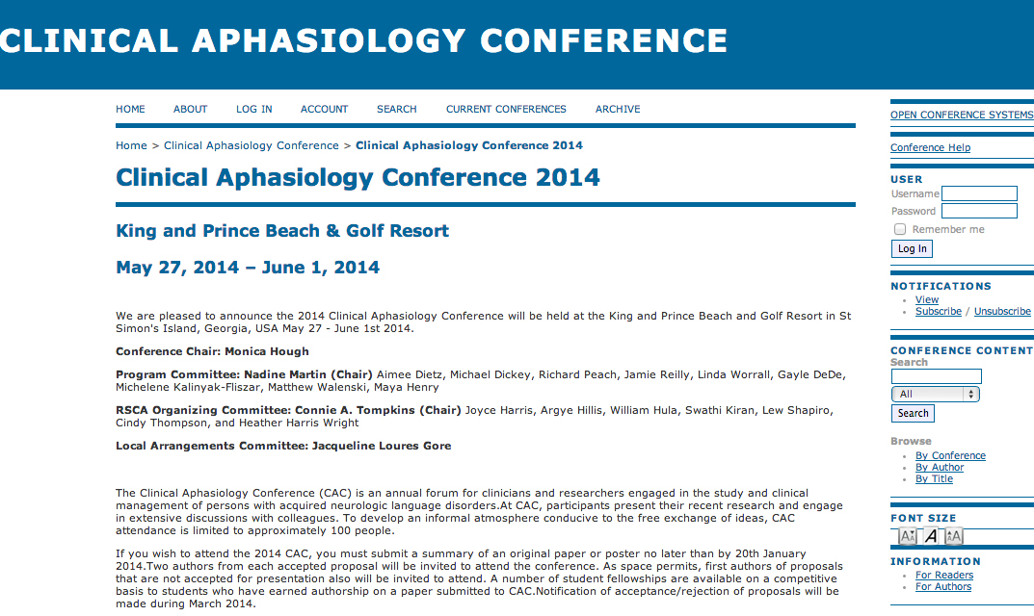

Slide 6

Why is this important?
Pennsylvania Digital Library
Based on PKP’s Open Harvester Systems
Uses OAI Protocol for Metadata Harvesting
Includes digital collections from universities, public libraries, and cultural institutions
Content is by, for, or about Pennsylvania

Slide 7
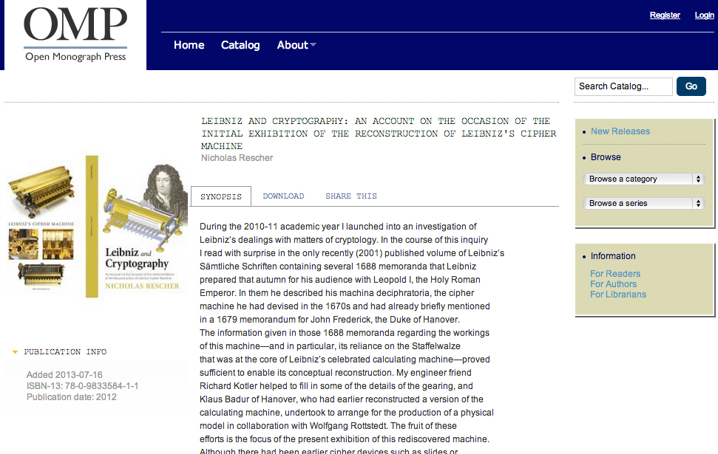

Slide 8
PKP – quick facts
number of countries using OJS (up to 2012): 105
OJS 2.3.8 downloads (released Sept. 2012): 30,953
OMP 1.x downloads (released Sept. 2012): 4,572
OJS has been translated into 29 languages
total questions on forum: 35,830

Slide 9
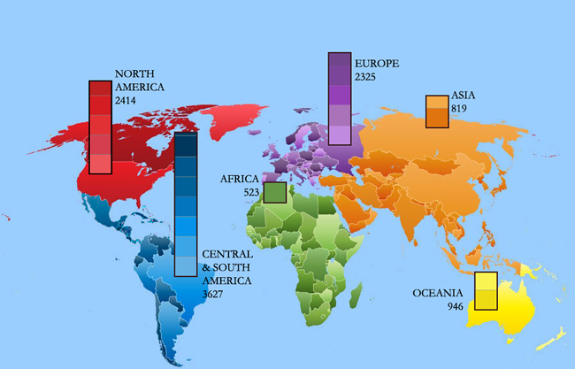
Journals using OJS – January 2012

Slide 10
Other PKP activities
User Forums
The PKP School for Journal Managers and Editors
Publishing Services
  Hosting for 450 journals
  Consulting and customization
  But NOT a publisher
Outreach and advocacy
Research Projects

Slide 11
PKP research grants
New Reading Environments for Scholarly Work
Synergies: the Canadian Information Network for Research in the Social Sciences and Humanities
Strengthening African Research Culture and Capacities
Toward an Intellectual History of Publishing
Assessing and Improving the Impact and Reach of Open Access Latin American Scholarly Production

Slide 12
Dataverse/OJS integration
Joint Project with Harvard’s Institute for Quantitative Social Science
Integrates Harvard’s Dataverse platform with OJS
Allows automatic deposit of and access to research data side-by-side with published articles
Pilot project include a ULS publication
(Journal of World-Historical Information)

Slide 13
Smarter Scholarly Texts
Improves cross-platform publishing, text-mining, and indexing
Joint project with Stanford University
Automated article parsing and production service.
Transforms an unformatted Word (or compatible) document to publication-ready HTML and PDF, using NLM XML 3.0 standard

Slide 14
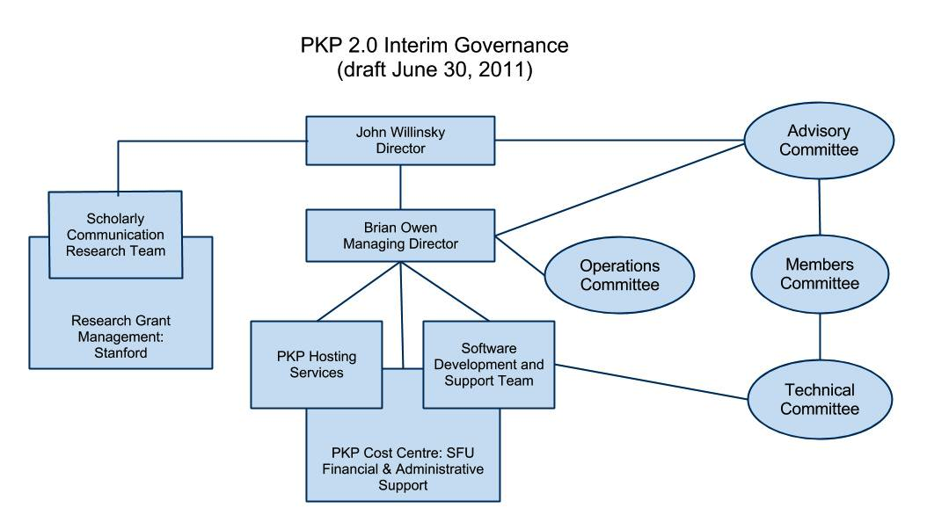
New governance structure

Slide 15
PKP Advisory Committee
Tim Deliyannides – Chair
provides guidance and advice on PKP’s evolving governance and organizational structure
provides input on general strategic direction and priorities for PKP’s software development and related activities
reviews PKP financial reports and provide advice on ongoing sustainability

Slide 16
PKP Technical Committee
Brian Gregg– Member
provides technical input and advice on PKP’s software development methodologies and priorities
undertake specific “technical” assignments on behalf of PKP (contributes programming)
Monthly meetings via Skype

Slide 17
PKP Membership Committee
Vanessa Gabler – advisory member
provides a community-based forum for feedback on PKP’s general strategic direction and priorities for PKP’s software development
provides guidance and advice on support priorities, educational and other services for the PKP user community
assist in planning and supporting PKP conferences, workshops, and other related activities

Slide 18
PKP Major Development Partners
University of Pittsburgh (the first!)
California Digital Library
Ontario Council of University Libraries
Simon Fraser University
Stanford University School of Education
University of British Columbia

Slide 19
Pitt’s contribution
Financial support
Participation in governance
Software development/code contribution
Support for user forums
Contribution of training materials
Early adopters of new software
Testing and evaluation

Slide 20
How does this benefit Pitt?
PKP’s free software generates revenue for the ULS
Huge savings for our publishing activities
ULS manages around 90 individual Web sites using PKP software
Opportunity to develop transformative technologies
Opportunity to influence a far-reaching program on a global scale
Chance to work with like minded organizations dedicated to open sharing of scholarship

Slide 21
Highlights from the
PKP 2013 Scholarly Publishing Conference
Universidad Nacional Autónoma de México
Mexico City, August 19, 2013 – August 21, 2013
http://pkp.sfu.ca/pkp2013

Slide 22
UPCOMING EVENTS
OpenOxford, Open Access, and the Transformation of Discovery: Recent Developments in Open Access, Collections and Systems Support for Research-Intensive Universities
  Scholarly communication and open access: September 19, 10-11 am (272 Hillman)
Lunchtime Talk for ULS Colleagues: Recent National and International Policy Initiatives on Open Access
  October 10, 12 noon-1 pm (272 Hillman)

Slide 23
Open Access Week events
Copyright & Your Research
  Peter Hirtle, Senior Policy Advisor, Cornell University Library, and Research Fellow, Berkman Center for Internet Security and Society, Harvard University
  October 22, 4 pm (Ballroom A, University Club)
The White House Directive on Open Access and Its Impact on Researchers and Universities
  Michael W. Carroll, Professor of Law and Director, Program on Information Justice and Intellectual Property, American University, Washington College of Law
  October 24, 4 pm (Ballroom A, University Club)

