Slide 1
Library Research Services at the University of Leicester, UK
Ian Rowlands
Research Services Manager and University Bibliometrician
Notes:
Brief background to history of the team
Key messages from the research services review

Slide 2
The University context

Slide 3
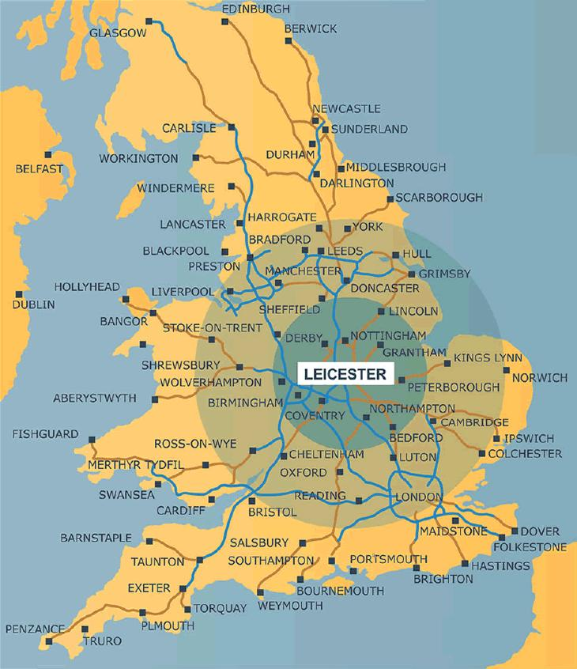
University of Leicester
Colleges
Arts, Humanities & Law
Engineering & Science
Medicine & Life Sciences
Social Sciences
People
21,800 students (7,700 distance)
1,300 academic staff
Research income
Research grants and contracts
£ 55 million (2013)
REF-related QR income
£ 24 million (2013)
Famous for
DNA fingerprinting
Space science
Richard III

Slide 4
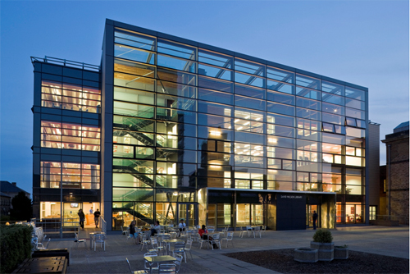

Slide 5
Drivers for change

Slide 6
Old (traditional) structure
Deputy Librarian
Academic Liaison
Arts and humanities
Social sciences
Biblio-metrician
Subject teams
Natural sciences
Biomedical and life sciences

Slide 7
Drivers for change 1
Reconnecting with the research community
  The growth of digital library services was slowly dissolving the social links between the library and many researchers, especially in the sciences and engineering
Funder-led open access mandates
  New opportunities for libraries to manage Green and Gold open access services (specialist knowledge required)

Slide 8
Drivers for change 2
Researchers need to be more information-savvy
  The information landscape is changing rapidly and researchers need regular briefing and training
Growing interest in bibliometrics
  To support internal decision-making and external research evaluation (e.g. Research Excellence Framework 2014)

Slide 9
Drivers for change 3
The emergence of CRIS systems
  Another opportunity for libraries to contribute expertise in the area of bibliographic information management (possibly linked to bibliometrics)
Closer integration with other central services
  A library model more closely focused on the needs of researchers also makes it easier to work with other services, notably Research Support Office, Planning Office and IT Services

Slide 10
New (focused) structure
Deputy Librarian
Research
Training
Info mngmt
Learning & Teaching
Subject teams
Oversight
Academic Liaison
Work teams
Metrics

Slide 11
Why are we needed, what do we do, and are we succeeding?

Slide 12
Why are we needed?
use information tools and resources
… because researchers need to know how to
Notes:
The information landscape is complex and researchers need professional guidance.
Tools, resources, shortcuts.
Multi-agency provision: we partner with the Graduate School, Academic Practice Services, Learning Development and Colleges directly. So we know what researchers need.

Slide 13
Why are we needed?
use information tools and resources
maximise the impact of their research
Stronger, more competitive research environment
Research analytics
… because researchers need to know how to

Slide 14
Why are we needed?
use information tools and resources
maximise the impact of their research
Stronger, more competitive research environment
measure and understand their impact
… because researchers need to know how to

Slide 15
Why are we needed?
use information tools and resources
maximise the impact of their research
become a more effective researcher
measure and understand their impact
… because researchers need to know how to
Highly trained and supported researchers who understand `information’
Research outputs and data that are open, well-managed, and have maximum impact
A community that understands its research impact and can make informed decisions

Slide 16
Why are we needed?
expert subject knowledge
+
professional understanding
use information tools and resources
maximise the impact of their research
become a more effective researcher
measure and understand their impact
… because researchers need to know how to
Highly trained and supported researchers who understand `information’
Research outputs and data that are open, well-managed, and have maximum impact
A community that understands its research impact and can make informed decisions

Slide 17
What do we do?
Researcher training and development
Information and digital literacy training
Supporting the doctoral journey
Information briefings and advice for career researchers

Slide 18
What do we do?
Researcher training and development
Research information management
Leicester Research Archive
Gold open access
Research data management

Slide 19
What do we do?
Researcher training and development
Research information management
Research analytics
Support the University’s strategic information needs
Support grant applications
Support evidence-based publication strategies

Slide 20
How are we doing?
Significant increase in teaching contact hours
  1,621 contact hours in year 1 (up 341%)
Greater reach for training materials
  Use of Adobe Connect to reach new audiences
Great interest in new researcher web pages
  Page views up 67%, dwell time up 145%

Slide 21
How are we doing?
Gold open access fund successfully embedded
  120 papers made Gold OA in 2013
Significant growth in repository full text
  non-thesis deposits up 33%
  PhD theses being digitised back to 1926
Bibliometric work made a difference
  Key role in REF2020 submission
  Use of bibliometric data to support grant capture

Slide 22
What are we going to do next?
Stronger, more competitive research environment
develop more effective and joined-up training provision
increase Green full text and raise external research visibility
make Green content easier to find and maintain
research data management demonstration project
build a data warehouse

