Slide 1
Bibliometric Research Services -
An iSchool Dean’s Perspective
Ronald L. Larsen
May 22, 2014

Slide 2
Applications of bibliometric services*
Trace relationships amongst academic journal citations
Determine the popularity and impact of articles, authors, and publications
Gauge the importance of one's work (e.g., for tenure)
Assess core journal titles and watershed publications
Identify interrelationships between authors
Plan retrospective bibliographies
Create bibliographies and thesauri
Measure term frequencies
Extract metrics for scientometric analysis
Explore grammatical and syntactical structures of texts
Measure usage by readers
* Wikipedia

Slide 3



What faculty seek
Qualitative validation
  Peer review (publications, proposals, …)
  Teaching evaluation (student, CIDDE, …)
  Awards (grants, professional recognition, …)
  Patents (engineering, medicine, …)
  Software (licensing, open source, …)
  Data (mining, analytics, …)

Slide 4


What faculty seek
Quantitative validation
  Funding (salary, prizes, …)
  Students (research, fellowships, …)
  Benchmarks (peers, competitors, …)
  Reputation (papers, citations, …)
Professional recognition
  Promotion & tenure
  Impact
  Ranking

Slide 5

Why bibliometric services?
Faculty / Researchers
  Stay abreast of scholarship in their discipline
  Identify potential collaborators and competitors
  Select preferred publication venues
  Enhance dossier
Dean / Department Chair
  Faculty performance review
  Promotion and tenure consideration
  Benchmarking against peers & competitors
  Positioning within university

Slide 6



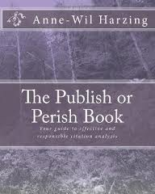



What bibliometric resources?
Web of Science
Scopus
Google Scholar
  Harzing’s Publish or Perish
  Scholarometer
Microsoft Academic Search
CiteSeer
…

Slide 7
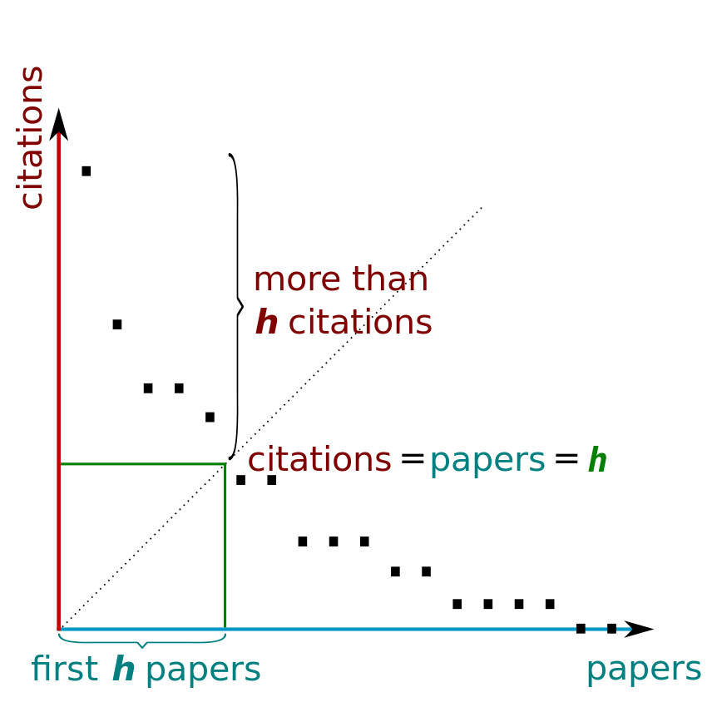
Measuring scholarship and impact
Hirsch’s h-index (2005) – n papers with ≥ n citations

Slide 8


A profusion of indexes
confusion
Hirsch’s h-index (2005) – n papers with ≥ n citations
Egghe’s g-index (2006) – greater weight to highly cited papers
Contemporary h-index (2006) – greater weight to recent papers
Individual h-index (2006) – addresses co-authorship by normalizing citation counts (3 variants include h_{I}, h_{I,norm}, and h_{m})
AR-index (2007) – introduces age-weighting to h-index (several variants)
Multi-authored h-index (2008) – another approach to address co-authorship using fractional paper counts
Zhang’s e-index (2009) – another measure to differentiate high citation patterns with similar h-indexes
Average annual increase in h-index – reduces effects of career length
Google’s i10-index (2011) – number of papers with at least 10 citations

Slide 9
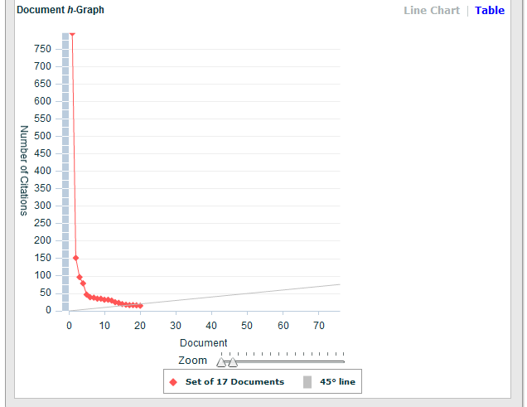
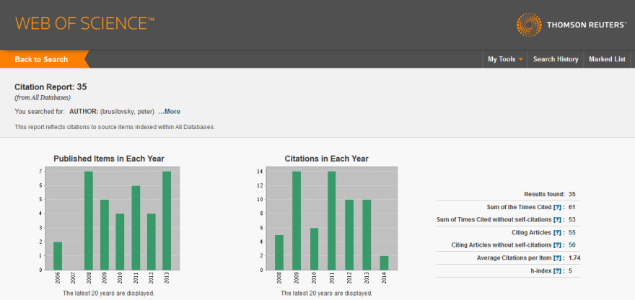
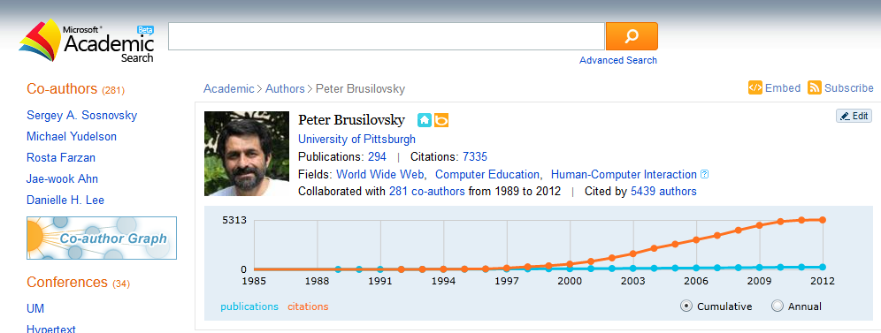
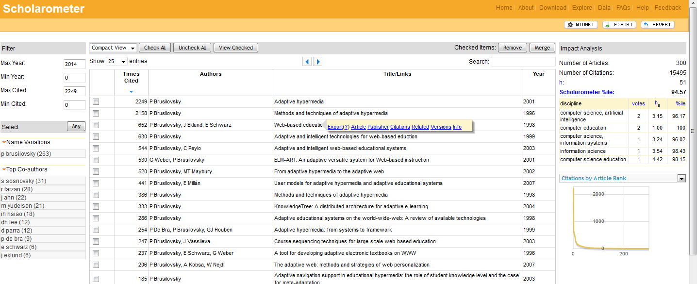
Peter Brusilovsky
Scopus
h-index = 20
h-index = 5
h-index = 51
Harzing’s Publish or Perish
No. of papers = 311
Citations = 15,524
h-index = 51
g-index = 122
e-index = 103.13
hc-index = 34
hI-index = 23.02
hI,norm = 38
…

Slide 10
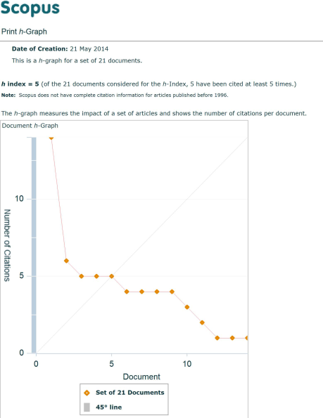
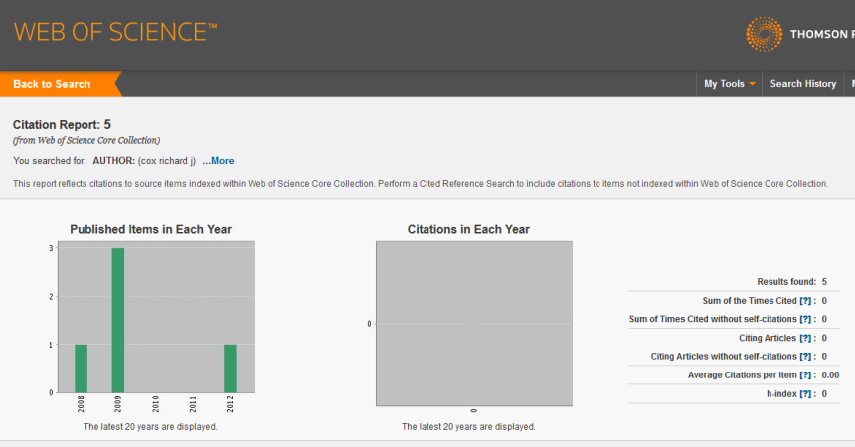
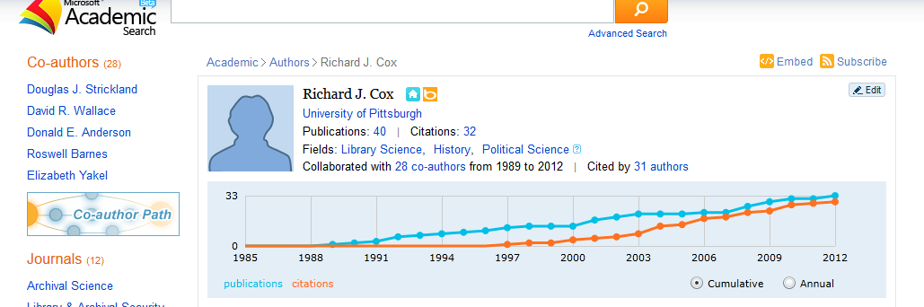
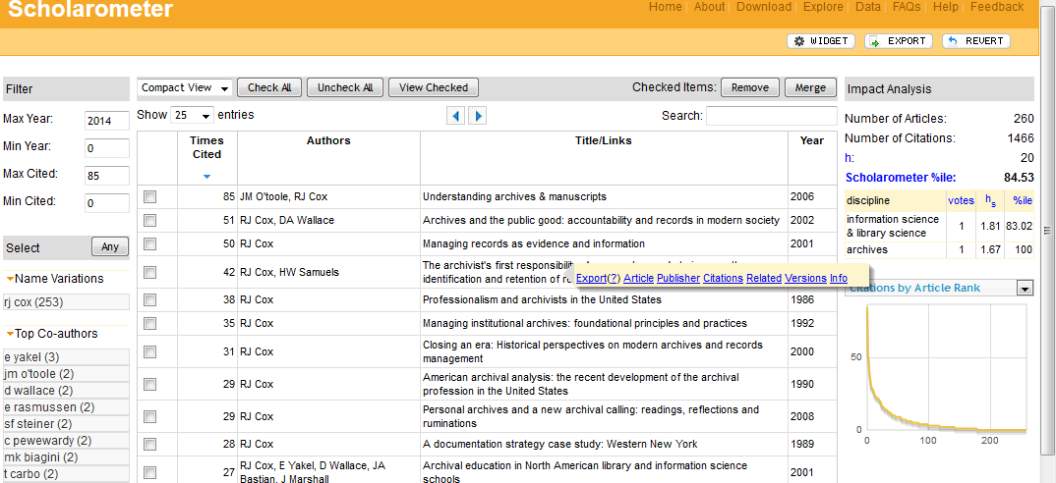
Richard J. Cox
h-index = 5
h-index = 0
h-index = 20
Harzing’s Publish or Perish
No. of papers = 117
Citations = 677
h-index = 14
g-index = 21
e-index = 12.96
hc-index = 8
hI-index = 9.80
hI,norm = 13
…

Slide 11
Two challenges…
Consistency of index computation among bibliometric services
  Coverage (journals, conferences, books, book chapters, …)
Normalization across disciplines
  Traditions, expectations, and publication venues
Accompanying risks…
Misalignment of coverage with discipline
  Indexes underestimate impact
Inappropriate aggregation for comparative benchmarks
  Institutional decision making is flawed

Slide 12
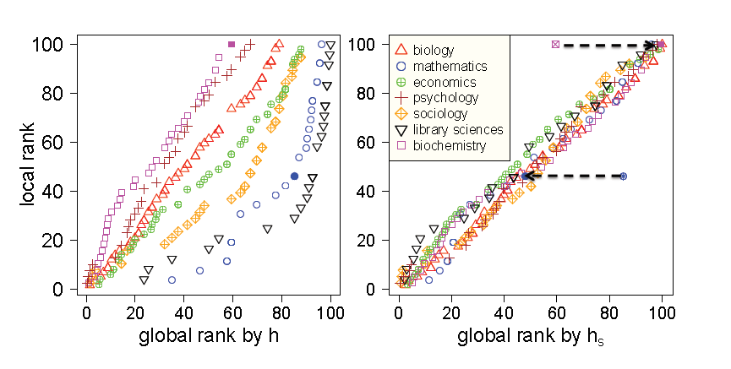
Normalizing the h-index to discipline*
*Kaur, Radicchi, & Menczer, “Universality of scholarly impact metrics” (2013)

Slide 13
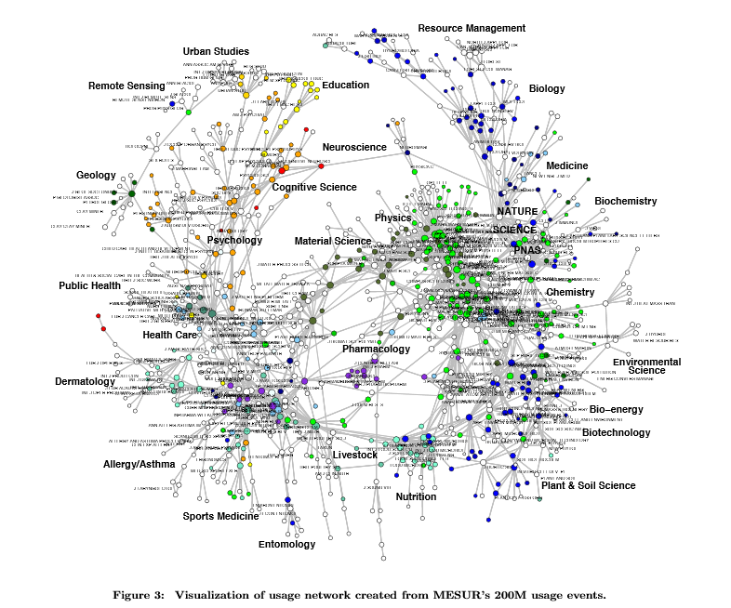
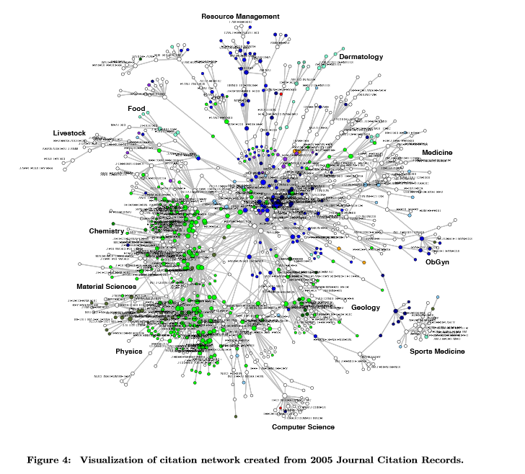
Extended journal usage and citation networks*
* Bollen, Van de Sompel, & Rodriguez, “Towards Usage-based Impact Metrics: First Results from the MESUR Project”

Slide 14
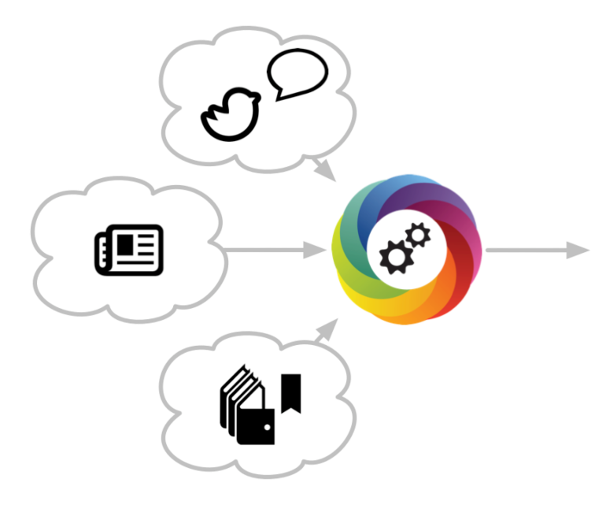
Altmetrics* (2010)
Number of views and downloads
  HTML, PDF
Discussions on social media
  Facebook, Google+, Twitter, blogs
Bookmarked
  CiteULike, Mendeley
Cited
  Google Scholar, CrossRef, PubMed Central, Scopus, ImpactStory, CitedIn
Recommended
  LinkedIn, Amazon, Pinterest
You
*Wikipedia, Altmetric.com

Slide 15


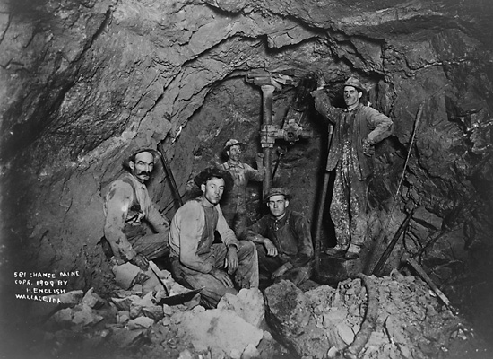
The land of opportunity
Bibliometric research services are …
  Valuable
  Seductive
  Dangerous
Good bibliometric research services are …
  Increasingly important
  Labor-intensive
  Hard (even with good tools)
University bibliometric research services are …
  Too vital to leave to others
  An opportunity for proactive leadership and education
  A natural domain for libraries and librarians to excel

Slide 16

(Still) the solution …

