Slide 1

The Library as Publisher
Lauren B. Collister, PhD
Electronic Publications Associate
University Library System, University of Pittsburgh
Timothy S. Deliyannides, MSIS
Director, Office of Scholarly Communication and Publishing
and Head, Information Technology
University Library System, University of Pittsburgh
Open and Shut: The Case for OA in Libraries
PaLA CRD Spring Program
Arcadia University, May 30, 2014

Slide 2
Overview
Explore the benefits of the academic library becoming a publisher
Follow a detailed case study of the University of Pittsburgh
Learn how the Pitt program operates and how we sustain and grow it
Identify resources to help you get started
Notes:
Introductions
Library as publisher: new trend, brief history
-History of publication
-From print to online
-How technology has changed the very idea of publication.

Slide 3
Library as Publisher
New Trends, New Technologies

Slide 4
Libraries as Publishers – Current Trends
More than 75% of ARL libraries offer or plan to offer publishing services.
Most expect to expand these services in future.
Dedicated publishing staff are rare.
Most do not have sustainability plans.
Most plan to expand cost recovery mechanisms moving forward.
Source: Library Publishing Services: Strategies for Success Research Report , v. 2.0. http://wp.sparc.arl.org/lps/

Slide 5
Why become a Publisher?
Provide services that scholars understand, need and value
Transform the unsustainable commercial subscription pricing system
Take direct action to support Open Access
Deepen our understanding of scholarly communications issues

Slide 6
Crisis in scholarly journal pricing
Bill Hooker, April 2009. Data sources: Library Journal Annual Serials Price Surveys, Association of Research Libraries, US Dept. of Labor

Slide 7
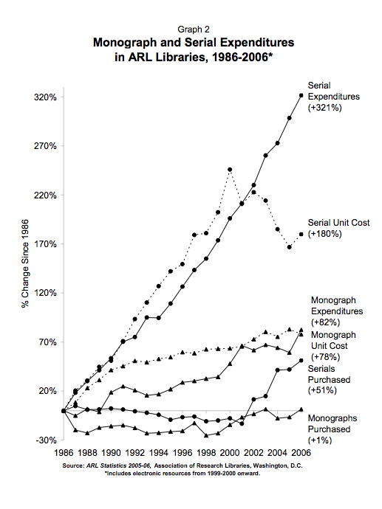

Slide 8

Case Study:
University Library System
University of Pittsburgh
Notes:
How did we do it? A brief overview of the ULS's publishing program
-Our D-Scribe scholarly journals.
-Offered to both people at the Pitt community and outside of it.
-Scholarly Exchange hosting service to facilitate blossoming scholarship for those without many options.
-D-Scholarship repository
-Other repositories
-OMP
-Etc.

Slide 9

Strategic Goal
Innovation in Scholarly Communication
Support researchers in
  efficient knowledge production
  rapid dissemination of new research
  open access to scholarly information
Build collaborative partnerships
around the world
Improve the production and sharing of scholarly research
Support innovative publishing services
Establish trusted repositories for the research output of the University

Slide 10
Growth in number of titles published

Slide 11
ULS E-Journal Publishing
Rapid growth to 35 journals since 2007
Peer-reviewed scholarly research journals
Most are Open Access and electronic-only
Based on PKP Open Journal Systems (OJS)
Editorial teams are located around the world
Six journals have multilingual content

Slide 12

Journal publishing goals
Propel scholarship at the University of Pittsburgh
Extend service beyond the home institution
Save ‘at-risk’ journals without the infrastructure or know-how to go electronic
Incentivize Open Access Publishing worldwide

Slide 13

Student Publications
Only supported for University of Pittsburgh
Provides valuable learning experience
Faculty involvement is required to maintain continuity
Selection criteria are relaxed for student publications
  Peer review process
  Quality of editorial board

Slide 14
Scholarly Exchange™
http://www.scholarlyexchange.org
Approximately 40 additional Open Access journals
Acquired by the ULS on August 1, 2012
Hosting service only
ULS is NOT the publisher and does not provide publishing services

Slide 15
Journal Publishing
The Process:

Slide 16

Journal Publishing Strategies
Maintain quality and academic integrity
Choose partners carefully
Rely on self-sufficient editors
Work smart, not hard
Keep costs low

Slide 17
Software
Open Journal Systems (OJS) (http://pkp.sfu.ca/?q=ojs)
Scholastica (scholasticahq.com)
BePress (https://www.bepress.com/editors.html)
Aries Editorial Manager (http://www.editorialmanager.com/)
Bench>Press (http://highwire.stanford.edu/publishers/benchpress.dtl)
ScholarOne (http://scholarone.com/products/manuscript/)
Notes:
-OJS
-scholastica : scholasticahq.com - charges by submission $5 for law reviews $10 for everyone else
-totally hosted, just a black box, little customization options
-BePress Digital Commons, EditKit and Full Service https://www.bepress.com/editors.html
-Manuscript tracking - submission, review, editorial decision.
-Full Service journal publishing provides publication online
-batch or per-article delivery to other publishing platforms besides Full Service
-many universities have a Digital Commons agreement already and access to this service -
see https://digitalcommons.bepress.com/subscriber_gallery/
-Aries Editorial Manager http://www.editorialmanager.com/homepage/home.htm
-manuscript tracking submission through acceptance
-full support and training services
-no platform for final publication
-Bench>Press
-online manuscript tracking system, handles submission, peer review, copyright agreements, and prepublication
-production takes place outside of the system - handled by HighWire Press
-excellent support team to train and help you
-high subscription costs (Vanessa suggested ballpark $15,000 year)
-ScholarOne Manuscript Central
-very similar to Bench>Press but does not provide an online platform for production process or final publication

Slide 18
We provide:
Hardware and software hosting services
Advice on best practices in e-publishing
Consultation on editorial workflow management
Web-based training for editorial staff
Graphic design services
ISSN Registration
Assignment of DOIs (Digital Object Identifiers)
Assistance in establishing formal acceptance and recognition of the scholarly content
Digital preservation through LOCKSS

Slide 19
Our Process
Connect with publishing partners
Journal Proposal Form
Service Agreement
Graphic design (website and article)
Training editorial staff
Ongoing consultation

Slide 20

Based on self-sufficient editors
Editorial staff are expected to become self-sufficient by the time first issue is published
Editors are responsible
for managing:
  all content decisions
  all processing workflow
  all communication with
  reviewers, authors, readers
  all editing, including layout

Slide 21

Journal Proposal Form
Collects detailed information on which to base selection decision
Focus, scope, description of content
Justification of need
Credentials of Editorial Board
Description of review process

Slide 22

Selection Criteria
Original scholarly content
Rigorous blind review process
Commitment to Open Access for content
Editorial Board of internationally recognized scholars

Slide 23
Publications Advisory Board
Includes leaders in scholarly publishing and Open Access issues
Provides strategic guidance and expertise for ULS digital publishing program
Assists in development of publication policies governing:
  Selection and evaluation criteria for partners
  Open Access and Creative Commons licensing
  Cost recovery mechanisms

Slide 24
Service Agreement
Builds common understanding before problems occur
Defines roles and responsibilities
Identifies ULS as publisher of record
Articulates policies on:
  changes to published content/issuing errata
  handling infringement claims,
  publication schedule/continuity issues
  long-term preservation

Slide 25
Author Copyright Agreement
Comes in several flavors:
  Immediate Open Access (standard)
    CC BY
  Delayed Open Access (subscription-based)
    CC BY-NC-ND
License terms are included in digital rights statement in article metadata

Slide 26
Author Copyright Agreement
The author warrants that the work:
  belongs to the author
  is original
  has not been submitted elsewhere
  does not infringe others’ copyright
Authors encouraged to deposit works in OA archives pre- and post-publication
Permission to use third party content is the responsibility of the author

Slide 27
Graphic Design Brief
Defines the scope of graphic design possibilities
Explains software design limitations
Prepares the client to give input on design
Defines publisher branding requirements
Establishes process for client input and timeframe for design

Slide 28
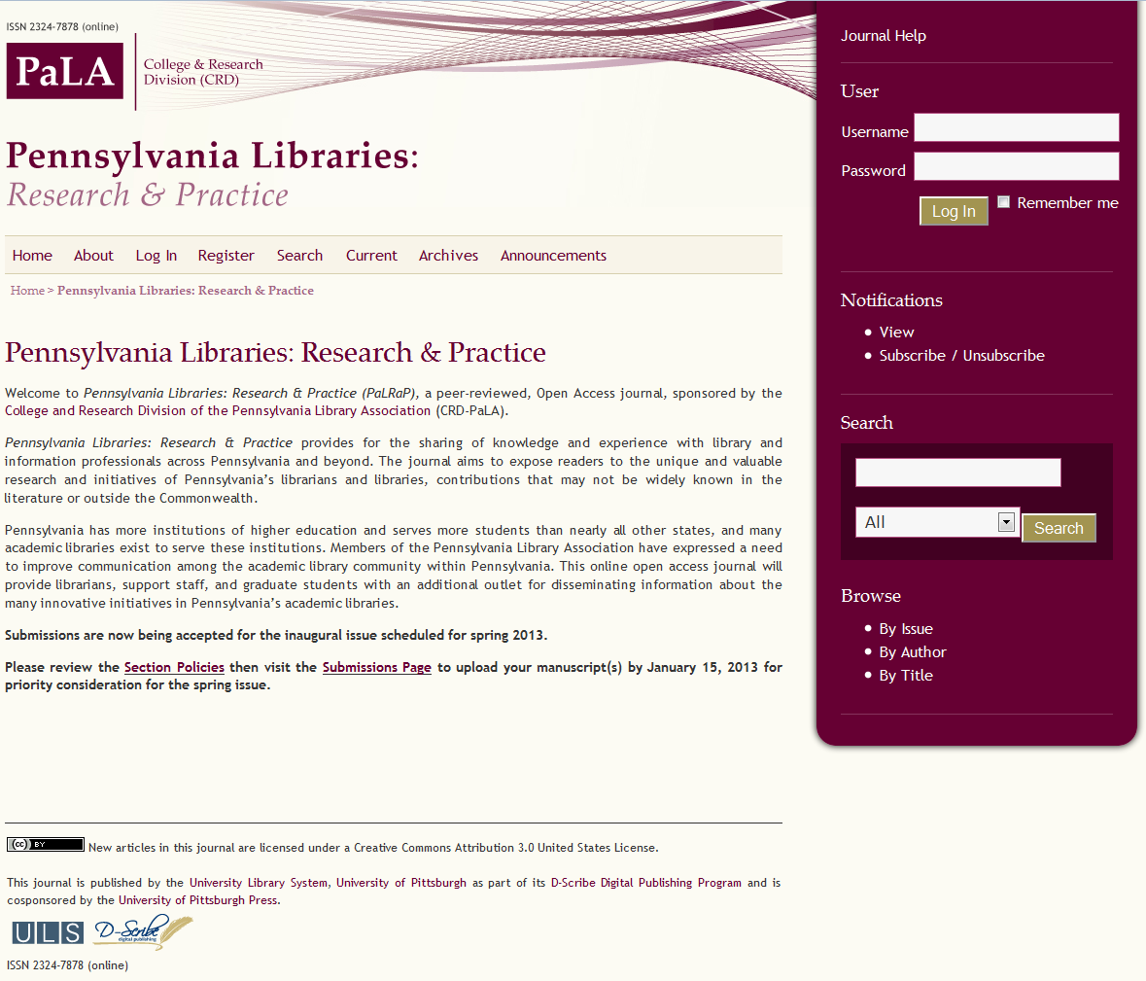

Slide 29
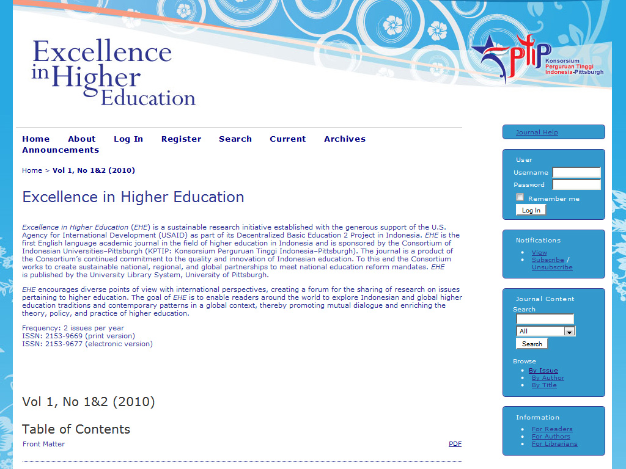

Slide 30


Slide 31
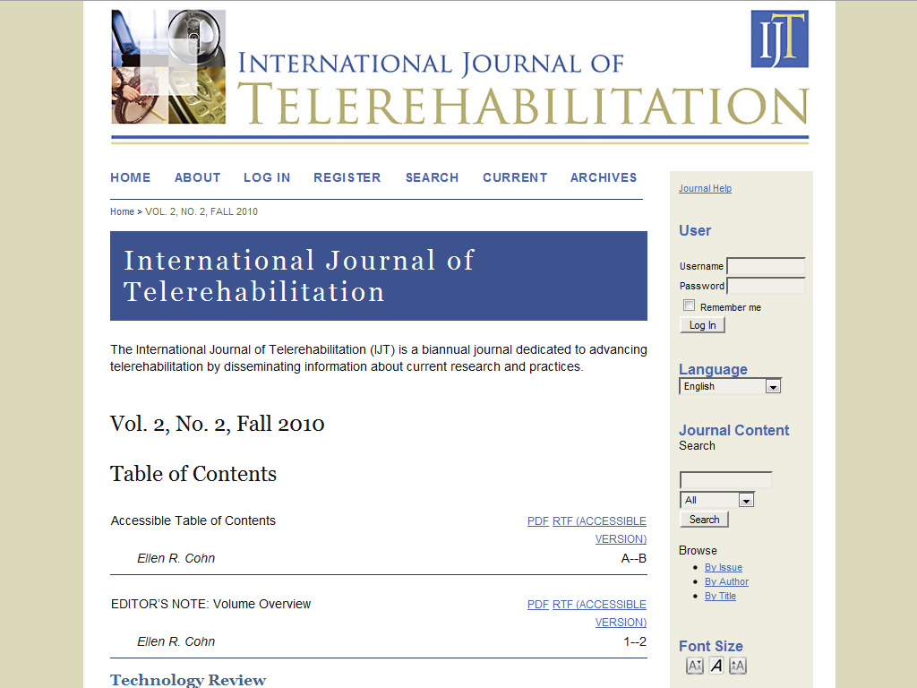

Slide 32
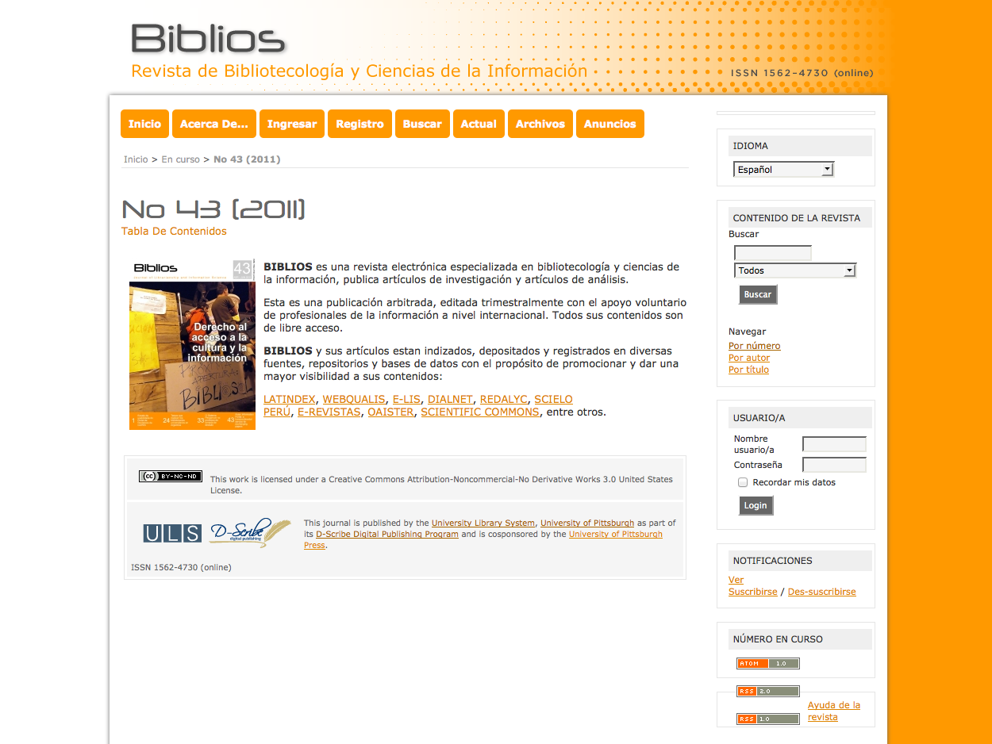

Slide 33


Slide 34
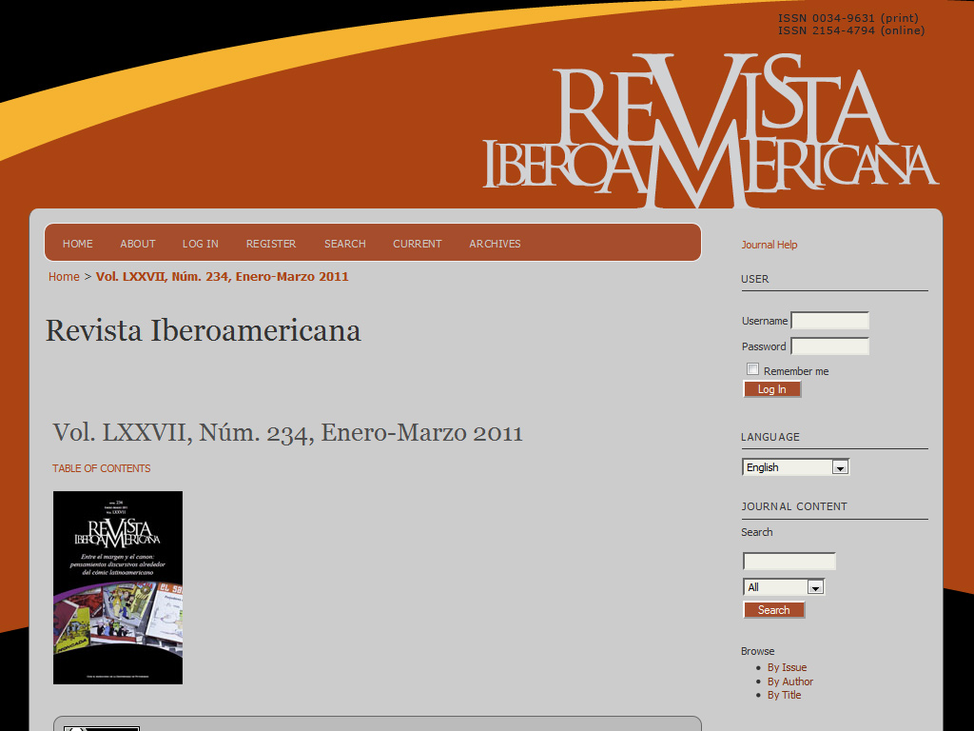

Slide 35
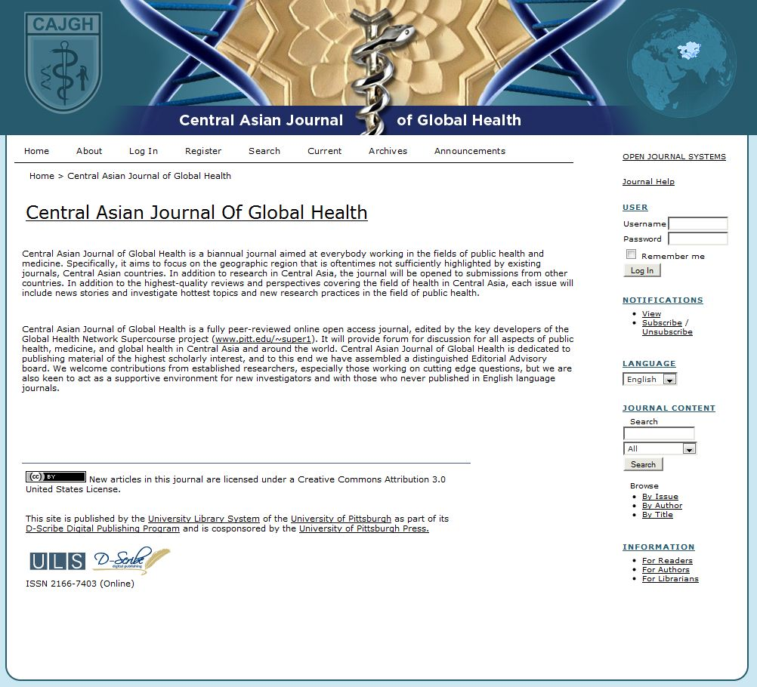

Slide 36
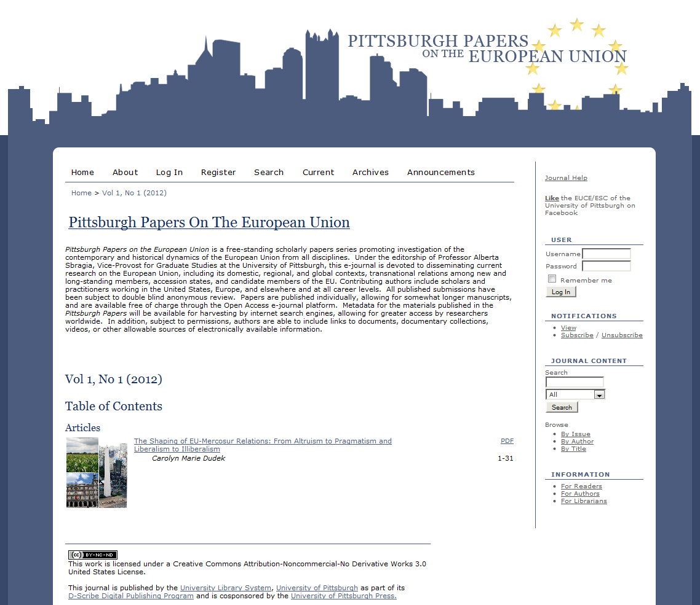

Slide 37
Article Template
Design Questionnaire
Defines the look of each formatted article
Echoes web site design
Default is MS Word
Includes publisher’s formatting and branding requirements
complete citation including DOI must appear on each page

Slide 38
Editor Training
Either in person or via teleconferencing (WebEx, Lync)
First meeting:
  Introduce them to the software
  Guide them through the setup of the journal
Second meeting:
  Workflow consultation
  Training on editorial process in OJS

Slide 39
After the First Issue
Editors become self-sufficient in workflow management
Our focus shifts to promotion and indexing
  Marketing
  Press releases
  Registration with abstracting/indexing services

Slide 40
GROWTH and SUSTAINABILITY
Journal Publishing

Slide 41
Staffing for journal publishing
2.00 FTE OJS operations and customer support
0.25 FTE administration, partner relations, marketing
0.30 FTE graphic designers
0.50 FTE OJS sys admin
_____________________
3.05 FTE TOTAL
100% funded from internal reallocation of operating budget

Slide 42
Sustaining the Pitt journal publishing program
Open Access incentivized through subsidies
(at least 50% discount)
Pitt journals discounted; student publications free
Includes base package, with additional services a la carte such as:
  Domain registration
  Document layout (per article charge)
  XML conversion (per article charge)
  Supplementary blog
  Special design work & custom programming
Notes:
Explain fee schedule

Slide 43
A Comprehensive Program for OA
Support for Gold Open Access:
  Publishing journals, books and conference proceedings
  Open Access Author Fee Fund; COPE
Support for Green Open Access:
  6 global, subject-based repositories
  Local institutional repository and OA Mandate
Learning and teaching about OA
Advocacy and support for our OA partners
Measuring and marking success

Slide 44
Learning and teaching about OA
Pitt Open Access Web site (openaccess.pitt.edu)
Lunch and learn series for liaison librarians
  Monthly series of informal talks
  24 topics on wide range of Open Access & scholarly communications issues
  Inform ourselves and strategize how we can best talk to our patrons about the issues
Outreach to the university community
  Faculty and student orientations
  Elevator talks
  Open Access Week activities

Slide 45



Advocacy for OA publishing
Founding member of the Library Publishing Coalition
Member of Compact for Open-Access Publishing Equity (COPE)
Major Development Partner for Public Knowledge Project (PKP)
First library publisher in North America to join the Open Access Scholarly Publishers Association (OASPA)

Slide 46
Measuring scholarly impact
Increasingly scholars work on the Web
More scholarly work takes place outside of published journal literature
Altmetrics combines traditional impact measures (citation counts) with non-traditional measures:
  online references in gray literature
  online links to published and unpublished works
  measures of impact through social networking

Slide 47

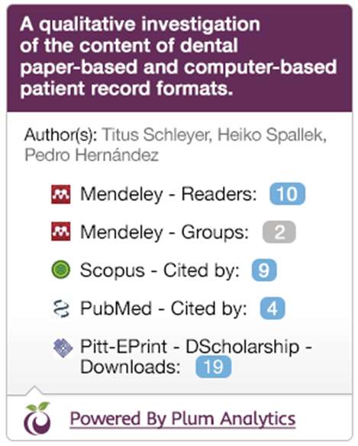
Measuring success: altmetrics
Altmetrics pilot project (PlumX by Plum Analytics)
Aggregates dozens of traditional and new measures
altmetrics widget imbedded in OJS journals and in institutional repository

Slide 48
Resources
COPE http://publicationethics.org/
LPC http://www.educopia.org/programs/lpc
PKP http://pkp.sfu.ca/
OASPA http://oaspa.org/
SPARC http://www.sparc.arl.org/
DOAJ http://www.doaj.org
SHERPA/ROMEO http://www.sherpa.ac.uk/romeo/
Creative Commons http://creativecommons.org/

Slide 49
Find this presentation here: http://d-scholarship.pitt.edu/21716/
For more detail, see:
Collister, Lauren Brittany and Deliyannides, Timothy S. (2013) The Library as Publisher (preconference workshop). In: NASIG 28th Annual Conference, June 5-9, 2013, Buffalo, NY.
http://d-scholarship.pitt.edu/19047/
Here you’ll find the slides from our four-hour workshop on “The Library as Publisher” along with links to many of the documents and tools we discussed today.

Slide 50
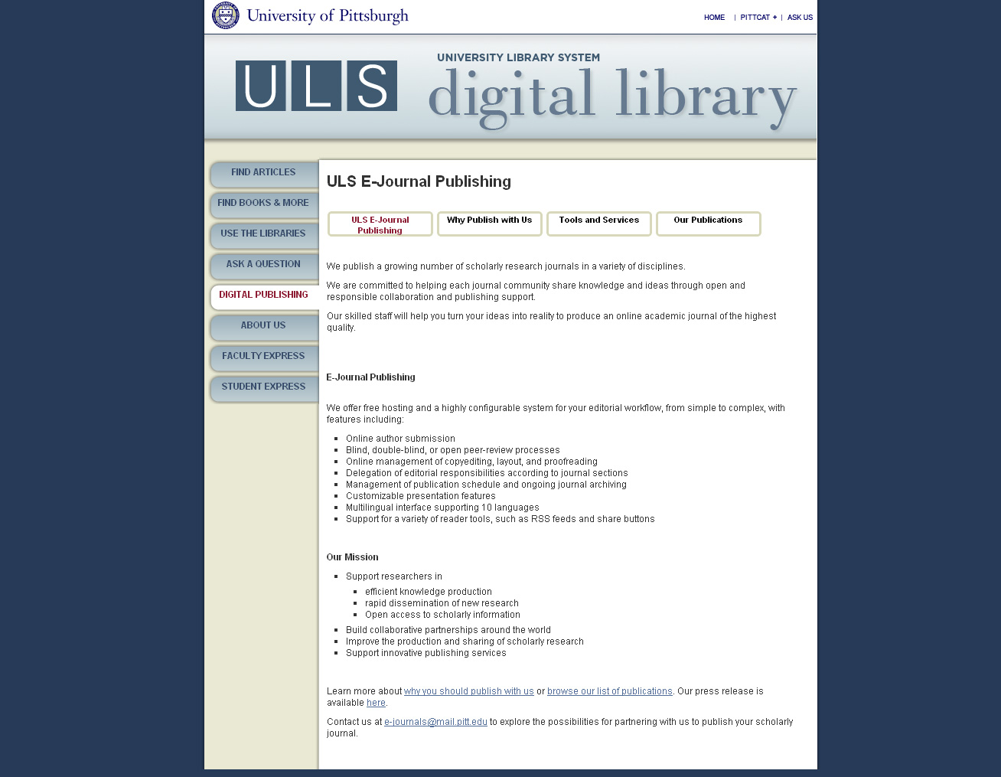
http://www.library.pitt.edu/e-journals

Slide 51
Questions?

Slide 52
Contact us
ULS Office of Scholarly Communication and Publishing
oscp@mail.pitt.edu Twitter: @OSCP_Pitt
Tim Deliyannides, Director Twitter: @deliyannides
Lauren B. Collister, Twitter: @parnopaeus
Electronic Publications Associate

