Slide 1
For your consideration:
New approaches to scholarly communications & publishing
John Barnett
Scholarly Communications Librarian
University of Pittsburgh
http://d-scholarship.pitt.edu/22330

Slide 2
Today’s goals
What in the world is “scholarly communication”?
Advice Information for graduate students and early career researchers
Copyright +
Open access to research
Measuring scholarly impact
Resources to go (pro tips)
Your turn

Slide 3
But first, a disclaimer . . .
I’m a librarian, not a scholar, not an early career researcher
I can offer ideas, suggestions, and opinions
This is most definitely not legal advice
Nor is it professional advice (for your profession)
Ultimately, you have to do what you believe is best for your career
I’m learning, too

Slide 4
Scholarly communications 101
“The creation, transformation, dissemination, and preservation of knowledge related to teaching, research, and scholarly endeavors”
“The process of academics, scholars and researchers sharing and publishing their research findings so that they are available to the wider academic community”
So, simply stated, it’s the process of scholars sharing their research results with the wider world

Slide 5
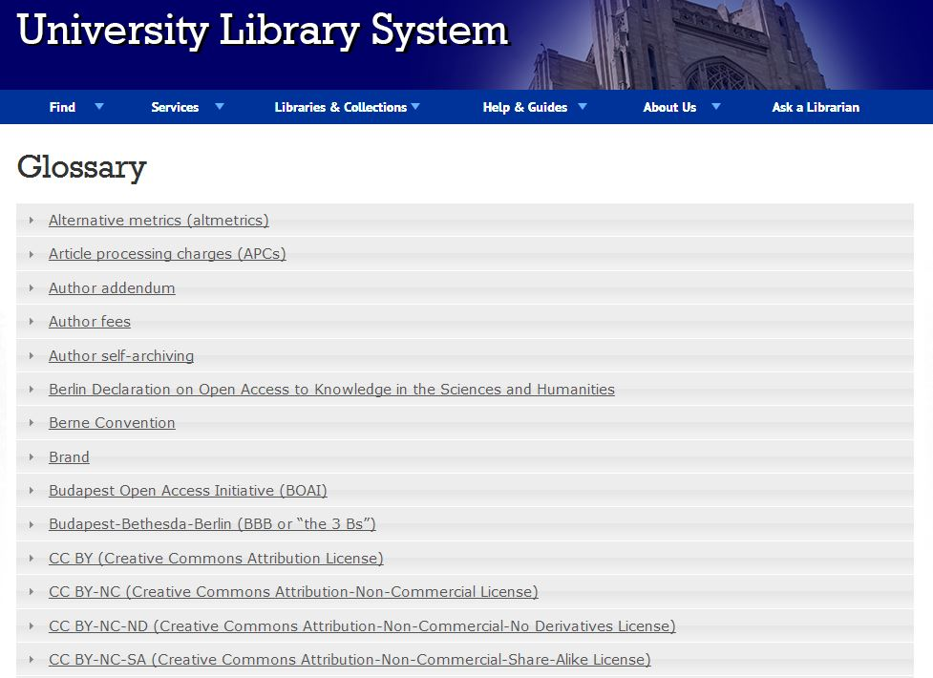
Pro tip #1: SC glossary
http://www.library.pitt.edu/oscp/glossary

Slide 6
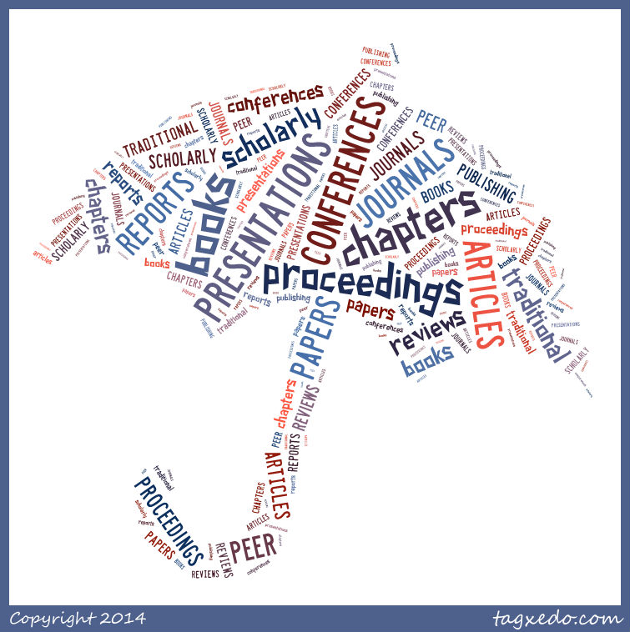

Slide 7
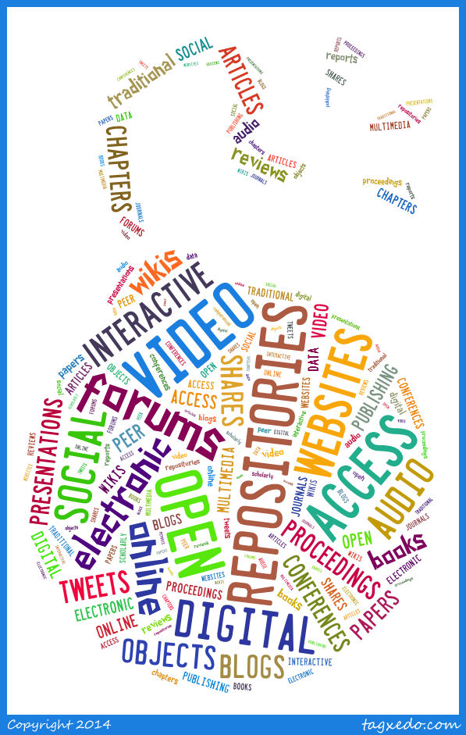

Slide 8
Prone to flooding
Graduate students and Early Career Researchers (ECRs) report
  Writing blog posts about their research and teaching
  Publicizing their work on social media
  Finding collaborators via social networks and blogs
  Sharing papers on Academia.edu, ResearchGate, Mendeley, etc.
New scholars invest a lot of time in social media and dissemination—time that could be used for research
How do you manage all of these information streams?
How can librarians and others help?

Slide 9
Copyright & other intellectual property
Librarians and libraries deal with this a lot
  Contracts for electronic resources or special collections
  Public performance rights
  Face-to-face teaching
  Distance education
  Citation and reuse of others’ works
  Fair use

Slide 10
No advice please
Generally, librarians can only suggest or guide
We cannot and should not give legal advice
Others may be able to help
  General counsel
  Computing and technology services
  Distance education
  A copyright or contract law specialist

Slide 11
Pro tip #2: Copyright resources
Copyright Basics (Circular 1 from the U.S. Copyright Office)
U.S. Copyright Law, Title 17 of the U.S. Code
World Copyright Terms
Your university’s copyright and intellectual property policies
Your university’s compliance with the Technology, Education, and Copyright (TEACH) Act – nonprofit educational use of copyright protected works in distance education
Digital Millennium Copyright Act (Appendix B, U.S. Copyright Law) – copyright in the digital environment

Slide 12
Pro tip #3: How long does it last?
It depends (on where and when the work was published)
The short version: Most new works are protected for the life of the author + 70 years
Works published before 1978 were required to have a copyright notice; this is no longer the case—but the work is still protected
Works published between 1923 and 1978 could have protection for up to 95 years
Is It Protected by Copyright? For Works First Published in the U.S.A.
ULS Copyright FAQ

Slide 13
Pro tip #4: Keeping up with copyright
Copyright Advisory Office Blog (Columbia University Libraries)
Direct Dispatch: ALA Washington Office Blog
SPARC Blog and SPARC News & Media
Kip Currier Copyright and “Open” Movements Blog

Slide 14
Fair use
The rights of copyright owners are subject to limitations
A fair use of a copyrighted work might include criticism, comment, news reporting, teaching, scholarship, and research
Four factors for determining fair use
  The purpose and character of the use (commercial, nonprofit, etc.)
  The nature of the copyrighted work (factual or creative)
  The amount and substantiality of the portion used
  The effect of the use upon the potential market for, or value of, the work
“There is no specific number of words, lines, or notes that may safely be taken without permission”

Slide 15
Pro tip #5: Determining fair use
Try to learn how to determine fair use on your own—but don’t be afraid to ask for help
U.S. Copyright Office factsheet on fair use
Thinking through fair use (University of Minnesota)
Fair use checklist (Columbia University)
Other resources to help with images and other types of IP
ULS Copyright FAQ on fair use

Slide 16
Copyright with something extra
Creative Commons licenses
Alternative to “all rights reserved”
Enables authors/creators to apply copyright terms to their works in a way that allows others to use, build upon, and share your creations while still getting credit
Multiple licenses = more compatible with web activities and communication

Slide 17
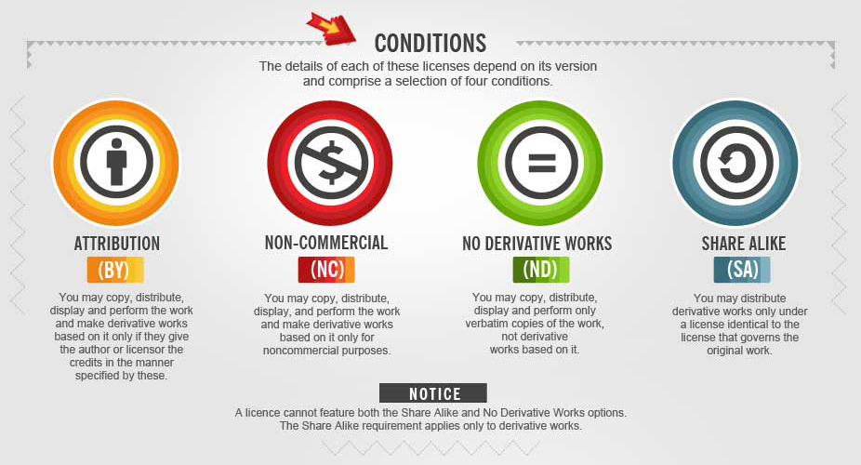
Pro tip#6: CC licenses

Slide 18
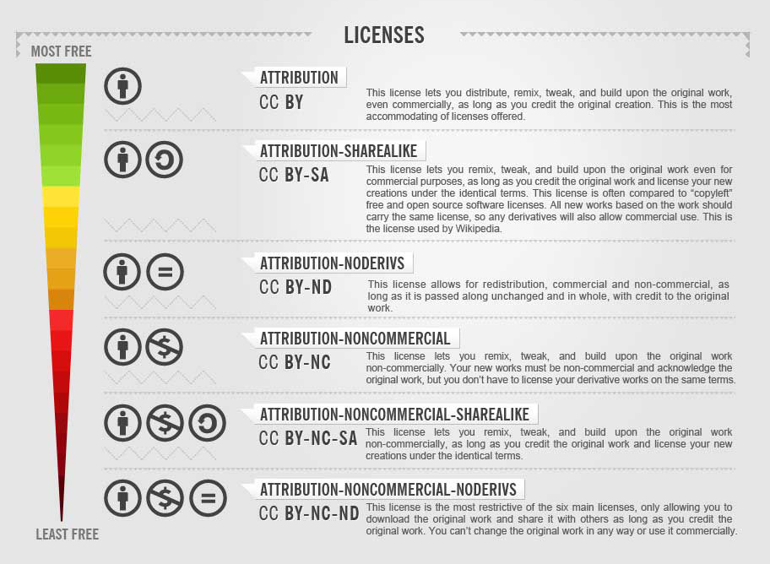

Slide 19
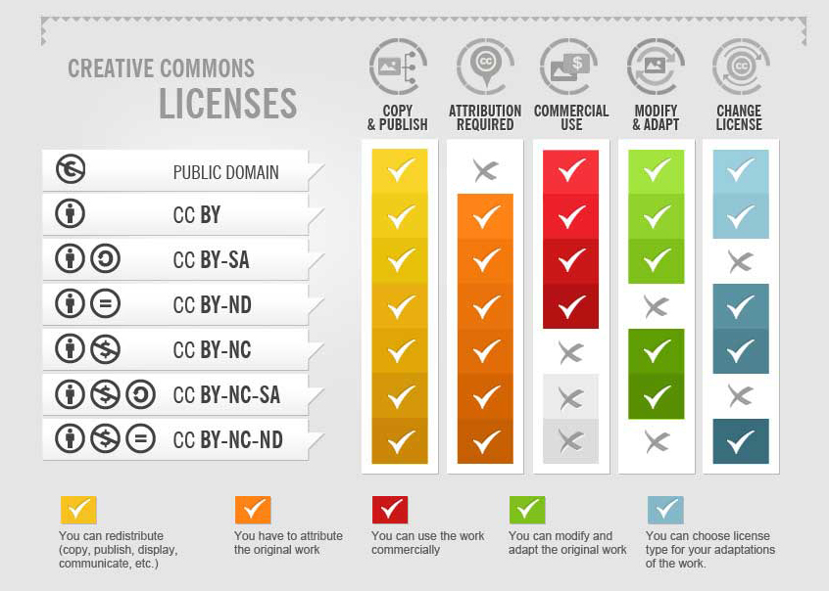

Slide 20
Author agreements
Librarians may not be able to advise university authors
Your institution’s general counsel may not advise you either . . .
But you can be better informed about the language used and its meaning in author agreements—and librarians can often help with that
A publisher may or may not accept these terms—but at least you will better understand your agreements (and may be able to effect change over time)

Slide 21
Pro tip #7: Terms of agreement
SPARC Author Addendum for Author Rights
  Developed by the Scholarly Publishing and Academic Resources Coalition (SPARC)
  A legal tool used by authors to modify publisher agreements to keep key rights, such as archiving, redistribution, etc.)
Scholars’ Copyright Addendum Engine (SCAE)
  Developed by Science Commons
  Non-exclusive rights to create derivative works and to reproduce, distribute, publicly perform, and publicly display your article in connection with teaching, conference presentations, lectures, other scholarly works, and professional activities.

Slide 22
Pro tip #8: SHERPA RoMEO
SHERPA RoMEO
  Database of publisher copyright and author self-archiving policies
  Developed by the University of Nottingham but aims to be international in scope (better coverage of the English-speaking world)

Slide 23
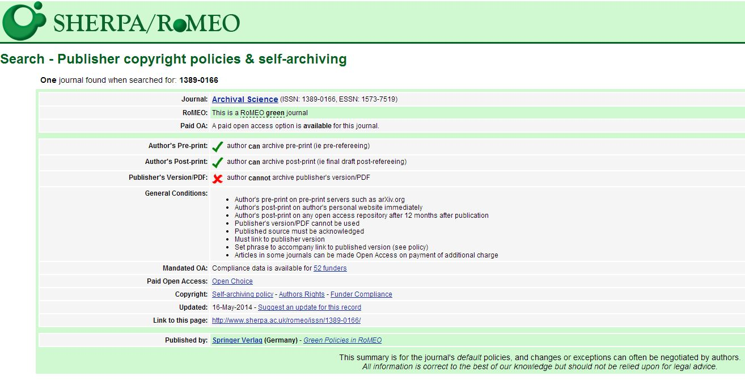

Slide 24
Open access to research
Open access literature is digital, online, free of charge, and free of most copyright and licensing restrictions.
Peter Suber, Open Access. MIT Press. 2012

Slide 25
What OA is and isn’t
Open access is compatible with . . .
  Peer review
  Promotion and tenure criteria
  Copyright law
  Revenue and profits
  Any genre or format
OA does not . . .
  Equal low quality
  Constitute vanity publishing
  Violate copyright
  Reduce author choice or academic freedom

Slide 26
Where did OA come from?
Significant and continual growth in scholarly publishing
  ≈50 million research articles published 1665-2009
  ≈1.35 million journal articles published per year (2006 est.)
  Average number of science articles per journal increased from 185 to 273 from 1990 to 2009
  Number of scientific articles indexed by ISI was <600,000 in 1990 & >1 million in 2009 – a rise of 72%
Rise of the Internet and the Worldwide Web
Concern among libraries
  Huge costs and price increases for journals, electronic resources
  Concentration of ownership among handful of publishing companies
  Sources: Jinha (2010), Bjork et al. (2009), & Jump (2010)

Slide 27
Pro tip #9: All about OA
ULS Open Access LibGuide
  OA explained, origins, resources, tools
Open Access Week
  An international commemoration of OA
Open Access by Peter Suber
Being Open as an Early Career Researcher
  Presentation by Erin McKiernan, neuroscientist
WTFINRESEARCH?!
  A Tumblr that encourages you to “share the irony” of articles about open access published in closed access journals

Slide 28
OA policies
Faculty adopted
  Institution-wide
  College or departmental
Author grants institution non-exclusive right to post online for open access scholarly articles written by the researcher
Faculty members retain copyright to articles and can turn copyright over to a third party, such as a publisher
Faculty may be discouraged from signing publishing contracts that prohibit OA posting but usually receive an exemption
An institutional repository may be designated as the official distributor for faculty works

Slide 29
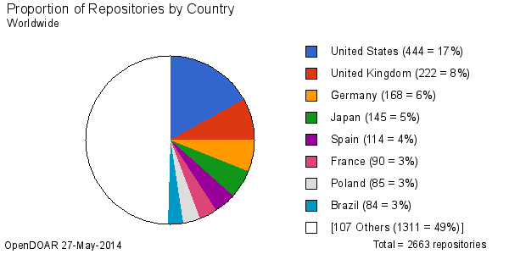
Notes:
Repositories: an early platform for OA
May be institutional, subject-oriented, or commercial

Slide 30
Open access journals (DOAJ)
Journals
9,772
Countries
134
Articles
1,646,119
Notes:
Note: Not all OA journals are listed in DOAJ. There are easily many more OA journals in the world.

Slide 31
Other open models
Open educational resources (OERs)
  Teaching and learning materials freely available online for everyone to use
  Examples: Full courses, course modules, syllabi, lectures, homework assignments, quizzes, lab and classroom activities, pedagogical materials, games, simulations, and many more
Open textbooks
  A type of OER
Open data
  Data that are freely available to use and republish, without copyright or patent restrictions
Open source software

Slide 32
Pro tip #10: Finding open content
Repositories –
  OpenDOAR
Journals –
  Directory of Open Access Journals (DOAJ)
Books –
  OAPEN
  Knowledge Unlatched
Educational resources (OERs) –
  Merlot
  OER Commons
Data –
  DataOne (NSF-funded)
  Dataverse Network Project (Harvard-sponsored)
  Dryad (science, medicine)
  Figshare (commercial)

Slide 33
Scholarly concerns about OA
Quality (of peer review and content)
  OA isn’t self-publishing
  Bad peer review can affect both subscription and free journals
Cost (“paying to publish”)
  Generally only OA journals in STEM disciplines have article-processing charges (APCs)
A fear of being scooped or plagiarized
The worry over prestige = “OA won’t help me with tenure and promotion”

Slide 34
Pro tip #11: Beall’s List
Beall’s List: Potential, Possible, or Probably Predatory Scholarly Open-Access Publishers
  Compiled by Jeffrey Beall, a librarian at Auraria Library, Colorado
  Also provides a list of criteria for determining predatory publishers
Also see Open Access Scholarly Publishers Association (OASPA) Code of Conduct
And Committee on Publication Ethics (COPE) Code of Conduct for Journal Publishers

Slide 35
ULS e-journal publishing
The library as publisher
Publish more than 35 OA journals in a variety of disciplines and languages
Publishing partners at Pitt and around the world
Using the Open Journal Systems (OJS) platform from Public Knowledge Project (PKP)

Slide 36
My life as a journal editor
Co-editor of Pennsylvania Libraries: Research & Practice (PaLRaP)
Sponsored by the College & Research Division, Pennsylvania Library Association
Published by the ULS e-journal program
Online, peer-reviewed, OA journal for/by/about PA libraries and library professionals
Focus on academic libraries but welcome contributions from all libraries
Includes research and practice articles, features, commentaries, and news
Publish twice a year; now preparing for our 4th issue

Slide 37
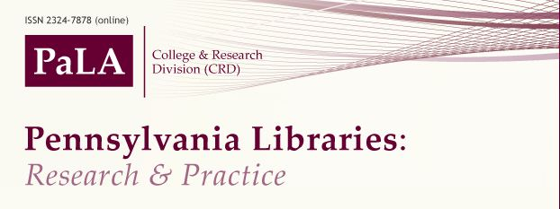
A learning experience
Soliciting contributions
Evaluating research
Communicating with authors and reviewers
Developmental editing, copyediting, and layout
Training in use of the platform, editorial practices, writing, and research
Promoting and fundraising
It’s a lot of work! (But it’s fun, too)

Slide 38
Measuring research impact
Bibliometrics
Alternative metrics (altmetrics)

Slide 39
Defining bibliometrics
The branch of library science concerned with the application of mathematical and statistical analysis to bibliography; the statistical analysis of books, articles, or other publications (OED Online)
In other words…data about publications or citation frequency
  Source: Kear (2014)

Slide 40
Why bibliometrics matter
They may help answer questions such as
  What are the best journals in my discipline? (Or most cited?)
  Who is citing my articles?
  How many times have I been cited? And where?
  How do I know this article is important?
  Which journal should I publish in?
    Source: Kear (2014)

Slide 41
Some concerns
Accuracy
Comprehensiveness
  Journals only—what about books and proceedings?
  Location and language of the journal
  Disciplinary coverage
Reliance on the Journal Impact Factor (without understanding it)
Is it possible to game the system?
Scholarly “worth” reduced to a number (which may or may not have real meaning)

Slide 42
Journal impact tools and measures
Journal Citation Reports (Thomson Reuters)
Scopus (Elsevier)
Article Influence
Eigenfactor
Impact Factor
Journal Analyzer
SNIP
SJR (SCImago Journal Rank)
    Source: Kear (2014)

Slide 43
Citation tools and measures
Citation Map (Web of Science)
Citation Reports (Web of Science)
Citation Tracker (Scopus)
H-index (researchers impact)
H-graph (depicts impact of a set of articles
    Source: Kear (2014).

Slide 44
Research evaluation tools
Generally used at the institutional level to evaluate research impact
  SciVal (Elsevier Scopus dataset)
  InCites (Thomson Reuters Web of Science)
  Symplectic Elements (orange—different focus to the others)

Slide 45
Pro tip #12: Understanding bibliometrics
ULS LibGuide: Citation Searching and Bibliometric Measures
  By Robin Kear, University of Pittsburgh
Robin’s handout
Scholarly Communication Lunch and Learn Talk #8: Using Bibliometric (Publication and Citation) Indicators to Demonstrate Impact
  By Berenika Webster and Robin Kear, University of Pittsburgh
Bibliometrics Seminar held at Pitt (22 May 2014)
  Presentations and recordings

Slide 46
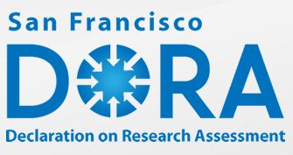
Pro tip #13: Explore the DORA
San Francisco Declaration on Research Assessment
Initiated by the American Society for Cell Biology + a group of editors and publishers of scholarly journals

Slide 47
1 general recommendation
Do not use journal-based metrics, such as Journal Impact Factors, as a surrogate measure of the quality of individual research articles, to assess an individual scientist’s contributions, or in hiring, promotion, or funding decisions

Slide 48
17 specific recommendations
Funding agencies
  Consider the value and impact of all research outputs (e.g., datasets, software) in addition to research publications
Institutions
  Be explicit about the criteria used to reach hiring, tenure, and promotion decisions
Publishers
  Greatly reduce emphasis on the journal impact factor as a promotional tool
Organizations supplying metrics
  Be open and transparent by providing data and methods used to calculate all metrics
Researchers
  When involved in . . . Making decisions about funding, hiring, tenure, or promotion, make assessments based on scientific content rather than publication metrics

Slide 49
Defining altmetrics
Altmetrics = Alternative ways of measuring the use and impact of scholarship
Altmetrics combine traditional impact measures (citation counts) with non-traditional measures
  “Altmetrics are measures of scholarly impact mined from activity in online tools and environments” – Jason Priem, Co-Founder, ImpactStory
Altmetrics = All metrics

Slide 50
The benefits
More comprehensive
  Citations, usage, social media
Covers impact of online behavior
  Because scholars increasingly work online
Measures impact immediately
  Because citation counts take years to appear in literature
Show impact for early career faculty & graduate students
Good numbers = potential for further publishing, research,
employment, and funding?

Slide 51
Some concerns
Prestige and tenure are often still locked into Journal Impact Factor
Apples and oranges?
  A “like” is not the same as a citation
Older vs. newer works
  Newer works may receive more attention from social media
Gaming the system
  Also a concern with traditional metrics

Slide 52


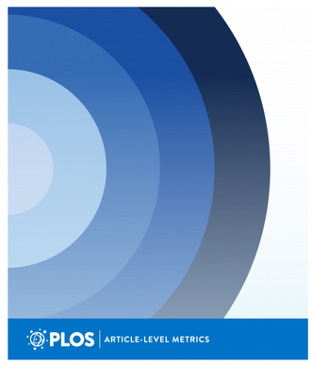

Altmetrics services

Slide 53
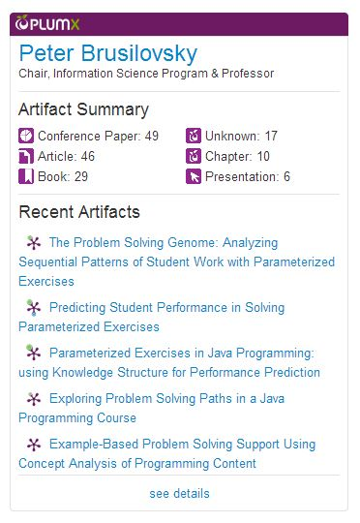
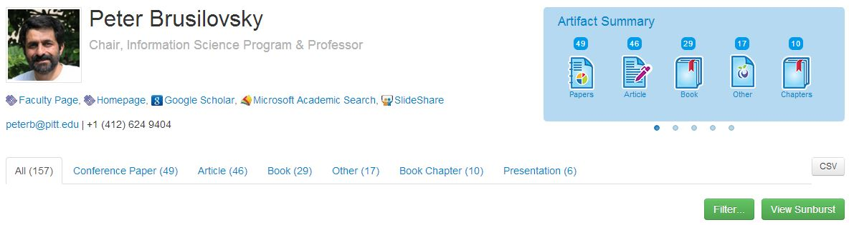
PlumX at Pitt
Profiles for researchers, schools,
departments, labs, and more
Researcher-level widgets
Journal article-level widgets
Repository item-level widgets

Slide 54
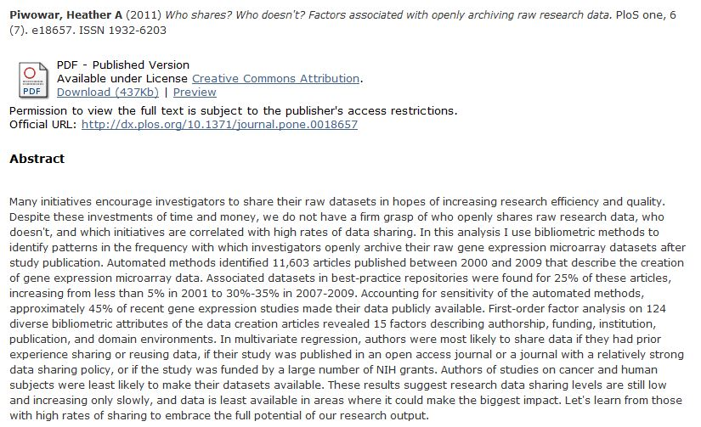

Slide 55
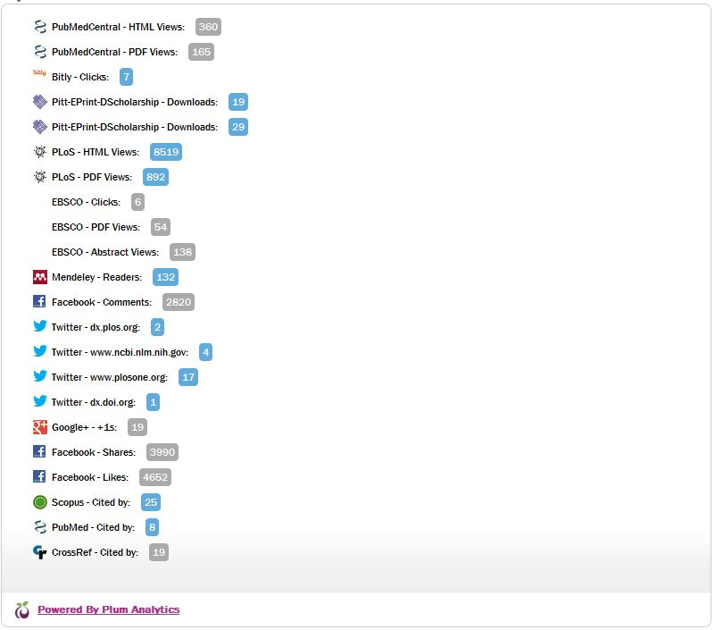
Data in blue are hyperlinked so we can find out more about the downloads and tweets
Data in gray are not hyperlinked so no further information is available—at least at this time

Slide 56
Pro tip #14: Easy intro to altmetrics
Impactstory
  Created by scholars and funded by Open Society Foundation, Alfred P. Sloan Foundation, National Science Foundation
  See where works have been cited, viewed, downloaded, tweeted . . .
  Reports impact of articles, slides, datasets, software
  Free!
Talkwalker Alerts
  Create alerts about yourself or your research
  Talkwalker monitors social media and online media and alerts you when there’s something of interest being discussed
  Free!
  Alternative to Google Alerts

Slide 57
Pro tip #15: Rubriq
Rubriq – “explore the possibilities of independent peer review”
For a fee, Rubriq will conduct peer review of your manuscript on your behalf
Rubriq reviewers will give feedback and recommend journals that are the best match for your work
This is untried by me but sounds interesting . . .

Slide 58
Your turn
John Barnett
Scholarly Communications Librarian
Office of Scholarly Communication and Publishing
University Library System, University of Pittsburgh
jhb23@pitt.edu or oscp@mail.pitt.edu
Twitter: @OSCP_Pitt

Slide 59
Sources
Bjork, B., Roos, A., and Lauri, M. (2009). Scientific journal publishing: Yearly volume and open access availability. Information Research 14(1), paper 391. http://InformationR.net/ir/14-1/paper391.html
Jinha, A. (2010). Article 50 million: an estimate of the number of scholarly articles in existence. Learned Publishing 23(2), 258-263. doi:10.1087/20100308
Jump, P. (2010). The expanding universe of scientific authorship. Times Higher Education Supplement (8 July 2010), 10.
Kear, R. (2014). Citation and bibliometric measures. LibGuide. Retrieved from http://pitt.libguides.com/bibliometrics
Suber, P. (2012). Open access. MIT Press. http://mitpress.mit.edu/books/open-access

