Slide 1
Bibliometrics, altmetrics and social networks to support your research career development
Berenika Webster
ULS
2 October 2015

Slide 2
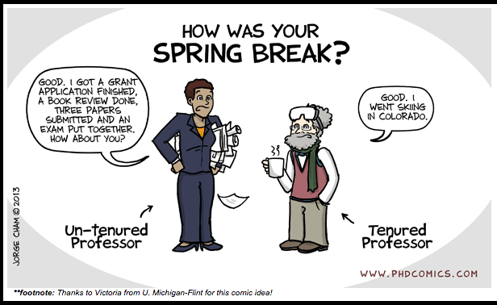

Slide 3
Sources of academic prestige
Excellent research (scholarship)
Excellence in teaching
Service to community – discipline and institution

Slide 4
Within the Dietrich School of Arts and Sciences, tenure is awarded for demonstrated excellence together with the promise of continued excellence in scholarship, in whatever form that scholarship takes. Teaching and research (or creative activity), the two principal functions of the University, are also the two principal forms of scholarship. […] Excellence in research should not excuse incompetence in teaching, and teaching that is not founded in scholarship can make no claim to excellence.
http://www.as.pitt.edu/fac/governance/criteria-promotion-or-appointment-tenured-rank
Overall, the most important consideration in promotion and tenure decisions is how the candidate’s research is perceived by experts in the field. Is his or her work cited, respected, and impactful? Determination of impact relies heavily on external letters – at least ten – from worldwide leaders in the field or subfield. Quantitative metrics may be considered (e.g., the
candidate’s h-index, citation counts), but there is no magic number that must be achieved. The candidate’s metrics should be within the range achieved by peers, but will be interpreted within the context of the candidate’s entire portfolio of work and accomplishment. Interview with administrator of School of Engineering, CMU
Generally I believe they break it down into three categories – teaching, service/leadership, scholarly activity/research. Also patenting activity is important. SSoE administrator
Indicators of such activities include publications of books and articles, especially in refereed journals, book reviews, invited and contributed talks at professional meetings and conferences, invitations to give seminars and colloquia, participation in workshops, funding for sponsored research, awards of grants and fellowships, and selection to the National Academy or to major national advisory committees. Pitt, Dept of English
What will your success look like?

Slide 5
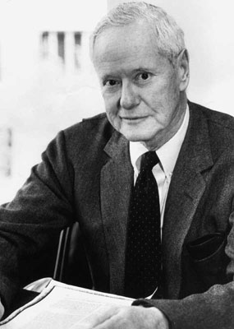
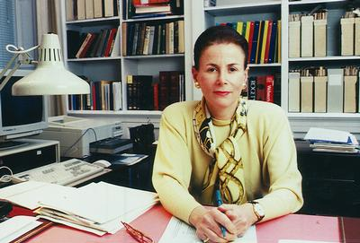
ECR and the Matthew Effect
For whosoever hath, to him shall be given, and he shall have more abundance: but whosoever hath not, from him shall be taken away even that he hath. Matthew xiii.7

Slide 6
Reputation is everything*
Sources of research reputation
  Publications (where and how many)
  Conference presentations (where, by invitation?)
  Collaboration (prestige of collaborator)
  Research funding (source and amounts)
Other forms of scholarly outputs (data and code, performance, artifact)
Application outside academia (impact – “how many lives were saved?”)
*Bourdieu Actes de la Recherche en sciences sociales, 1994.

Slide 7
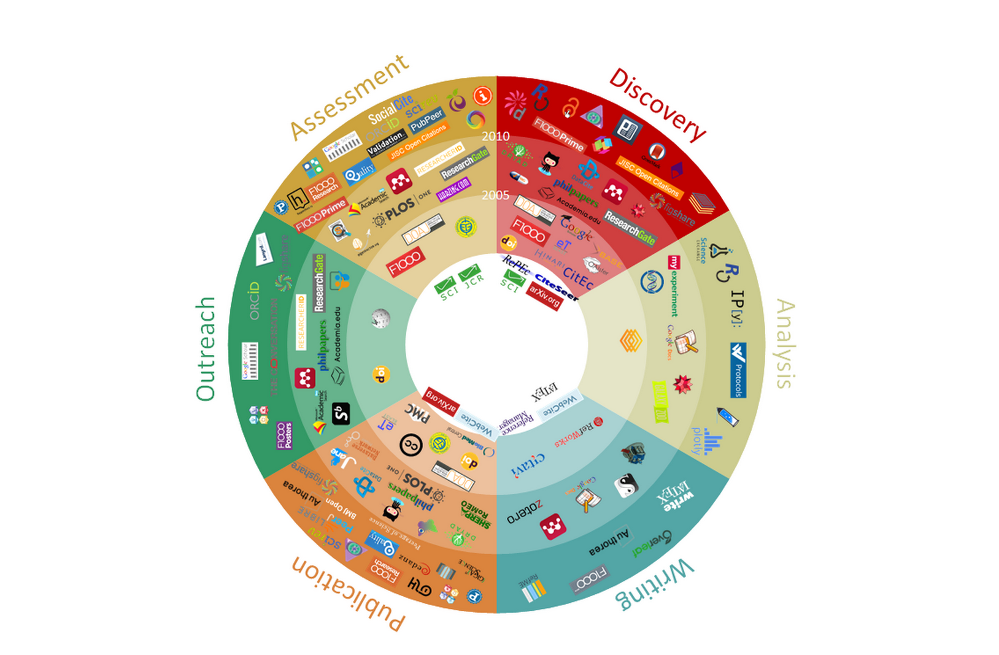
Research lifecycle and tools that support it
https://innoscholcomm.silk.co/

Slide 8
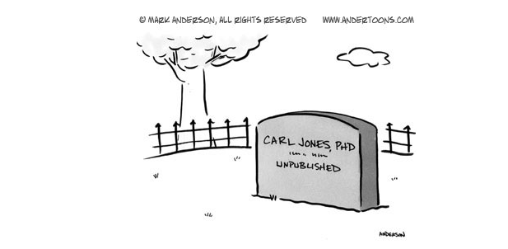
Publish or perish

Slide 9
Where to “publish” and how to track impact
Publications | Traditional Measures of impact | New measures of impact
Peer- reviewed Journal articles | Quality of journal; citation rates | Use (downloads, saves in bibliographic tools); Mentions (in media, in blogs, on twitter); Application (in policy documents, in patents)
Conference proceedings | Prestige of conference/ plenary, invited, keynote
Books | Quality of publisher
Book chapters | Quality of publisher; prestige of editor
Other outputs | Traditional Measures of impact | New measures of impact
Presentations |  | Downloads; shares, etc.
Data sets |  | Evidence of re-use - citations
Code |  | Use
open discourse |  | Followers, size of network, tangible outcomes of activity. Mentions (in media, in blogs, on twitter); Application (in policy documents, in patents)
non-scholarly outputs |  | Mentions (in media, in blogs, on twitter); Application (in policy documents, in patents)
performances, musical scores, artifacts |  | Prestige of venue

Slide 10
Journal Impact Indicators
Journal Impact Factor (based on Web of Science) and much more
Scimago (based on SCOPUS)
Ranking lists
Notes:
Journal of power sources

Slide 11
Citation-based indicators
Total citation count
Citation per publication
Always in context
  Normalized by publication year, discipline and document type
  Below or above a baseline (average)
  In top percentiles of distributions (excellence)

Slide 12
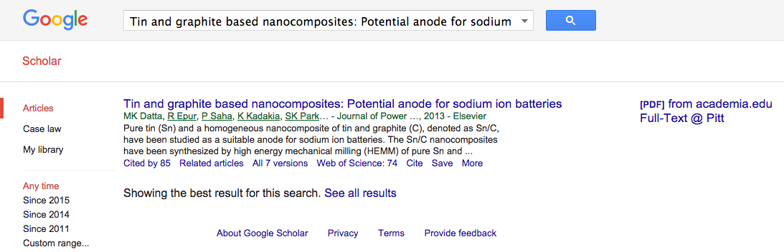
Citations: Google scholar

Slide 13
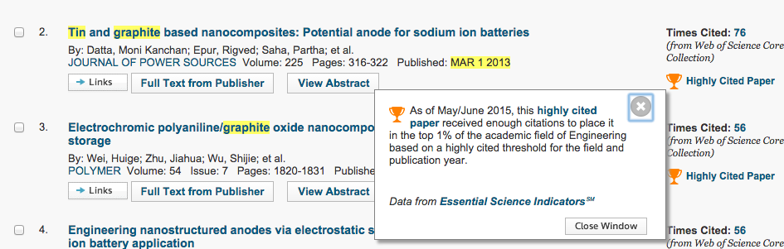
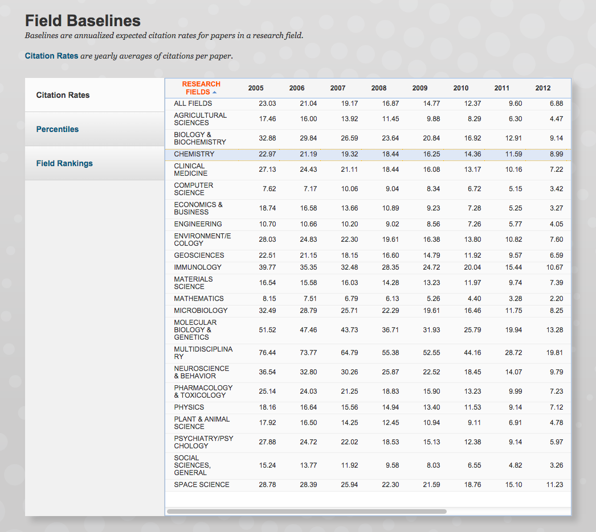
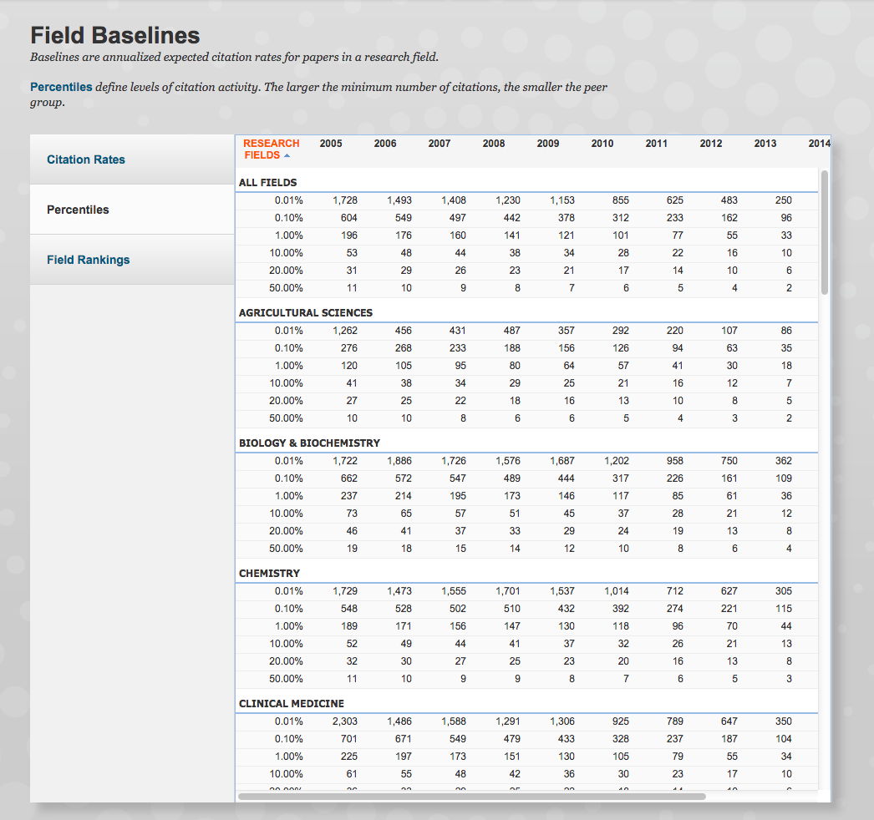
Web of Science and Essential Science Indicators

Slide 14
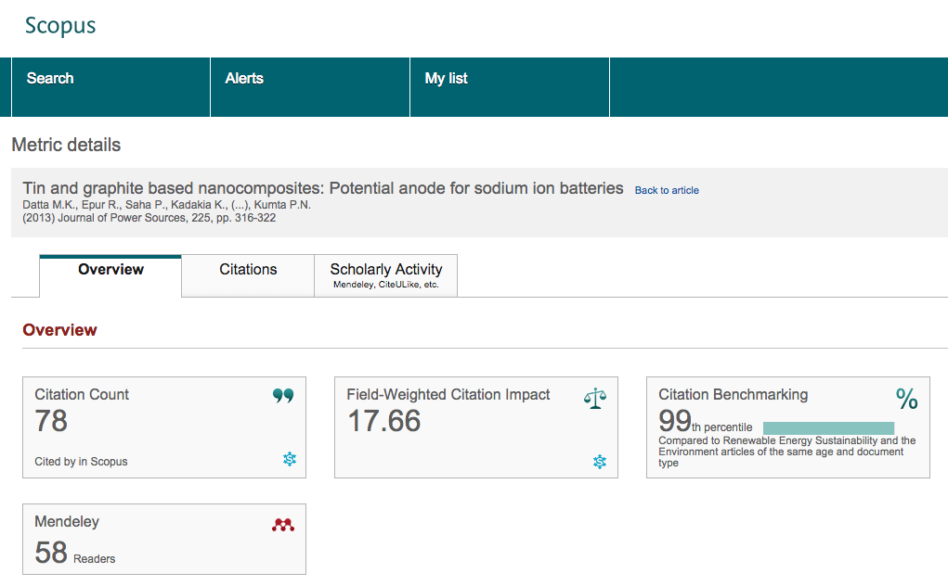
Scopus

Slide 15
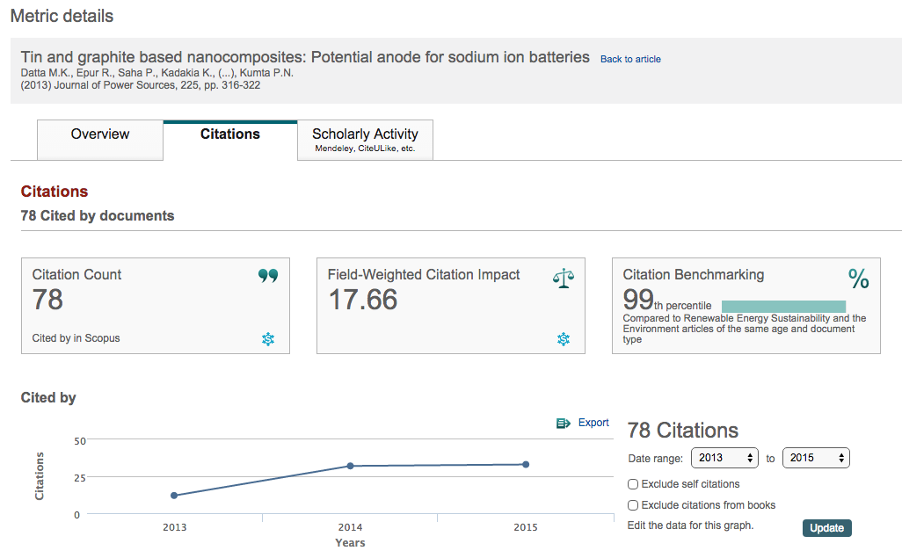
Scopus

Slide 16
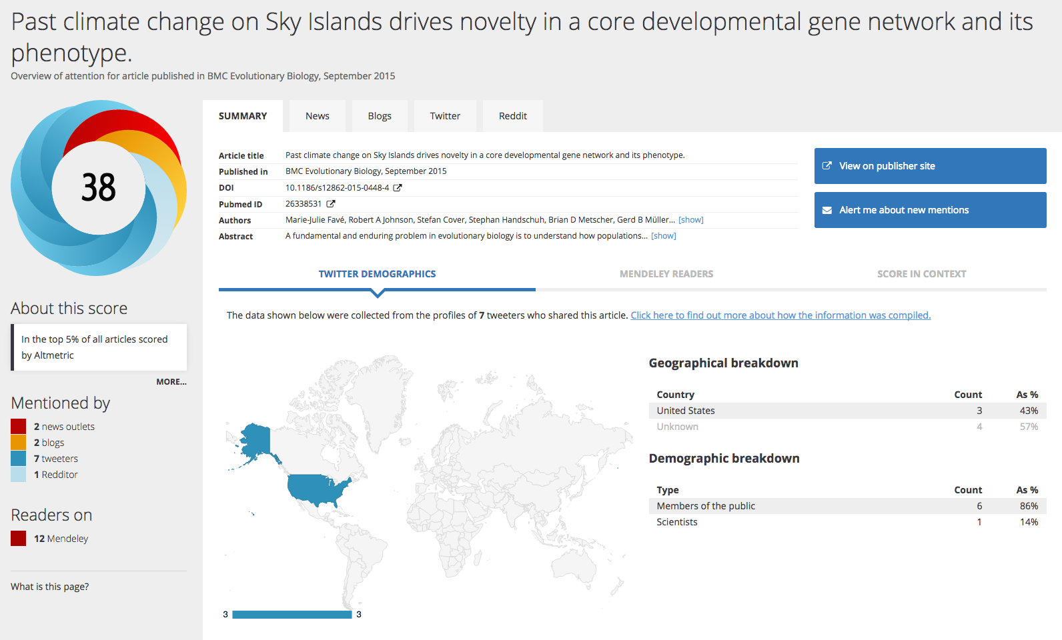
No citations? No problem: your research in social networks (altmetric.com)
Notes:
Hyperlinked to the Altmetric site

Slide 17
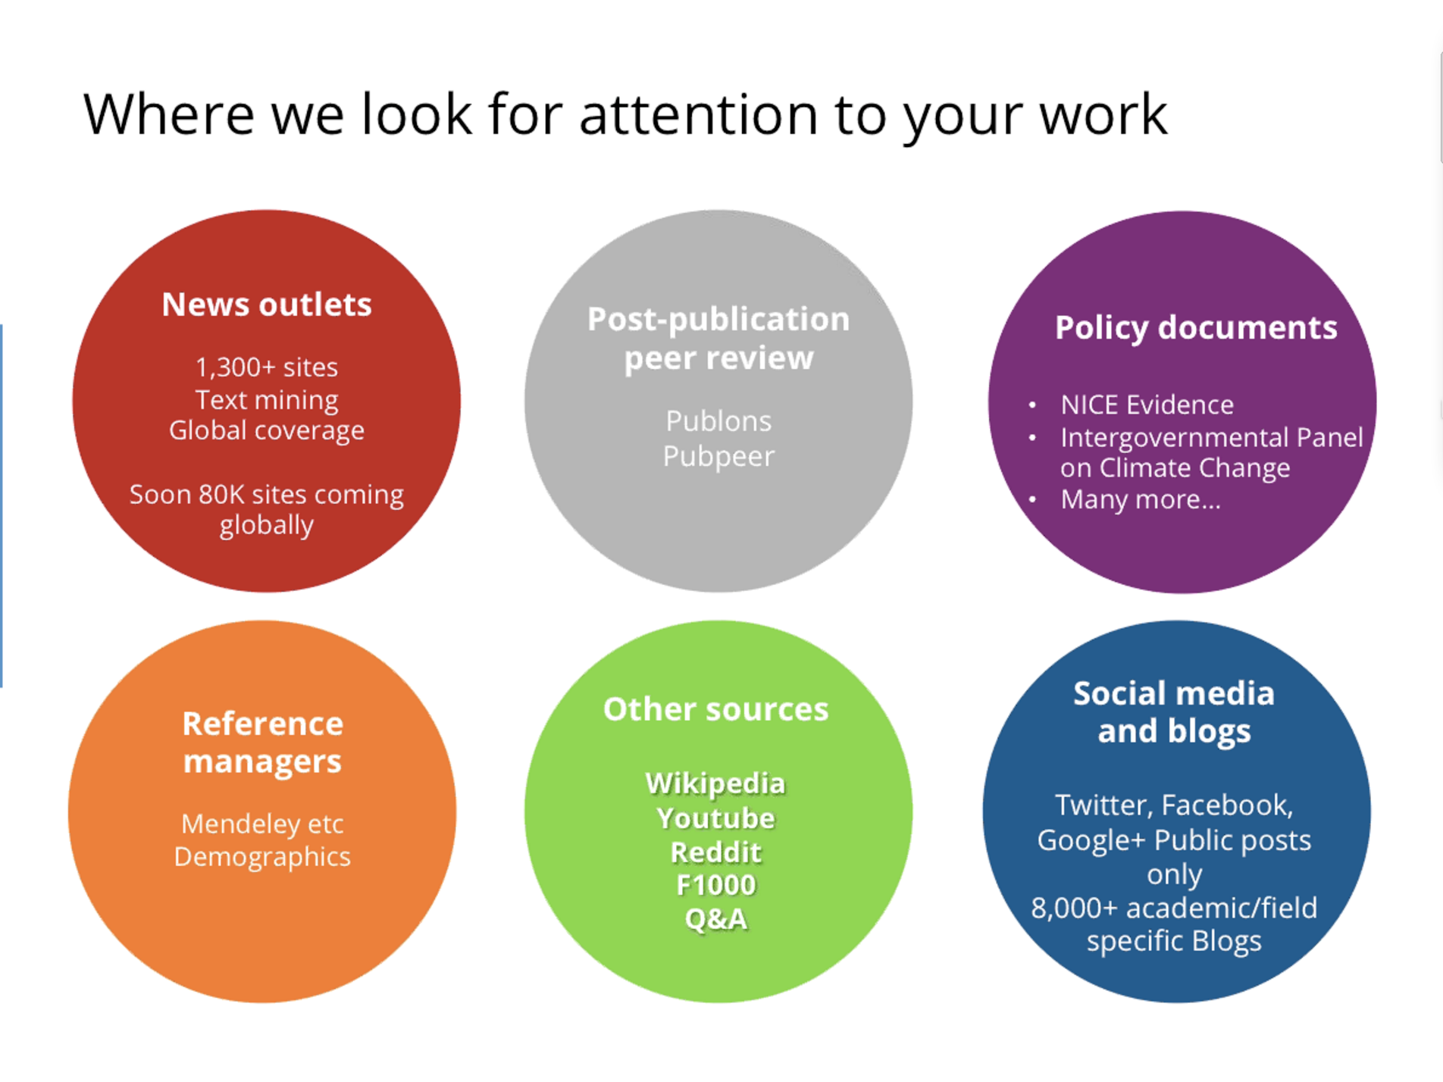
Altmetric.com sources

Slide 18
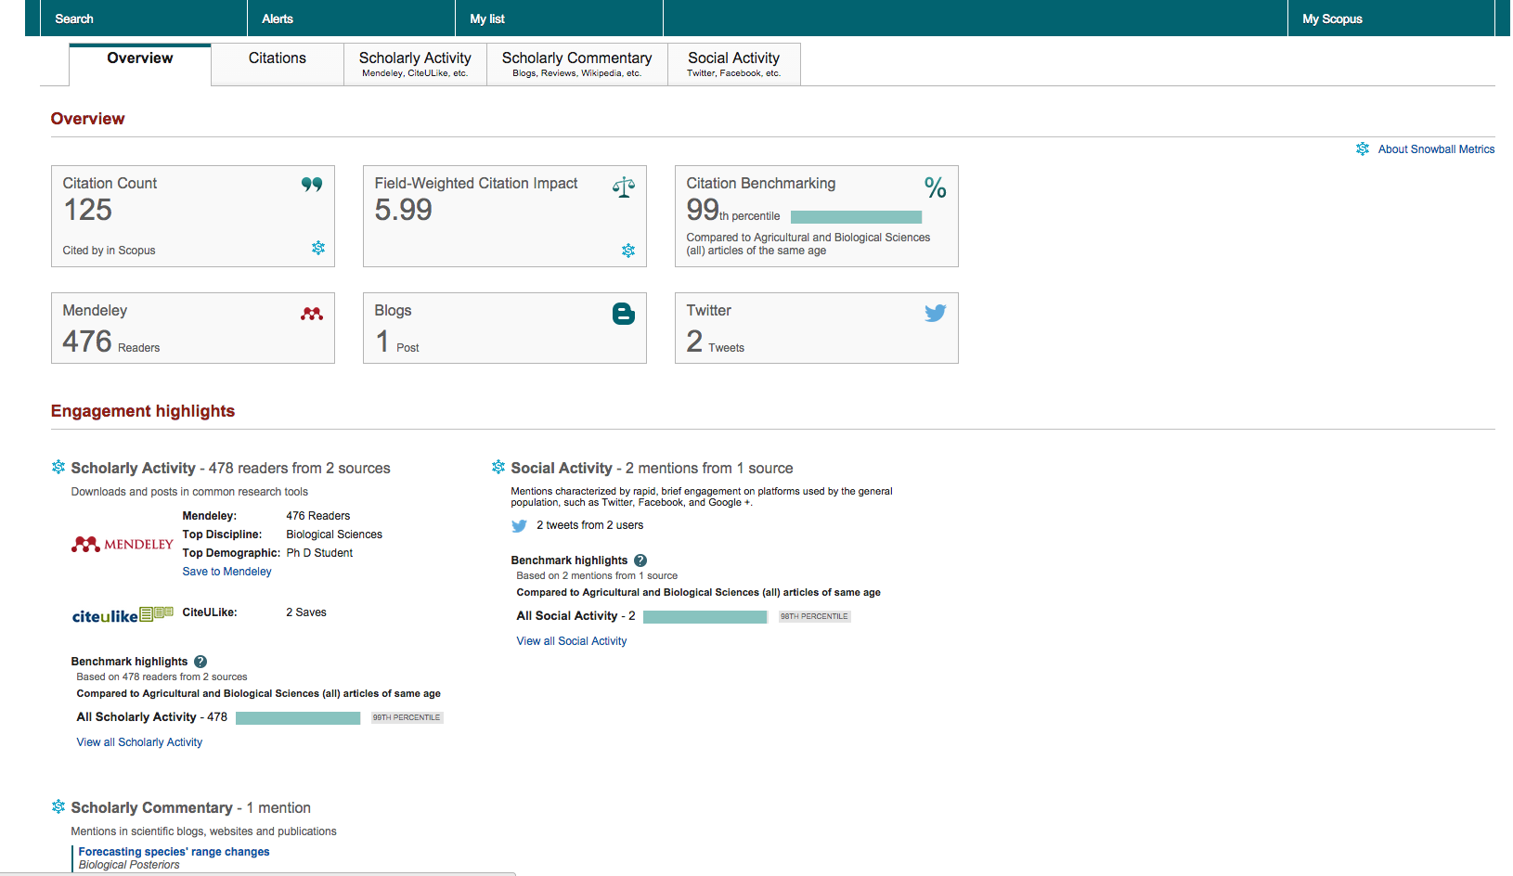
Other sources of altmetrics: Scopus powered by Altmetric.com

Slide 19
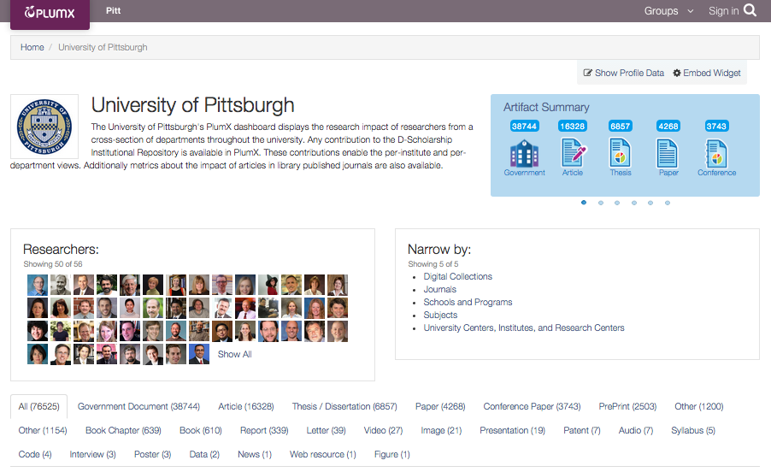
Other sources of altmetrics: D-scholarship powered by PlumX
Notes:
Other types of outputs as long as deposited with D-Scholarship

Slide 20
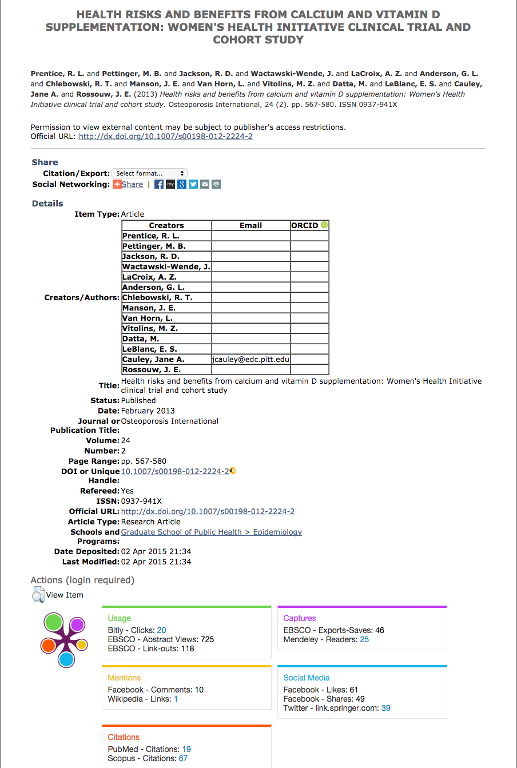
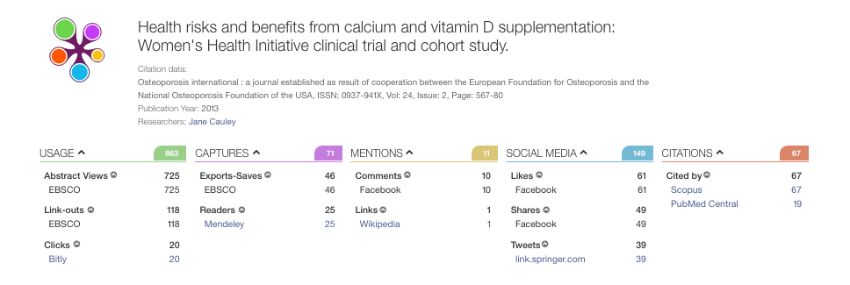

Slide 21
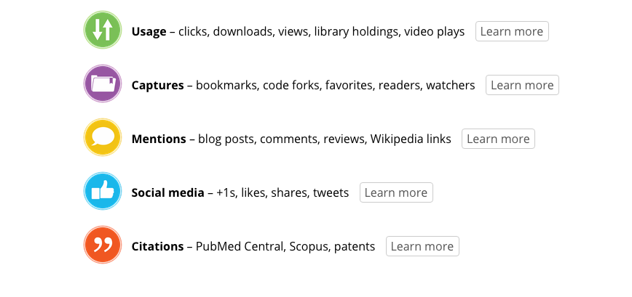
PlumX sources

Slide 22
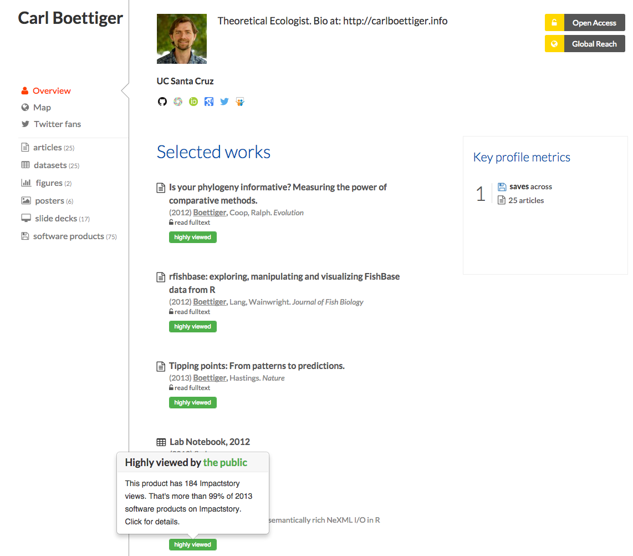

Impact Story
Notes:
$60 annual Impactstory supports a range of research products including articles, posters, figures, slides, videos, datasets, software products and so on.
It relies on third party data for scores and statistics. Third parties include services such as Altmetric, YouTube, PLoS, Scopus, PMC, Vimeo, Dryad, GitHub, Figshare, Slideshare, CiteULike, Delicioius, Mendeley, Wikipedia, Twitter, Arxiv, CrossRef, and a few others. Users simply add their products and then monitor altmetric-based impact scores of their products.
fee

Slide 23

“Discoverability or death”: how to increase visibility of your research (and reputation…)

Slide 24
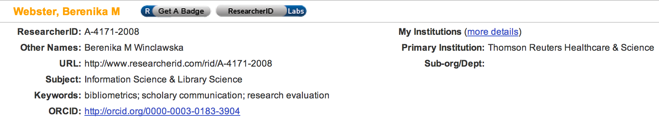
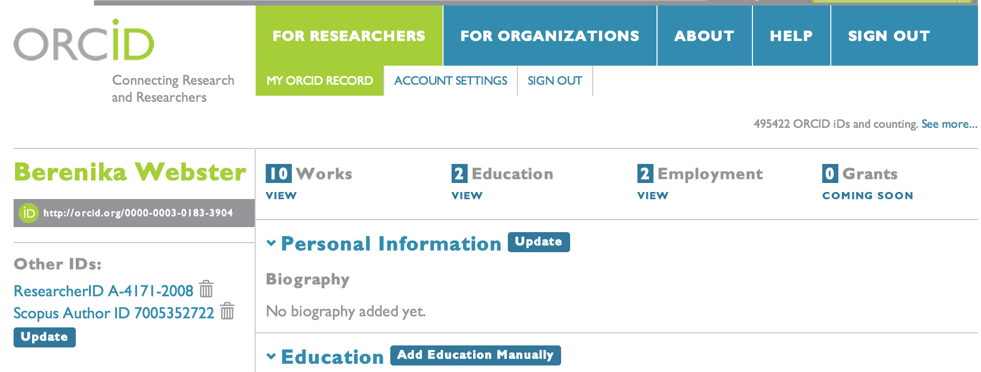
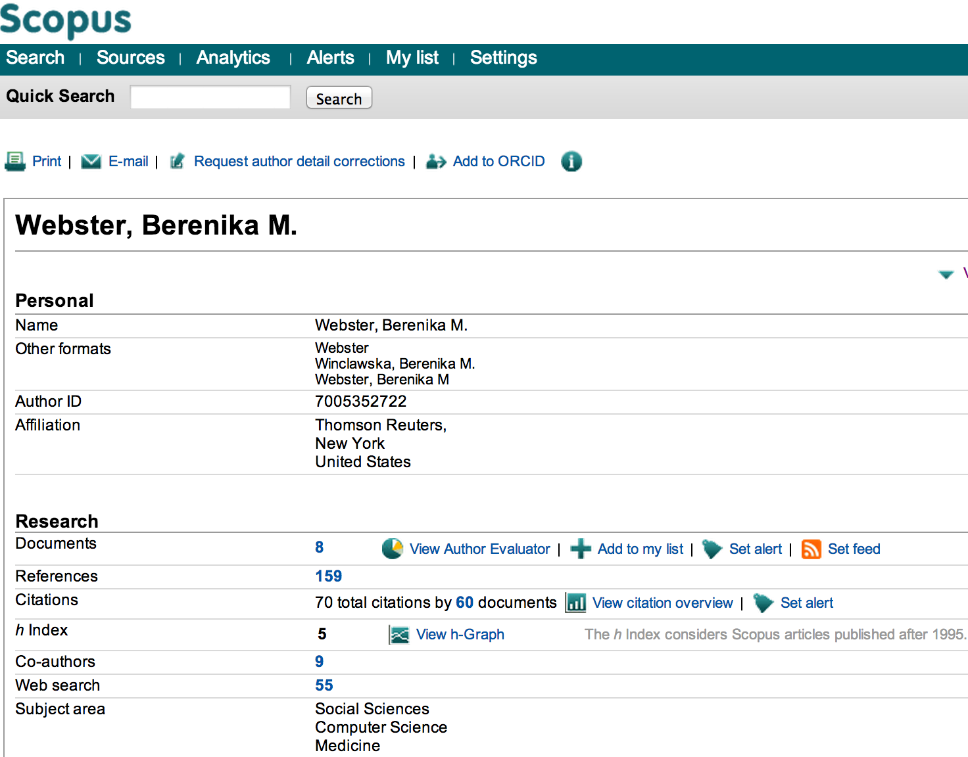
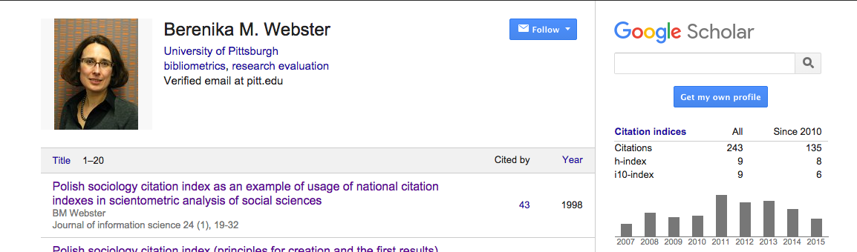
Create a profile

Slide 25
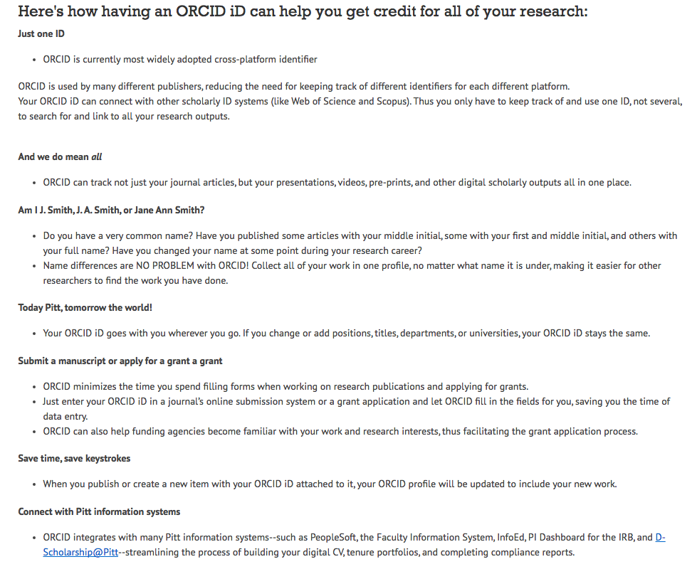
ORCID@Pitt
https://orcid.pitt.edu/

Slide 26
How to increase your citation rates?
Publish in the right journals (prestige; importance to the discipline; intended audiences)
Publish in English
Write review articles
Engage in basic research
Become a journal editor
Acquire a co-author (preferably from US or UK)
Get external funding (from different sources)
Make and maintain professional/social contacts with others in your research area
Make your outputs available in open access
Use social media

Slide 27
Share your research outputs
Preprints (your IR, ArXiv, bioxiv.org, etc.)
Software (e.g. GitHub)
Data (your IR, Figshare)
Slides (your IR SlideShare)

Slide 28
Let everyone know…
Become a resident of the online environment
Blog
Tweet
Try out Kudos (growkudos.com)
researchers aiming to enhance their reputation are likely to be more successful by adopting a resident approach rather than a visitor one. This, because cultivating digital identities and relationships online, indeed, turning the web into a crucial component of one's research undertakings, as Residents do, can be of great benefit for remaining relevant and visible. (Esposito, 2013)

Slide 29
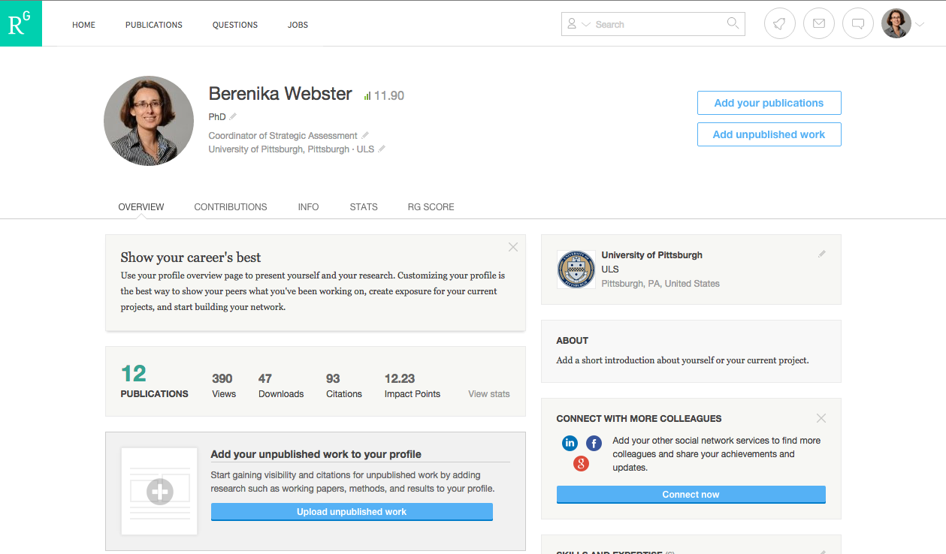
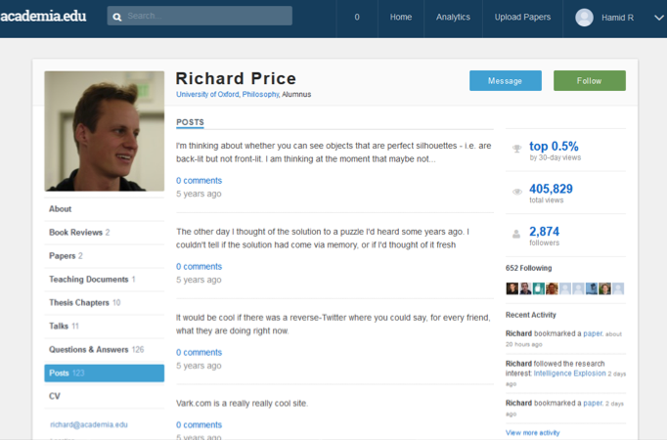
Join informal research networks

Slide 30
About blogging…
Figure out why you want to blog and who your targeted audience is (potential collaborator, employer, guy on the street)
Set it up (WordPress or Tumblr?)
Join a blog network (e.g. ResearchBlogging.org or scienceblogs.com)
Find and stick to your niche
Link to others and credit their work
Remember the headline
Promote your blog on Twitter, Facebook, etc.
Be regular in your habit
After Kelly Oakes, Guardian Science Writer, April 2014

Slide 31
To tweet or not to tweet…
As a means of participating in a community
  To finding collaborators,
  To connecting with others at conferences;
  To keep on top of your field;
  To showcase your research and other work

Slide 32
How to tweet effectively…
Have a decent profile picture and text - this is how people will find you. (Jon Tennant, https://twitter.com/Protohedgehog)
Use the Twitter search (or Goolge search) to find topics that interest you - this will allow you to find and follow people working in your area - and they may, in turn, follow you back. If someone follows you, unless they are selling snake oil, follow them back.
Look out for hash tags for events in your field (conferences/seminars). Follow them, even (some would say especially) if you aren’t there. Comment on tweets that interest you or where you have something to say.
Set up search alerts to keep abreast of activity that’s of interest to you.
Use a decent Twitter app on your mobile and desktop devices to manage your activity. (e.g. TweetDeck on the desktop and Echofon on iPhone and iPad)
Tweet when your community is most active, and most likely to see your stuff. Use a service like Buffer to schedule tweets if you are normally tied up in labs or classes when your audience is active.
Make use of Twitter lists to organize people you follow into thematic groups so that you don’t miss key things.

Slide 33
Twitter tips…
Tweet things that you find interesting or useful - news items, stuff you have read and so on. Offer your own take on these items.
Tweet regularly but don’t overdo it - you don’t want to come across as addicted! Appear engaged.
Engage in conversations and good-natured debate
Retweet other people’s tweets - they will retweet your own stuff - and that all helps to build your visibility in the community
Some key things to follow - journals in your field (@nature @NEJM @PLOSONE); research agencies in your field (@NSF @NIH); departments/universities (@PittTweet @PittHealthSci); research stars /PIs (you can use something like SciVal to find key names and look for them on Twitter); professional bodies in your field – (@TheOfficialACM, @ACEPNow)
Track your ‘impact’ - use a service like SumAll to see trends in your follower numbers, reach of your tweets and retweets
Use a service like bit.ly to shorten URLs that you wish to include in a tweet
If it’s appropriate, add an image to your tweet - this will make it stand out more

Slide 34
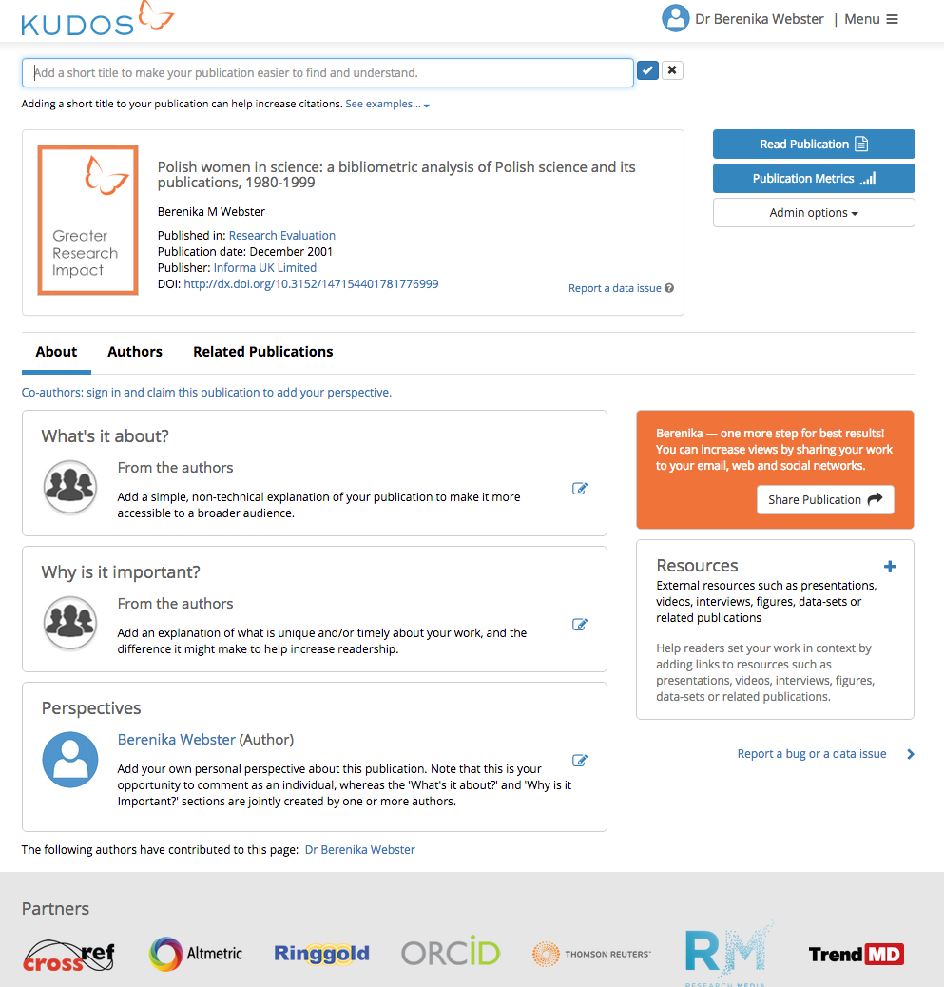
Kudos
“a web-to maximize the visibility and impact of their published articles.”
Notes:
Launched in April 2014. Claims 70k users. Own research shows that papers which were given “kudos treatment” attracted 19% more traffic than control group. Publications only (need DOI)

