Slide 1


Mike Bolam
Metadata Librarian
Digital Scholarship Services
University Library System
michael.bolam@pitt.edu // 412-648-5908

Slide 2
Assessment Survey
http://goo.gl/MiDZSm

Slide 3
Learning Objectives
What is OpenRefine? What can I do with it?
Installing OpenRefine
Exploring data
Analyzing and fixing data
If we have time:
  Some advance data operations
    Splitting, clustering, transforming, adding derived columns
  Installing extensions
  Linking datasets & named-entity extraction

Slide 4
What is OpenRefine?
Interactive Data Transformation (IDT) tool
A tool for visualizing and manipulating data
Not a good for creating new data
Extremely powerful for exploring, cleaning, and linking data
Open Source, free, and community supported
Formerly known as Gridworks Freebase then GoogleRefine
  OpenRefine 2.6 is still considered a beta release, so we’ll be using GoogleRefine 2.5.

Slide 5
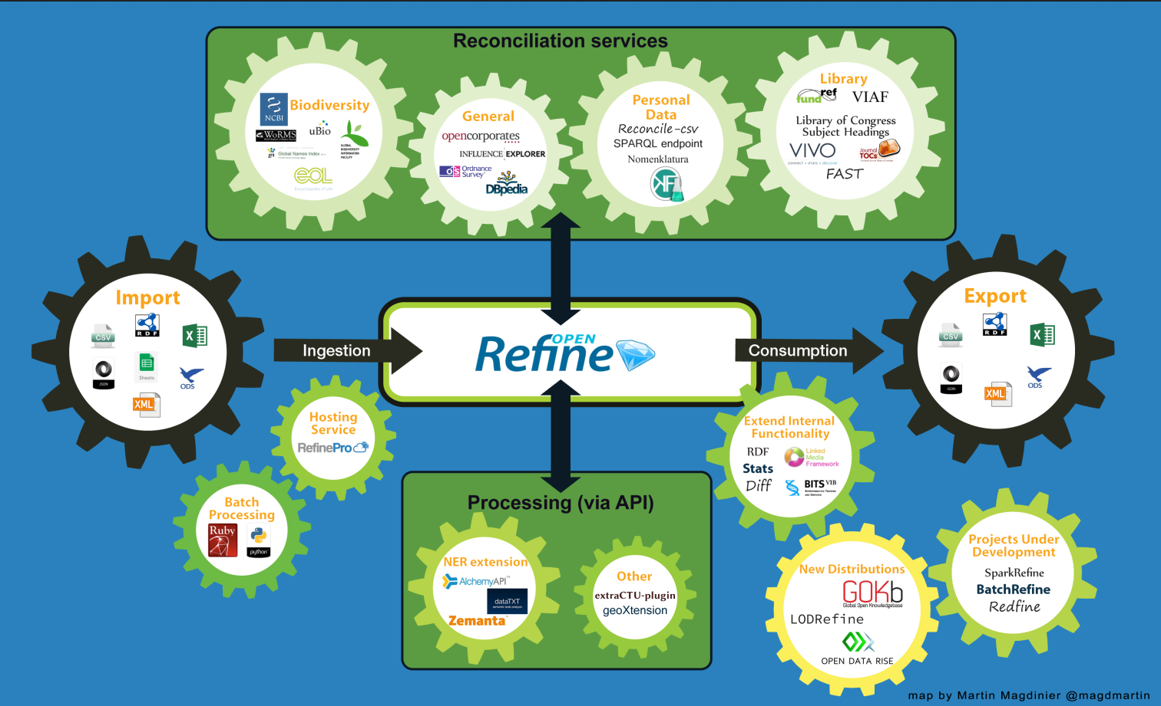
http://openrefine.org/2015/01/26/Mapping-OpenRefine-ecosystem.html

Slide 6
Why OpenRefine?
Clean up data that is:
  In a simple tabular format
  Is inconsistently formatted
  Has inconsistent terminology
Get an overview of a data set
Resolve inconsistencies
Split data up into more granular parts
Match local data up to other data sets
Enhance a data set with data from other sources

Slide 7
Installing OpenRefine
http://www.openrefine.org
Direct link to the downloads
  https://github.com/OpenRefine/OpenRefine/wiki/Installation-Instructions
Windows
  Download the ZIP archive.
  Unzip & extract the contents of the archive to a folder of your choice.
  To launch OpenRefine, double-click on openrefine.exe.
Mac
  Download the DMG file.
  Open the disk image & drag the OpenRefine icon into the Applications folder.
  Double-click on the icon to start OpenRefine.

Slide 8
Installing OpenRefine
OpenRefine runs locally on your computer. It does not require an internet connection, unless you want to reconcile your data with external sources.
  If you close you browser, you can get back OpenRefine by pointing it here: http://127.0.0.1:3333/ or http://localhost:3333
Your data is not stored online or shared with anyone.

Slide 9
Getting some data
http://www.powerhousemuseum.com/collection/database/download.php
  http://www.powerhousemuseum.com/collection/database/opensearch/phm_collection_mar12.zip
Created from the Powerhouse Museum metadata which been released under a CC-BY-SA Creative Commons Attribution Share Alike license.

Slide 10
OpenRefine Demo

Slide 11
Creating a new project
Left hand menu
  Create project
  Open project
  Import project
Mention File Formats
Choose Create Project – This Computer
  Choose PHM TSV file
  Click next
Give tour of upload page
  Explain tick boxes – especially Parse Cell into Number, etc, and
  Quotation Marks – Quotes have not syntactic meaning in this data
    Uncheck this box. Some data may use quotes as a delimiter (especially common in comma separated data)

Slide 12
Exploring your data
Total number of rows - 75,814
Column Headers and Menus
  All – Star, Flag, and ID – Can star/flag rows for later operations
  Click one of the triangles – Look at menus
Cell Contents
  Quick review of the data to make sure it parsed correctly (change to view 50 rows)

Slide 13
Manipulating columns
Collapsing columns
  Dropdown, View, Collapse options, collapse all
  All dropdown, view, expand all
Rename & Remove
  Dropdown, Edit, rename – remove period at end of Description header
Moving columns around
  Move a single column? From the column dropdown. Edit column. Describe options
  Reorder or remove multiple columns? All dropdown, Reorder/Remove

Slide 14
Analyzing and fixing data
Sorting
Faceting
Detecting duplications
Using text filters
Simple cell transformations

Slide 15
Sorting Data
Can sort as a visual aid or make permanent.
Record id - Sort
Options (point out submenu smallest/earliest first,etc)
  Text (case ignored)
  Number
  Dates
  Boolean
  Point out we can reorder blanks and errors (don’t match our sort type).
Sort by number, smallest first & look at results.
Right now, only effects display
Let’s look at the new Sort menu at the top:
  One click to reverse, remove, or make permanent.
  Make permanent change the order of your data.

Slide 16
Faceting data
Doesn’t affect the values, but is helpful for understanding data.
  Find errors and blanks, find misspellings, other inconsistencies
Can be used to perform operations on a subset of data

Slide 17
Text Facets
Can give you a quick idea of the type of data in a field.
Categories, Facet, Text Facet
  14,805 – uses too much memory
  Click Facet by choice counts – brings up new menu
  Move 0 to 1000 to show most common
  Shows top 7 – Click “7 Choices” – opens a field you can copy/paste
  Slide back to 100 – 89 categories show up in more >= 100 records
  Click one to return the objects with that value in categories
  Talk about multi-value cells. We’ll use GoogleRefine later to split
Height, Facet, Text Facet
  Note that we can’t do numeric here, because of units
  Sort by count, scroll down towards the bottom. Learn that units weren’t used consistently and over 45,000 records don’t have height listed

Slide 18
Numeric Facets
Numbers are green, assuming you checked “parse dates, numbers…”
  If not, reload data
Record ID, Facet, Numeric
  Get an overview of the number. Move slider – 0 to 500,000. See just the 536 with ids higher than 500,000
  Check out the check boxes – 3 Non-Numeric?
  Mouse over record id & click edit – See there is a space there?
  Click it and apply to all matching cells
  Just “cleaned up” some data

Slide 19
Timeline and Scatterplot
Timeline
  Production date, edit cells, common transformations, “to date” (only 72 converted)
  Facet Timeline – Most don’t have dates, but we can use to see those that do
  Unclick blank & Non-Time - Move slider
Scatterplot
  Good for grouping numeric data. This data set doesn’t really have a good data, but check it out

Slide 20
Customized Facets
Many other options –
  Customized using GREL – GoogleRefine Expression Language
  Some pre-designed options
    Word – lists all the different words (text facet lists strings). Data set a bit large for this
    Duplicates – Find duplicate records (do more with this in a minute)
    Numeric Log & 1-bounded numeric log – Can be used to help correlate dissimilar numeric sets.
    Text length – number of characters field (try on description – Move slider around)
    Unicode Char-code – less than 128 – English; accented & other characters up to 256, even higher for Arabic or Chinese, for example
    Error – True/False
    Blank – True/False – Try it on “Weight”

Slide 21
Faceting by Star/Flag
Want to find all the rows that either have either diameter or weight
Facet by blank on both and click “false”, but this isn’t right. Showing objects that have weight & diameter, not weight or diameter
  Mouse over and exclude “weight”, so we’re just showing objects with diameter.
  All – Edit Rows – Star
  Mouse over and exclude “diameter”, and click false on weight.
  All – edit rows – star
  Close facets – All – Facet by star – Click True – 2256 rows that have weight, diameter or both!
  Unstar the rows before moving on

Slide 22
Detecting Duplicates
This only works on strings, so it won’t work with the numeric data in the first Record ID column
Registration Number – Facets – Customized Facets – Duplicate (281)
  Click true to display – A lot are blank – but some appear to be true dups.
Registration Number – Facets – Customized Facets – Blank
  Click false to show the 163 real duplicates
Registration Number – Facets – Text
  Sort by count – Most show up twice, with a few outliers
Record ID – Sort – Numbers – Smallest first
  This time, use sort menu to make it permanent – See the dups together now
Record ID – Edit Cells – Blank Down (can be dangerous, but you can undo if something doesn’t work).
  Blank down keeps the first instance, and deletes everything below it
Remove all facets – Record id – facets- custom – facet by blank – to show the redundant rows.
  We’ll learn how to remove them later.

Slide 23
Using the project history
Click Undo/Redo tab
Demonstrate earlier actions
  Be careful – Going back will erase all subsequent steps. Can’t go from step 5 to step 2 without undoing 3 & 4.
  Note – Can extract and edit JSON of actions for more control. Outside scope.

Slide 24
Removing matching rows
Start with the baseline data again – Use undo/redo to go to step 0.
Change data from records to rows
Remove all rows without a record id
  Record ID – Numeric Facet – uncheck numeric – show 3 non-numeric
  All – Edit Rows – Remove all matching – Clear Facet – 75,811
Remove all with no registration number (suspicious in museum collection)
  Registration Number – Facets – Custom – Facet by blank – Click true (all blank)
  All – Edit Rows – Remove all matching – Clear Facet – 75,696
Remove duplicates (remember back with we detected them. A bit trickier)

Slide 25
Removing matching rows (cont.)
Registration Number – Facet – Custom – duplicate – True (163)
  If we suppress all of these, we lose the original and the duplicate data.
Registration Number – Sort – text – a-z // Sort – Reorder Rows Permanently
Registration Number – Edit Cells – Blank down (should effect 84)
  All – Edit Rows – Remove all matching – Clear Facet – 75,612
  First removed 3 blanks, then 115 further that only had record ID. Then 84 dups by reordering/blank down on the Reg. Number.
    Cleaned up a total of 202 rows

Slide 26
Applying Text Filters
Object Title, Text Filter – USA - 1866 matching rows
  Might be getting words like Jerusalem or usable
  Flip on case-sensitive – 1737 rows, but could still get JERUSALEM or USABLE
Try adding a space in front and behind – Drops to 172– maybe missing examples because of commas or other characters at the front or end
We can use a regular expression
  \bU.?S.?A.?\b – 1983 Rows – Catches USA & U.S.A.
    \b sets word boundary
    .? – Match preceding character 0 or 1 times

Slide 27
Simple Cell Transformations
Object Title, edit cells, common transforms
  Trimming whitespace - at beginning or end of string
  Collapse consecutive whitespace – remove multiple spaces
  Unescape HTML Entities - &eacute; or &00010; - can convert that to appropriate text
  To titlecase/To uppercase/to lowercase
  Blank out cells – Clear everything from a column

Slide 28
Exporting a project
Top left menu-
  Export project lets you save everything, including history of edits (undo/redo). Share with others or move to another device
    Import project from original menu
  Variety of data export options
  Triple Loader and MQLWrite – must align with pre-existing schema (outside scope)
  Custom table exporter – Tight control over export. Can select and order columns exported, control date format, reconciliation results
  Templating – More advanced control using JSON (outside scope)
  More on RDF exports later

Slide 29
Getting more memory
Windows
  Google-refine.l4j.ini
    # max memory memory heap size
    -Xmx2048M
Mac (more complicated)
  Ctrl-click application, choose Show Folder Contents, Contents, info.plist
  Find VMOptions – change Xmx1024 to Xmx 2048

Slide 30
Going for more memory
Consider how much memory you have available.
  I probably wouldn’t increase above the standard 1gig, if you only have 4 gig RAM on your device.
Close Refine – ctrl-c (windows)
Switch to powerpoint.
  Windows
    Google-refine.l4j.ini
      # max memory memory heap size
      -Xmx2048M
  Mac (more complicated)
    Ctrl-click application, choose Show Folder Contents, Contents, info.plist
    Find VMOptions – change Xmx1024 to Xmx 2048

Slide 31
Advanced Data Operations
Handling Multi-value Cells
Alternating between rows & records
Clustering similar cells
Transforming cell values
Splitting data across columns
Transposing rows & columns

Slide 32
Handling Multi-value cells
Categories, facet, text facet – “too many to display”
  Edit cells, split multi-valued – enter “|” and click okay
  Sort facet by count – show editing option with clothing and dress, but don’t change it.
Demonstrate rejoining them with comma or other separator, but don’t do it.

Slide 33
Alternating between rows and columns
Click on numismatics
  Problem – Just see the rows where numismatics appears, but not the rest of the data.
  Switch to record view at the top, and will show full record that contain numismatics
  Point out the way the grey/white goes from rows to columns
Make sure you’re in row view for the rest of the exercise.

Slide 34
Clustering similar cells
Categories – Edit Cells, Cluster and edit…
  Describe the columns – Point out “Biological specimans” – Caps not consistent with others. Fix, select all, and Merge & Recluster
Other clustering options – ngram fingerprint
  Looks like good combinations – see a problem? T-shirt vs shirt? Select all, then unselect that one.
Nearest neighbor w/defaults – probably not that helpful for this dataset, but worth taking a look at.
  Geological specimens vs geological specimen
  Hell money vs Shell Money? Looks like a typo to me. Click “browse this cluster” to get a better idea
Usually best to try out different options and see what works best for your dataset.

Slide 35
Linking Datasets
Installing Extensions
Adding reconciliation service
Reconciling with Linked Data
Extracting named entities

Slide 36
Installing extensions
Hit the “open button” in the top left – Look for Browse Workspace Directory - See extensions folder?
Or…go to installation point, click webapp – see extensions folder?
Go to http://refine.deri.ie // Downloads.
  Download latest and unpack the zip file
Move the rdf-extension folder to the GoogleRefine Extensions folder
Restart GoogleRefine, and open your project
Should see an RDF menu on the right side

Slide 37
Adding a reconciliation service
Click RDF – Add reconciliation service – based on SPARQL endpoint
You can use any publicly available endpoint, but for the exercise, we’re going to use one set up by the freeyourmetadata.org crew using Library of Congress Subject Headings
  Name: LCSH
  Endpoint URL: http://sparql.freeyourmetadata.org/
  Graph URI: http://sparql.freeyourmetadata.org/authorities-processed/
  Type: Virtuoso
  Label Properties – tick only skos:preflabel

Slide 38
Named Entity Extraction
http://software.freeyourmetadata.org
Download ner-extension.zip and unpack it.
Put it in your extensions folder (just like before)
Restart GoogleRefine
Create new project, using the same dataset

Slide 39
Adding a reconciliation service
Endpoint URL – address where the endpoint is located
Graph URI – identify which dataset within the endpoint to use
Type – endpoint software – knowing the correct type improves speed
Label properties – names of fields that can be used to look up the cell value

Slide 40
Linking Data
This can be slow, depending on internet connection, network traffic, size of data set.
We’re going to work with an arbitrary subset. Text facet on height, sort by count, include just 215mm results –
  Text facet on categories (84 categories, 400 rows).
Categories, Reconcile, Start Reconciling
  LCSH – might take a minute – Should say skos:Concept & have a path.
This might take a little while – Going out over the network to pull back these terms
While running, show NER downloads and talk about other resources.
Good time to fill out your survey, too!

Slide 41
Linking Data
Automatically linked those with high confidence
  Click link – explain LOC page
Suggests matches for those with lower confidence
  Can choose or search. Understanding subject headings and structure of vocabulary would help at this point.
Some it will find no results
Edit Column – Make new column based on these “Category URLs”
  cell.recon.match.id with “set to blank” chosen
Can clear the reconciliation now
  Reconcile, actions, clear recon data

Slide 42
Named Entity Extraction
Use a subset again. Same method – Height - Text facet – Pick one around 10 – 885mm?
Again, will take a while – Finish up survey?
Check out the results – Linking to DBPedia, the database behind Wikipedia.

Slide 43
Take it to the next level
Regular Expressions
  GREL – GoogleRefine/OpenRefine Expression Language
  JYTHON – Python Written in Java
  Clojure – A dialect of the LISP programming language
GREL Resources
  https://github.com/OpenRefine/OpenRefine/wiki/Google-refine-expression-language

Slide 44
Resources
OpenRefine Wiki
  https://github.com/OpenRefine/OpenRefine/wiki
OpenRefine User Documentation
  https://github.com/OpenRefine/OpenRefine/wiki/Documentation-For-Users
Using OpenRefine [book – ebook available via PittCat]
  https://www.packtpub.com/big-data-and-business-intelligence/using-openrefine
Free Your Metadata Site
  http://freeyourmetadata.org
Linked Data for Libraries, Archives, and Museums [book – available at Hillman Library]
  http://book.freeyourmetadata.org

Slide 45
Assessment Survey
http://goo.gl/MiDZSm

