Slide 1


Mike Bolam
Metadata Librarian
Digital Scholarship Services
University Library System
michael.bolam@pitt.edu // 412-648-5908

Slide 2
Assessment Survey
http://goo.gl/MiDZSm

Slide 3
Learning Objectives
What is OpenRefine? What can I do with it?
Installing OpenRefine
Exploring data
Analyzing and fixing data
If we have time:
  Some advance data operations
    Splitting, clustering, transforming, adding derived columns
  Installing extensions
  Linking datasets & named-entity extraction

Slide 4
What is OpenRefine?
Interactive Data Transformation (IDT) tool
A tool for visualizing and manipulating data
Not a good for creating new data
Extremely powerful for exploring, cleaning, and linking data
Open Source, free, and community supported
Formerly known as Gridworks Freebase then GoogleRefine
  OpenRefine 2.6 is still considered a beta release, so we’ll be using GoogleRefine 2.5.

Slide 5
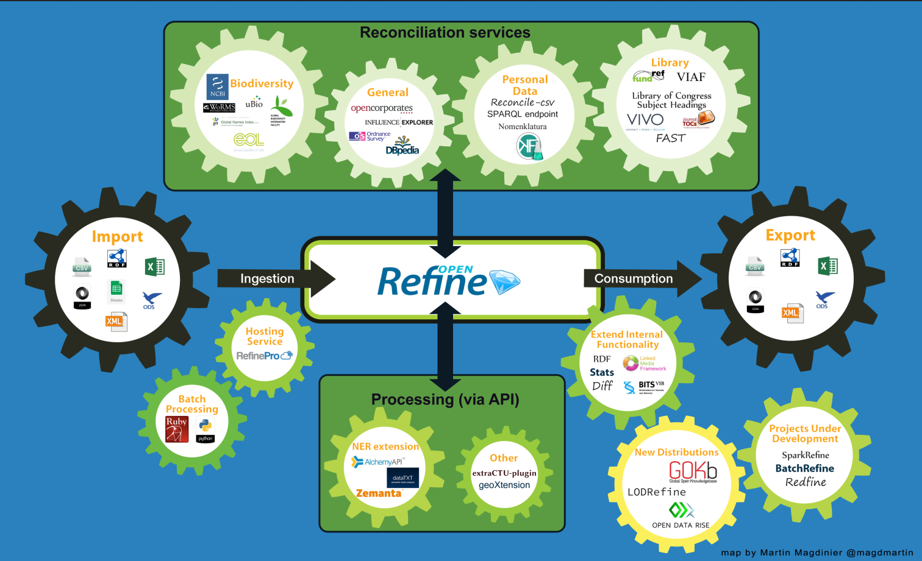
http://openrefine.org/2015/01/26/Mapping-OpenRefine-ecosystem.html

Slide 6
Why OpenRefine?
Clean up data that is:
  In a simple tabular format
  Is inconsistently formatted
  Has inconsistent terminology
Get an overview of a data set
Resolve inconsistencies
Split data up into more granular parts
Match local data up to other data sets
Enhance a data set with data from other sources

Slide 7
Installing OpenRefine
http://www.openrefine.org
Direct link to the downloads
  https://github.com/OpenRefine/OpenRefine/wiki/Installation-Instructions
Windows
  Download the ZIP archive.
  Unzip & extract the contents of the archive to a folder of your choice.
  To launch OpenRefine, double-click on openrefine.exe.
Mac
  Download the DMG file.
  Open the disk image & drag the OpenRefine icon into the Applications folder.
  Double-click on the icon to start OpenRefine.

Slide 8
Installing OpenRefine
OpenRefine runs locally on your computer. It does not require an internet connection, unless you want to reconcile your data with external sources.
  If you close you browser, you can get back OpenRefine by pointing it here: http://127.0.0.1:3333/ or http://localhost:3333
Your data is not stored online or shared with anyone.

Slide 9
Getting some data
http://goo.gl/hlUA5f
Created from the Powerhouse Museum metadata which been released under a CC-BY-SA Creative Commons Attribution Share Alike license.

Slide 10
OpenRefine Demo

Slide 11
Getting more memory
Windows
  Google-refine.l4j.ini
    # max memory memory heap size
    -Xmx2048M
Mac (more complicated)
  Ctrl-click application, choose Show Folder Contents, Contents, info.plist
  Find VMOptions – change Xmx1024 to Xmx 2048

Slide 12
Installing extensions
Hit the “open button” in the top left – Look for Browse Workspace Directory - See extensions folder?
Or…go to installation point, click webapp – see extensions folder?
Go to http://refine.deri.ie // Downloads.
  Download latest and unpack the zip file
Move the rdf-extension folder to the GoogleRefine Extensions folder
Restart GoogleRefine, and open your project
Should see an RDF menu on the right side

Slide 13
Adding a reconciliation service
Click RDF – Add reconciliation service – based on SPARQL endpoint
You can use any publicly available endpoint, but for the exercise, we’re going to use one set up by the freeyourmetadata.org crew using Library of Congress Subject Headings
  Name: LCSH
  Endpoint URL: http://sparql.freeyourmetadata.org/
  Graph URI: http://sparql.freeyourmetadata.org/authorities-processed/
  Type: Virtuoso
  Label Properties – tick only skos:preflabel

Slide 14
Named Entity Extraction
http://software.freeyourmetadata.org
Download ner-extension.zip and unpack it.
Put it in your extensions folder (just like before)
Restart GoogleRefine
Create new project, using the same dataset

Slide 15
Take it to the next level
Regular Expressions
  GREL – GoogleRefine/OpenRefine Expression Language
  JYTHON – Python Written in Java
  Clojure – A dialect of the LISP programming language
GREL Resources
  https://github.com/OpenRefine/OpenRefine/wiki/Google-refine-expression-language

Slide 16
Resources
OpenRefine Wiki
  https://github.com/OpenRefine/OpenRefine/wiki
OpenRefine User Documentation
  https://github.com/OpenRefine/OpenRefine/wiki/Documentation-For-Users
Using OpenRefine [book – ebook available via PittCat]
  https://www.packtpub.com/big-data-and-business-intelligence/using-openrefine
Free Your Metadata Site
  http://freeyourmetadata.org
Linked Data for Libraries, Archives, and Museums [book – available at Hillman Library]
  http://book.freeyourmetadata.org

Slide 17
Assessment Survey
http://goo.gl/MiDZSm

