Slide 1
Alternative metrics
ULS Bibliometric Services: Workshop 4
August 2016
Notes:
Welcome. This is the fourth in a series of four workshops presented by the Bibliometric Services Track. Over the past months, the prior workshops have taken a dive into traditional citation-based bibliometric indicators, and we’ve looked at how aggregating and analyzing scholarly citations from one article to another can help us identify impact and help us demonstrate value for authors, for articles, and for journals. This workshop focuses on the next frontier in bibliometrics: altmetrics.

Slide 2
Creating and Engaging a Public
Stadler, Matthew. “What is Publication?” Montehermoso Art Center, Vitoria, Spain. 27 Sept. 2008
Maxwell, John, Ph.D. "Making Knowledge and Making Publics: The Evolving Role of the Publisher" Fifth PKP Scholarly Publishing Conference. Proc. of PKP5, Vancouver, BC. Public Knowledge Project, 12 Aug. 2015.
Graham, Clinton. “Alternative Metrics” Bibliometic Services Workshop #4, University Library System, University of Pittsburgh. Aug. 2016.
Notes:
Scholarship and research is about creating and engaging a Public.
In a seminar held at Montehermoso Art Center in Vitoria Spain in 2008, Matthew Stadler described the publication process as not the creation of a beautiful output, but rather as the creation and maintenance of a public for whom that work is meaningful: “These construct a common space of conversation, a public space, which beckons a public into being. This is publication in its fullest sense.“ Stadler explicitly framed this is a political sense - putting something out there creates room for new narratives to be acknowledged and allows for the status quo to be challenged.
At the Fifth PKP Scholarly Publishing Conference in 2015, John Maxwell referenced Stadler’s concept from the specific perspective of scholarly communication. For Maxwell, a simple way to describe the public for a scholarly output is “the people who are willing to pay attention.” So if the output is a means to connecting people and ideas, he asked the audience to flip the traditional question of “How can we use this output to evaluate the researcher?” to new questions of “Are we engaging? Are we doing the cultural-level interpretation of audiences?” The question could shift from “can I justify my existence?” to “where is my work creating space which overlaps other people’s interests, and how can I understand and facilitate that interaction?”
I’m drawing on these ideas for this presentation on Alternative Metrics, because this is what excites me about Bibliometics. By analyzing the datapoints surrounding scholarly outputs, we can discover and enhance the publics where the meaning of the publication is living and growing. This data can help us identify, energize, and enhance the communities we are creating by the publication of scholarly works.
Audio from the seminar in Spain was recorded, is available online, and a blog about it is cited in Wikipedia. The lecture I attended in British Columbia was videorecorded and posted on the conference website. This presentation will ultimately end up within Pitt’s institutional repository. None of these steps involve a journal article citation and you won’t find counts of the references in Scopus or Web of Science. But I and others, and maybe even you, may become a part of the public of this idea. Altmetrics aims to help us tell the stories surrounding this public.

Slide 3
What are Altmetrics?
Measure scholarly impact
Supplement other measures
Include “non-traditional” outputs and effects
Notes:
Altmetrics are measures of research impact that supplement peer review and traditional citation-based bibliometric indicators. They can capture “non-traditional” usage of research output such as mentions in mass media or references in public policy. They can track impact of “non-traditional” outputs of the research process, such as datasets, code repositories, and conference presentations. Increasingly, scholars are doing more of their work online, and this leaves digital footprints behind as a side effect. Altmetrics use these footprints to provide researchers insight into how their work is being discussed, shared, saved, read, and reused by other scholars and by the public.

Slide 4
Benefits
Track beyond journal article citations
Measure societal and practical outcomes
Become quickly discoverable
Align with the Open movement
Notes:
Altmetrics fill in some of the gaps of traditional citation-based bibliometrics, which are largely bound to scholarly citations within journal articles. With some fields, such as the humanities, taking upwards of five years to publication, it is helpful to have measures which are not bound to at least two publications cycles. Another significant benefit is that altmetrics can describe societal and practical outcomes of research. We can measure social impact, such as online discussions, news media coverage, or popular reception. We can capture “real world” effects, such as references in public policy documents and reuse of code and data. Whereas citation-based bibliometrics are bound by the speed of the traditional publication process, altmetric indicators are often based on realtime usage or mentions so they can become quickly discoverable. Altmetric indicators frequently come from open sources and are often collected via open APIs. This provides the potential for these indicators to be able to be reproduced, reused, and remixed, without being bound to a proprietary vendor or particular walled garden. (Though we still have a ways to go there.)

Slide 5
Challenges
Still being defined
Measure recent activity
Notes:
The field of Altmetrics is relatively new and standard definitions are still evolving. There are competing definitions which may be vendor specific, and data is not normalized so comparisons across sources are unavailable. As with all bibliometric indicators, one of the ongoing challenges is disambiguation of contributors and of outputs. Disambiguating outputs usually relies on a DOI, but not all research outputs have a registered DOI. Disambiguating contributors typically relies on an external id, such as an ORCID or Scopus ID. Since altmetrics are geared toward modern online interactions, most data sources measure only recent activity, so older publications may not have relevant altmetric data. Because a citation is a recorded part of a document, we can continue to retrospectively add citiation-based bibliometric data for historical articles. We cannot, on the other hand, measure tweets before Twitter, or calculate downloads for URLs which don’t have historical access logs.

Slide 6
What can Altmetrics do for me?
Tell a story beyond article citations
Discover popular use of research output
Compare impact within your field
Connect and promote research conversations
Notes:
If you want to tell a compelling story of the impact or effect of research beyond the scope of traditional journal article citations, altmetrics can highlight the value of videos, posters, and book chapters. If you want to discover ways scholarly articles are generating media buzz or online conversations, altmetrics can enhance the view of existing “traditional” publications. This is especially helpful for scholars who need to prepare a portfolio before the publication cycle has provided time for traditional citations to accumulate. While altmetrics can’t be used to compare across indicators or across fields, we can use metrics for comparison with other research or researchers within the same field. Altmetrics can help to identify scholarly bookmarks, shares, and social media discussions; this allows a researcher to connect with communities and conversations which are forming around research topics. This is, I think, one of the more interesting possibilities of altmetrics. While altmetrics can help in the “justify your existence” use-case, I hope the far more compelling use for a researcher will be as a means to discover and engage the research audience. Again, this is the true end of a scholarly output: not the “product” of an article or dataset or performance; but the “public” which forms around that output and for whom that knowledge and experience creates meaning.

Slide 7
Types of Altmetric indicators
Bookmarks
Discussions
Shares
Views/Downloads
Ratings
Forks/Reuse
Plus, traditional citations
Notes:
So what are indicators of that public engagement? Users can bookmark items of interest for later access. This could be scholarly bookmarks such as Mendeley, or popular bookmarks such as del.icio.us or Twitter favorites. Similarly, discussions could originate from reviews on F1000 or other post-publication peer review sites, or from threads on Twitter or Facebook, or even comments on blogs, Youtube, or Github. Social media sharing operates similarly and is likely interwoven with bookmarks and discussions. Usage statistics have one of the best defined standards because of Project COUNTER, so views or downloads often prominently feature in altmetric indicators. This usage can be harvested across publisher’s sites, institutional repositories, and other scholarly services such as Figshare. Some outputs, such as books, book chapters, and videos lend themselves naturally to ratings via either a star system or like/dislike. Digital objects can leave traces of their reuse and enhancement; these references can give a picture of value, perhaps even in “real world” contexts. Of course, altmetrics can also leverage traditional citiation-based analysis.

Slide 8
Altmetrics aggregators
Notes:
Plum Analytics provides a subscription service called PlumX which offers dashboards and widgets to monitor and analyze altmetric indicators for research output. The University of Pittsburgh subscribes to several PlumX tools. The subscription is required for Plum to start tracking objects related to the subscriber; once tracked, the metrics for that author or output become public via a dashboard, API and widgets. You’ll find PlumX widgets in some EBSCO databases at the artifact level.
Altmetric.com aggregates altmetric data into dashboards and widgets as well. Researcher and institutional dashboards require a subscription, but widgets based on a specific output DOI can be created for free. You’ll find Altmetric.com widgets in Summon searches, and you’ll find Altmetric.com data in Scopus.
Impactstory is a subscription based service targeted to individual researchers. Once the researcher’s outputs have been identified, Impactstory subscribes the researcher to mentions surrounding those research outputs and creates a public profile page highlighting those metrics.
Kudos is a free service which allows researchers to describe their work in plain language and then link it to related work. Kudos then maps the explanation, linking and sharing of their work against existing altmetic indicators in order to identify strategies for improving impact.
Let’s interact with each of these services as part of this workshop.

Slide 9
Kudos – growkudos.com
Notes:
The Kudos service essentially invites authors to describe an article in terms of “What it’s about?” and “Why is it important?”, and then offers the opportunity for the authors to add personal perspective on the scholarship. This screen is the default template you’ll see for an article that has not yet been claimed and has no lay summary.

Slide 10
Kudos – growkudos.com
growkudos.com
Menu
Search
Enter DOI
10.12688/f1000research.8460.1
Notes:
If you can think of an article or other scholarly output which you think deserves a simple language description for popular consumption, grab the DOI for it and go to “growkudos dot com” now. You can use the menu to select “Search” and then enter the DOI. If you don’t have an article that comes to mind, we can use one from our own Lauren Collister. That DOI is “10 dot 12688 slash f1000research dot 8460 dot 1”.

Slide 11
Kudos – growkudos.com
Notes:
Here one of the authors has filled out the “What’s it about” and “Why is it important” sections, and Collister has added a note in the authors’ “Perspectives”. Another co-author could come in and add additional “Perspectives”.

Slide 12
Kudos – growkudos.com
Notes:
In return for the author’s description, Kudos offers some basic measures on sharing, views, and accumulated Altmetric and bibliometic “scores”. Metrics are only available after an author has claimed the article and provided the simple-language description, and only available to the author or authors. It’s probably not a great value package, as most of this is freely available elsewhere. Kudos would probably be particularly helpful, however, if a researcher deliberately wanted to make a scholarly work accessible to the general public.

Slide 13
Impactstory – impactstory.org
Notes:
Impact Story promises to keep the researcher in touch with mentions of his or her work. It requires a subscription via ORCID, but is free at this time. There was a brief period where they tried charging $60/year, but they rolled back that cost in April. As a side effect, if you know anyone’s ORCID, you can find anyone’s profile view with impactstory.org slash u slash ORCID iD. If an author-created profile does not exist yet, a default profile will be autogenerated.

Slide 14
Impactstory – impactstory.org
0000-0002-1902-1464
Notes:
Let’s take a look at the autogenerated profile for Peter Brusilovsky from the iSchool. Impact Story automatically tries to identify some notable Achievements as a hook. Here it tags Brusilovsky as top 10% for “Global Reach” and top 25% for “Open Access”. If you have a scholar for whom you can find an ORCID iD (hint: use orcid.org or Scopus) you can find that user now. Otherwise, navigate to “impactstory dot org slash u slash 0000 dash 0002 dash 1902 dash 1464”.

Slide 15
Impactstory – impactstory.org
Notes:
We can drill into more detail on the Achievements. Some of these might be of interest to the researcher, such as the diversity of countries in which research has been disseminated, or the better-than-average reach of the Global South. Some of these are pretty clearly Impactstory reaching a bit, such as this purple “Fun” categorization of “Big in Japan”. This “honor”, by the way, links to the “Alphaville” music video from 1984. Maybe someone understands this better than I do, because to me it seems like a really backhanded compliment.

Slide 16
Impactstory – impactstory.org
Notes:
The Activity tab reports tweets and references in YouTube as well as Mendeley saves. With Impactstory, when new tweets or comments about an output are made, Impactstory will catalog them and then notify the scholar. This can allow the researcher keep a finger on the pulse of his or her research, and enables the possibility of diving into conversations on the research which may have otherwise remained unknown.

Slide 17
Altmetric – altmetric.com
altmetric.com
Products
Altmetric Badges
Enter a DOI
10.1016/j.chb.2010.08.005
Notes:
ImpactStory listed Brusilovsky’s “greatest hit” as “Encouraging user participation in a course recommender system: An impact on user behavior”. Let’s take a look at that in Altmetric.com. Or, if you are following along with your own DOI, you can use that now. The DOI for “Encouraging user participation” is “10 dot 1016 slash j dot chb dot 2010 dot 08 dot 005”. Navigate to “altmetric dot com”, select “Products”, then “Altmetric Badges”, then scroll down to the sample implementation. Change the DOI to be your sample DOI.

Slide 18
Altmetric – altmetric.com
Notes:
If you click through the Altmetric.com donut, you will find the details that Altmetric.com has gathered about this article. Similar to ImpactStory, you can ask Altmetric.com to alert you by email when new mentions of this article are found. Altmetric.com takes this a step further, however, by allowing anyone to subscribe to any output.

Slide 19
Altmetric – altmetric.com
Notes:
For ranking and comparison information, you can drill into the “Score in Context”. This describes the items performance in a ranked list against research tracked, against those in the same source, against those of similar age, and against those of a similar age in the same source. The indications of percentiles might be something useful if a researcher wanted to show evidence of quality or impact beyond traditional citation counts. Altmetric.com regards this article as better-than-average, but still very middle-of-the-pack.

Slide 20
PlumX – plu.mx/pitt
plu.mx/pitt
Search – brusilovsky
Article
Scroll to 2011
Notes:
We can take a look at this same article in PlumX, to which Pitt subscribes. Navigate to “plu dot mx slash pitt”, then search for “brusilovsky”. Select the Article tab and scroll down to 2011, where we find “Encouraging user participation in a course recommender system: An impact on user behavior”.

Slide 21
PlumX – plu.mx/pitt
Notes:
Note that the Plum widget deliberately does not try to assign a specific score for ranking the article, but rather tries to visually describe what domains of impact the article has. This article is strongest in terms of it’s usage statistics, and has a showing of captures and citations, but Plum has captured relatively little social media attention and blog mentions. Let’s go back to Brusilovsky’s article list and find something that has generated online conversation.

Slide 22
PlumX – plu.mx/pitt
Notes:
Sorting by Social Media mentions, we can drill into “User-controllable personalization: A case study with SetFusion”.

Slide 23
PlumX – plu.mx/pitt
Notes:
This article is pretty new and has generated just a few citations so far, but seems to have a bit of conversation going on Twitter. In the most recent tweet, Brusilovsky’s co-author Denis Parra has mentioned another researcher’s paper from the ACM Recommender Systems conference. The paper presented there was titled “Letting Users Choose Recommender Algorithms: An Experimental Study”. This “Letting Users Choose” paper mentions several future studies intended by the authors. Parra links to this tweet to his own “User-controllable personalization” paper where he and Brusilovsky detail their own research on three of those “future studies”. That is almost certainly the conception of a future citation.

Slide 24
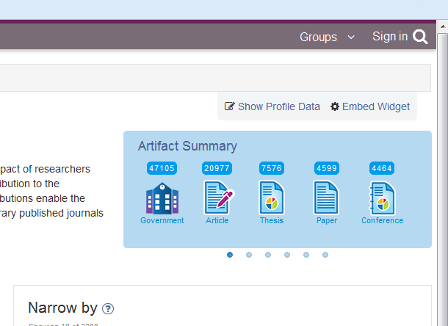
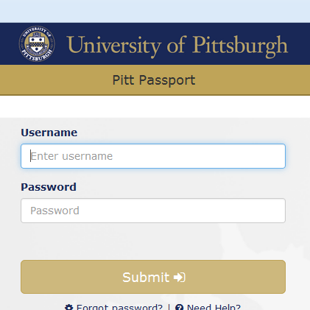
PlumX – plu.mx/pitt
Notes:
Every user at Pitt is eligible to sign in to PlumX to view and manage a dashboard of their scholarly publications. In the upper-right hand corner, click on the “Sign in” link, then enter your Pitt username and password on the Passport login.

Slide 25
PlumX – plu.mx/pitt
Notes:
You may be asked to claim your profile. If you have already signed up with ORCID@Pitt or deposited works into D-Scholarship, Plum is already tracking your research or scholarly output. Once you have claimed our initialized your profile, you can customize it by clicking on your name, then “My Profile”.

Slide 26
PlumX – plu.mx/pitt
Notes:
This is the stock profile for me. Click on “Edit this Profile” for the opportunity to customize the page.

Slide 27
PlumX – plu.mx/pitt
Notes:
This is the stock profile for me. Click on “Edit this Profile” for the opportunity to customize the page.

Slide 28
PlumX – plu.mx/pitt
Notes:
Adding links to repositories and individual outputs here will allow PlumX to index the scholar’s work and provide additional altmetric indicators for the scholar to consider.

Slide 29
PlumX – plu.mx/pitt
For more information:
http://pitt.libguides.com/altmetrics/PlumX
Notes:
For more information on working with PlumX at Pitt, visit (or send inquiries to) “pitt dot libguides dot com slash altmetrics slash plumx”.

Slide 30
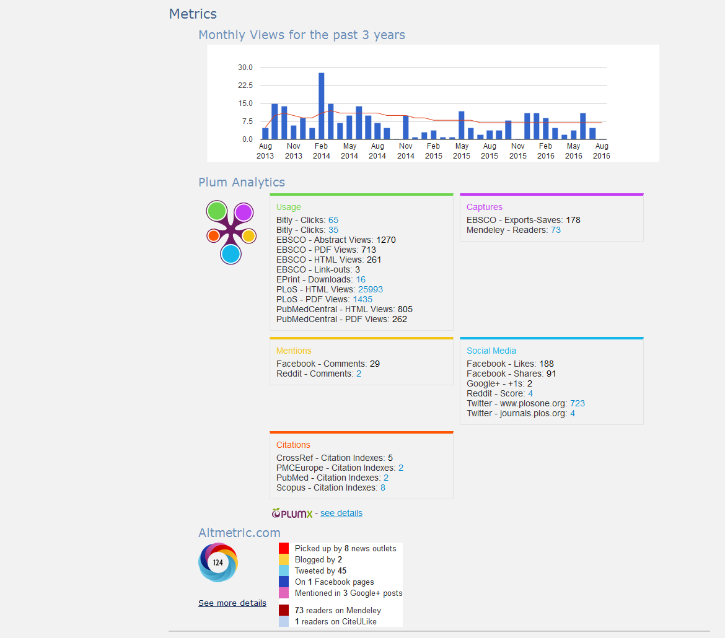
An example
http://d-scholarship.pitt.edu/18672/

Slide 31
What’s next?
Challenges to overcome
Institutional acceptance
Standarization/Normalization
Proprietary distribution
Notes:
What’s next for the field of altmetrics? There are a few challenges to overcome. There needs to be improved acceptance at the administrative level for the value which altmetrics can provide to the hiring and tenure and promotion processes. You may hear about departmental or unit policies which require citation based metrics in contexts where they are inappropriate or ineffective. The Bibliometics Services Track can help to provide altmetric strategies which may provide a better fit, but there is a lot of institutional inertia to overcome.
Normalization is both a blessing and a curse. We don’t want standardization to prevent new metric sources from emerging, but the normalization of metrics does allow for comparison and aggregation. We need to balance the collaboration of everyone sharing the same stuff while resisting the stagnation of no one being willing to try something new.
We’re also faced with the challenge of breaking out of the pattern of locking these metric indicators behind paywalls and proprietary services. As mentioned earlier, many altmetric indicators are sourced from open data and available via open APIs, but almost inevitably access to this is channeled through proprietary aggregation tools. As a university library we can find ways to support and open the sources of altmetrics.

Slide 32
What’s next?
Possible future alternative metrics
Contributor roles
Credit for peer review
Usage referral sources
Other?
Notes:
The field of altmetrics is current and evolving. As a research library and as a publisher, we not only have the opportunity to use the latest altmetric indicators, we have the opportunity to help shape the future of altmetric indicators. Here are some places I think altmetrics could be head in the future: Altmetrics could help us report on the different roles scholars undertake within the research workflow. For example, instead of just a list of 30 coauthors on a paper, enhanced metadata could describe which contributors were involved in methodology vs. data curation vs. computation vs. writing. Altmetrics could also help us give credit to the largely voluntary and uncredited work of peer review. Peer review remains a critical part of the research process; why shouldn’t a reviewer be able to report quantitative and qualitative measures of his or her work? If an industry standard could encourage the collection and communication of this scholarly activity, altmetrics could make the measurement possible. Altmetrics already does a good job capturing usage statistics. Technologically, a next step could be reporting the referral source for this usage. This could give an author a view into how other researchers were discovering a particular research output. And finally, there are bound to be many other possibilities for altmetrics which haven’t been fully identified yet. You may know of evidences of impact in your particular field which haven’t yet been captured. Maybe a scholarly output for your field is a live performance and an altmetric indicator could be ticket sales. Maybe the best indicators for your field can’t be captured… yet. We have existing relationships with standards organizations and development partners which we can leverage to make a difference. In the subscription we have with Plum Analytics, we are continually solicited for feedback on the existing service and on new opportunities for development. Keep your eyes and ears open and be mindful of what the next innovation might be.

