Slide 1
Uses and Misuses of Quantitative Indicators of Impact
Berenika Webster
7 October 2016
ULS/ISchool Digital Scholarship Workshop and Lecture Series

Slide 2

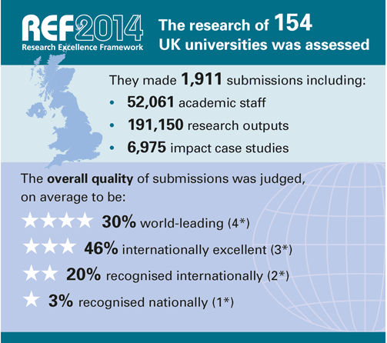
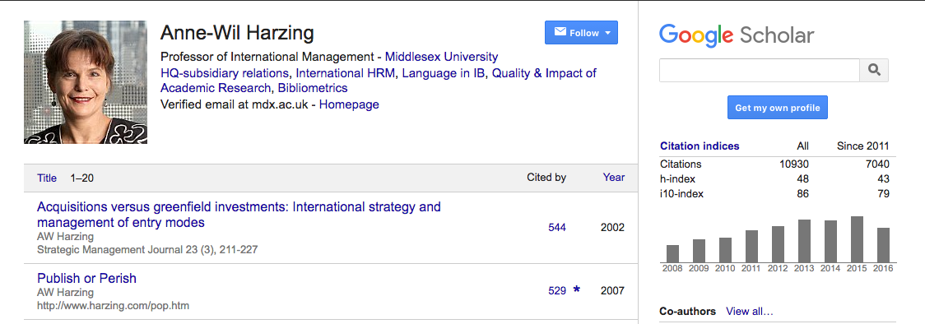
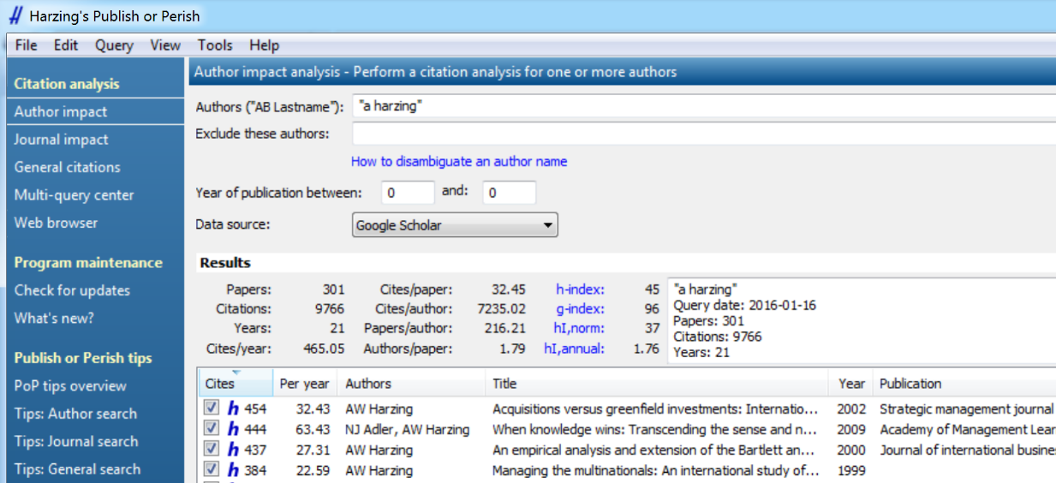

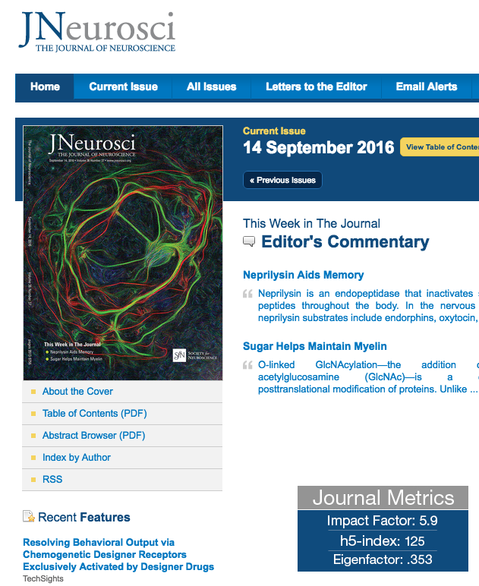
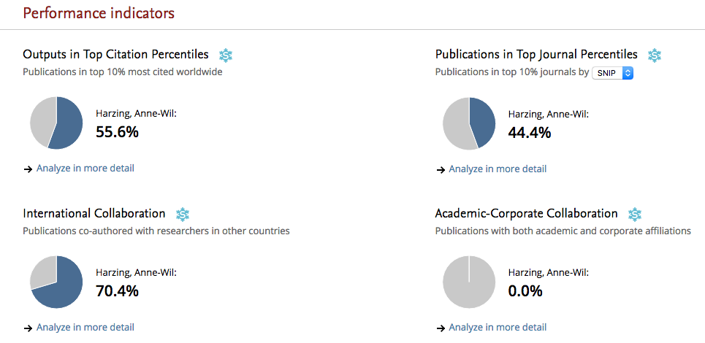

Metrics are everywhere

Slide 3
Everyone talks about…
Productivity (publications counts)
  leads to “salami slicing”, maybe
  quantity vs quality
Impact (citation counts)
  but what impact?
Impact factor
  Speaks to prestige of outlet, not quality of individual paper
h-index
  simplistic
  it’s always highest in Google Scholar

Slide 4
What are we measuring exactly?
San Francisco Declaration on Research Assessment, 2012 (DORA)
  Against using JIF to demonstrate impact of individual publication
H-index problem
  Can we really show impact of a researcher through one number?
Leiden Manifesto (2015)
  Bibliometrics practitioners stating some known truths

Slide 5
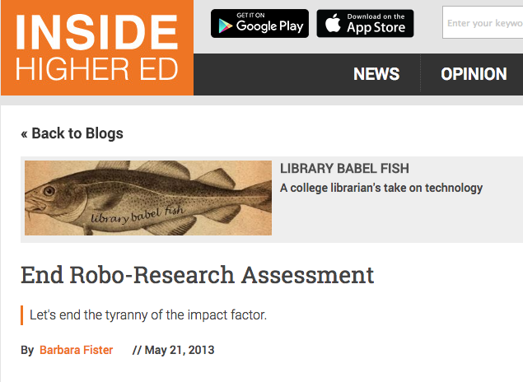
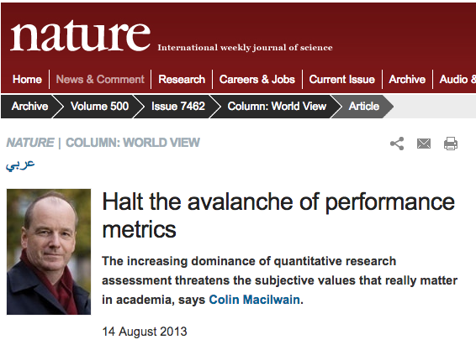

The backlash

Slide 6
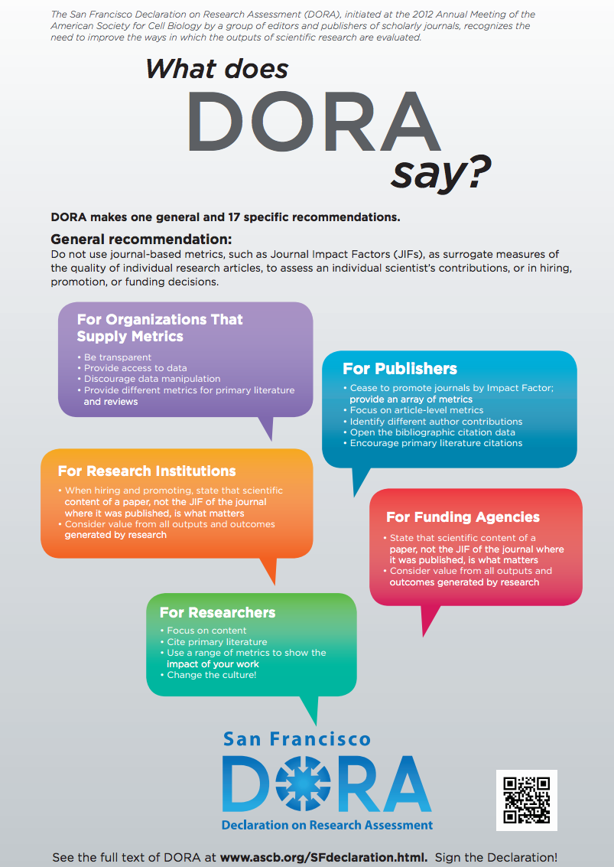
Over 12,000 individual signatories
800 institutional signatories (but not Pitt)
The steps that DORA recommends for universities and research institutions are measured and practical: be clear about the criteria used in researcher assessment; emphasise that a paper’s content is more important than where it is published; make sure to consider the value and impact of all types of research output; and use a broad range of measures when doing so. There is no blanket ban on metrics.
Stephen Curry, Who is afraid of DORA, http://www.researchresearch.com/news/article/?articleId=1360100, 11 May 2016

Slide 7
I am not a number but…
Funders need to be responsible in the way that they use metrics, to resist the reduction of researchers’ careers to decimal points.
Researchers need to learn to use metrics to enhance the narratives that they develop to describe their ambitions and careers.
Providers need to understand that the data, analysis and visualizations they provide have a value over and beyond a simple service.
Mike Taylor, Metrics and The Social Contract: Using Numbers, Preserving Humanity https://www.digital-science.com/blog/perspectives, 26 July 2016

Slide 8
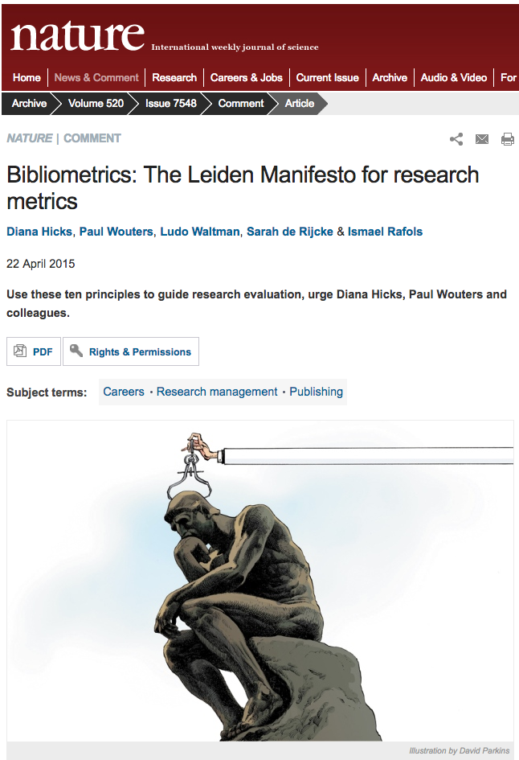

https://vimeo.com/133683418

Slide 9
Principle 1
Metrics-based evaluation can supplement and provide additional dimensions to qualitative assessment, but should never replace it.

Slide 10
Excellence in Research
Australia
ERA is a comprehensive quality evaluation of all research produced in Australian universities against national and international benchmarks. The ratings are determined and moderated by committees of distinguished researchers, drawn from Australia and overseas.
ERA is based on expert review informed by a range of indicators. The indicators used in ERA include a range of metrics such as citation profiles which are common to disciplines in the natural sciences, and peer review of a sample of research outputs which is more broadly common in the humanities and social sciences.

Slide 11
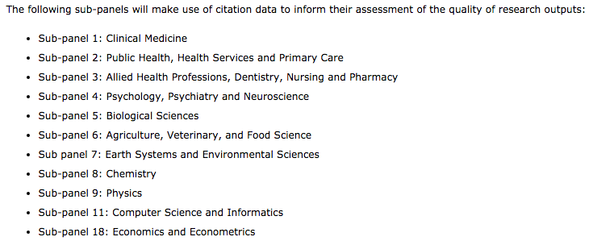
The REF team will provide the following information for each publication year in the period 2008 to 2012, and for each relevant ASJC code:
The average (mean) number of times that journal articles and conference proceedings published worldwide in that year, in that ASJC code, were cited
The number of times that journal articles and conference proceedings in that ASJC code would need to be cited to be in the top 1 per cent, 5 per cent, 10 per cent and 25 per cent of papers published worldwide in that year.

Slide 12
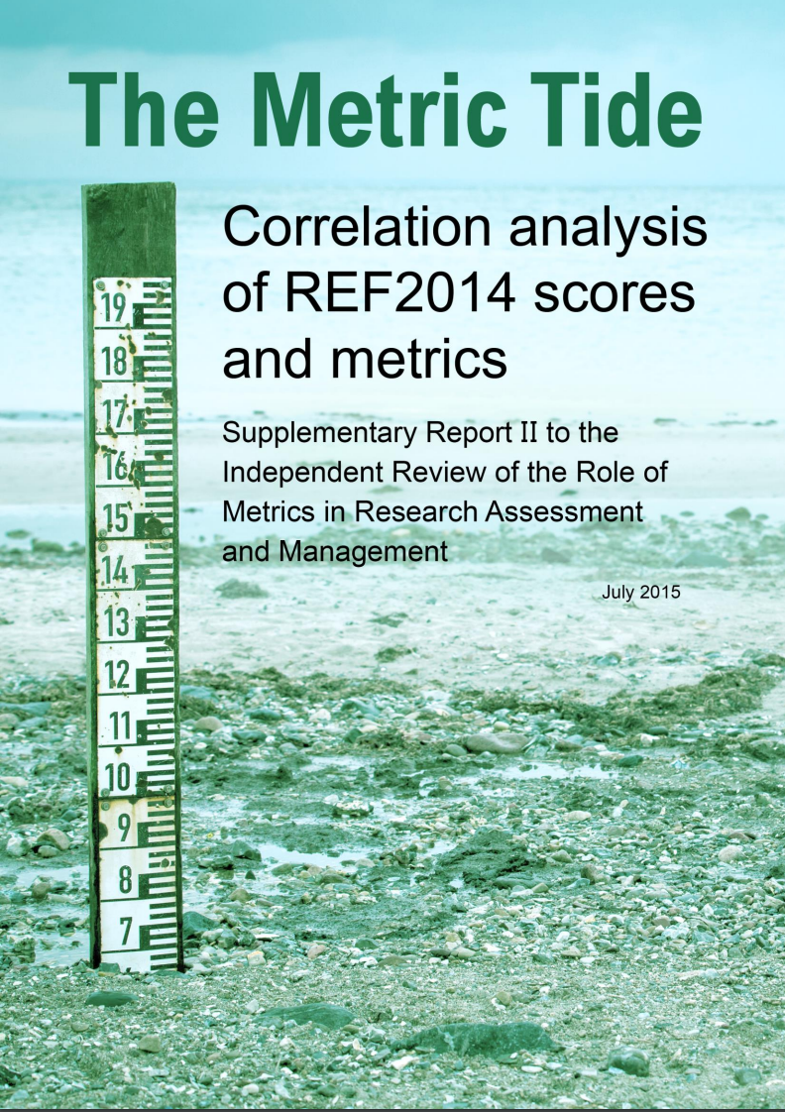
This work has shown that individual metrics give significantly different outcomes from the REF peer review process, showing that metrics cannot provide a like-for-like replacement for REF peer review. Publication year was a significant factor in the calculation of correlation
with REF scores, with all but two metrics showing significant decreases in correlation for more recent outputs. There is large variation in the availability of metrics data across the REF submission, with particular issues with coverage in units of assessment (UOAs) in REF Main Panel D. Finally, there is evidence to suggest issues for early career researchers (ECRs) and women in a small number of disciplines, as shown by statistically significant differences in
the REF scores for these groups at the UOA level.

Slide 13
Principle 2
Metrics used to evaluate research performance should reflect the research objectives of the institution, research groups or individual researchers.
No single metric or evaluation model can apply in all contexts.

Slide 14
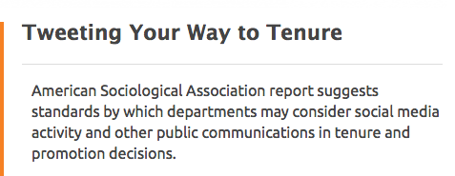
Example: which impact?
https://www.insidehighered.com/news/2016/09/08/, 8 Sept. 2016
Citations
Patents
Commercialisation income
Changed legislation
Created jobs
Improved quality of life
Saved lives
Which impact?
Academic
Social
Economic
Environmental

Slide 15

Example: quality and impact over volume
http://cra.org/resources/best-practice-memos/incentivizing-quality-and-impact-evaluating-scholarship-in-hiring-tenure-and-promotion/

Slide 16
Principle 3
Measure locally relevant research using appropriate metrics, including those that build on journal collections in local languages or that cover certain geographic locations. Big international citation databases (used most frequently to derive data used for constructing indicators) still mostly focus on English-language, western journals.

Slide 17
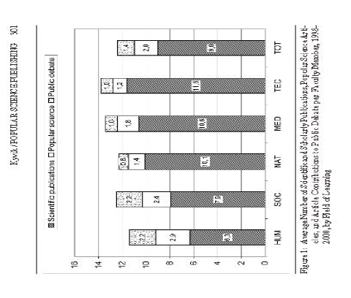
Example: Scientific, popular & public debate publications at Norwegian
HE institutions
http://www.scientometrics-school.eu/images/esss1_Sivertsen.pdf After Kyvik, 2005

Slide 18
Example: Polish Sociology and Spanish Law
Some research NEEDS to be published in local language (culture-creating role and intended audiences are local and/or practitioner)
  Polish sociology in PSCI looks different than that in SSCI (Winclawska,1996/Webster,1998)
  Current assessment regime in Spain (rewarding English-language publications) has a detrimental impact of Spanish law research (Hicks, 2015)

Slide 19
Principle 4
Metrics-based evaluation, to be trusted, should adhere to the standards of openness and transparency in data collection and analysis.
What data are collected? How is it collected? How are citations captured? What are the exact methods and calculations used to develop indicators? Is the process open to scrutiny by experts and by the assessed?

Slide 20
Example: how much of my output is captured?
L. Butler, 2006

Slide 21
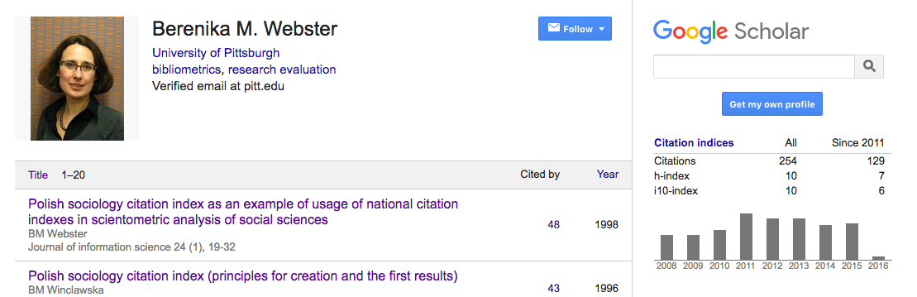
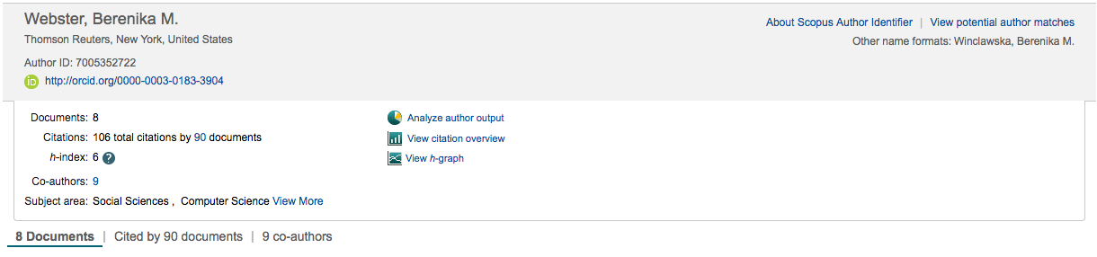
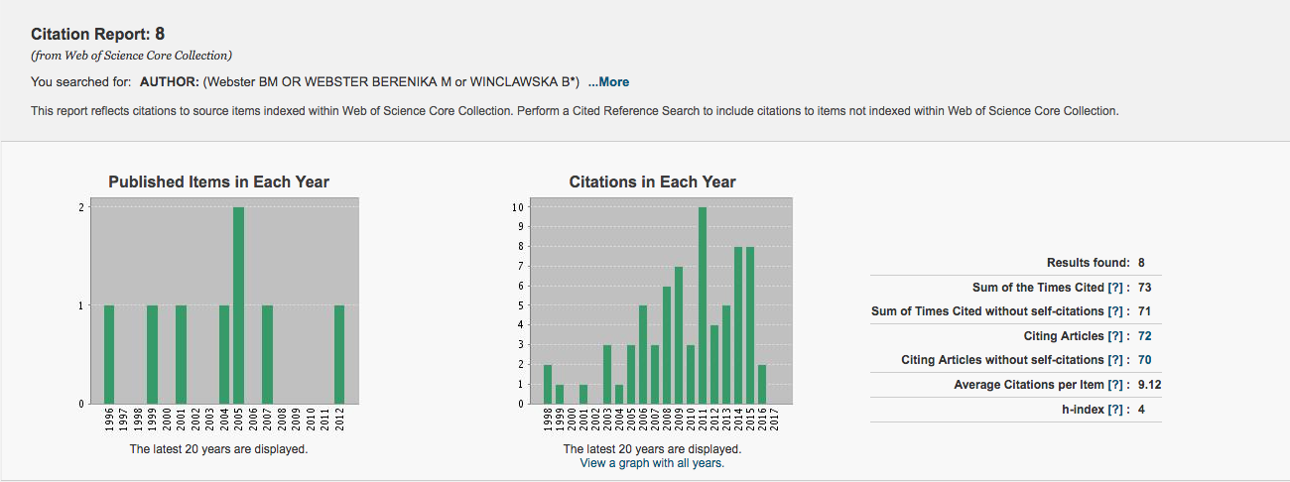

Slide 22
Principle 5
Those who are evaluated should be able to verify data and the analyses used in the assessment process.
  Are all relevant outputs identified, captured and analyzed?

Slide 23

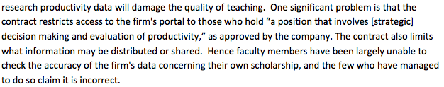
Example

Slide 24

https://facultyinfo.pitt.edu/

Slide 25
Principle 6
Metrics cannot be applied equally across all disciplines

Slide 26
Example: All disciplines are not equal (…bibliometrically)

Slide 27
Psychology – 4.6 CPP
Notes:
a bibliometric profile of a researcher studying causes of lung disease will be rather different from that of a researcher studying the social effects of smoke cessation programs. Health policy research tends to behave more in line with the “softer” disciplines, with fewer citation counts, a more diffuse set of outlets, and top journals with lower impact factor values. In contrast, biomedical research tends to behave more in line with the “harder” sciences (i.e., with higher average citation rates). For instance, the top-ranking health policy journal has a JIF of 4.9 while the top respiratory system journal has a JIF of 12.6

Slide 28
Example: Not all disciplines are equal
Notes:
Some fields are very fast moving, particularly within the life sciences, and published research gets cited at a relatively rapid pace. Research in other fields, mathematics for example, makes its impact more slowly over an extended period of time.

Slide 29
Example: “novel research” (defined by concentration of distant references)
More likely to be in top 1% in its field and more likely be cited by other papers in top 1%
Delayed recognition
Cited outside “home” field
Less likely to be published in top IF journal
Wang J, Veugelers R, Stephan P (2016) Bias against novelty in science: A cautionary tale for users of bibliometric indicators. CEPR Discussion Paper No. DP11228; NBER Working Paper No. 22180.

Slide 30
Principle 7
Do not rely on a single quantitative indicator when evaluating individual researchers.

Slide 31
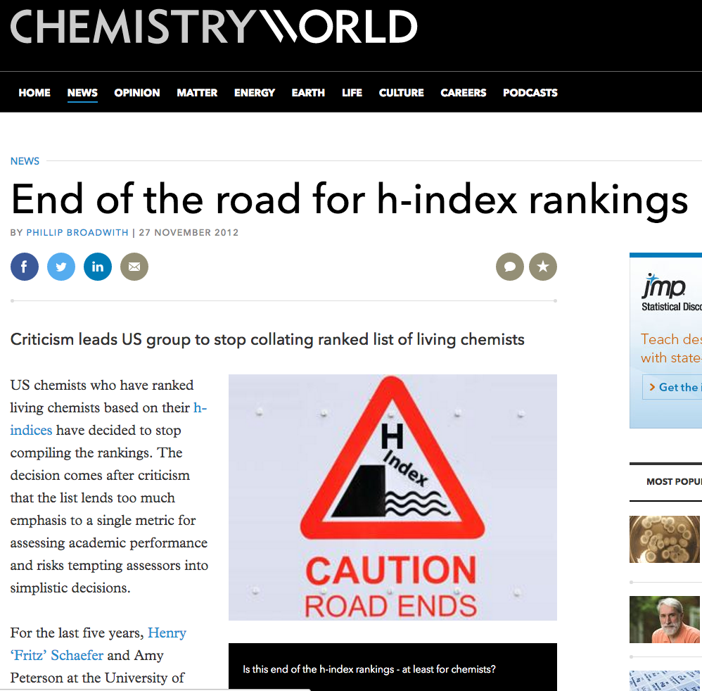
Does not account for:
insensitive to highly-cited publications
citation characteristics of publication outlets
citation characteristics of fields of science
age of publications
type of publications
co-authorship
self-citations
Author 1 | Author 2 | Author 3
15 | 150 | 15
10 | 100 | 10
10 | 50 | 10
5 | 25 | 5
5 | 5 | 5
4 | 1 | 0
4 | 0 | 0
3 | 0 | 0
3 | 0 | 0
1 | 0 | 0

Slide 32
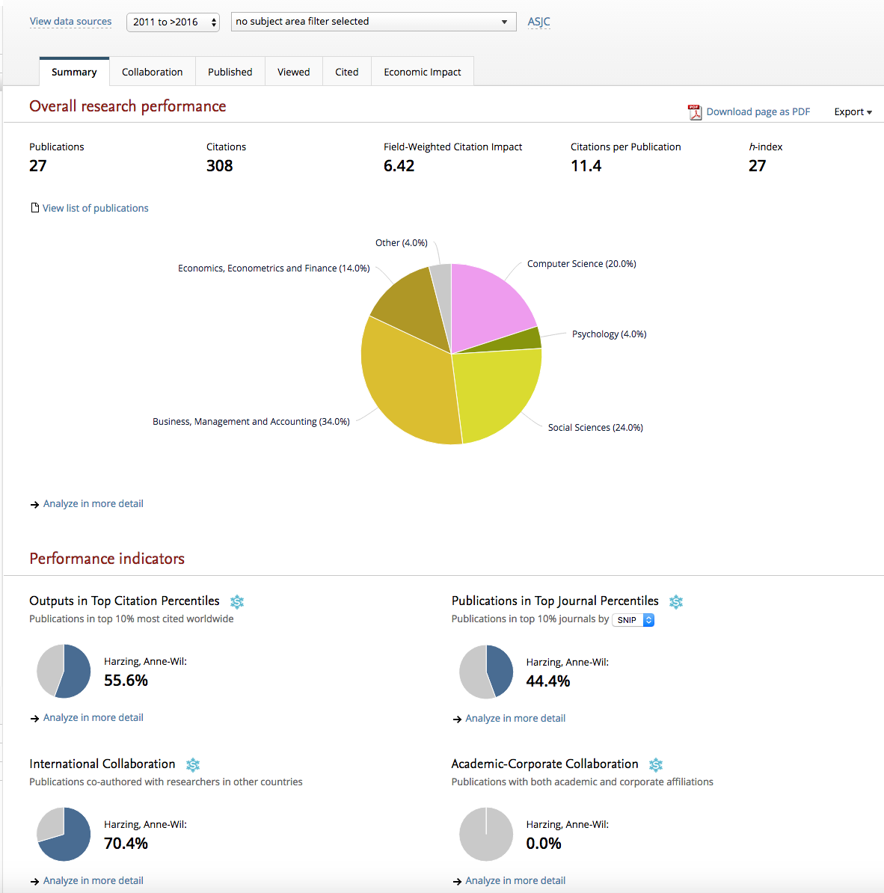
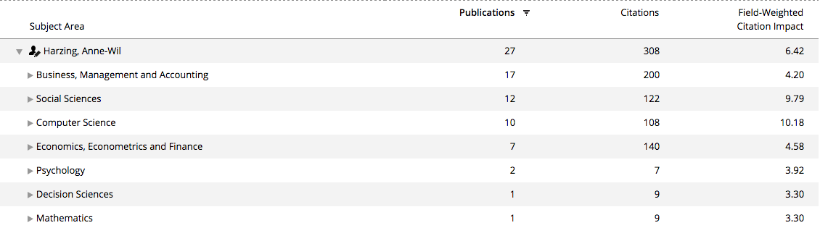
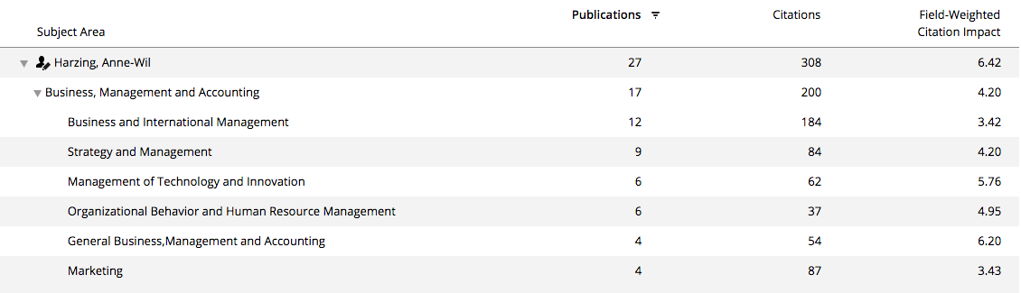
Source: SciVal

Slide 33
Principle 8
Sets of indicators can provide a more reliable and multi-dimensional view than a single indicator.

Slide 34
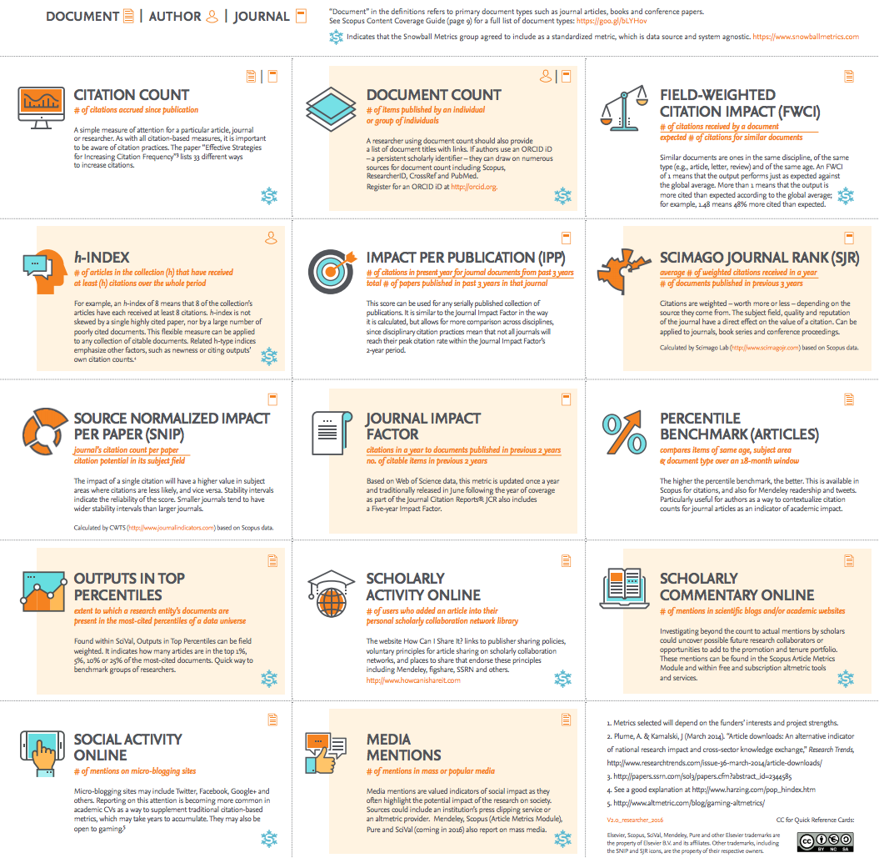
https://libraryconnect.elsevier.com/sites/default/files/ELS_LC_metrics_poster_V2.0_researcher_2016.pdf

Slide 35
Principles 9 and 10
Goodhart’s Law states that, “when a measure becomes a target, it ceases to be a good measure”.
Every evaluation system creates incentives (intended or unintended) and these, in turn, drive behaviors.
Use of a single indicator (like JIF) opens the evaluation system to undesirable behaviors like gaming. To mitigate against these behaviors multiple indicators should be used.
Furthermore, indicators should be reviewed and updated in line with changing goals of assessment, and new metrics should be considered as they become available.
Notes:
A good example of gaming are so-called “citation clubs” designed to artificially increase citation rates to publications, while goal displacement refers the behaviors in which the measurement becomes a goal (e.g., the only criterion for the selection of a publication outlet is its impact factor).

Slide 36
Example: Assessment regime will modify behaviour
Explaining Australia's increased share of ISI publications: the effects of a funding formula based on publication counts (L. Butler, Res Eval, 2003)
“Significant funds are distributed to universities, and within universities, on the basis of aggregate publication counts, with little attention paid to the impact or quality of that output. In consequence, journal publication productivity has increased significantly in the last decade, but its impact has declined.”
Evidence for excellence: has the signal overtaken the substance? An analysis of journal articles submitted to RAE2008 (J. Adams, Digital Science Report, June 2014)
“What researchers actually do under assessment differs from what surveys say they believe about the signals of research excellence. When it comes to the RAE, with the exception of the humanities, academics prioritise journals over other publications, they accelerate publication rates at RAE time, they favour journals with high average citation impact and among those journals they are persuaded that a high Impact Factor beats a convincing individual article.” (p.8)

Slide 37

http://www.library.pitt.edu/bibliometric-services

