Slide 1
Viable Vocabularies
An Introduction to Controlling, Cleaning, and Linking Your Data

Slide 2
Instructors
Metadata and Discovery Unit
Mike Bolam - Head, Metadata & Discovery Unit
Gabi Gulya - Metadata Librarian
Heajin Kim - Authority Control Specialist
Staci Ross - Visiting Cataloging/ Metadata Librarian

Slide 3
Metadata & Discovery Unit
The Metadata and Discovery Unit provides metadata consultation, development, and production support for students, faculty, and staff. As a center for expertise in descriptive, technical, and administrative metadata, we work with researchers at the University of Pittsburgh to support their metadata needs.
If you are starting a new project, want to improve the quality of existing metadata, or want to learn more about what metadata can do for you, specialists in the Metadata and Discovery Unit are available for consultations to help you get started. Training on standards and best practices, using controlled vocabularies, and data cleaning tools are also available through scheduled consultations. Contact us to make an appointment.

Slide 4
Introductions
Introduce yourself and tell us why you are here today.

Slide 5
Learning Objectives
Participants will be able to define controlled vocabulary and identify its purpose in the research process
Participants will be able to find appropriate vocabularies for their research needs.
Participants will be able to select appropriate terms from a controlled vocabulary.
Participants will be able to perform the basic tasks of cleaning and linking data using OpenRefine.

Slide 6
Agenda
Introduction to controlled vocabularies
Finding the best vocabularies to meet your needs
Using controlled vocabularies in your research
Introduction to linked data
Using OpenRefine to clean and link data

Slide 7
Workshop Files
Workshop Slides: http://bit.ly/vv_slides
Workbook: http://bit.ly/vv_workbook
OpenRefine: http://www.openrefine.org
Workshop Data Set: http://bit.ly/vv_data
Named Entity Recognition Extension: http://freeyourmetadata.org/named-entity-extraction/

Slide 8
What are controlled vocabularies?
A controlled vocabulary is "an organized arrangement of words and phrases used to index content and/or to retrieve content through browsing and searching." (Patricia Harpring). To put it simply: "Find out what they call it, then select it." (Allen Smith) There are many types of controlled vocabularies, created and maintained by professionals in the subject area.
It is usually given to content when the content is cataloged/published by a cataloger, publisher or researcher. Therefore, controlled vocabulary is a tool for cataloger/publisher/ researcher to organize information,and it is a key to easily retrieve accurate information for the user.

Slide 9
What about thesauri?
A thesaurus represents all the concepts for a specific domain in a consistent manner and labels each concept with a preferred term
Controlled term, but includes synonyms and variant labels
Discipline-specific
Hierarchical relationships between concepts are expressed
Example: “apartments” from Getty’s Art & Architecture Thesaurus (AAT)
apartments
Hierarchical Position:
Objects Facet
.... Components (hierarchy name) (G)
........ components (objects parts) (G)
............ <components by specific context> (G)
................ building divisions (G)
.................... rooms and spaces (G)
........................ <rooms and spaces by location or context> (G)
............................ interior spaces (spaces by location) (G)
................................ combinations of rooms (G)
.................................... apartments (G)
Keywords and tags may not come from controlled terms, so there is a higher chance of variance and inconsistency
Notes:
Thesauri definition source:
van Hooland, S. and Verborgh, R. (2017) “Linked Data for Librarians.” Available at http://course.freeyourmetadata.org/

Slide 10
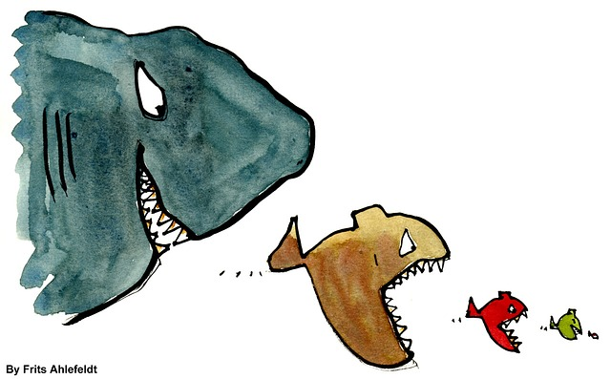
What about taxonomies?
A taxonomy is “the rules or conventions of order or arrangement”
Allows for classification according to a pre-determined system.
Helps you organize your data into hierarchical relationships
Example : King Philip Came Over For Good Soup : Kingdom -> Phylum -> Class -> Order -> Family -> Genus -> Species.
Lambe, P. (2007). Organising Knowledge: Taxonomies, Knowledge and Organisational Effectiveness. Oxford, UK: Chandos.

Slide 11
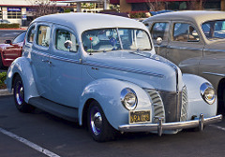
Examples of controlled vocabulary and natural words (from LC headings)
AUTOMOBILES
SUVs
Sedans
Sports cars
Notes:
Headings source:
Library of Congress Subject Headings (LCSH). Library of Congress Linked Data Service. http://id.loc.gov/authorities/subjects.html

Slide 12
Controlled Vocabulary Activity

Slide 13
Why use controlled vocabularies in your research?
The need for controlled vocabulary is caused by the ambiguity of our language.
We are often confused by different places or persons having the same names. We sometimes use the same terms in unrelated disciplines. And there are variant spellings for the same word.

Slide 14
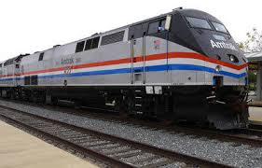
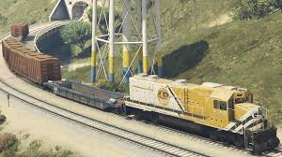
Examples of controlled vocabulary and natural words (from LC headings)
Railroad trains
Passenger trains
Freight trains

Slide 15
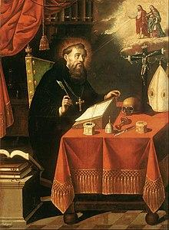
Examples of controlled vocabulary and natural words (from LC headings)
Aurelius Augustine,
St. Augustine,
St. Augustine of Hippo,
St. Augustine Bishop of Hippo
Augustine, of Hippo, Saint, 354-430
Notes:
Headings source:
Library of Congress Name Authority File (NAF). Library of Congress Linked Data Service. http://id.loc.gov/authorities/names.html

Slide 16
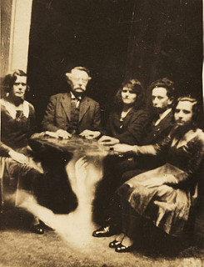
Channeling : in Physics vs. in Spiritualism
Channeling (Physics)
Channeling (Spiritualism)
Notes:
Channelling [in Physics] is the process that constrains the path of a charged particle in a crystalline solid (Wikipedia)
Headings source:
Library of Congress Subject Headings (LCSH). Library of Congress Linked Data Service. http://id.loc.gov/authorities/subjects.html
Image sources:
"Si110 channeling4 zoom800.png" by Knordlun. CC BY-SA 3.0. Accessed 2018-03-13. https://commons.wikimedia.org/wiki/File:Si110_channeling4_zoom800.png
"hope-seance" by The Public Domain Review. In the public domain. Accessed 2018-03-13. https://www.flickr.com/photos/publicdomainreview/15071439170

Slide 17
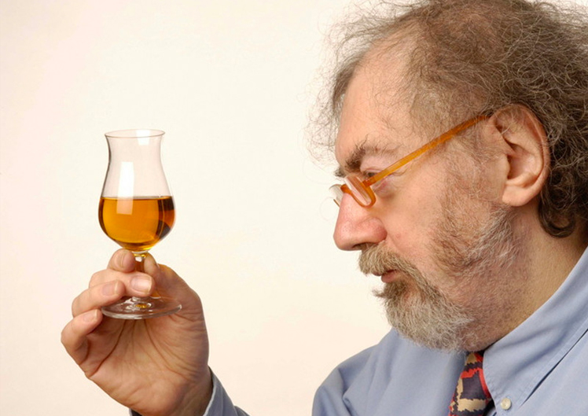
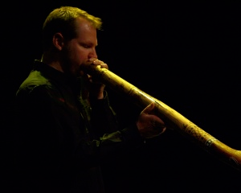
Michael Jackson, who is…..
a whisky expert, singer, and didjeridu player?
Jackson, Michael (Didjeridu player)
Jackson, Michael, 1942-2007
Jackson, Michael, 1958-2009
Notes:
Headings source:
Library of Congress Name Authority File (NAF). Library of Congress Linked Data Service. http://id.loc.gov/authorities/names.html
Image sources:
“Michael Jackson, the Whisky Chaser” [screenshot from documentary, The Whisk(e)y Chaser] by John Richards. Accessed 2018-03-14. https://www.kickstarter.com/projects/wandermedia/whiskey-chaser
“Jackson performing in 1992” by Casta03. CC BY-SA 3.0. Accessed 2018-03-14. https://en.wikipedia.org/wiki/Michael_Jackson#/media/File:Michael_jackson_1992.jpg
“Michael Jakson” Copyright © Amanda Handel, 2012. Accessed 2018-03-14. http://www.gardensofstone.com.au/performers.html

Slide 18
Advantages of using controlled vocabulary
Using controlled vocabulary can make your research more findable. When you use controlled vocabulary in your searches, you can get more meaningful results.
“gardening to attract butterflies” vs. “butterfly gardening”

Slide 19
Advantages of using controlled vocabulary
Controlled vocabulary can be used in any industry that collects and uses information: research, libraries, corporations, etc.
ex: The World Bank - WBG Thesaurus, WBG Business Taxonomy, WBG Topical Taxonomy [vocabulary.worldbank.org]

Slide 20
Advantages of using controlled vocabulary
Controlled vocabulary decreases possible misunderstandings in your research when a user searches for it. If you do research on a certain city, and there are several other cities having the same name, and you would be able to clarify which city it is in a glance.

Slide 21
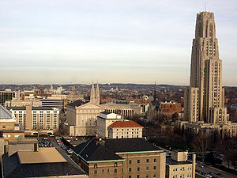
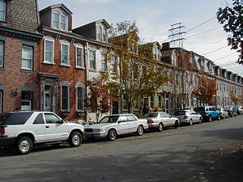
Advantages of using controlled vocabulary
Pittsburgh (Pa. )
Oakland (Pittsburgh, Pa.)
South Side (Pittsburgh, Pa.)

Slide 22
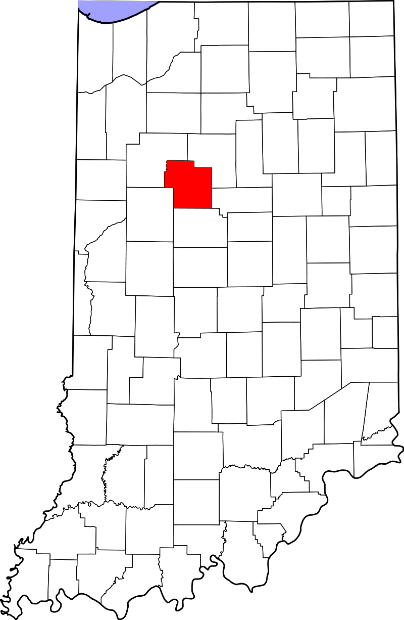
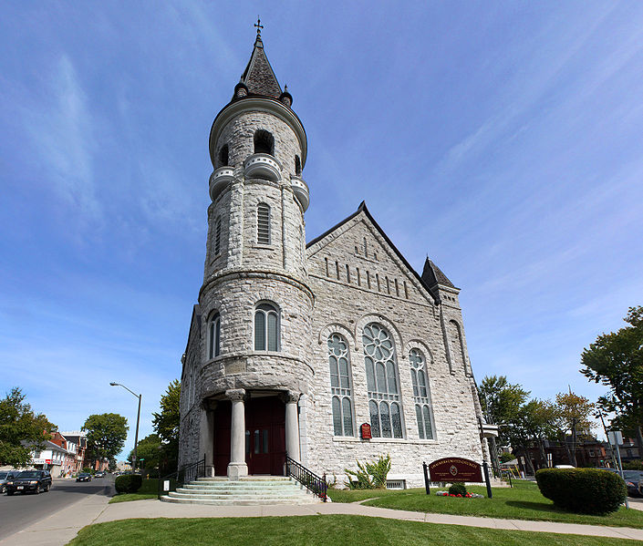
Have you ever been to Pittsburgh?
Pittsburgh (Ont.)
Pittsburgh (Pa.)
Pittsburgh (Sullivan County, Ind.)
Notes:
Headings source:
Library of Congress Subject Headings (LCSH). Library of Congress Linked Data Service. http://id.loc.gov/authorities/subjects.html

Slide 23
No more confusion!
To avoid misunderstandings we need to differentiate persons and places, confirm the usage of terms in a certain discipline and choose one spelling over the others.
Controlled vocabulary made by authorized institutions diminishes these uncertainties, which makes searches more efficient.

Slide 24
Vocabulary Finding Activity

Slide 25
Method to find the best vocabularies
If there is an existing controlled vocabulary list in your discipline…. (such as LC headings, Art & Architecture Thesaurus, MeSH etc.)
Go to one of the lists of controlled vocabularies for your discipline.
Think of possible term(s) of your research.
Search for those terms in the list.
When you get the search result, read the explanation carefully.
If a search result is different from your expectation, try synonyms/variants of the terms you had searched until you find a right one.
*When you need to choose a term, you can consider the purpose of your research, possible users, and relevance to existing research.

Slide 26
Finding Vocabularies
RDA Metadata Standards Directory lists hundreds of standards, extensions, tools, and use cases. The directory can be browsed by discipline and subject area.
Seeing Standards: A Visualization of the Metadata Universe provides a visualization of relationships between over 100 metadata standards used by cultural heritage organizations (libraries, museums, archives, galleries, etc.) The glossary provides links and brief descriptions for each of the standards represented.
Digital Curation Centre's Disciplinary Metadata links to information about these disciplinary metadata standards, including profiles, tools to implement the standards, and use cases of data repositories currently implementing them.
Metadata & Discovery @ Pitt LibGuide

Slide 27
Selected controlled vocabularies by discipline
General purpose
Names
Library of Congress Name Authority File (LCNAF)
Virtual International Authority File (VIAF)
Concepts, Objects, Topics, etc.
Library of Congress Subject Headings (LCSH)

Slide 28
Selected controlled vocabularies by discipline
Art & Humanities
Art & Architecture Thesaurus
Rare books and special collections vocabulary
Union List of Artist Names (ULAN) - bibliographic info about artists and architects
Getty Thesaurus of Geographic Names (TGN) - names of places important for the study of art and architecture.
Library of Congress Thesaurus for Graphic Materials (LCTGM)
UNESCO Thesaurus

Slide 29
Selected controlled vocabularies by discipline
Transportation Information
Transportation Research Thesaurus (TRT) developed by the National Transportation Library
Sciences
International Classification of Disease (ICD)
Medical Subject Headings (MeSH)
National Agriculture Library Thesaurus (NALT)
Unified Astronomy Thesaurus (UAT) from the American Astronomical Society

Slide 30
Linked Data:
An Introduction

Slide 31
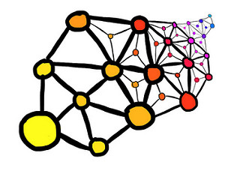
What is Linked Data?
Linked data is the framework behind the Semantic Web, which uses metadata to infer relationships between entities: people, concepts, and resources
In the Linked Data environment, controlled vocabularies include URIs (Uniform Resource Identifiers) to help humans and computers identify and reconcile names, concepts, and objects
Notes:
Image source
“Linked data” by elcovs. Licensed under CC BY-SA 2.0. Accessed 2018-03-19. https://flic.kr/p/gbA7WS

Slide 32
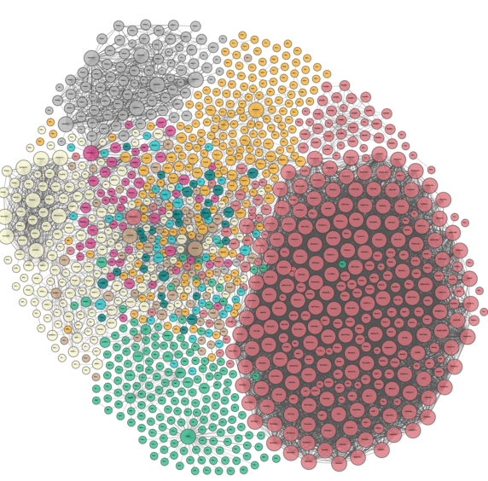
Four Rules for the Semantic Web
Use URIs as names for things (e.g., names, concepts, relationships).
Use web URIs so that people can look up those names.
When someone looks up a URI, provide useful information, using standards like controlled vocabularies.
Include links to other URIs, so users and computers can discover more things.
Notes:
Source: Berners-Lee, Tim. 2006-07-27. “Linked Data.” Last revised on 2009-06-28. https://www.w3.org/DesignIssues/LinkedData.html
Image source:
“Linking Open Data cloud diagram” (2017) by Andrejs Abele, John P. McCrae, Paul Buitelaar, Anja Jentzsch and Richard Cyganiak. CC-by-SA. Accessed 2018-03-13. http://lod-cloud.net/"

Slide 33
So… what is a URI?
A URI, or Uniform Resource Identifier, is a unique, controlled term used to identify something
Types of URIs:
URN (Uniform Resource Name): identifies an entity by name in a particular namespace
Example: Twain, Mark, 1835-1910 (VIAF)
Example: Mark Twain (Wikidata)
URL (Uniform Resource Locator): identifies an entity by a web address
Example: https://viaf.org/viaf/50566653

Slide 34
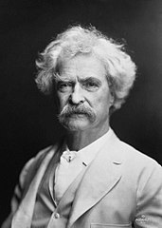
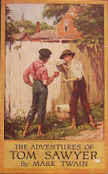
What about triples?
Relationships between entities are structured as three-part subject-predicate-object statements, called triples
Example: Mark Twain -- is author of -- The Adventures of Tom Sawyer
In a linked data system, each part of a triples statement is expressed as a URI, so computers can infer relationships between entities
Mark Twain
isAuthorOf
The adventures of Tom Sawyer

Slide 35
Triples and URIs
URN:
Twain, Mark, 1835-1910
isAuthorOf
The adventures of Tom Sawyer
is equivalent to
https://viaf.org/viaf/50566653
http://schema.org/author
https://viaf.org/viaf/178211495
URL:

Slide 36
Expressing Triples through Turtle
One way to express triples is through Turtle (Terse RDF Triple Language), which is both machine- and human-readable
Turtle provides a concise way to group three URIs to make a triple, and provides ways to abbreviate such information, for example by factoring out common portions of URIs

Slide 37
Example of Triples Expressed as Turtle
<http://www.w3.org/People/Berners-Lee/card#i>
<http://www.w3.org/1999/02/22-rdf-syntax-ns#type>
<http://xmlns.com/foaf/0.1/Person> .
<http://www.w3.org/People/Berners-Lee/card#i>
<http://xmlns.com/foaf/0.1/name>
"Tim Berners-Lee"@en .
<http://www.w3.org/People/Berners-Lee/card#i>
<http://xmlns.com/foaf/0.1/name>
"Τιμ Μπέρνερς Λι"@gr .
Same as -
@prefix foaf: <http://xmlns.com/foaf/0.1/> .
<http://www.w3.org/People/Berners-Lee/card#i> a foaf:Person ;
foaf:name "Tim Berners-Lee"@en , "Τιμ Μπέρνερς Λι"@gr .
Notes:
Both of these statements are written in Turtle. The three triples on top state that Tim Berners-Lee is a person, and has the name “Tim Berners-Lee” in English (language code “en”) and “Τιμ Μπέρνερς Λι” in Greek (language code “gr”).
The same triples are expressed more concisely on the bottom, using the @prefix in Turtle to shorten the URLs.
Example source: dig.csail.mit.edu/2010/Courses/6.898/resources/lab2_solutions.pdf

Slide 38
Example of Triples Expressed as Turtle
@prefix foaf: <http://xmlns.com/foaf/0.1/> .
@prefix rdfs: <http://www.w3.org/2000/01/rdf-schema#> .
@prefix corp: <http://www.example.org/corp#> .
<http://www.pipian.com/people/pipian/card#me> a foaf:Person;
foaf:name "Ian Jacobi"@en, "イアン・ジャコービ"@jp ;
foaf:age 24 ;
<http://purl.org/vocab/relationship/collaboratesWith> [
is corp:director of [
rdfs:label "World Wide Web Consortium"@en ] ] .
Notes:
There are seven triples above:
@prefix foaf: <http://xmlns.com/foaf/0.1/> .
@prefix rdfs: <http://www.w3.org/2000/01/rdf-schema#> .
@prefix corp: <http://www.example.org/corp#> .
@prefix xsd: <http://www.w3.org/2001/XMLSchema#> .
@prefix : <http://www.pipian.com/people/pipian/card#me> .
:me a foaf:Person .
:me foaf:name "Ian Jacobi"@en .
:me foaf:name "イアン・ジャコービ"@jp .
:me foaf:age "24"^^xsd:int .
:me <http://purl.org/vocab/relationship/collaboratesWith> _:director .
_:w3c corp:director _:director .
_:w3c rdfs:label "World Wide Web Consortium"@en .
It (roughly) says that Ian Jacobi is a person whose name is “Ian Jacobi” in English
(language code “en”) and “イアン・ジャコービ” in Japanese (language code “jp”),
collaborates with someone who is a director of something named the “World Wide Web
Consortium.”
Example source: dig.csail.mit.edu/2010/Courses/6.898/resources/lab2_solutions.pdf

Slide 39
Linking Data: Reconciliation
Vocabulary reconciliation is a process where automated systems use terms from unstandardized metadata to search controlled vocabularies and return URIs.
Reconciliation is an integral part of linking data to other datasets.

Slide 40
OpenRefine for Data Cleaning and Linking

Slide 41
OpenRefine is powerful tool for working with messy data: cleaning it; transforming it from one format into another; and extending it with web services and external data.
You can use OpenRefine to:
Get an overview of a data set
Split data up into more granular parts
Clean up tabular data by removing inconsistencies in format and terminology
Enhance a data set with data from other sources

Slide 42
Installing OpenRefine
http://www.openrefine.org → Download → OpenRefine 2.8
Windows Kit
Download the ZIP archive.
Unzip & extract the contents of the archive to a folder of your choice.
To launch OpenRefine, double-click on openrefine.exe.
Mac Kit
Download the DMG file.
Open the disk image & drag the OpenRefine icon into the Applications folder.
Double-click on the icon to start OpenRefine.

Slide 43
Installing OpenRefine
OpenRefine runs locally on your computer. It does not require an internet connection, unless you want to reconcile your data with external sources.
If you close your browser, you can get back to OpenRefine by pointing it here: http://127.0.0.1:3333/ or http://localhost:3333
Your data is not stored online or shared with anyone.

Slide 44
Sample Data Set
The data set we’ll be using is a subset of the Powerhouse Museum Objects Database, which was made available under a CC-BY-NC license. The original data set has over 75,000 objects, but for simplicity, the test data set is a csv file with 1095 objects.
http://bit.ly/vv_data

Slide 45
OpenRefine Activity

Slide 46
Getting Started
Creating a project
File formats, create/open/import
Exploring your data
Rows, column headers, menus, “All” column, quick data review to make sure it looks ok
Manipulating columns
Collapse, expand, rearrange, remove

Slide 47
Analyzing and Fixing Data
Faceting
Facet by text on height (we’ll do more with this later)
Facet by blank on categories
Duplicates facet on record id
Text filter
Find a word or phrase (e.g. USA in title)

Slide 48
Analyzing and Fixing Data
Simple Cell Transformations
Demo Trimming whitespace on Title
Explain collapse consecutive/Unescape HTML/etc.
Splitting Multivalue cells
Categories - demo facet unsplit
Split - demo facet again

Slide 49
Analyzing and Fixing Data
Understanding row vs. record
Demo with categories facet. Sometimes you want to be working with records and sometimes you want to be working with rows.
Clustering
Demo clustering with split categories. Make sure facets are cleared.

Slide 50
Linking to Another Data Set
Linking to Wikidata (built into OpenRefine 2.8)
Wikidata is a free and open knowledge base that can be read and edited by both humans and machines.
Wikidata acts as central storage for the structured data of its Wikimedia sister projects including Wikipedia, Wikivoyage, Wikisource, and others.
Wikidata also provides support to many other sites and services beyond just Wikimedia projects! The content of Wikidata is available under a free license, exported using standard formats, and can be interlinked to other open data sets on the linked data web.

Slide 51
Linking to Another Data Set
Add column “CatId” based on this column: “https://www.wikidata.org/wiki”+cell.recon.match.id
The wikidata reconciliation is returning the id. We want the URI
cell.recon = an object encapsulating the reconciliation results for that cell
recon.match = null, or the recon candidate that has been matched against this cell
id = the captured identifier for the object
Merge:
Add column “CatAndId” based on this column two columns
cells['Categories'].value + ' (' + cells['CatId'].value + ')'
Join cells

Slide 52
Named Entity Extraction
Reconciliation works when your data is already in a structured format.
However, many fields (e.g. “description”) contain unstructured text, yet they usually convey a high amount of interesting information. To capture this in machine-processable format, named entity recognition can be used.

Slide 53
Named Entity Extraction Extension
http://freeyourmetadata.org/named-entity-extraction/ → Refine extension → Download
Download ner-extension.zip and unzip it
Copy the unzipped folder to your extensions folder
To find your extensions folder, choose Browse workspace directory from the Refine interface, and navigate to the folder extensions (which you should create if it doesn't exist yet).
Start or restart Refine.
Open or create a project
Restart OpenRefine
Open your project

Slide 54
Named Entity Extraction
Run on Description Field
Demonstrate links to DBPedia
DBpedia (from "DB" for "database") is a project aiming to extract structured content from the information created in the Wikipedia project. This structured information is made available on the World Wide Web. DBpedia allows users to semantically query relationships and properties of Wikipedia resources, including links to other related datasets. Tim Berners-Lee described DBpedia as one of the most famous parts of the decentralized Linked Data effort.
Get uri --
Add column based on this column: cell.recon.match.id
Join cells back together

Slide 55
Named Entity Extraction
Get uri --
Add column “NERId” based on this column: cell.recon.match.id
Merge:
Add column “CatAndId” based on this column two columns
cells['DBpedia Spotlight'].value + ' (' + cells['NERId'].value + ')'
Join cells

Slide 56
Exporting a Project
Top left menu-
Export project lets you save everything, including history of edits (undo/redo). Share with others or move to another device
Variety of data export options
Triple Loader and MQLWrite – must align with pre-existing schema (outside scope)
Custom table exporter – Tight control over export. Can select and order columns exported, control date format, reconciliation results
Templating – More advanced control using JSON (outside scope)

Slide 57
Questions?

