Slide 1
Facsimile Finder
for Libraries
Giovanni Scorcioni | Facsimile Finder | giovanni@facsimilefinder.com
Kiana Jones | Fine Arts Librarian, University of Pittsburgh | krg51@pitt.edu

Slide 2
What is FacsimileFinder.com ?
Commercial website for selling medieval ms. facsimiles
Structured as a catalog, built with scholars and libraries in mind
Consolidate all useful information on facsimiles:
Historical information on the original manuscript
Bibliographic info on the facsimile
Pricing
… and then librarians started to use Facsimile Finder in a creative and unexpected way!

Slide 3
So, what is Facsimile Finder for Libraries?
The Baffling Nature of Medieval Manuscript Facsimiles
Modern printed book that strives to represent an ancient relic
Tends to be lost or difficult to find in library catalogs
Librarians feel the need to create separate lists to manage facsimiles
Lists are used to make the facsimiles known to the scholarly community
Facsimile Finder for Libraries is a database of all medieval manuscript facsimiles available in a university library. The database connects seamlessly to the library’s catalog to help patrons discover the manuscript facsimile holdings.

Slide 4
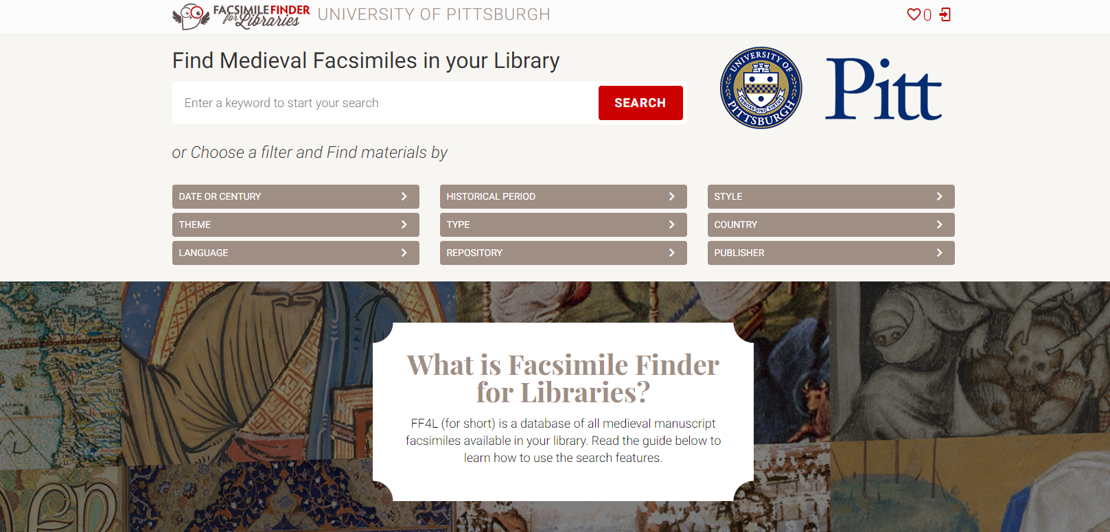

Slide 5
What Makes it Unique?
Manuscript Feature Search
Keyword Search
Brief Historical Background of Manuscripts
High Quality Facsimile Images and Videos
Facsimile Edition Bibliographic Description
Connects Directly to Library Catalog
Notes:
Manuscript Feature Search

Slide 6
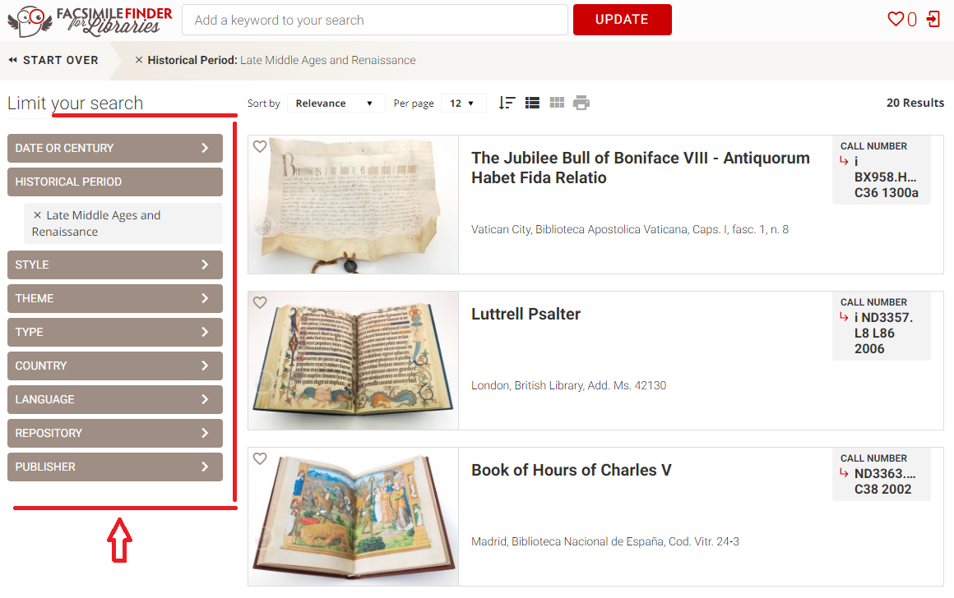
Manuscript Feature Search

Slide 7
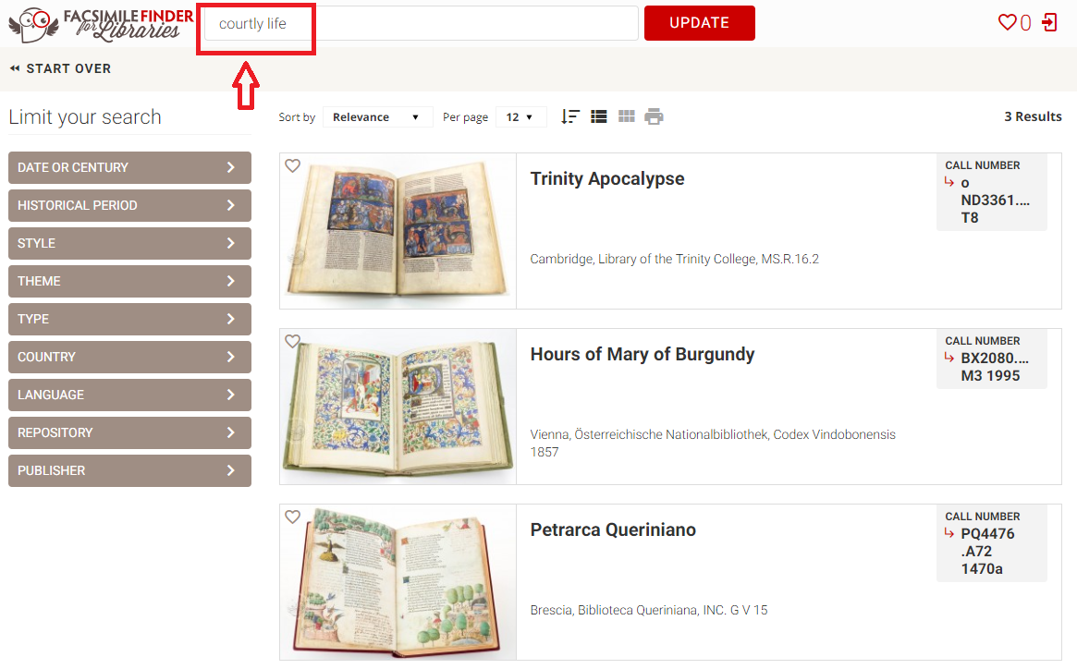
Keyword Search
Notes:
Keyword Search

Slide 8
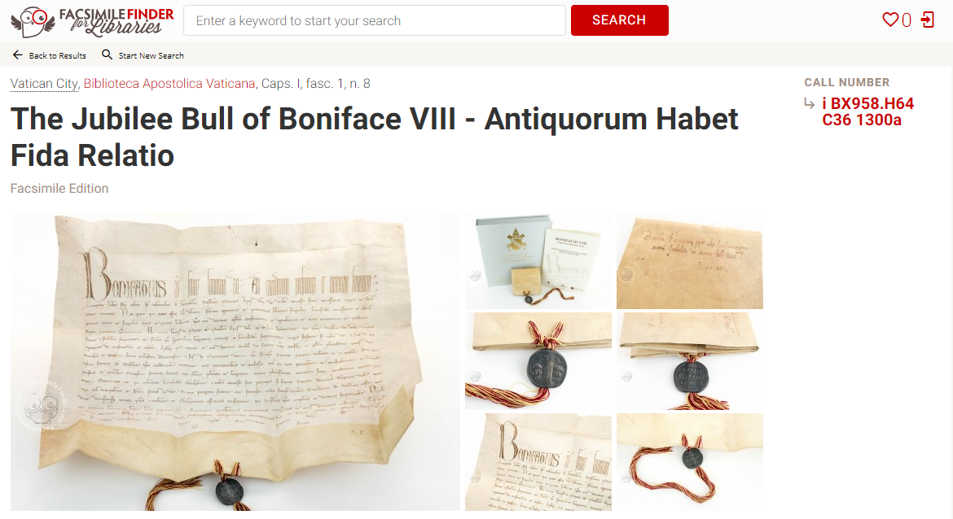
High Quality Facsimile Images

Slide 9
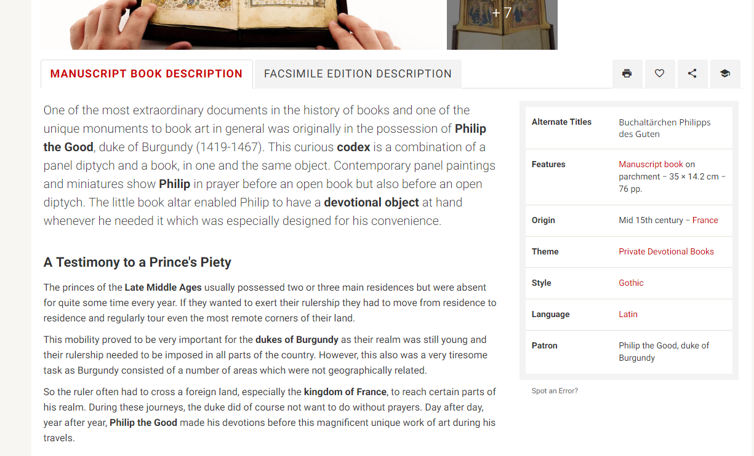
Historical Background of Manuscripts

Slide 10
Facsimile Edition Description

Slide 11
Connects Directly to Library Catalog

Slide 12
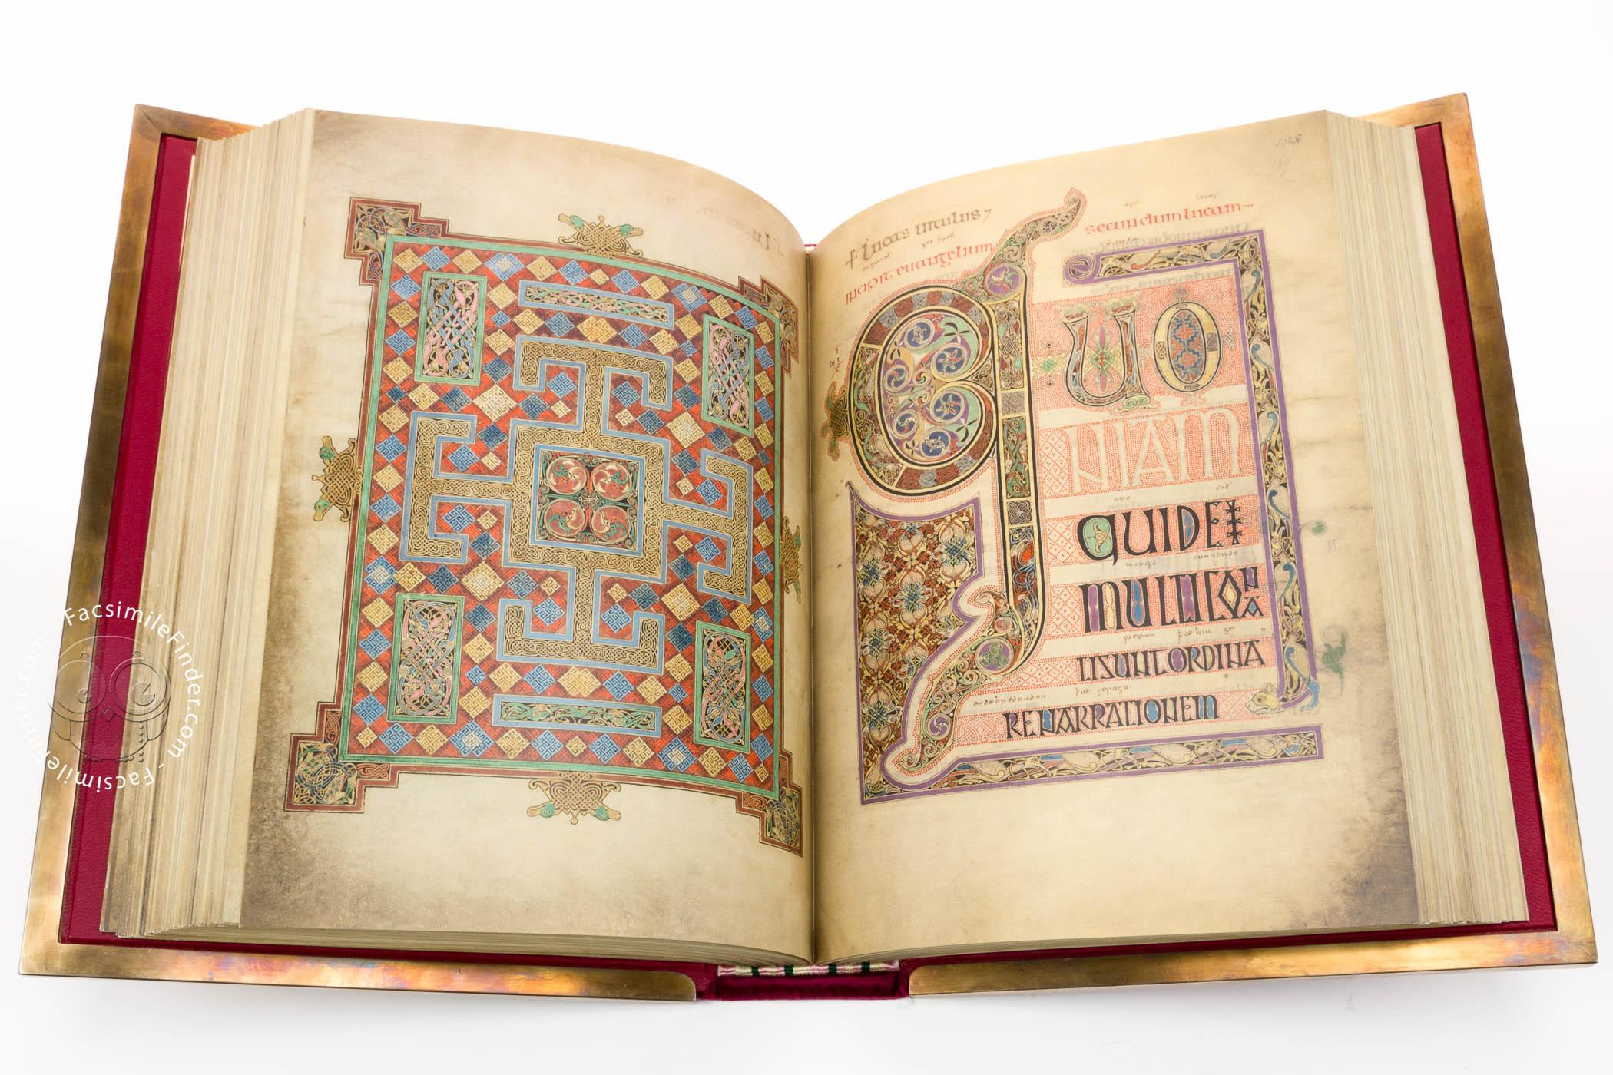
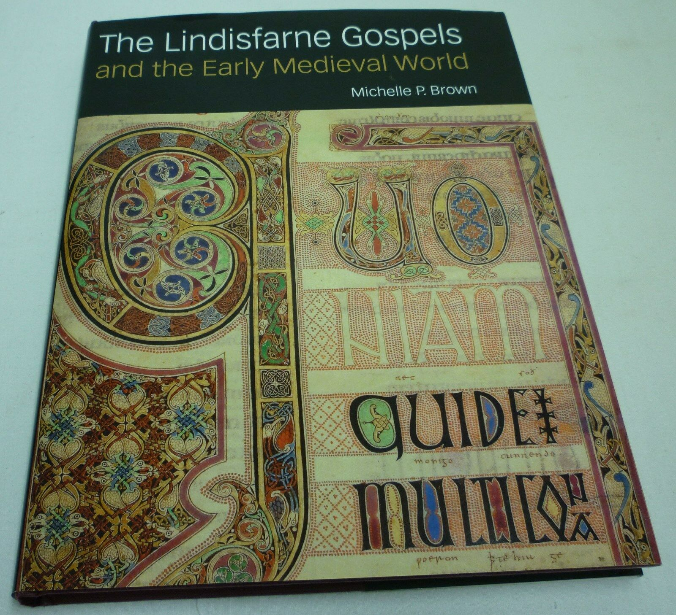
Both are described as facsimiles in library catalog records
Facsimile
“Facsimile”

Slide 13
Case Study: Building a Test Site for the University of Pittsburgh
What we started with was a spreadsheet created by graduate Art History student Alison McCann about 4 years ago
The limited access spreadsheet is used regularly by student researchers and faculty to find facsimiles in the collection.
The spreadsheet has been used by Archival Scholars for research purposes (Claudia Haines, Kenneth Wahrenberger).
Giovanni was given access to our spreadsheet and built a Facsimile Finder for Libraries test site for us.

Slide 14
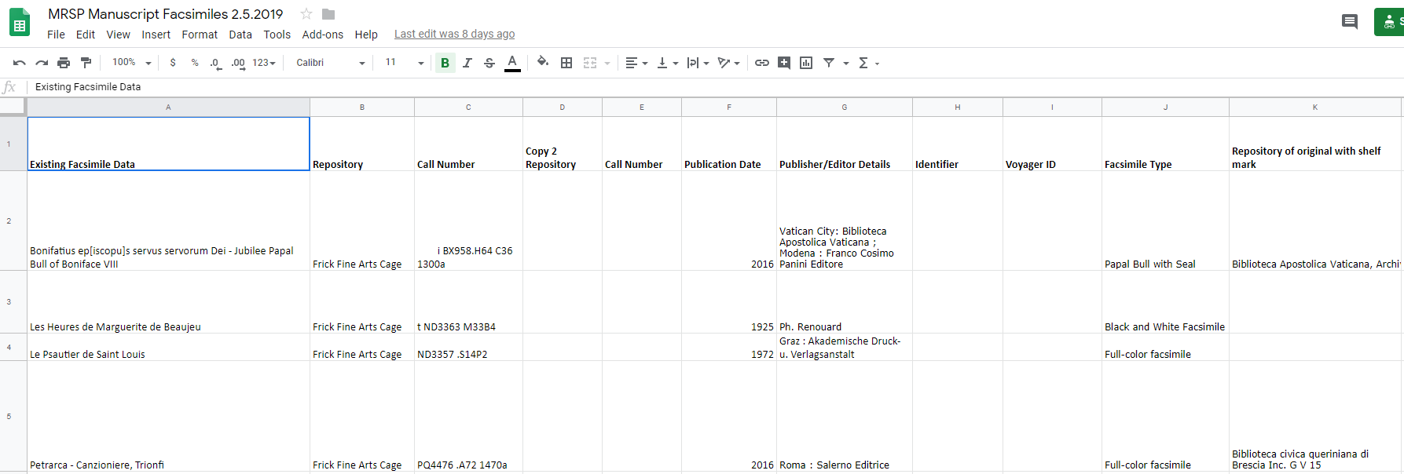
Our Manuscript Facsimile Spreadsheet

Slide 15
First Step: Facsimile Edition Analysis Surveys
Pitt’s spreadsheet had a lot of older facsimiles, as well as facsimiles that did not have enough descriptive cataloging for Giovanni’s team to be able to tell what kind of facsimiles they were.
A facsimile edition analysis survey designed by Giovanni’s team was filled out for each of these.
The majority of these surveys were filled out by Kiana’s Archival Scholar this semester, Kenneth Wahrenberger, whose research focused on facsimiles as reproductions and how interacting with reproductions might change the experience of viewers.
The surveys aided Kenneth and Kiana in becoming more familiar with facsimile edition types, and helped Giovanni’s team learn more about our holdings and decide which items were actual facsimiles and worthy of the database.

Slide 16
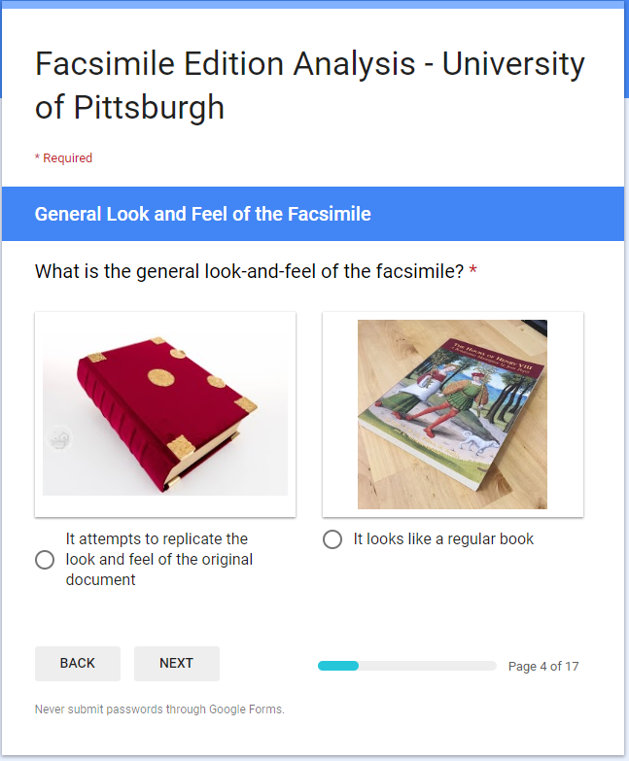
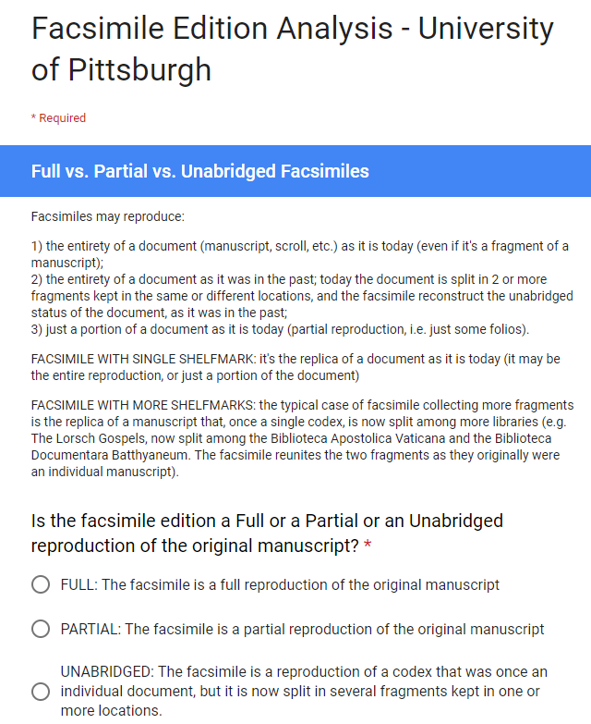

Slide 17
Faculty and Student Feedback
After the test site was launched, Kiana met with key stakeholders including Pitt’s Head of Special Collections and Archives Jeanann Haas, Music Librarian Jim Cassaro, Head of the Frick Fine Arts Library Kate Joranson, and Medieval and Renaissance Studies Librarian Clare Withers to gather feedback on long term implications and questions, and to discuss vital faculty contacts.
Kiana reached out to faculty and students across Pitt’s campus to gather feedback.
Questions asked:
Do you find the website helpful (concept, specific features, etc)? Why?
In what ways can you envision yourself and students using this site? How can the site facilitate teaching and research?

Slide 18
Professor Elizabeth Archibald - Pitt History Dept
“For our class session, where they were already working with specific facsimiles in small groups, it was really helpful to be able to point them toward a resource that wasn't Google where they could find a solid introduction to the material. The scope and length of the descriptions were perfect for the kind of basic research work they were doing, and it was a somewhat unexpected bonus that they could compare the items they were looking at with others from the same genre, date, etc. Nearly all of the groups used it as the basis for their presentations.
I'm also considering having them (or perhaps another class, in the future) do some more intensive searching, so as to identify materials they might want to work with later on – it's helpful to have something that actually provides student-friendly context for the materials!
All in all, I think it's a really useful infrastructure for the facsimile collection. Thanks for giving us access!”

Slide 19
Professor Adam Shear - Pitt Religious Studies Dept
“It would be useful for teaching to know what we have here. This would be helpful for my Christians, Muslims, and Jews in the Middle Ages class. One thing that is really helpful with this [database] is that it enables the student to more clearly see the date of the manuscript as opposed to the date of the publication of the facsimile which is something that Pittcat is not great with (or at least not very consistent with).”

Slide 20
Anonymous - Art History PhD Student
“I can see this website being incredibly useful for both teaching and my own research. The project addresses a huge issue in the study of medieval and early modern books, being able to locate and browse the holdings of a collection easily. I have encountered many frustrating library websites, and it can be difficult to know if the result on the screen in front of you is actually representative of the holdings.
In contrast, the design of this website is user friendly and intuitive. It reminds me of online shopping. The like button is helpful for collecting together examples for later review. I really appreciate the use of images alongside the most basic information about the objects, which declutters the page and supports faster browsing. While they have to choose a single view here, it is so much easier to recognize an object you are looking for now that you can see it alongside its name and location from the scrolling page. The filters are helpful and actually attend to the sort of constraints I would want to place on a search (such as collection location or time period produced).”

Slide 21
Remarks Cont.
“I could imagine using this site in research or for teaching. Seeing the codex as an object in the first key image is wonderful, and I hope photos like this remain highly visible. Even in my own research, this website would allow me to feel more confident about my understanding of various collections' holdings. It would be an engaging way to better familiarize myself with the content of different institutions and better grasp the type of materials that exist broadly. This website would ultimately make collections more accessible to scholars (and perhaps even the public) by leveraging our ready familiarity with online features.”

Slide 22
Jackie Lombard - Art History PhD Student
“If I remember correctly the previous way of finding facsimiles was just to look at that old excel spreadsheet, right? This is way better. I would certainly use this for teaching, as it’s nice to be able to pull up a curated spread of manuscripts. Being able to search by category and time period makes this a lot easier to do!”

Slide 23
Continuing This Work
Putting out a working version of Facsimile Finder for Libraries for the University of Pittsburgh
Data Dictionary
Photographing facsimiles currently without photographs
Better library catalog records
Publication of an academic library paper discussing our collaborative work

Slide 24
Thank You

