Slide 1
Learn to Use the University of Pittsburgh ETD Template
John Fudrow
Jonah McAllister-Erickson
University Library System – Office of Scholarly Communication and Publishing

Slide 2
ETD Workshop
Overview of ETD Resources
Using the ETD Template
Commonly Asked Questions
Converting to a PDF
Submitting your ETD to D-Scholarship

Slide 3
Where to Begin?
etd.pitt.edu

Slide 4
Website Features
ETD Guidelines
Word and LaTeX Templates
Document Creation Tips
ETD Support Information

Slide 5
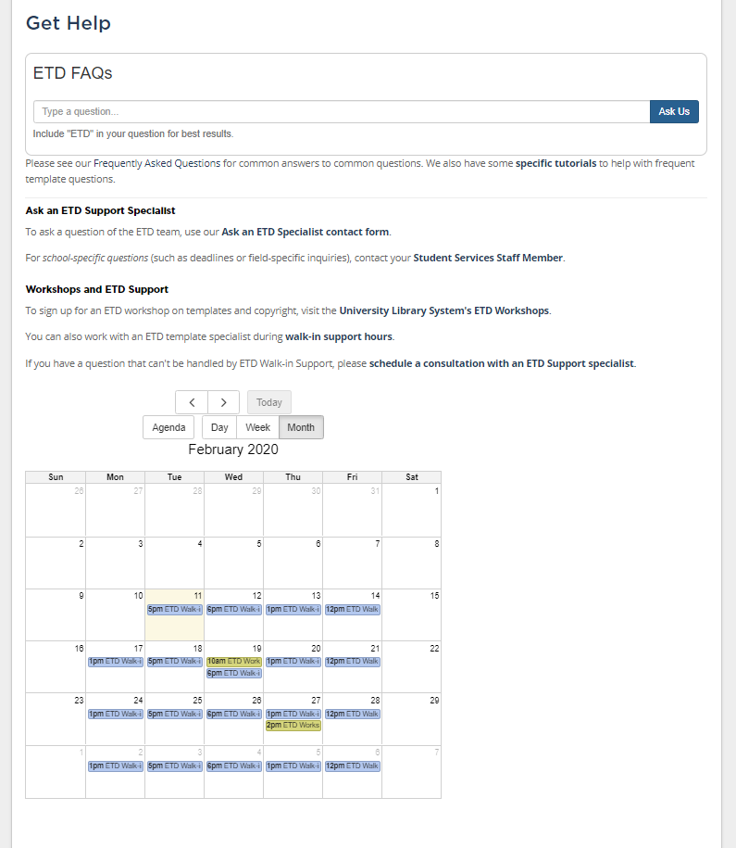
ETD Support
https://etd.pitt.edu/help
Student Services Staff Member
https://etd.pitt.edu/school-specific-information
Support Form
Walk-in Support
Expert Consultation
FAQs

Slide 6
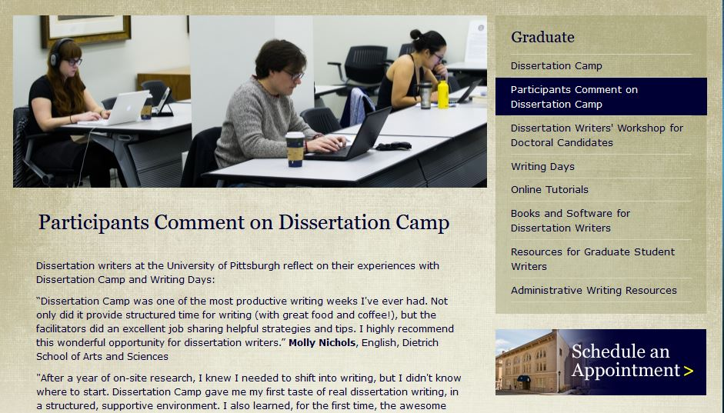
ETD Actions Outside of the ULS
Writing Assistance

Slide 7
Alternate ETD Styles
ETD Guidelines are applied to all schools
Any alternate styles need to be approved by the student services staff member for your school

Slide 8
Where to begin?
Getting Started – Prepare
Learn to Use the ETD Template
Guidelines
Word/LaTeX Template Instructions
Tutorials
How to Use the Pitt ETD Word Template

Slide 9
Word Template Styles
Styles are Used to Format the Document
Conforms to guidelines
Styles Manager (Shift+Ctrl+Alt+S)
LibGuide for using the Styles

Slide 10
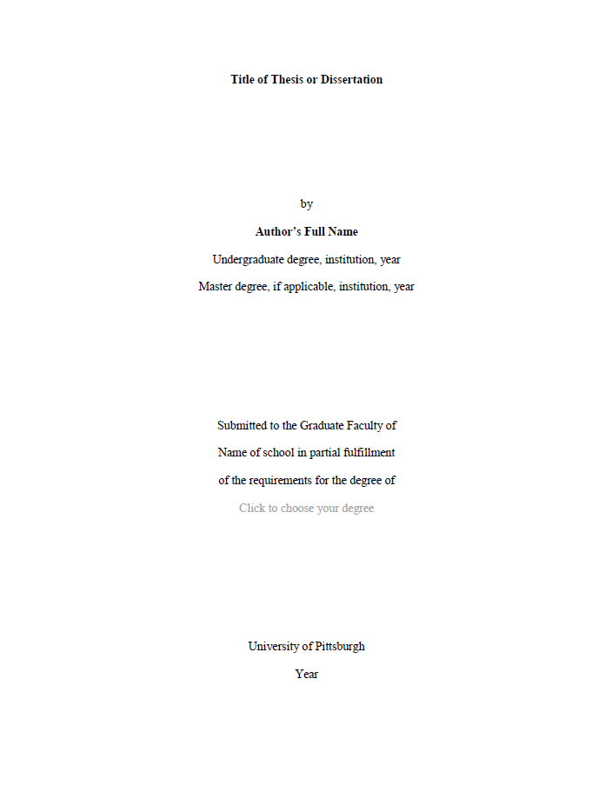
ETD Sections
Title Page
Committee Page
Copyright Page
Abstract Page
Table of Contents*
List of Figures*
List of Tables*
Other Lists*
Preface
Body
Appendix
Bibliography
*Do Not Edit These Fields

Slide 11
Solutions to Common Edits
Removing the Preface
Follow the instructions in the template
Landscape page orientation
Captioning Figures and Tables
Adding Descriptions to Captions
Ctrl+Alt+Enter inserts Style separator at the end of caption link
Then use Extended Caption style to format the remaining text

Slide 12
What to Check Before PDF Conversion
Check your preliminary sections for accurate information
Right-click on your TOC, List of Tables/Figures to utilize the Update Field function
Check to make sure links are working from TOC and List of Tables/Figures
Locate any blank pages or out of place headings

Slide 13
Converting to PDF
If you are using the Updated Template you may be able to use the Save as PDF function in Word.
If you are using an older version of the Template to convert to PDF you will use the Acrobat plug-in
Mac users will need to use a Computing Lab device
In both instances please see the Instructions for converting
Check that bookmarks are linked and all TOC/Table links are functioning
Check the file size (no larger than 2 GB)
File Name Standards (name_ETDfinal_2019)

Slide 14
Deposit in D-Scholarship@Pitt
http://d-scholarship.pitt.edu/
Login using your Pitt username and password
Browse to Manage Deposits and select New Item
Select University of Pittsburgh ETD as item type
Fill in all metadata fields with a symbol
Upload your PDF
Choose embargo length if needed
Deposit the ETD and wait for feedback from your school

Slide 15
Supplemental Files
Any supplemental files can be included with your ETD submission
The files should be linked from your Appendix
To obtain that link you can copy the URL from the Download link within your record
If you upload a new version of the file(s) the link may be different so be sure to check the link that was used in your ETD
Contact ETD Support if you are unable to upload a file or locate the URL

Slide 16
Supplemental Files (cont.)
Datasets from your research can be uploaded to D-Scholarship as individual records
Sharing Data guide
The link in the Appendix should be updated once the dataset is approved in D-Scholarship

Slide 17
Embargo?
University of Pittsburgh allows a maximum of a 2 year embargo on the initial approval of an ETD. With an optional two-year extension for a maximum of 4 years.
Extensions must be requested before the expiration of the embargo period

Slide 18
Embargo?
Your dissertation contains patentable intellectual property for which you have not yet received a certificate
Your dissertation contains sensitive data. (that won’t be sensitive in 4 years)
A publisher is interested in turning your dissertation into a book and has expressly told you they will not do so if the dissertation is available online

Slide 19
Embargo?
The more accessible your dissertation is, the more likely it is to be cited. One Dissertation has been downloaded 158,758 Times
You don’t want to be plagiarized/scooped.
If you’re worried about copyright infringement and/or plagiarism, then you should get your idea out there as soon as possible so that it’s publicly documented and accessible.

Slide 20
ETD Support (etd.pitt.edu/help)
Student Services Staff Member
Support Form
Walk-in Support
Expert Consultation
ETD Support Library Guide
FAQs

Slide 21
Examples?

Slide 22
EXAMPLES?

