Slide 1
The Fundamental Building Blocks Necessary to Educate Future Decision Makers in Marcellus & Utica Shale Gas
Presented by:
Kimberly M. Bailey
Instruction/Reference Librarian
University of Pittsburgh Bradford
Notes:
Hello everyone. I have to tell you that when I started this presentation, I knew virtually nothing about Marcellus & Utica Shale Gas. As I attempted to read government reports, I spent more time looking up terminology than reading the reports.
So I thought to myself, if I’m a librarian and I can’t make decisions about shale gas, how can the public?
On my adventures of learning about shale gas, I started to document the areas that I thought were important.
I’ll tell everyone upfront that this is by no means a comprehensive list of the necessary subject knowledge but it’s definitely a start of what we need to integrate into school curriculums so as students graduate, they have a good hold on the knowledge needed to make important decisions about the future of Marcellus & Utica Shale Gas.

Slide 2
TODAY’S AGENDA
History
Education
Questions
Notes:
Today I hope to give enough background and history to get educators thinking about shale gas.
Then I’ll go directly into the areas that I found to be valuable information.
At the end I’ll leave time for questions.

Slide 3
Hydraulic Fracturing, Hydrofracking Fracking
Photos from: http://www.petrocasa.com/drilling-processes.php
Notes:
Hydraulic fracturing, sometimes also called hydrofracking or fracking, is not a new process; in fact, it has been around for more than 3 decades, and used in many processes such as mineral mining, disposal of radioactive waste, coal, and natural gas extraction.
[Use pointer on screen]
On left - The straight down vertical well is the type of fracking that has been around for more than 3 decades.
On right – One well can have multiple horizontal drillings and is much more efficient

Slide 4
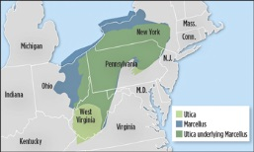
Marcellus & Utica Shale
Notes:
The resources within the Marcellus Shale basin are not a new discovery; geologists and the U.S. Department of Energy have known about this natural gas treasure for over 40 years, but the abundance of other fossil fuels, low natural gas prices, and access barriers kept extraction at low priority (Bierman, Kulp, & Bales Foote, 2011).
Left - This shows all the different shale plays in the United States.
Right – This shows how the Utica shale underlies the Marcellus Shale and the approximate location

Slide 5
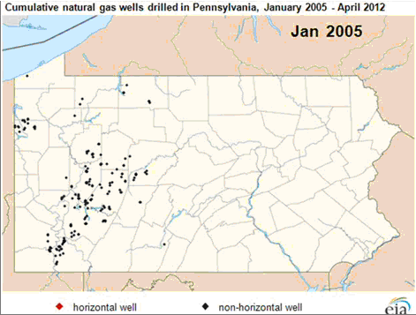
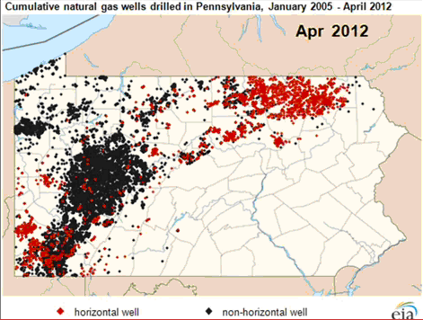
Above Photos from bizjournal.com
Natural gas wells drilled in Pennsylvania: January 2005
Natural gas wells drilled in Pennsylvania: April 2012
Source: U.S. Energy Information Administration, obtained from: http://www.eia.gov/todayinenergy/detail.cfm?id=6390#
Notes:
If you don’t think that Natural Gas drilling will ever affect you, well, maybe it won’t. But my perception of shale drilling was on top of a hill.
[click] It made me think twice when I ran into this second picture where you can see it is right in this person’s back yard.
[click] In January 2005, here’s a synopsis of the wells that were drilled in Pennsylvania.
[click] Here is that same chart in April 2012 and it keeps growing.
[Click on chart to show growth]
In the last 10 years as oil prices increased (McGlynn, 2011) and environmentalists deemed coal to leave a high carbon footprint (Kumar, 2012), many U.S. power plants, which generated electricity, were forced to turn to cheaper natural gas. This made the gas companies take an interest in the Marcellus Shale area. Fracking was the primary way of extracting natural gas and engineers worked to come up more efficient extraction methods. The big rush in Pennsylvania for extracting natural gas came in around 2002 with the invention of the horizontal drilling process. In 2001 George Mitchell sold his “light sand fracking” process to the Devon Energy company. Devon Energy combined Mitchell’s light sand fracking with their key process of horizontal drilling and thus discovered a viable method to extract natural gas from shale basins (Bierman et al., 2011).

Slide 6
Hydrogeology
Ground-Water flow
Soil sedimentation
Drinking Water (springs, wells, reservoirs)
Safe Drinking Water Act
Agencies:
Pennsylvania –DCNR
United States Geological Survey
U.S. Army Corps of Engineering
U.S. Environmental Protection Agency
First report: http://epa.gov/hfstudy/pdfs/hf-report20121214.pdf
Photo from: USGS website
Photo from U.S. EPA Website : http://www.epa.gov/hfstudy/index.html
Notes:
Jumping into education:
Hydrogeology is our first area.
Students will need to understand how ground-water travels. I think the biggest fear out there is contamination of the ground water.
Some states, like New York State, have shut down the fracking process until they are sure it isn’t contaminating the water.
Students in this area need to understand how springs, wells, and reservoirs work so they can make judgments on where it is safe to drill and where it is not.
The literature is all over the place on this topic, in one place I read that 85% of the contaminated water stays in the ground, in another article I read, a gas company worker actually drank some of the brine water (this is the chemically infused water) to prove that is was safe.
So it is important to know what agencies deal with water issues.
I want to mention that the U.S. Environmental Protection Agency is currently doing a study on groundwater and the first of several reports has been posted. I put the website above.

Slide 7
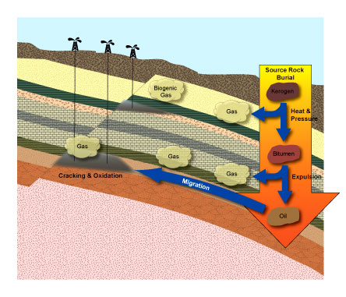
Chemistry
Conduct a water test
Be able to read a local water report
Know which chemicals are hazardous (OSHA.gov)
FracFocus (Chemical Disclosure Registry)
Formation of natural gas
Photo from: http://www2.fiu.edu/~ehs/chemical_safety/icep.html
Photo from peeri.org
Notes:
In Chemistry here’s what I felt was important.
Students need to understand how to test water for hazardous chemicals. That means they need to understand what is normally in water from treatment plants and how to read the water reports that are generated yearly from the treatment plants.
With this, they need to know which chemicals are hazardous - OSHA.gov contains a listing of hazardous chemicals.
Students also need to be aware of the FracFocus database which discloses what chemicals are being used in drilling processes. Contrary to popular belief, the government does regulate and know what chemicals drillers are using
Most of all, They need to know the process of how natural gas is formed

Slide 8
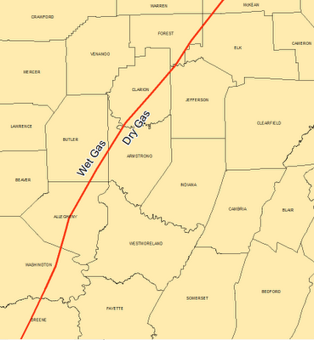
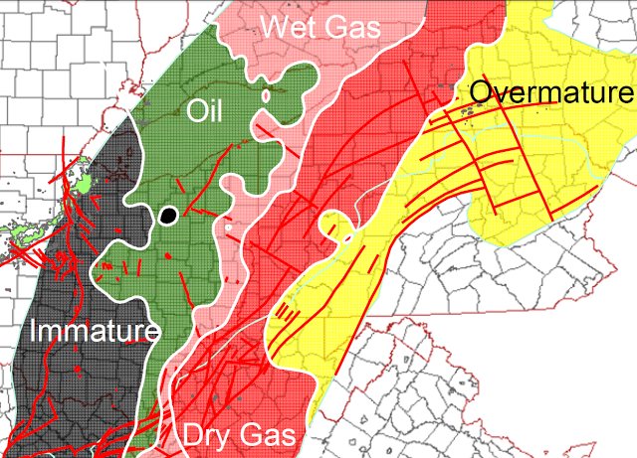
Geology
Geologic Time Scale, (Eon, Era)
Wet Gas vs. Dry Gas
Mineralogy
Fault Lines
Agency: United States Geological Survey
Notes:
This brings me into another area.
It is necessary to know about the Geological Time scale. At minimum the Eons and Eras. Obviously Geology reports are filled with this information so base information is required to read them.
It is also necessary to understand the where wet shale gas and dry shale gas line runs through PA.
Wet gas (not actually water wet) is the preferred gas because it contains condensable bi-products that can be used such as propane, butane, and ethane (used in the plastic process).
Dry gas doesn’t contain these liquids and has more methane which makes it less profitable.
A thermal process matures the oil to natural gas with the by-products, but as it keeps maturing, it eventually cooks out the by-products. In some parts of Pennsylvania you can see that there are overmature areas where it has been cooked so much it doesn’t contain hardly any hydrocarbons which is what these liquids are called.

Slide 9
Political Science
Safe Drinking Water Act
Clean Air Act
Natural Gas Policy Act
FRAC Act
NAT GAS act
Agency: PA Government http://www.state.pa.us/
Picture from: http://washington.edu/
Notes:
Political Science
More than ever it will be important to teach students about regulations. They will need to know about
Safe Drinking Water Act
Clean Air Act
Fracturing Responsibility and Awareness of Chemicals Act
New Alternative Transportation to Give Americans Solutions Act
Natural Gas Wellhead Decontrol Act
Natural Gas Policy Act
Students need to learn and understand the importance of monitoring the PA Government website for proposed bills.

Slide 10
Environmental Science
Methane Gas
Wastewater
Earth disturbances
Pipelines
Invasive species
Water consumption
Deforestation
Agencies:
PA DCNR: http://www.dcnr.state.pa.us/
Department of Environmental Protection: http://www.depweb.state.pa.us/
U.S. EPA Anonymous Non-emergency tip line: epa.gov/tips
Emergency Spills:
National Response Center:
1-800-424-8802
Picture from: http://www.msmary.edu
Notes:
Environmental science is incorporated in many of the school subjects, so I’m just going to mention a few things.
Methane Gas can get into the water (you may have heard in the news of people lighting their water on fire)
It can get into the air (I read an article were the leakage of methane gas killed bats)
Wastewater-if accidents happen or people don’t follow regulations – animals will die, people could get sick,
Earth disturbances
Pipelines
Invasive species
Water consumption
Forests are cleared
Agencies:
PA Department of Conservation and Natural Resources: http://www.dcnr.state.pa.us/
Department of Environmental Protection: http://www.depweb.state.pa.us/
U.S. Environmental Protection Agency – Now has an anonymous tip line to report violations of Non-emergency nature: epa.gov/tips
Emergency Spills:
National Response Center:
1-800-424-8802

Slide 11
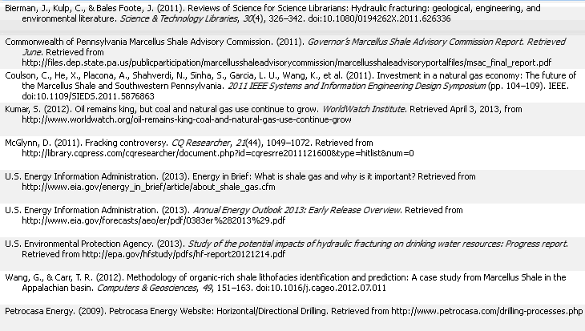
References

Slide 12
Questions?

Slide 13
THE END

