Slide 1
Tobacco Company Marketing: An Examination of Tobacco Use Among Pittsburgh Residents from 1950-1970
Paras Chand

Slide 2
Cigarette Marketing: Background
34.2 million American adults smoking cigarettes in 2018 (CDC 2019).
The number of college students who smoke and vape has been steadily increasing in recent years.
The CDC proposes is that large tobacco companies spend billions of dollars each year on marketing for cigarettes (CDC 2019).
The Project
Content analysis of tobacco advertisements within the Pitt News and Pittsburgh Post-Gazette from 1950-1970
What specific marketing strategies have these corporations utilized to mobilize a regular consumer base population within Pittsburgh?
Notes:
Which archives, how has your question changed/developed,

Slide 3
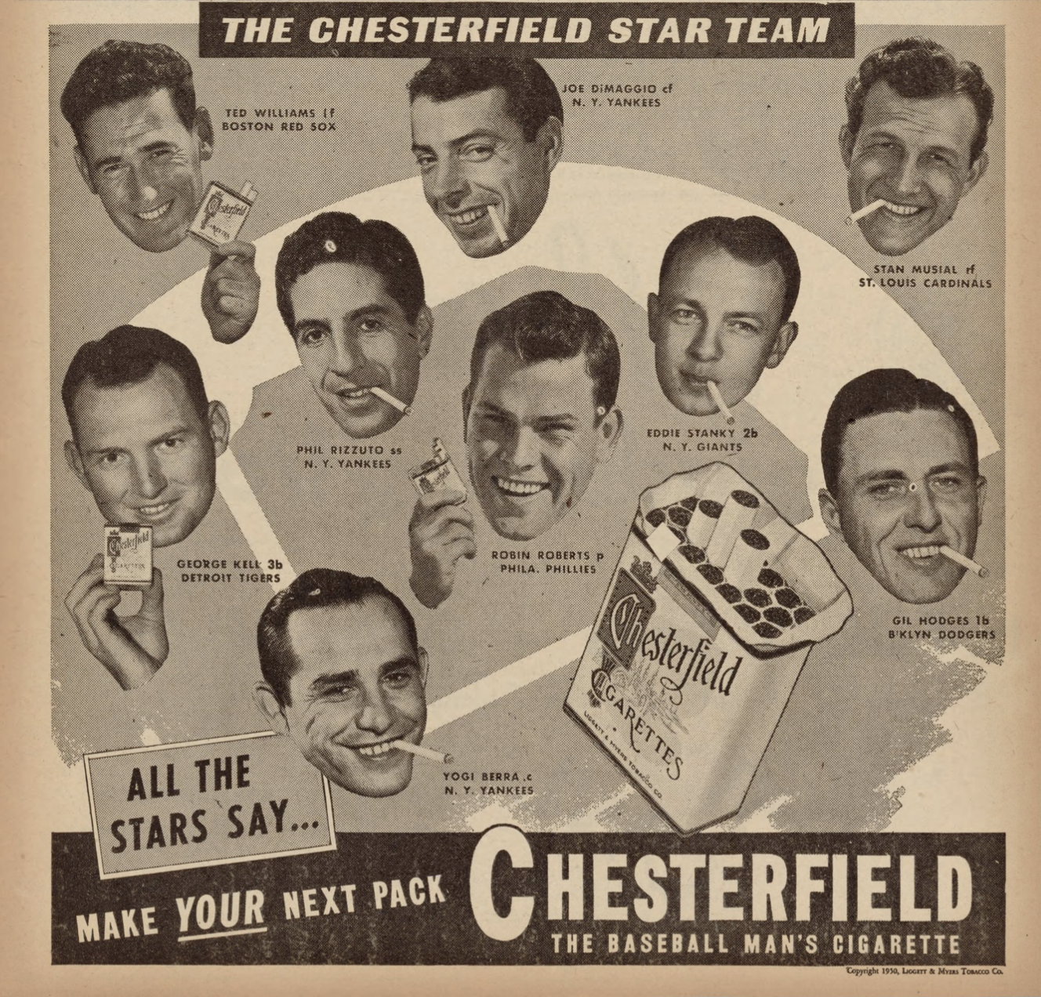
“Chesterfield Star Team”
Image from the Pitt News vol. 44, no.5, depicting an advertisement from the tobacco company Chesterfield distributed on October 6, 1950
Notes:
31735062156595

Slide 4
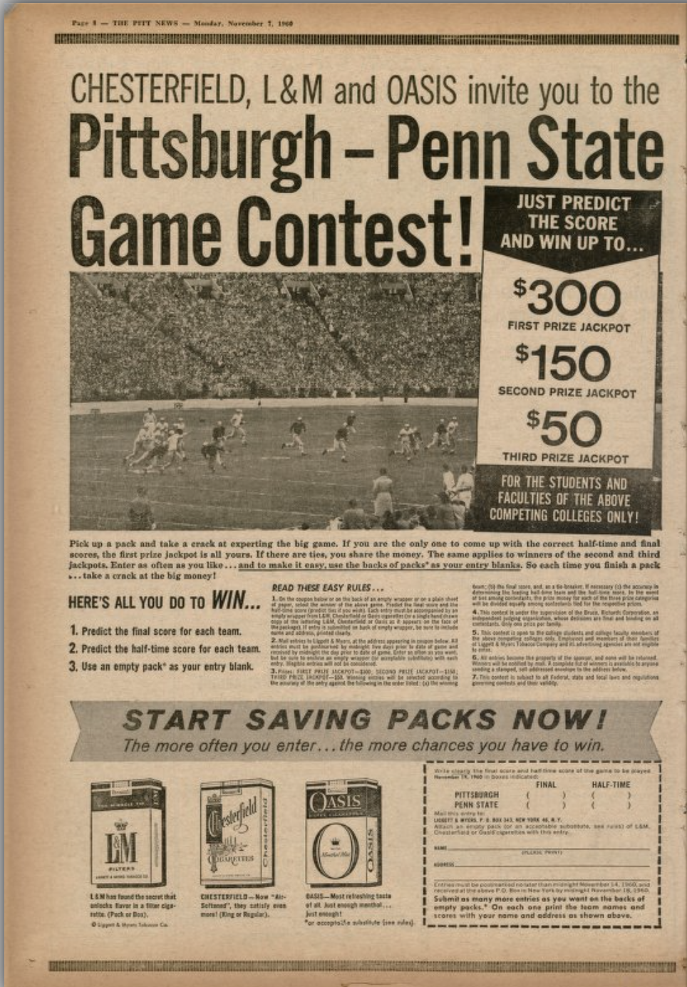
“Pittsburgh-Penn State Game Contest”
Image from the Pitt news. vol. 55, no. 18, depicting an advertisement from the tobacco companies Chesterfield, L&M and Oasis distributed on November 7, 1950
Notes:
31735066367321

Slide 5
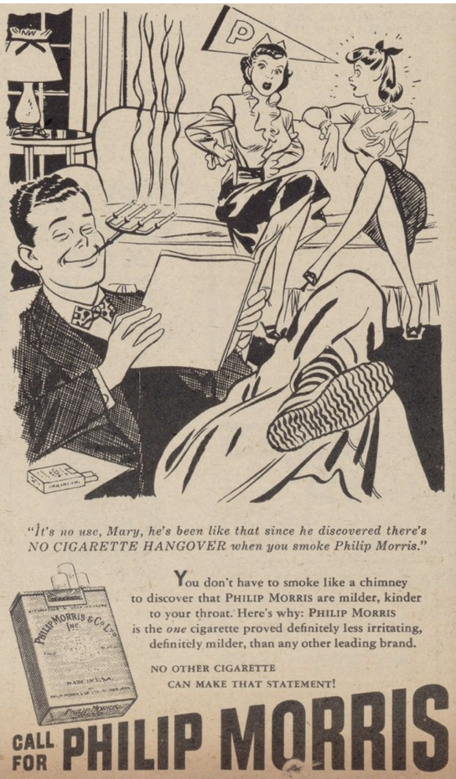
“Pittsburgh-Penn State Game Contest”
Image from The Pitt News. vol 43, no. 29 depicting a cigarette cartoon from the popular tobacco company Philip Morris on January 24, 1950
Notes:
31735066367321

Slide 6
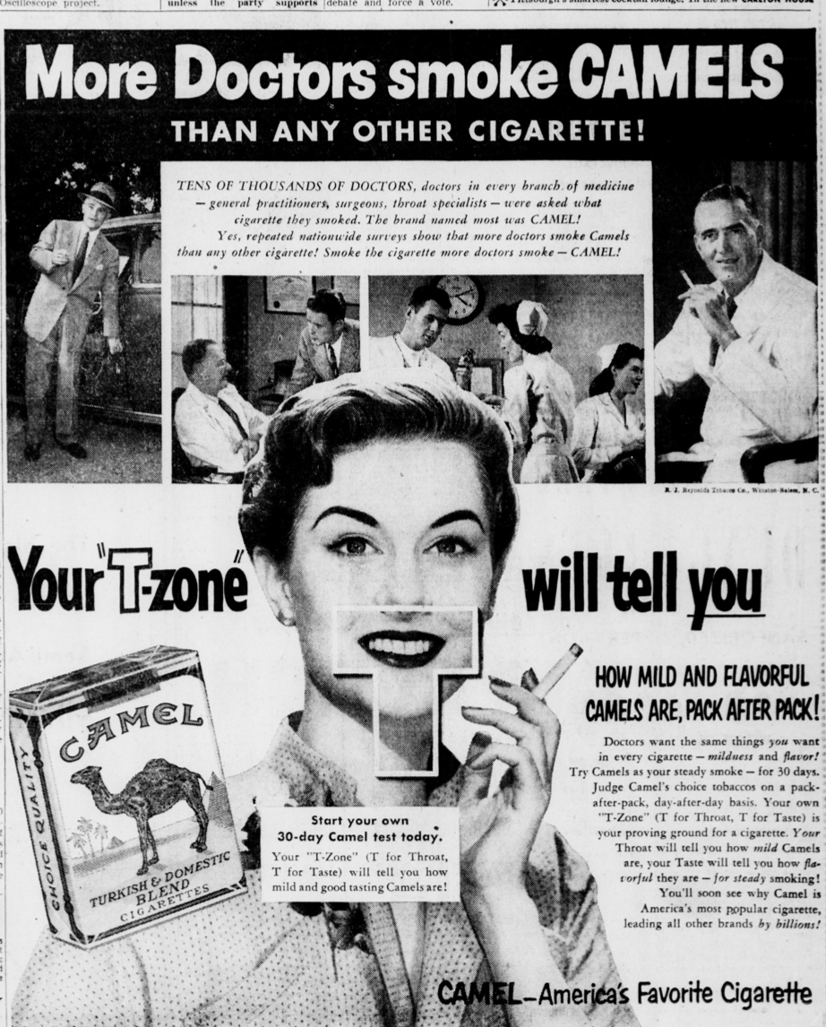
“More Doctors smoke Camels”
Image from the Pittsburgh Post-Gazette vol. 25, issue 304, depicting an advertisement from the tobacco company Camel distributed on July 21, 1952
Notes:
1854573463

Slide 7
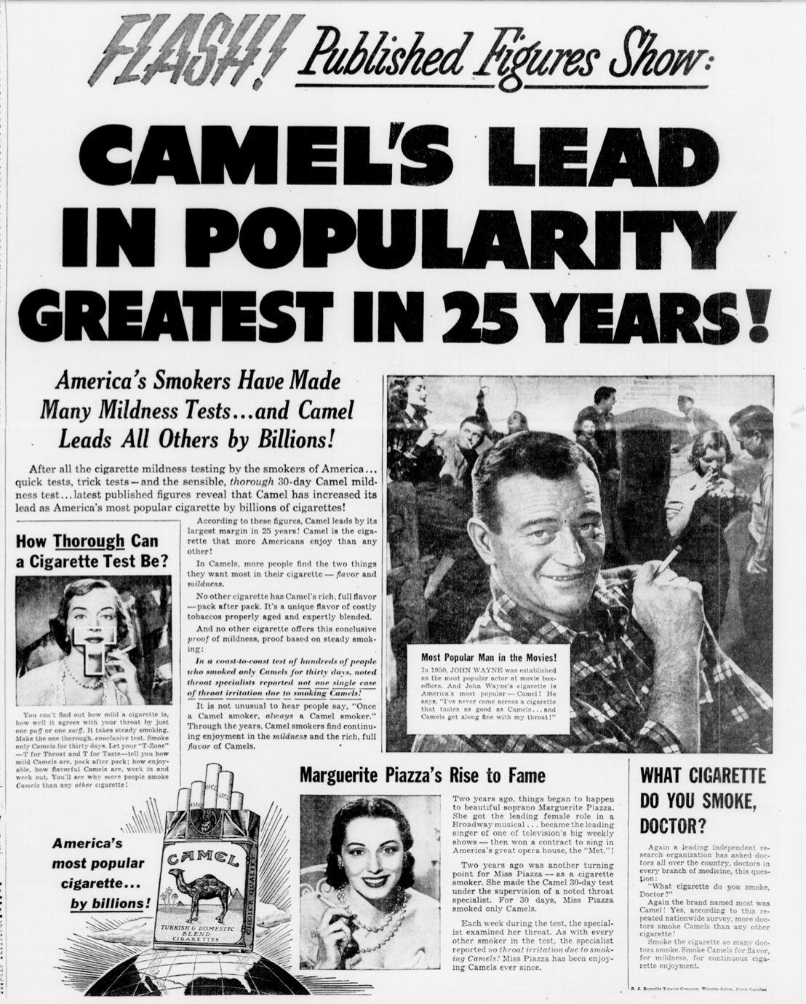
“Camel’s Lead in Popularity Greatest in 25 Years”
Image from the Pittsburgh Post-Gazette vol. 24, issue 173, depicting an advertisement from the tobacco company Camel distributed on April 9, 1951
Notes:
1854530534

Slide 8
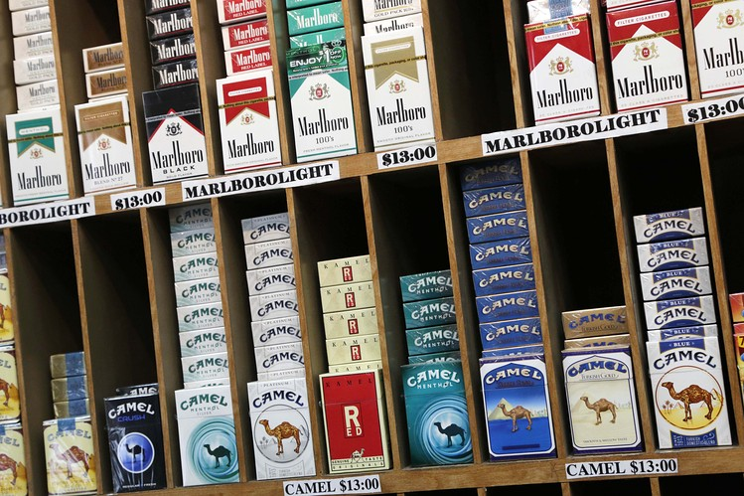
Impact of Cigarette Marketing on Youth Populations Today
Emphasizes Big Tobacco’s influence on the consumer market today with the current vaping epidemic
Represents the goals and endeavors of not only tobacco companies to target and involved youth to increase consumer sales and profit
Smoking was considered not only an accepted culture among Pittsburgh residents and youth, but an expectation to conform to society’s standards

Slide 9
Thank you!
Paras Chand, University of Pittsburgh
pac127@pitt.edu

