Slide 1
Effective Science Communication
Replace this box with key image to introduce talk’s scope, importance, or background
Barbara Granito
Director
Science Ambassadors
March 3, 2020
Notes:
Thank you…
What means “effective science communication?” If overnight all scientists became rock-star communicators, how know? [Ideas to draw out: CONNECTION and ENGAGEMENT. Recognize you. familiar, “a fan,” Science news, want kids PhDs, research funding…}
Point = successful communication is connection. “Communication” derives from Latin “commonality.” It literally involves making common cause with your audience.
Requires skills scientists aren’t necessarily trained in. (Lectures and papers for peer review actually are bad practice.)
Who thinks essence effective communication = making difficult material simple to interpret? Yes. Important. We’ll talk about why. But simple not enough. Something more fundamental.
Actuarial tables. To communicate = force yourself to be relevant to your audience, connect your work to things they care about. Without relevance, great presentations will FAIL because no one remembers. Well supported by brain research.

Slide 2
Scientific information presents a perfect storm of cognitive barriers to communication
IMAGE: © iStock Photo adventrr
Notes:
Unfortunately, the barriers to effective communication are many.
Thanks to Cognitive Science, Neuroscience, Brain Imaging, even Artificial Intelligence and Machine Learning we understand the challenges better than ever before. Research shows the bar is especially high – a sort of perfect storm of interference – when communicating scientific information to non-technical audiences. The reasons for this relate to:
How the brain processes information
How people’s values and beliefs impact their reasoning
The special nature of scientific information, which involves things like statistical reasoning, data and uncertainty – things the human brain has a natural aversion to.

Slide 3
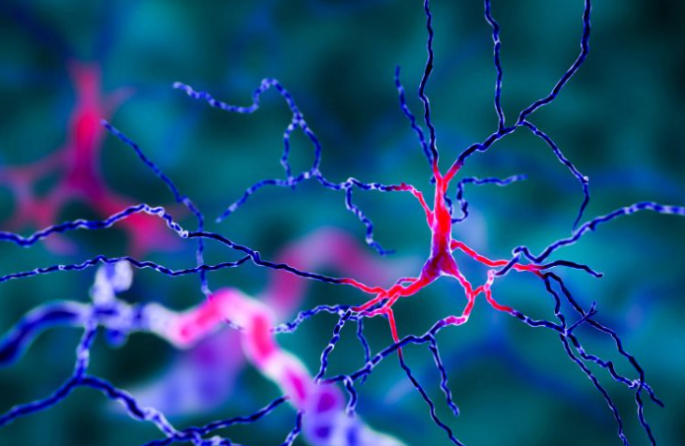
There is known physical resistance to learning
Notes:
The first set of cognitive barriers arises from how the brain works. These barriers physical, embedded in the biochemistry and structure of the brain.
Actual photo of brain cells – average brain 100 billion neurons, millions firing at once. When focused/absorbed, body sends energy/nutrients to these cells, which thicken/grow. This = experience of “learning.” The first point = learning requires physical change in the structure of the brain, is hard work and requires energy.
The second point = brain tires easily and can’t learn much at once. Like at Gym… Studies of working memory capacity show that in a perfect setting, the typical brain can retain a maximum of about 5-7 new things. The more difficult and unfamiliar the material, the less it absorbs. And if bored, distracted, hungry, tired, number drops toward zero.
The strategic advice, then = respect your audience’s limitations. Don’t fight the neurochemistry of the brain. Focus on what you want people to remember. Plan your presentation around 1 key takeaway and 2-3 supporting points.

Slide 4
People “reason” in ways that aren’t always rational
Social reasoning
People identify with and adhere to beliefs of their social groups.
Notes:
Second set of barriers = how values/beliefs impact mental processes. People are NOT always – rarely are – objective, rational creatures we like to think we are. Our brains have many hard-wired shortcuts that can cause us to be irrational in predictable ways.
From an evolutionary standpoint, these shortcuts are useful. They help us navigate reality successfully – help us process massive amounts sensory data coming at us. To prioritize, to simplify complex/difficult questions, come to speedy conclusions, anticipate and respond to threats, recognize allies, and generally protect self-interest.
They are survival mechanisms, also among the toughest cognitive barriers you may face as a communicator.
Some quick examples: Social reasoning (read slide).
This is the power of “group think.”

Slide 5
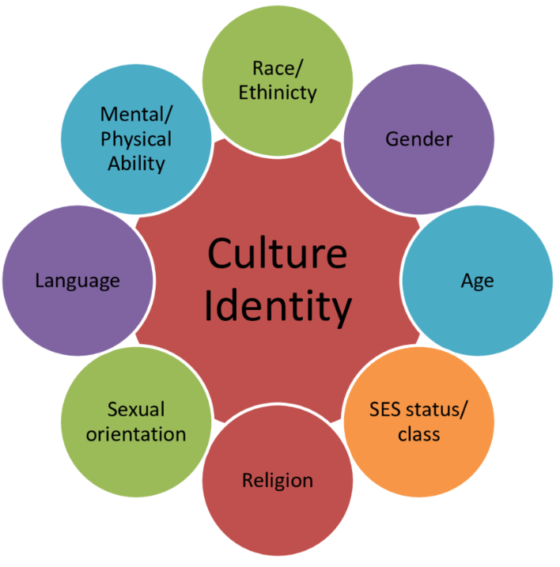
“Social reasoning” causes people to selectively credit or dismiss evidence in ways that can seem contradictory
Notes:
Social reasoning causes people to selectively credit and/or dismiss evidence in favor of beliefs of their particular social groups.
Interestingly, social reasoning can cause culturally diverse individuals (more than one social identity) to hold what seem like contradictory views.
Dan Kahan at Yale’s Cultural Cognition Project cites interesting case concerning a scholarly survey of individuals who did not believe in Evolution.
Depending on social context, we all are subject to selective, situational reasoning.
You want to be sensitive to values and perspectives that might differ from your own. Look for alternative points of entry that align with audiences’ sensitivities.

Slide 6
“Motivated reasoning” is the tendency to rationalize to reach a preferred conclusion
Notes:
MOTIVATED REASONING = is the mental sleight of hand that leads us to rationalize information to reach a preferred conclusion. (Read slide)
Examples: Sports fans to see a referee’s call as correct when it favors their team, and vice versa. Tendency for individuals to play down early symptoms of serious disease. Voters shown to be particularly susceptible – for instance, when they downplay an undesirable act committed by their candidate or attribute it to situational factors.
When very active, motivated reasoning can cause us to form and cling to false beliefs despite clear evidence to the contrary.
Point: Anticipate the implications inherent in your findings and the resistance this may raise.

Slide 7
“Confirmation bias” is the tendency to hear and believe that which confirms our existing beliefs
Notes:
Similarly, CONFIRMATION BIAS is the tendency to seek, favor, and recall information that confirms our existing personal beliefs or hypotheses. The opposite is also true. People discount information that conflicts with what they believe to be true.
Confirmation bias helps explain why disagreements can sometimes become more extreme even when both sides are exposed to the same evidence, as in arguments Climate Change, Vaccines, or GMOs.
Scientists are not immune! There’s ample scholarly evidence of confirmation bias when scientists look for confirming and supporting evidence in their research, or when they assess the quality of other’s scientific work in peer review.
Point: There are dozens of these mental sleights of hand. Common to us all, because hard-wired in the brain.
So, given such pervasive physical resistance to new and challenging information, what do we do about it?

Slide 8
Do not fight the neurochemistry of the brain
Notes:
The takeaway assertion is Do NOT fight the neurochemistry of the brain.
Want to be clear this does not mean bending facts, accommodating bias.
It means understanding what you’re up against, thinking strategically about how to work with, not against, the brain.
To surmount the cognitive barriers to effective communication, 3 basic strategies help:
Understand your audience.
Be relevant to THEM.
Keep it simple.
These are the principles that will help you be effective not only in getting your message across to different audiences, but also in making it STICK.

Slide 9
1. Know Thy Audience!
Notes:
Rule #1: UNDERSTAND YOUR AUDIENCE
By definition, communication is a two-way street, involving “connection,” and “commonality.”
To figure out how to successfully connect with a given audience, it helps to begin by asking yourself:
Who are they and what do they care about?
How do they see themselves?
What are their values and beliefs, and how do my findings align with or challenge them?
Point: When approaching any audience, be as aware as you can of their personal sensitivities.

Slide 10
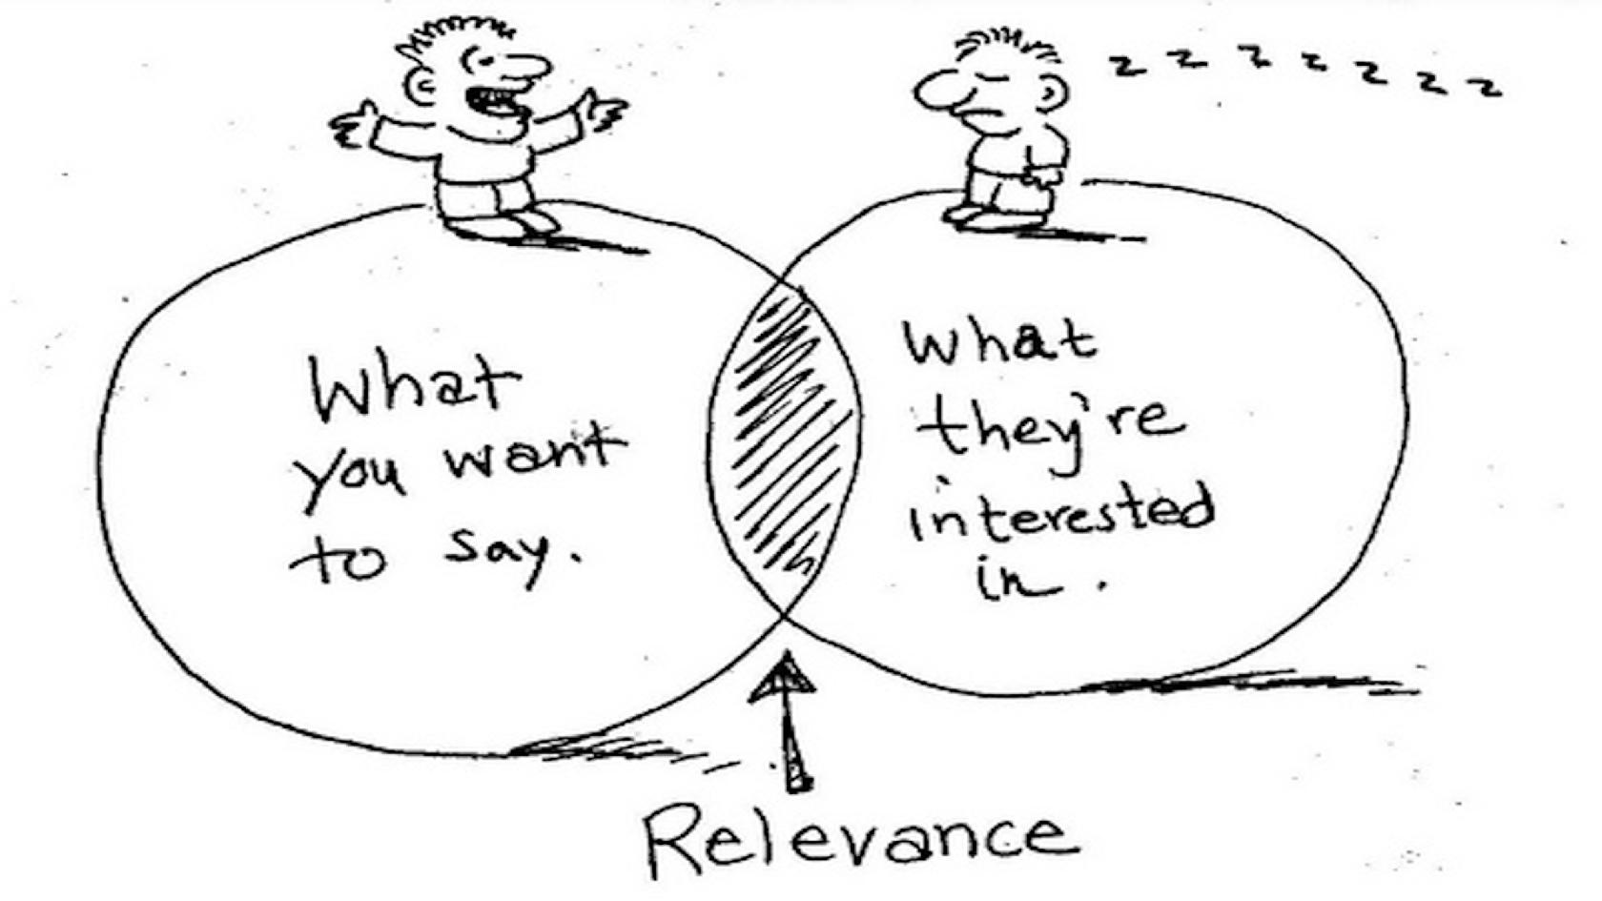
Be Relevant
Notes:
It’s not enough to know your audience. You must also force yourself to BE RELEVANT to them.
Ask yourself
What do they want?
What interests and motivates them?
What are their challenges?
What do I know that’s helpful?
Because the fact is that people generally don’t want to know what you know. They want to know what you know that’s relevant to THEM.
This is the sweet spot where you should focus your key takeaway.

Slide 11
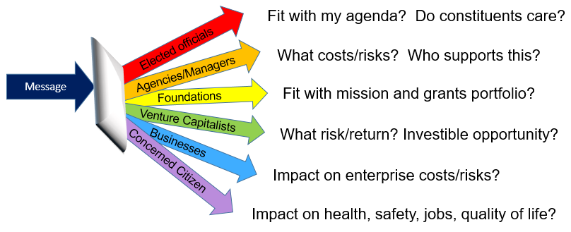
Context matters
Adapted from COMPASS Science Communication, Inc.
Notes:
Context matters, because different audiences will connect with your research for different reasons.
If you’re talking to elected officials, for instance, know that they will be viewing you through the lens of how your message fits with their political agenda and their constituents’ concerns. (READ the SLIDE)
Put aside agendas you may have and think strategically about how your expertise aligns with what matters to a given audience.

Slide 12
Notes:
Besides knowing your audience and being relevant, the third Rule #3: Keep it simple
Remember that working memory capacity is very limited. Don’t fight the neurochemistry of the brain: Frame your presentation around 1 takeaway assertion, 2-3 supporting points. MAX.
A similar rule of thumb applies to making slides: one primary assertion per slide and one supporting visual.
This, by the way, is why you should steer away from jargon or technical language at any cost, as this will use up limited working memory for no real gain.

Slide 13
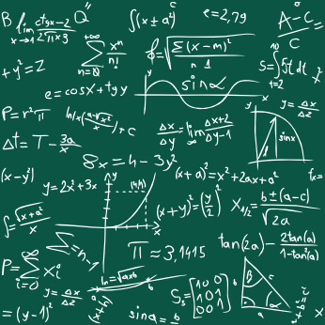
The nature of scientific information presents special communications challenges
Thinking, Fast and Slow (D. Kahneman, 2011)
System 1
System 2
2 + 2 =
17 x 24 =
Notes:
The nature of scientific information presents a third set of communications challenges.
Daniel Kahneman (famous Behavioral Psychologist and Nobel laureate) – THINKING FAST/SLOW has a mental model that suggests why. He postulates 2 ways we “know” things – “System 1” and “System 2”. System 1 is 2+2, System 2 is 17X24. Another example = DRIVING A CAR. System 1 = Automatic, “instinctive;” involves muscle memory; is emotional and intuitive
System 2 = deliberative, takes self-control and mental effort; good at statistical reasoning, analyzing data, uncertainty, risk – all things the brain is naturally reluctant to do. Can’t do two System 2s!
Kahneman’s model highlights why communication is especially difficult for scientists: Curse of Expert Knowledge.

Slide 14
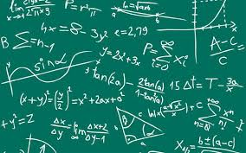
Your “easy” is most other people’s “hard”
EASY
2 + 2 =
HARD
17 X 24 =
Notes:
Think of the time and effort it took for you to become an expert. By now, much is 2+2, obvious, rote to you – but is 17X24 to everyone else.
This is why you can’t expect to reach people by downloading what you know. Instead, try to communicate in ways that involve ”muscle memory,” that resonate with known concepts. If you can’t avoid complexity, try to scaffold your points in concrete analogies. Do not try to communicate every nuance of your research.

Slide 15
With thanks to Melissa Marshall
Notes:
Here’s an example of what I mean.
Take a look at this slide (from a workshop given to the Science Ambassadors by Melissa Marshall of Penn State).
It is dull visually and lists facts and jargon that will not resonate with a lay audience. All the Sins of Death by PowerPoint.

Slide 16
With thanks to Melissa Marshall
Notes:
Compare it with this slide, which uses visual imagery, associative reasoning, and metaphor to send the point HOME. (read slide)
Much more compelling and memorable, right?
Importantly, this slide does not misrepresent the information or dumb it down. It’s just more effective messaging.

Slide 17
In most encounters, you have one shot to get your message across
Learn from the science of science communication
Source: Quantified Communications
Notes:
Another reason to keep it simple is that In most encounters, you will have about 15 seconds to connect with your audience – and about 5 minutes before you can expect to lose their attention. Basically, you’ve got one shot to get people’s attention and get your message across.
To make the most of it, science is going to be a better guide than intuition.

Slide 18
Work with the neurochemistry of the brain
1. Know your audience
2. Be relevant
3. Keep it simple
Notes:
What the science suggests is: Work with the neurochemistry of the brain by
Understanding your audience.
Being relevant to them.
Keeping the communications strategically simple.

Slide 19
Exercise
You are an expert in climate science and are charged with the task to “make climate change fly” with opinion leaders in the Mon Valley, PA.
What do we know about the audience?
Using the techniques we shared with you, sequence the provided list of supported assertions into a presentation outline.
Using the slide deck provided, prepare a presentation of no more than 20 slides.
Notes:
Now we have an exercise to help you put this into practice.

