Slide 1
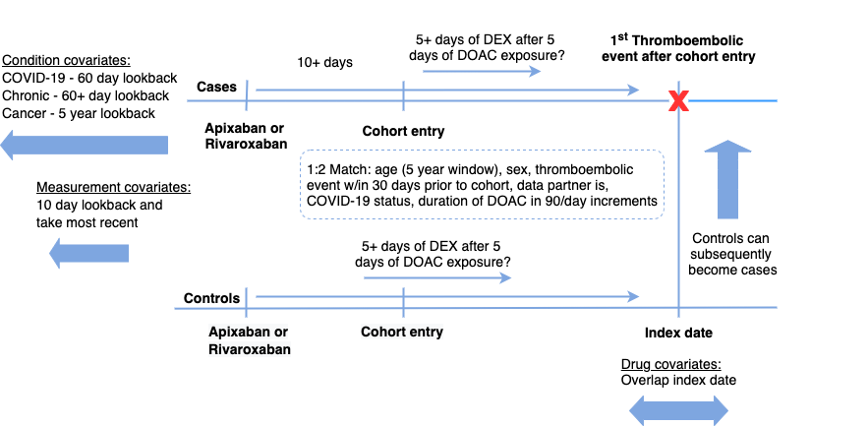
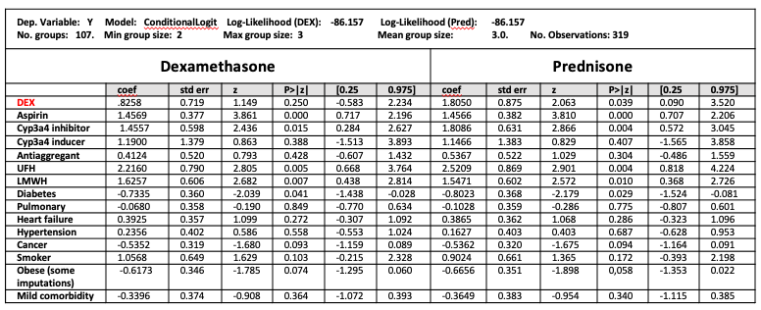
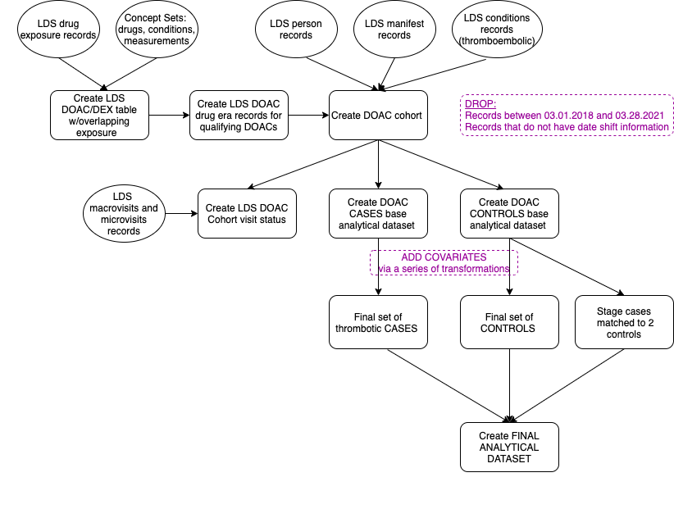
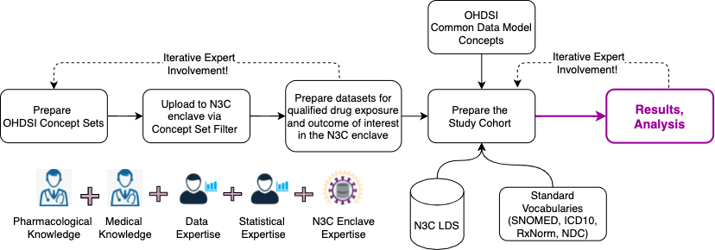
Drug interaction of oral anticoagulants and dexamethasone,
a nested case control study in the National COVID Cohort Collaborative (N3C)
Olga V. Kravchenko, PhD¹, Ainhoa Gomez-Lumbreras, MD, PhD², Paul T. Kocis, PharmD, MPH³, Daniel Malone, PhD, FAMCP², Charles E. Leonard, PharmD, MSCE⁴, Richard D. Boyce, PhD¹
¹University of Pittsburgh, Pittsburgh, PA; ²University of Utah, Salt Lake City, UT; ³Penn State Health, Hershey, PA; ⁴Perelman School of Medicine at the University of Pennsylvania, Philadelphia, PA
Introduction
Study Design
Results
Dexamethasone (DEX) improves the outcomes of patients with moderate to severe COVID-19
Many COVID-19 patients are treated with Direct Oral Anti-Coagulants (DOACs) to reduce the chance of blood clots
DEX is an inducer of cytochrome p-450 (CYP 3A4) enzyme
CYP3A4 enzyme participates in clearance of the DOACs Rivaroxaban and Apixaban
This study examines if co-exposure to DEX and Rivaroxaban or Apixaban may reduce the efficacy of the DOACs and increase the rate of thrombotic events
This is the first drug-drug interaction pharmacoepidemiologic study conducted in the N3C enclave.
Retrospective observational nested case control study of patients with and without thromboembolic events to access their previous co-exposure to Apixaban or Rivaroxaban and DEX
Conditional Logit Model Regression Results
Objectives
Evaluate the odds of concomitant exposure to the corticosteroid DEX in Apixaban and Rivaroxaban users among persons with and without thromboembolic events. Compare the odds ratio with prednisone – a corticosteroid that is not known to induce CYP3A4
Cohort Generation Workflow
McNemar Chi-square test with continuity correction for DEX and Pred
DEX: Chi-squared = 1.3889, df = 1, p=value = 0.2386
Pred: Chi-squared = 2.7692, df = 1, p=value = 0.2386
Methods
Study Conclusion
Limited Data Set (LDS) in the N3C enclave with dates shifted at the person level up to 35 days for some Data Partners
Includes diagnoses, drug exposure, labs, procedures, demographics
Data from Quarter 2 of 2018 to Quarter 1 of 2021
24 OHDSI concept sets
Final study cohort: 19 data partners, 104 cases, matched 1:2 controls
Final results show that there is no statistically significant association that supports the hypothesis about DDI due to cyp3a4 induction with Apixaban or Rivaroxaban within the N3C enclave population.
Limitation: since the study is conducted within the enclave using limited amount of data it is not likely to generalize this result to the outside population.
DROP:
Records before 03.01.2018 and after 03.28.2021
Records with no date shift information
Project Workflow
Lessons Learned
Overall, we found N3C environment suitable for conducting DDI studies where dosing information is not critically important and other kinds of missing data (dosing, measurements, BMI, date shifting) can be handled.
Evaluation of a study feasibility takes significant amount of time and relies on iterative work that involves multidisciplinary expertise.
N3C enclave provides tools that help operationalize project workflow, for example: SQL, Python and R in the Spark environment, concept set creation within OHDSI common data model, templates can be shared by users and utilized by other users, COVID-19 phenotyping with matching within data partners, access to engaged scientific community via regular meetings.
Quality control:
Descriptive statistics to identify data issues
Examine drug exposure of time
Validity of drug information codes
Completeness of clinical encounter data
Patient age corresponds with use of anticoagulants
Analysis of the facility level to detect changes in exposure
Consider time ranges to eliminate a facility from a study
Determine patient demographic changes over time
Achilles heat maps for drug exposure in data partner
Acknowledgements
This work is funded by the NLM T15 grant 5T15LM007059-34; the data and infrastructure are provided by the National COVID Cohort Collaborative (N3C)

