Slide 1
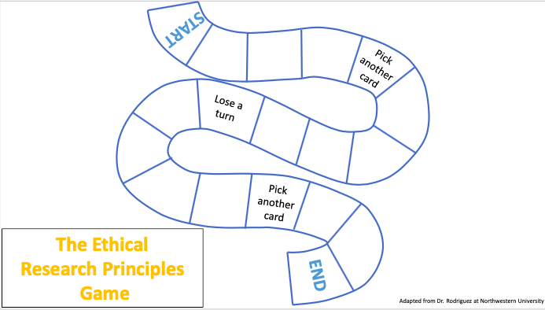
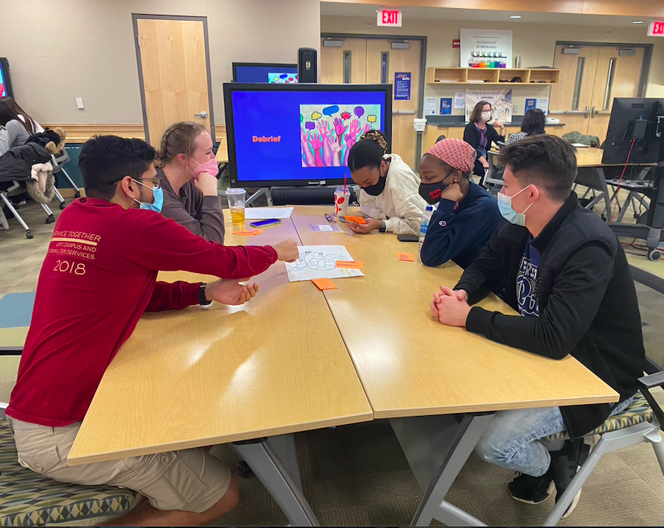
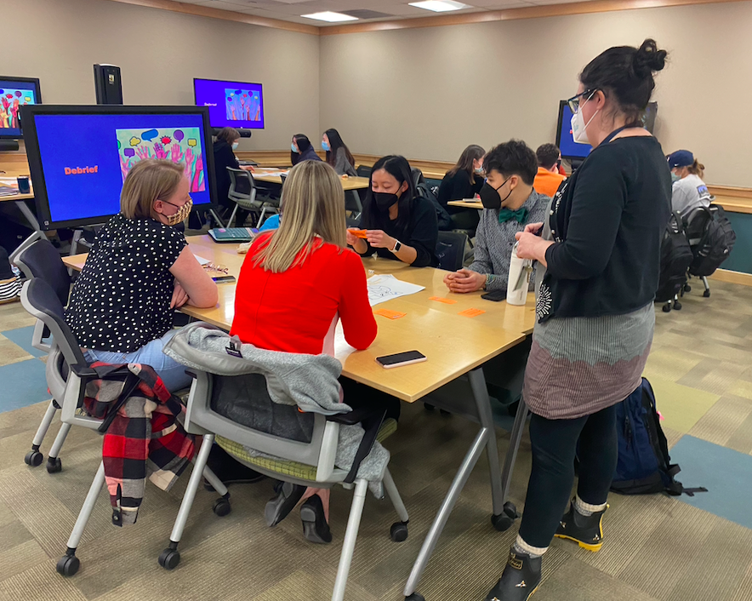
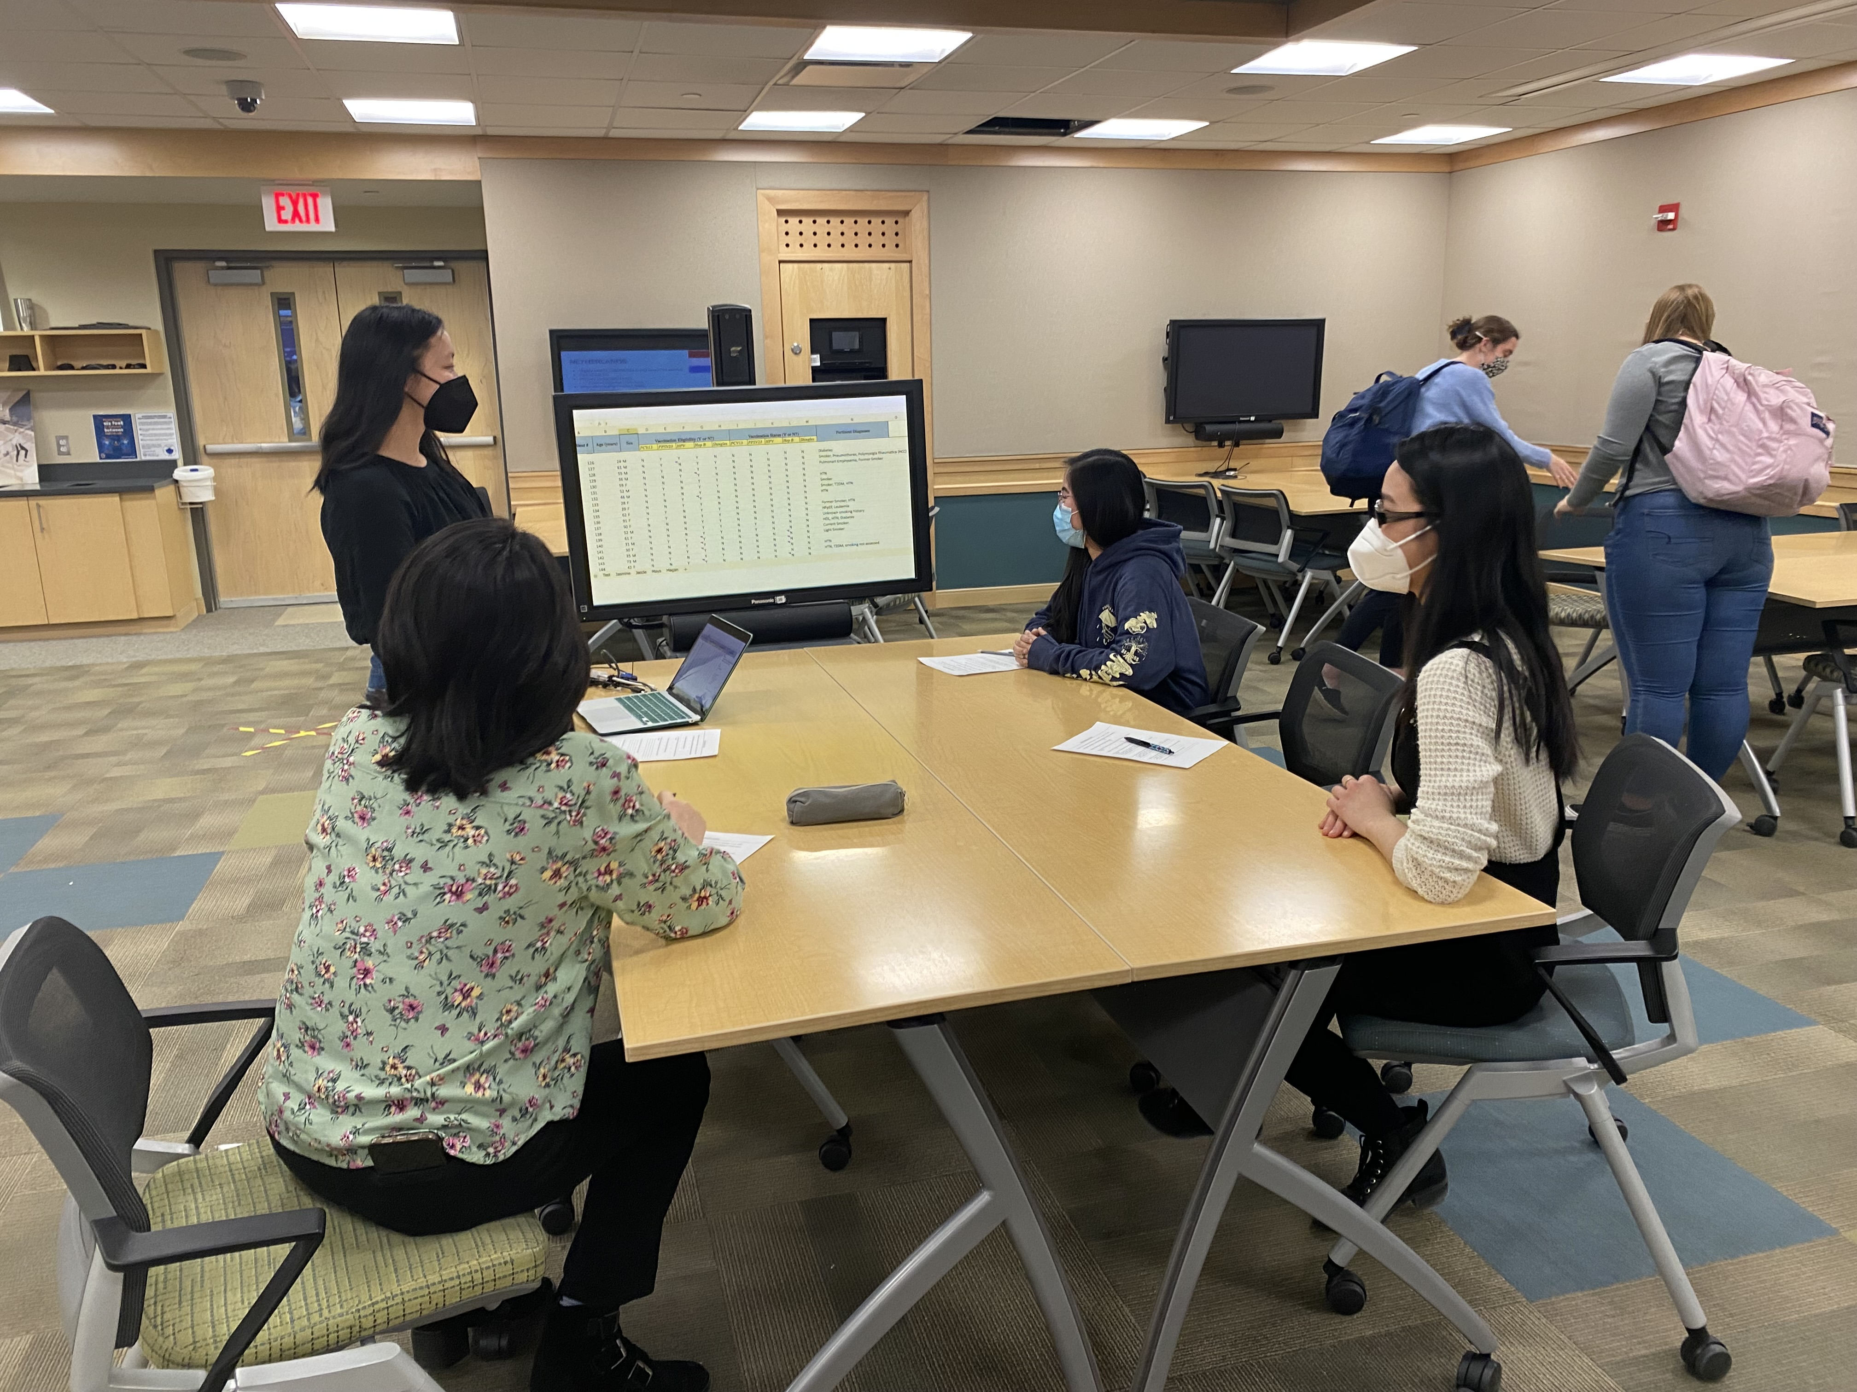
Pitt Pharmacy Global Health Day
Event Description
Keynote address focusing on ethics in global health research and its impact on evolving pharmacy roles
Discussed significance within history
Examined potential consequences as a result of absent research ethics
“The Ethical Research Principles Game”
Applied ethical principles to real life scenarios
Poster Session
Students in the Global Health Area of Concentration presented their research among peers for feedback and to promote awareness about health inequities
Event Outcomes
~50 participants from the School of Pharmacy
53% of participants felt that they were able to adequately discuss ethical principles for global health partnerships and research collaborations
44% of participants felt prepared to assess options for conducting global health research and determining the best strategy to mitigate unethical practices
Jennifer Chai, University of Pittsburgh PharmD Candidate
Sustaining Impact
Generating new perspectives and understanding of current literature in society
Implementation of changes to practice to help provide accessible, quality care
Interests generated through the poster session allow project/program continuity
Recognize and improve existing resources
To understand the impact research ethics that has on literature and how it can contribute to a community’s wellbeing
Context and Background
Global Health is based on colonial medicine, which is influenced by the work of military operations and missionaries
Growth of interest in global health in health professions students
Unethical global health research practices aren’t adequately discussed within pharmacy literature
Changing focus and roles of a pharmacist
Previously focused on product dispensation, but now pharmacy has an emphasis on direct patient care
DEI Values
Focused on issues of health equity in global health research and strategies to ensure ethical, equitable practice
Recognized the impartiality needed to identify the diversity and value each community possesses
Emphasized the need for data to be inclusive and principled to avoid further perpetuation of stereotypes and inequities
Ethics game fostered an inclusive environment for participation through vocalization of beliefs without discrimination
Diverse student research topics were supported in an open environment
References and/or Acknowledgements
Special thanks to the Steering Committee for funding this event and Dr. Lauren Jonkman, Assistant Professor in the Department of Pharmacy and Therapeutics at University of Pittsburgh School of Pharmacy
Figure 1: Customized game board adapted from Dr. Rodriguez at Northwestern University
The interactive activity helped students apply their knowledge, while being self-reflective in a safe space. Players took turns reading scenario cards that are based on actual situations that may be encountered when completing research. Game board movement was pre-determined based on the student’s selection of the best solution.

