Slide 1
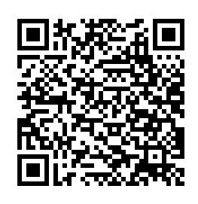
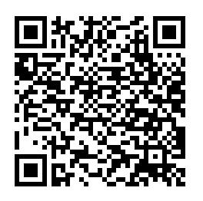
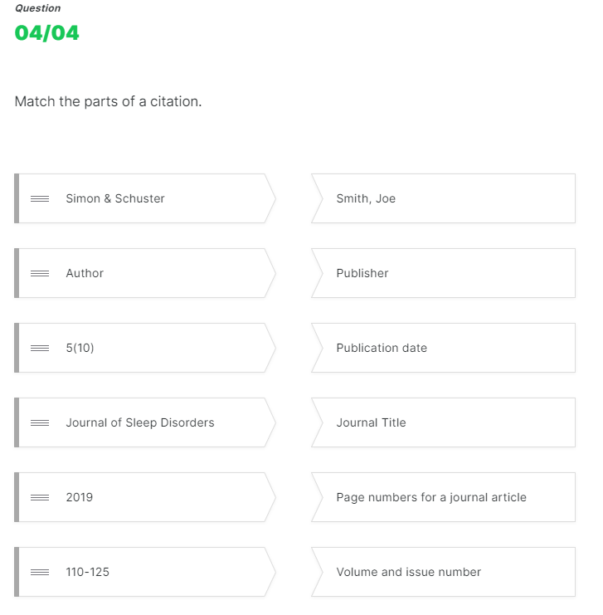
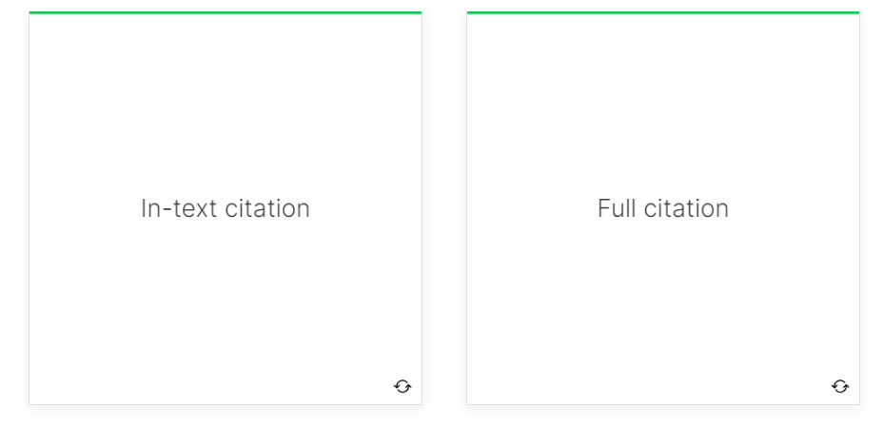
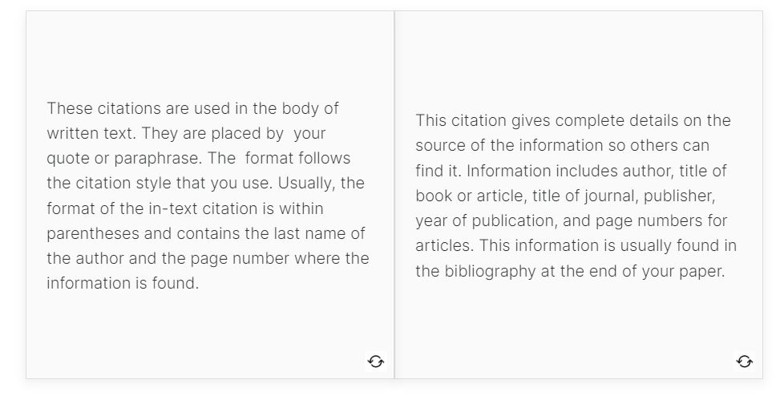
A Learner-Centered Approach to Academic Integrity
Academic Integrity Modules
Modules 2.0
Updates to these modules focus on creating an interactive, learner-centered experience encouraging students to think holistically about academic integrity in their own lives. Modules are more personalized to include stories and real-life examples that build upon student experiences rather than focusing on deficit thinking.
Knowledge checks are present throughout the modules encouraging reflection and review throughout the lesson. Additionally, new topics in academic integrity have emerged since the inception of this project. New and expanded modules cover topics including remote instruction, contract cheating, and life/ school balance.
Badging
The ULS will continue to issue badges to students who complete the entire suite of modules. Faculty will also have the option to embed individual modules into their own courses.
Assessment
Continue with adaptive release for badge
More knowledge checks for completion
Helpful for those using individual modules
Larger pool of questions for final quiz
Canvas Quiz results are used to award badges
Addition of reflective question to encourage metacognition
Urszula Lechtenberg, Leslie Poljak, Marnie Hampton, Diana Dill
University Library System (ULS)
Current Outline
Introduction to Academic Integrity Policies
Plagiarism
Paraphrasing and Citations
New Outline
Pitt Policies on Academic Integrity
Academic Integrity Overview
Plagiarism and Cheating
Citations and Integrating Research
Why the Library?
The ULS is in a unique position to provide expertise and instruction about academic integrity. Furthermore, in the Ithaka faculty survey conducted in Fall 2021, Pitt faculty identified the library as the ideal resource for providing academic integrity support, with 54% finding it valuable to extremely valuable.
Background
In 2016, ULS created Blackboard modules designed to teach students the basics of academic integrity and how to avoid plagiarism. The modules have been successfully used in the Katz MBA program, the First-Year Programs, and the Office of International Students. With the switch to Canvas, the ULS saw an opportunity to both update module content as well as improve module delivery.
Current attitudes around the topic of academic integrity tend to focus on the punitive consequences of cheating and plagiarism. While it is important to have consequences for this behavior, the updated modules will help faculty contextualize the topic through a learner-centered approach. Students are doing their best and the traditional approaches tend to increase anxiety and fears over academic integrity violations.
The modules have been available to all University of Pittsburgh instructors and students, but with the aid of a grant from the Provost's Committee on Open Educational Resources, they will now be available for any school or program to use. The updated modules will be published as OERs through Canvas Commons and will be licensed with a Creative Commons license, allowing free adaptation and reuse.
Preview & Review Updated Modules
Pitt Policies on Academic Integrity
Plagiarism
Future Considerations
Keeping up with technologies and their role in academic integrity violations. How can higher education and teaching respond?
EX: AI essay generators
Subject-specific modules based on discipline or program
Ex: Business Ethics
Other suggestions? Let us know!
Highlights
Learner-centered
New topics
Modular
Enhanced assessment
Open Educational Resource (OER)
Interactive Knowledge Checks
References
Webster, B. 2022. "Faculty Survey at Pitt (Fall 2021): Findings and Recommendations." https://library.pitt.edu/sites/default/files/pdf/assessment/2021%20Faculty%20Report_FINAL.pdf
Academic Integrity Modules are free and open for use by any Pitt faculty in Canvas.

